Slide 1


Sales and customer interaction
Bilal Al Hamouti

Slide 2
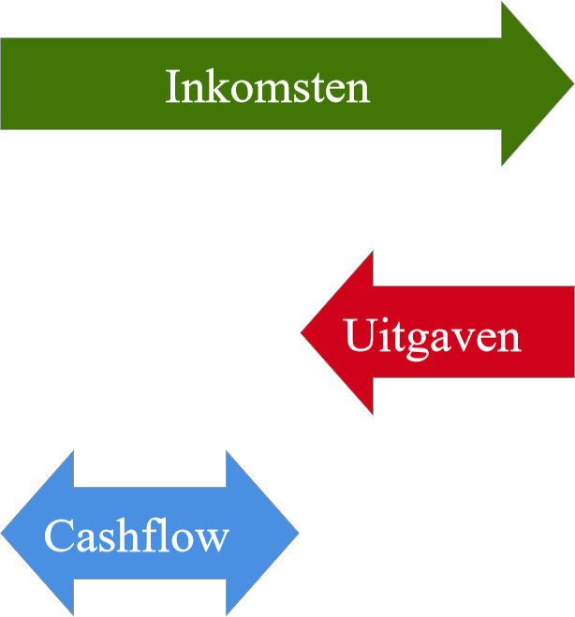
Cashflow (CF)
 | Period
Initial investment | 0 | -40.000,00 €
Cashflow (CF) | 1 | 15.000,00 €
 | 2 | 10.000,00 €
 | 3 | 12.000,00 €
 | 4 | 9.750,00 €
 | 5 | 11.000,00 €
 | 6 | 10.000,00 €
 | 7 | 13.500,00 €

Slide 3

Interest (I)
 | Period
Initial investment | 0 | -40.000,00 €
Cashflow (CF) | 1 | 15.000,00 €
 | 2 | 10.000,00 €
 | 3 | 12.000,00 €
 | 4 | 9.750,00 €
 | 5 | 11.000,00 €
 | 6 | 10.000,00 €
 | 7 | 13.500,00 €
Discount rate (I) | 7,00%
Net present value (NPV) | 22.900,27 €
Internal rate of return (IRR) | 22,47%

Slide 4
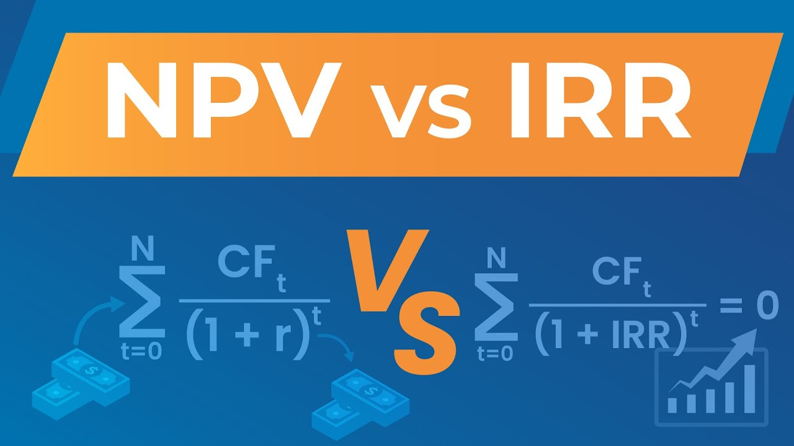
Calculator NPV and IRR
Net present value (NPV)
Internal rate of return (IRR)
 | Period
Initial investment | 0 | -40.000,00 €
Cashflow (CF) | 1 | 15.000,00 €
 | 2 | 10.000,00 €
 | 3 | 12.000,00 €
 | 4 | 9.750,00 €
 | 5 | 11.000,00 €
 | 6 | 10.000,00 €
 | 7 | 13.500,00 €
Discount rate (I) | 7,00%
Net present value (NPV) | 22.900,27 €
Internal rate of return (IRR) | 22,47%

Slide 5

Calculator FV
Interest rate | 7,00%
Number of periods | 10
Investment | 100.000,00 €
Payment | 150,00 €
Future Value (FV) | 198.787,60 €
Future value (FV)

Slide 6

Bedankt voor uw aandacht

