Slide 1

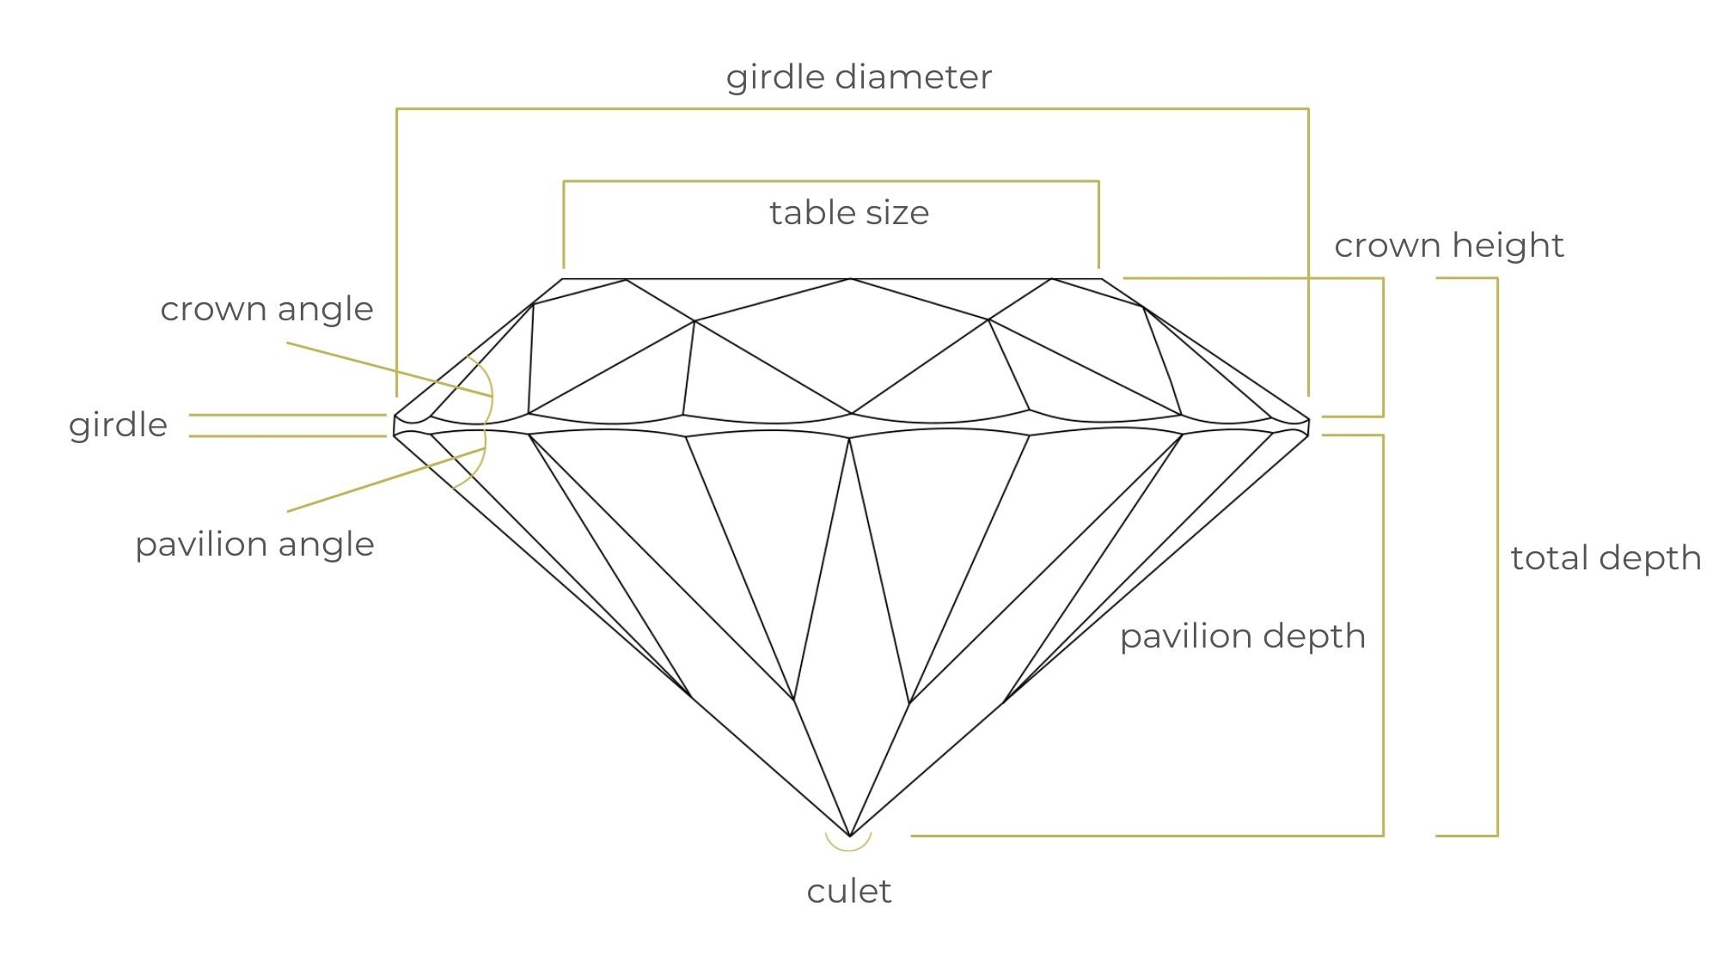
Diamond Price Prediction Project
This project is done by:
Ammar Yaser
Bilal Mohammed
Bouthaina Hamaissia
2022

Slide 2
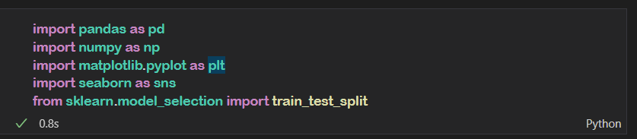
Diamond Price Prediction
For this project, we used a dataset from Shai competition in Kaggle website , performed data preprocessing transformations, and built a regression model to predict the price ($326-$18,823) of the diamond using basic diamond measurement metrics. Each diamond in this dataset is given a price. The price of the diamond is determined by 9 input variables:
carat weight of the diamond (0.2--5.01)
quality of the cut (Fair, Good, Very Good, Premium, Ideal)
diamond color, from J (worst) to D (best)
clarity a measurement of how clear the diamond is (I1 (worst), IF (best))
x length in mm (0--10.74)
y width in mm (0--58.9)
z depth in mm (0--31.8)
Depth total
table width of top of diamond relative to widest point (43--95)
The first step in Machine learning process is to Import all basic libraries.
02

Slide 3
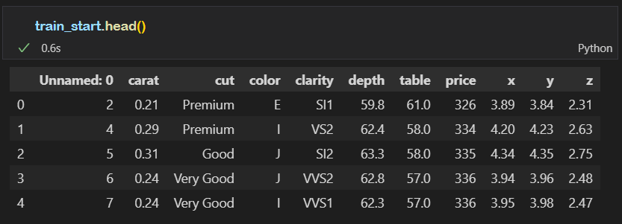
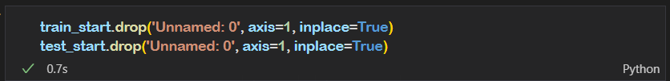
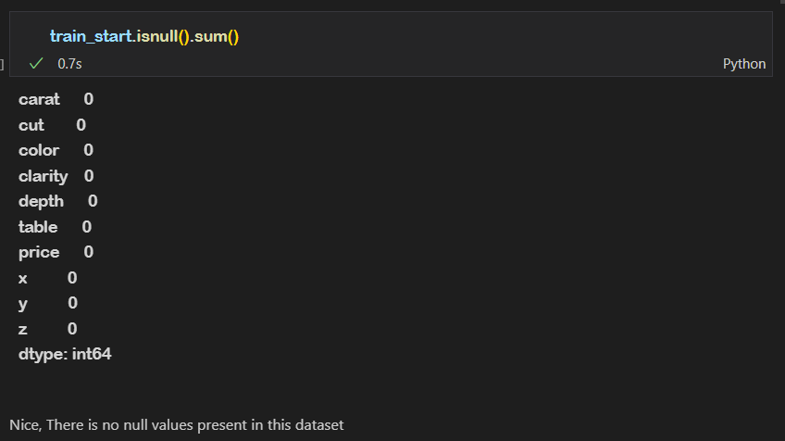
The output is something like the following:
First, We drop unnamed column; because it’s not import in training data
We will check if any null values or unexpected data type are present in the Kaggle Diamond price prediction dataset to ensure accurate diamond price prediction using python.
03

Slide 4
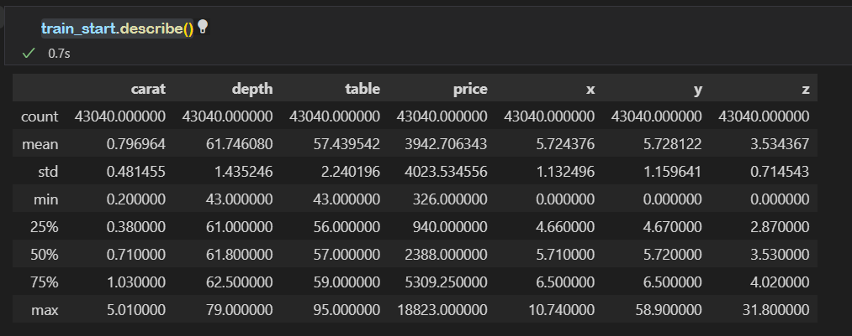
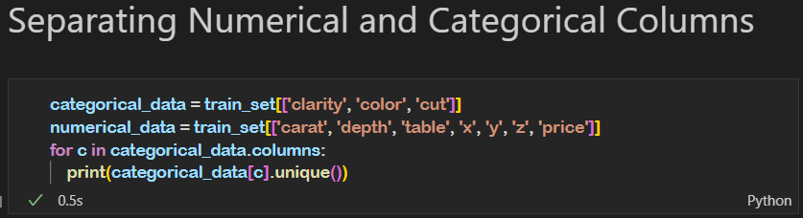
We make small describe for data to see if there is something attractive.
Look at y & z (there are outliers) huge gap between 75% and max value
And in (x,y,z) the minimum value is zero
And that is impossible.
So, We need drop any data that is like that.
To make an Exploratory Data Analysis we need to divide our data into Numerical and Categorical
04

Slide 5
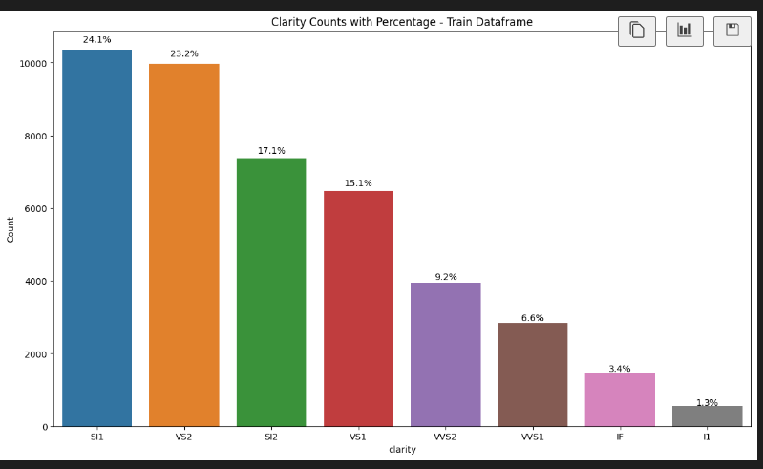
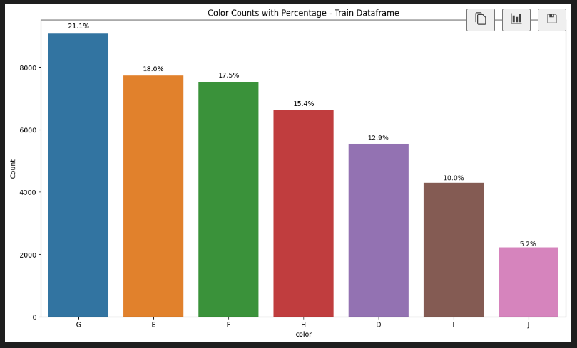
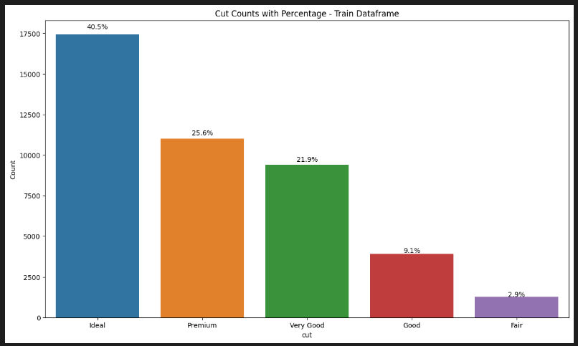
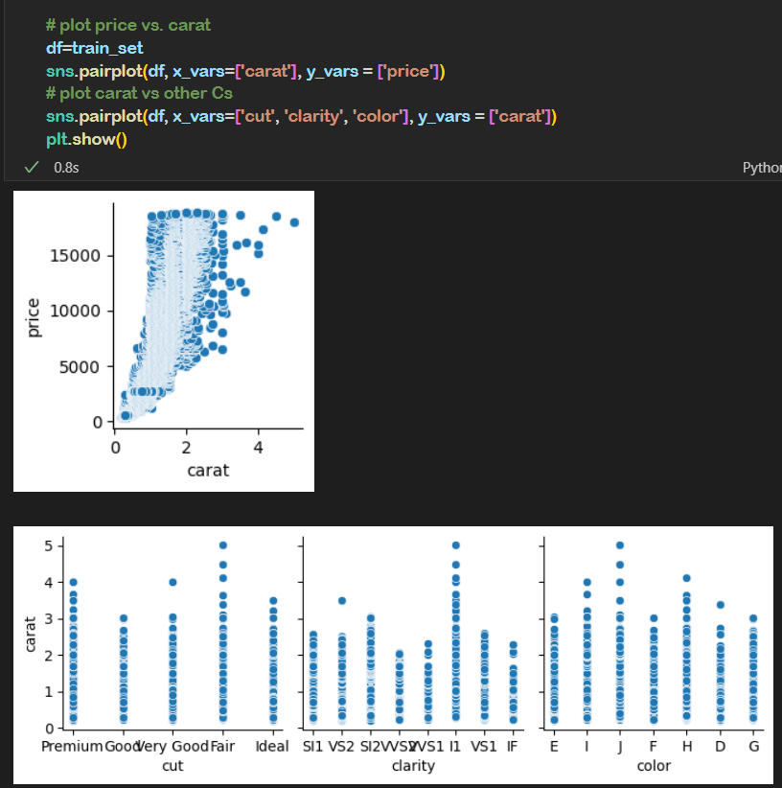

We can see that the properties charts reveal a lot about how and where bulk of diamonds fall under each property value e.g. most bigger diamonds (higher carat) fall in Fair cut, I1 clarity and H-I color. These are poor (commercial grade) diamonds generally sold by retail jewelry shops across the world to attract consumers with advertisements like ‘Diamonds at 50% off’
05

Slide 6
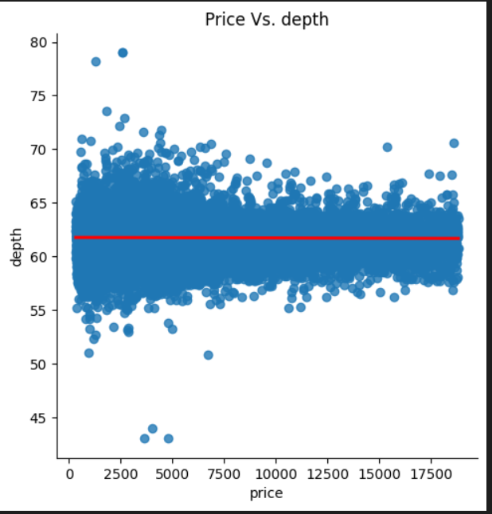
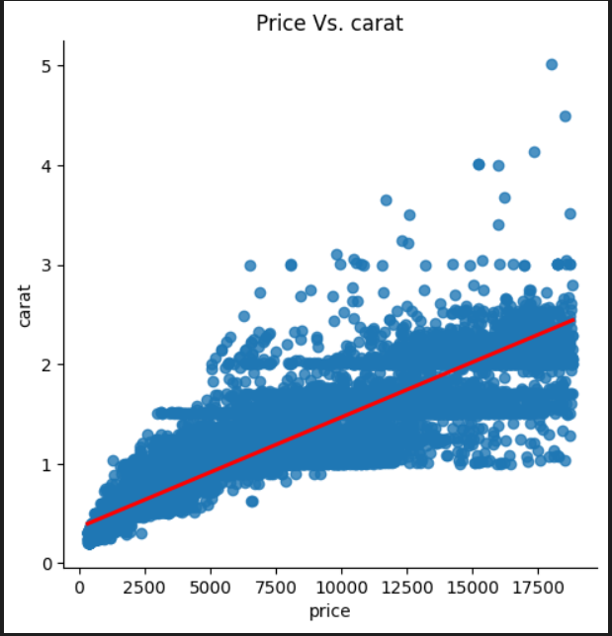
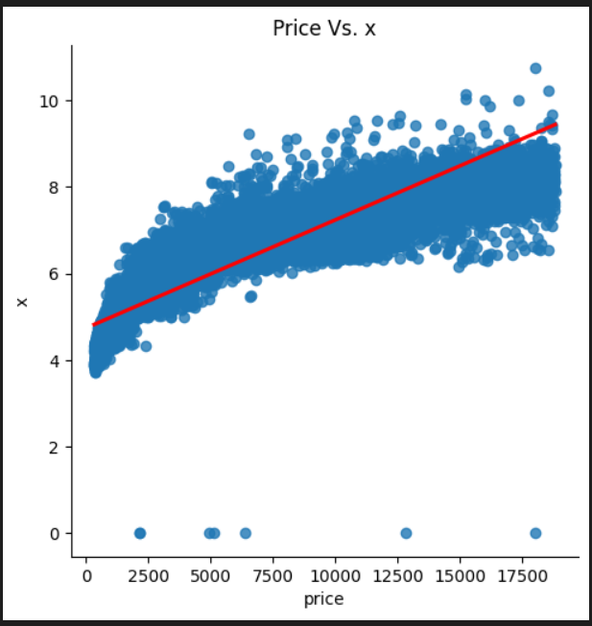
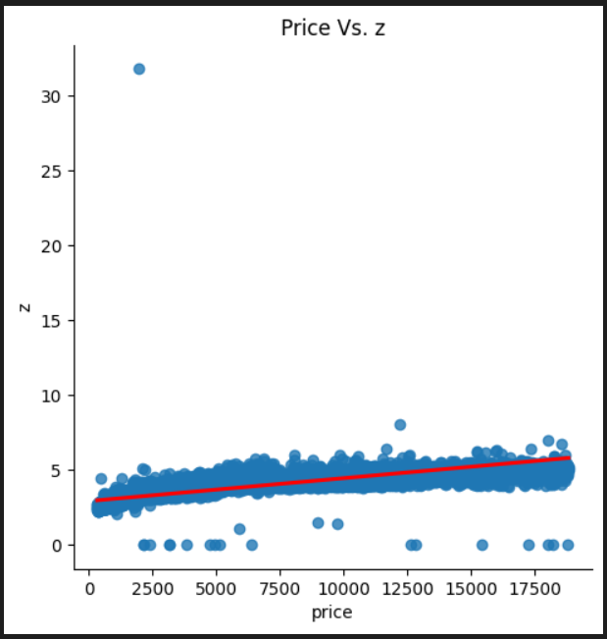
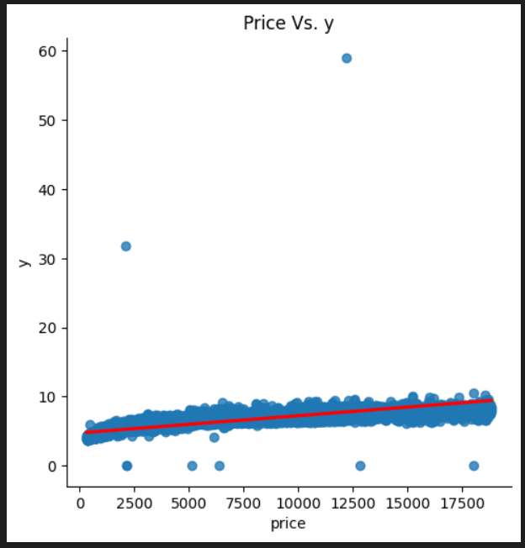
This plot shows that we have a strong relation between Price and Carat Weight
So, the price depend on Weight
We see at the plot that wee have a weak relation between Price and depth So, the price doesn’t depend on it
We have outliers in X,Y,Z
So, need to clean it up
06

Slide 7

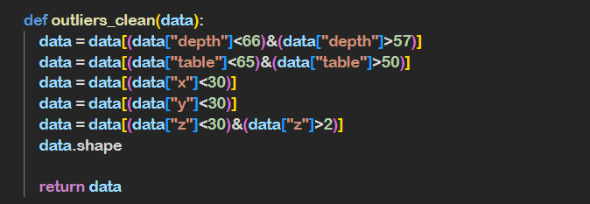
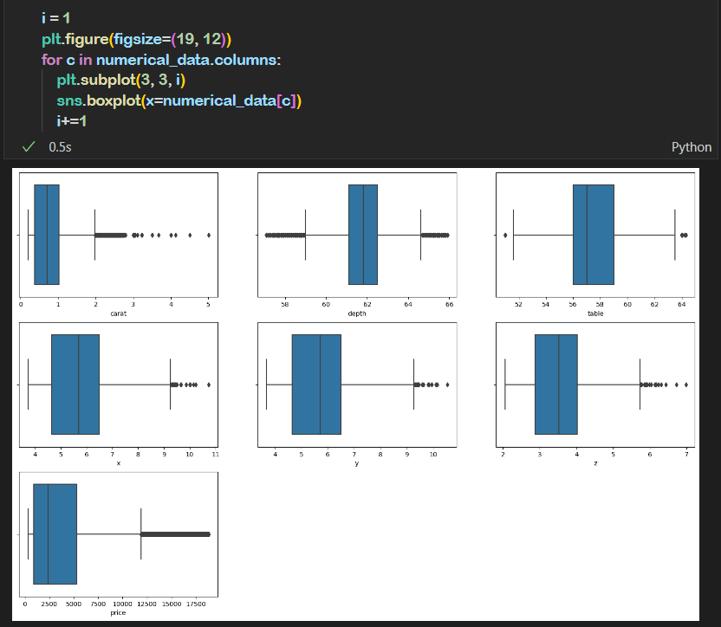

To clean data, we have to drop the outliers (since we have huge dataset) by defining appropriate measures across features then make a boxplot to see if we sill have big deviation in values
07

Slide 8


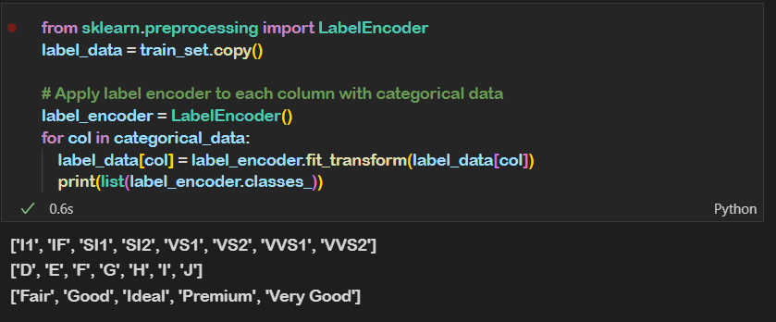
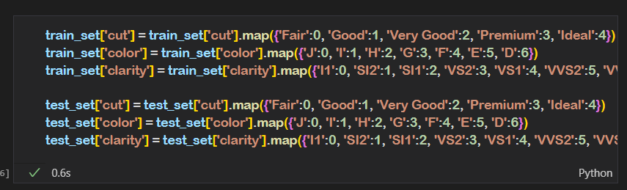
The order of the categorical variables `clarity`, `color`, `Cut`(form Worst to Best)
Then we must convert the categorical variables `clarity`, `color`, `Cut` into numerical by using label encode / or / Manual converting
08

Slide 9

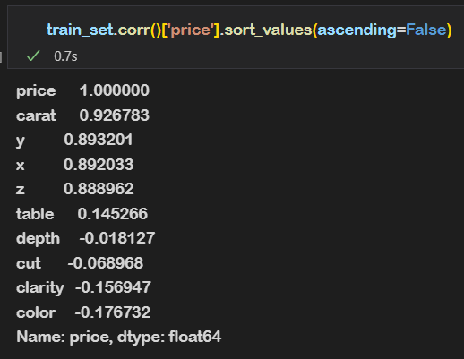
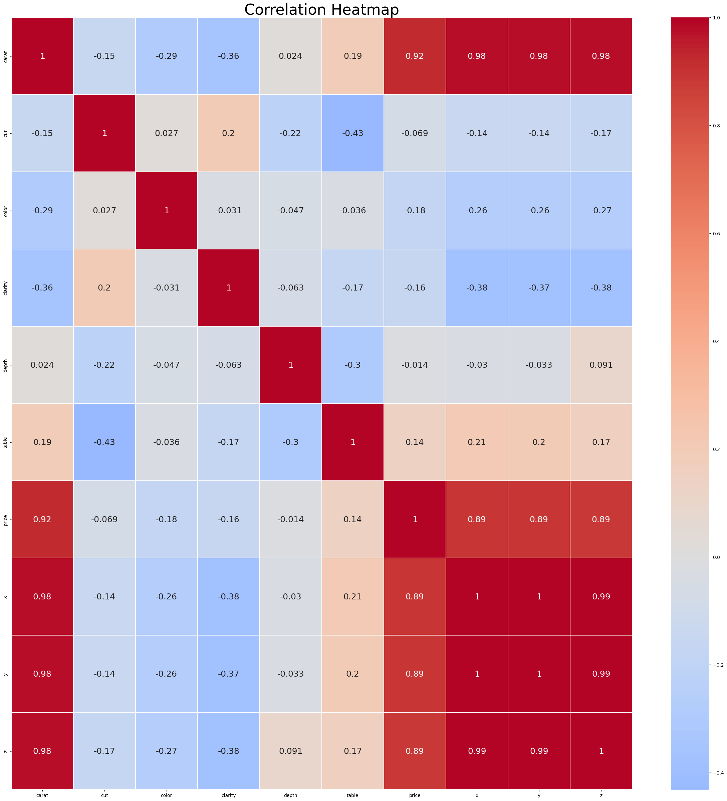
As we see the most variables that make good correlation is (Carat,x,y,z) of Dimond
09

Slide 10
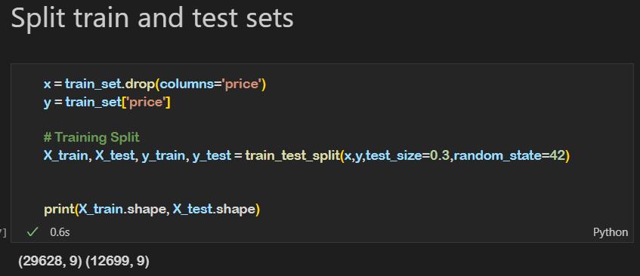
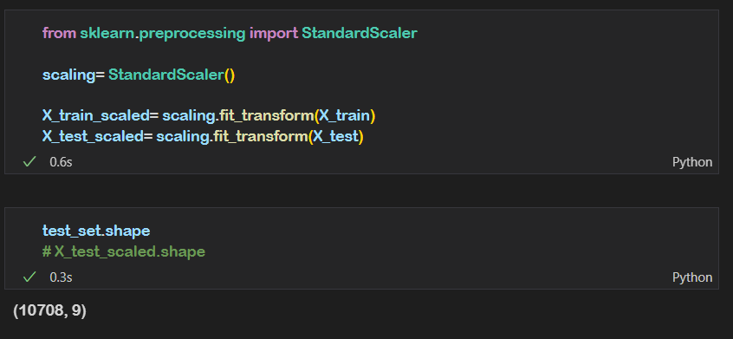
Before Training a model, we must split our Training_set into train and test sets
Standardization of a dataset is a common requirement for many machine learning estimators: they might behave badly if the individual features do not more or less look like standard normally distributed data (e.g. Gaussian with 0 mean and unit variance)
Different scales of the data features affect the modeling of a dataset adversely.
It leads to a biased outcome of predictions in terms of misclassification error and accuracy rates. Thus, it is necessary to Scale the data prior to modeling.
10

Slide 11
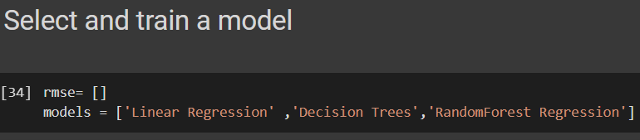
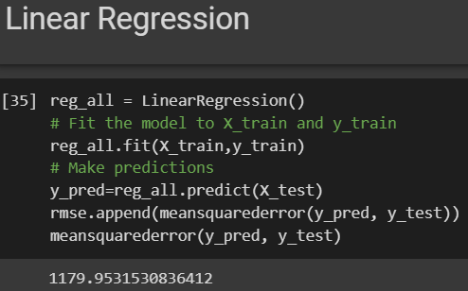
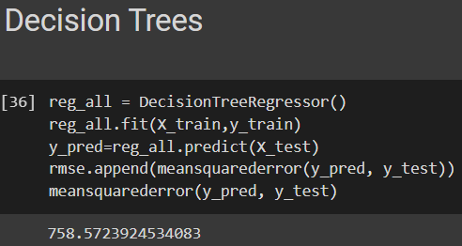
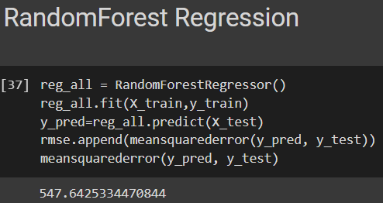
Training the models
We trained our data using 3 different Machine Learning models
With Linear Regression, a prediction error of 1179 is high. The model is underfitting, so we need to try using a more powerful model
With Decision Trees, the prediction error is better than the Linear Regression one, but we need to try using another model to gain a better result
Our Random Forest model gave us the best RMSE compared to our other models
11

Slide 12
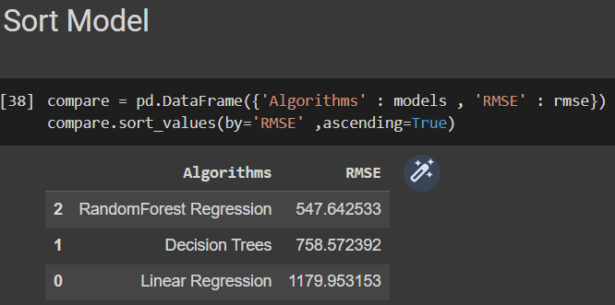
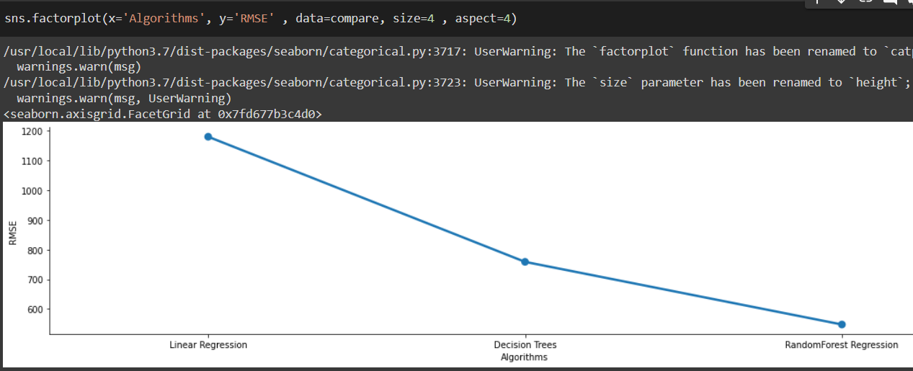
Results comparison
We can clearly see that we got the best RMSE with the Random Forest model
12

Slide 13
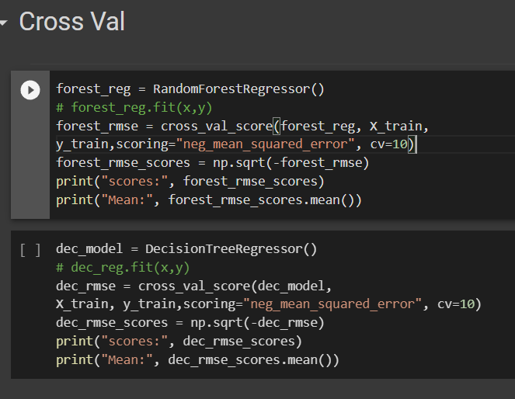


Using Cross-Validation
We randomly splits the training set into 10 distinct subsets , then train and evaluates the Random Forest Model and the Decision Tree model 10 times.
Score For Random Forest Model :
Score For Decision Tree Model :
13

Slide 14
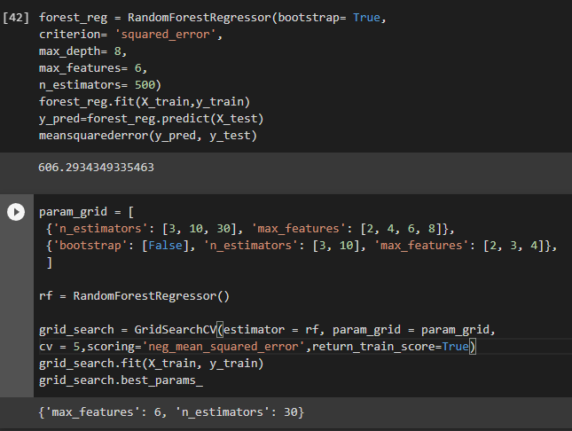
Fine-Tune :
After use the cross validation we select random forest as a model because it has the best result , then we should fine tune
Our model by “ GridSearchCV “ :
Now we should tune our model with this parameters
14

Slide 15
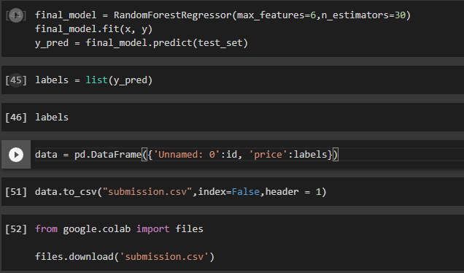
The Final step
The Final step is to use our test set to make prediction
Then preparing a data frame with unnamed column and the prices
After that we should get a csv file with the result of our predicted prices
15

Slide 16
Thank you
A.B.B Team
Ammar Yaser
Bilal Mohammed
Bouthaina Hamaissia

