Slide 1
Loop-IT group:
Ngoc Kieu Thanh Huynh – 2688093
Bilal Butt – 2688700
Michel Clerger – 2694646
Roman Siabro – 2224489

Slide 2

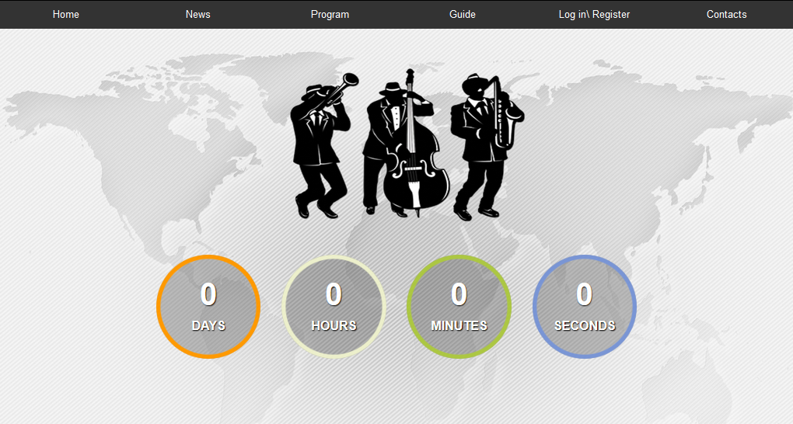
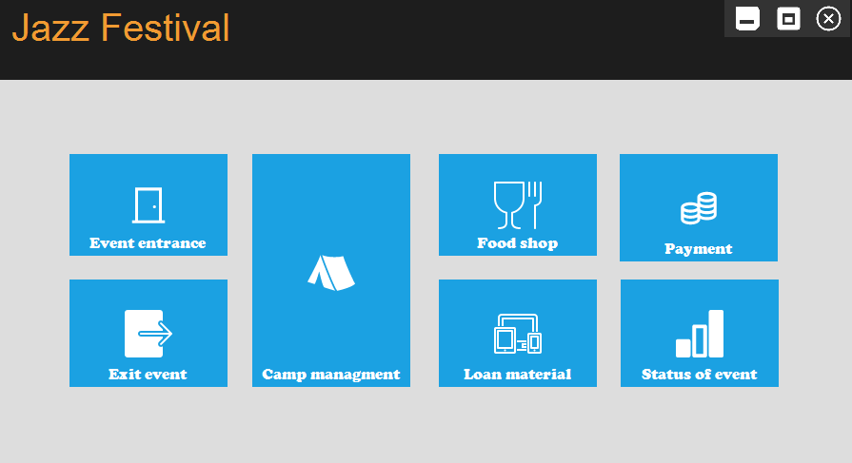
ALL-IN-ONE “LoopIT” SYSTEMS

Slide 3

Before the event
Information
Online registration
Notes:
What are the features organizers need before the events

Slide 4





Event’s webstie
Athena server: http://athena.fhict.nl/users/i333151/PropWebsite/index.php
http://ec2-54-152-33-198.compute-1.amazonaws.com/
Notes:
What are the features organizers need before the events

Slide 5





During event
Manage visitor’s check-in
Shops
Manage check-in at camping area
Loaning materials
Update payment from PayPal
Notes:
What are the features organizers need before the events

Slide 6
After event
Manage visitor’s check-out
Report for event
Notes:
What are the features organizers need before the events

Slide 7
Thanks!
Any questions?
You can find me at:
@username
user@mail.me

