Slide 1
Title: Indian House Rent Prediction Presented by: Muhammad Bilal Younis Date: 28-12-2024

Slide 2

Project Overview
Objective: Predict house rents in India based on various features (location, size, amenities, etc.).
Approach:
Data Preprocessing and Exploration
Feature Engineering
Model Training and Evaluation
Deployment using Flask

Slide 3

Exploratory Data Analysis (EDA)
Objective: Understand the data distribution, handle missing values, and analyze relationships between variables.
Steps:
Check for Null Values:
Identify missing values in the dataset.
Analyze the impact of missing values on the target variable (rent price).
Impact of Null Values on Target Variable:
Examine if missing values in features influence rent prediction.
Decide how to handle missing values based on their impact.

Slide 4
Feature Separation
Separate Numerical and Categorical Features:
Numerical Features:
Further divide into Discrete and Continuous features.
Categorical Features:
Count the number of categories in each feature (e.g., location, property type).

Slide 5

Feature Engineering
Handling Missing Values:
1
For Numerical Features, impute missing values using median (to avoid bias from outliers).
For Categorical Features, impute missing values using Label Encoding.
Feature Scaling:
2
Apply Standard Scaling to numerical features to bring them to the same scale.

Slide 6

Correlation Analysis and Feature Selection
Correlation Heatmap:
Visualize the correlation between features to identify strong relationships with the target variable.
Select the most important features that contribute to rent prediction.
Feature Selection:
Use Correlation Analysis and domain knowledge to select the best features for the model.

Slide 7

Model Training and Evaluation
Model Training:
Train multiple regression models, such as:
Linear Regression
Random Forest
XGBoost
Support Vector Machine (SVM)
Model Evaluation:
Evaluate models using R² Score (coefficient of determination) to select the best performing model.

Slide 8

Model Deployment
Save Model Weights and Scaler Object:
Save the trained model and scaler objects for future use during predictions.
Flask Web Application:
Build a Flask-based web app where users can input house details (e.g., size, location, amenities) and get predicted rent.
Deploy the Model:
Deploy the Flask app and ensure it works correctly in a web environment.

Slide 9
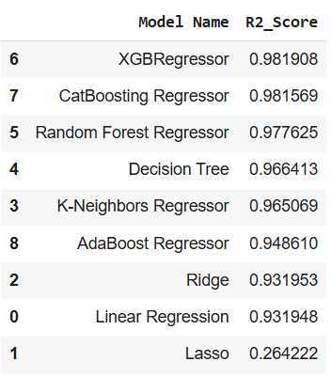
Results and Conclusion
Best Model:
Best model is selected based on R2 score
Deployment Outcome:
Successfully deployed the model in a web app.

