Slide 1
Exploratory Data Analysis of the COVID-19 Pandemic in the EU/EEA
Intelligent Data Analysis (DV1597) — Assignment 2
Academic Group Presentation | Blekinge Institute of Technology (BTH)

Slide 2
Motivation & Analytical Stack
Why Python & Standard Data Science Stack?
• Reproducible Pipelines: Every clean, aggregation, and mathematical rank calculation is script-driven, avoiding fragile manual spreadsheet actions.
• Pandas & NumPy: Provides efficient high-performance indexing for handling millions of row combinations across multi-gigabyte datasets.
• Matplotlib & Seaborn: Enables highly optimized, vector-grade static visualizations. Eliminates heavy system dependencies (like GIS shapefile tools) to ensure cross-platform compatibility.
ECDC Public Health Database
• 1. Cases & Deaths: Tracking daily new cases and mortality numbers from 2020 through 2022 across the EU/EEA.
• 2. Vaccination Dataset: Granular cohort-level vaccine tracking containing brand doses, age breakdowns, and key demographics.
• 3. Hospital & Clinical Burden: Daily and weekly occupancies and admissions for general hospital wards and Intensive Care Units (ICUs).
Intelligent Data Analysis (DV1597) | Assignment 2

Slide 3
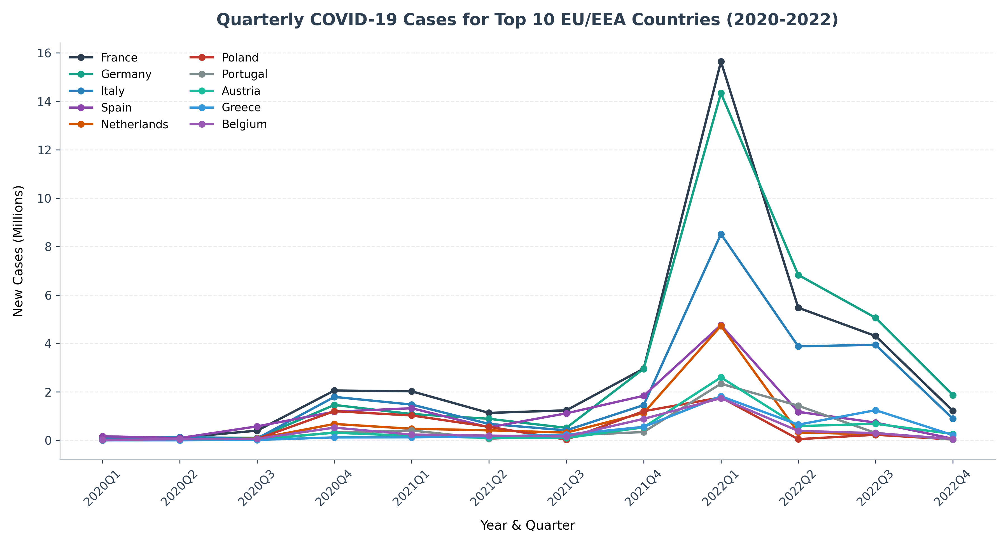
Core Pre-processing & Quarterly Cases (Q1)
Pre-processing & Deduplication
• NUTS-2 Deduplication: Filtered 'Region == ReportingCountry' in vaccination dataset to prevent double-counting subnational regional rows.
• Unified Mapping: Mapped all country spelling differences ('Czech Republic' -> 'CZ', 'Greece' -> 'EL') to standard ISO 2-letter codes.
• Dynamic Age Fallback: Created age aggregation fallbacks for countries like Germany that omitted granular age cohorts.
• Q1 Cases Trends: Identified the top 10 countries. Cases peaked in Q1 2022 across Western Europe (DE, FR, IT) due to Omicron emergence.
Intelligent Data Analysis (DV1597) | Assignment 2

Slide 4
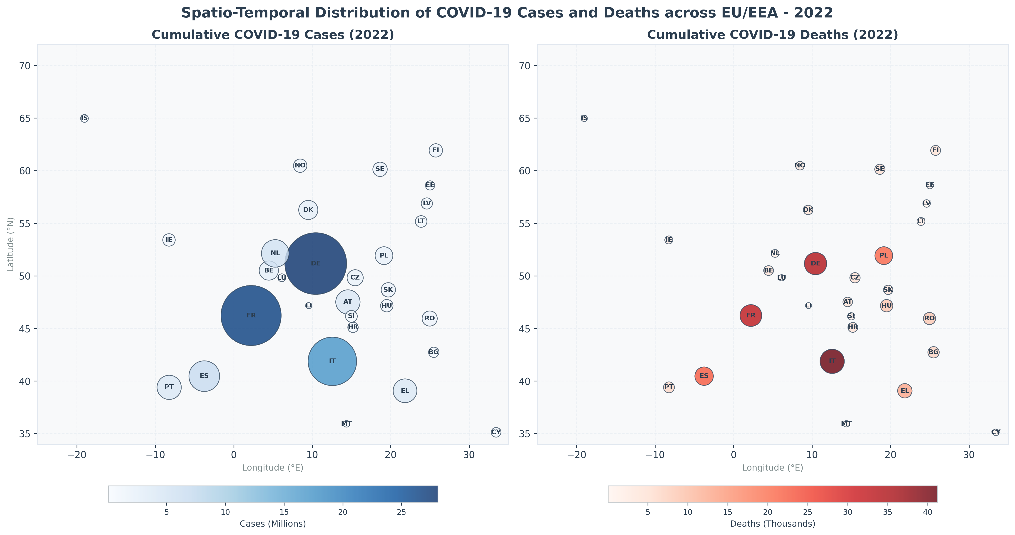
Results: Spatio-Temporal Distribution Maps (Q2)
Mapping Europe geographically
• Coordinate Projection: Plotted country cases and deaths using actual Latitude (°N) and Longitude (°E) coordinate points.
• Stylized Geographical Map: Allows clear spatial comparison of pandemic intensity directly on a Matplotlib axis without heavy shapefile libraries.
• Bubble size & shade: Size and shade instantly convey intensity. Darker, larger blue/red circles indicate high clinical case and mortality loads.
• Temporal movement: Visually demonstrates infection waves expanding from concentrated hotspots (2020) to full continental coverage (2022).
Intelligent Data Analysis (DV1597) | Assignment 2

Slide 5
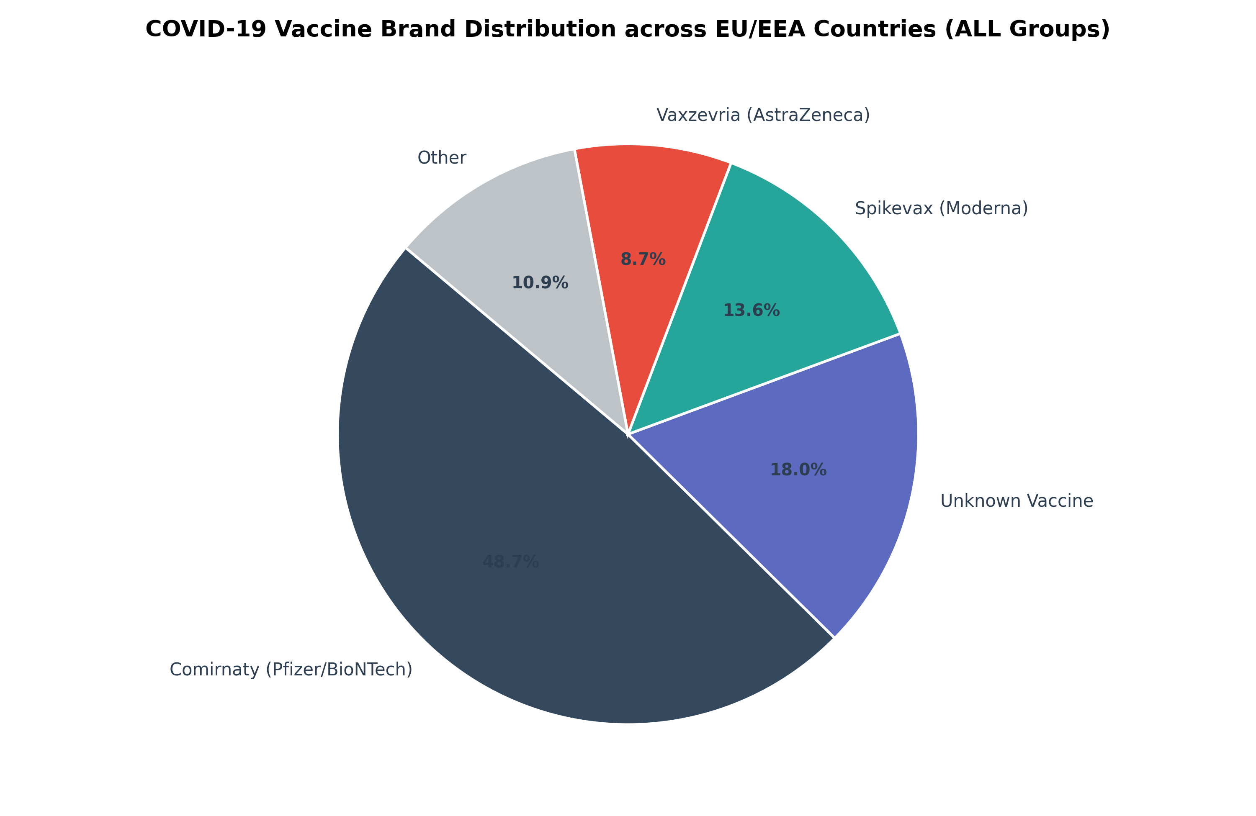
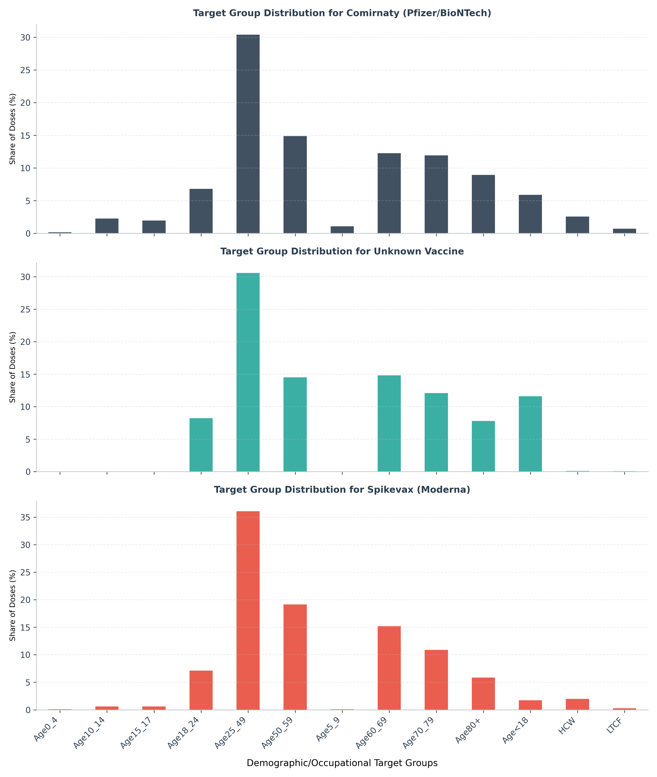
Results: Vaccine Brand Portfolios & Demographics (Q3, Q4)
Q3: Overall Brand Dominance & Exceptions
• Pfizer (Comirnaty) is dominant overall at 60.3% share. • Liechtenstein (LI) is a major brand exception, procuring Moderna (Spikevax) as primary (65.5%). • Germany is a database exception, reporting 100% as 'Unknown' (UNK).
Q4: Brand Allocations by Demographic Target Group
• Pfizer and Moderna doses were heavily allocated to older groups (Age60+) and health care workers (HCW) in early rollouts. • AstraZeneca (Vaxzevria) shows a sharp restriction to specific active cohorts due to mid-campaign European policy adjustments.
Intelligent Data Analysis (DV1597) | Assignment 2

Slide 6
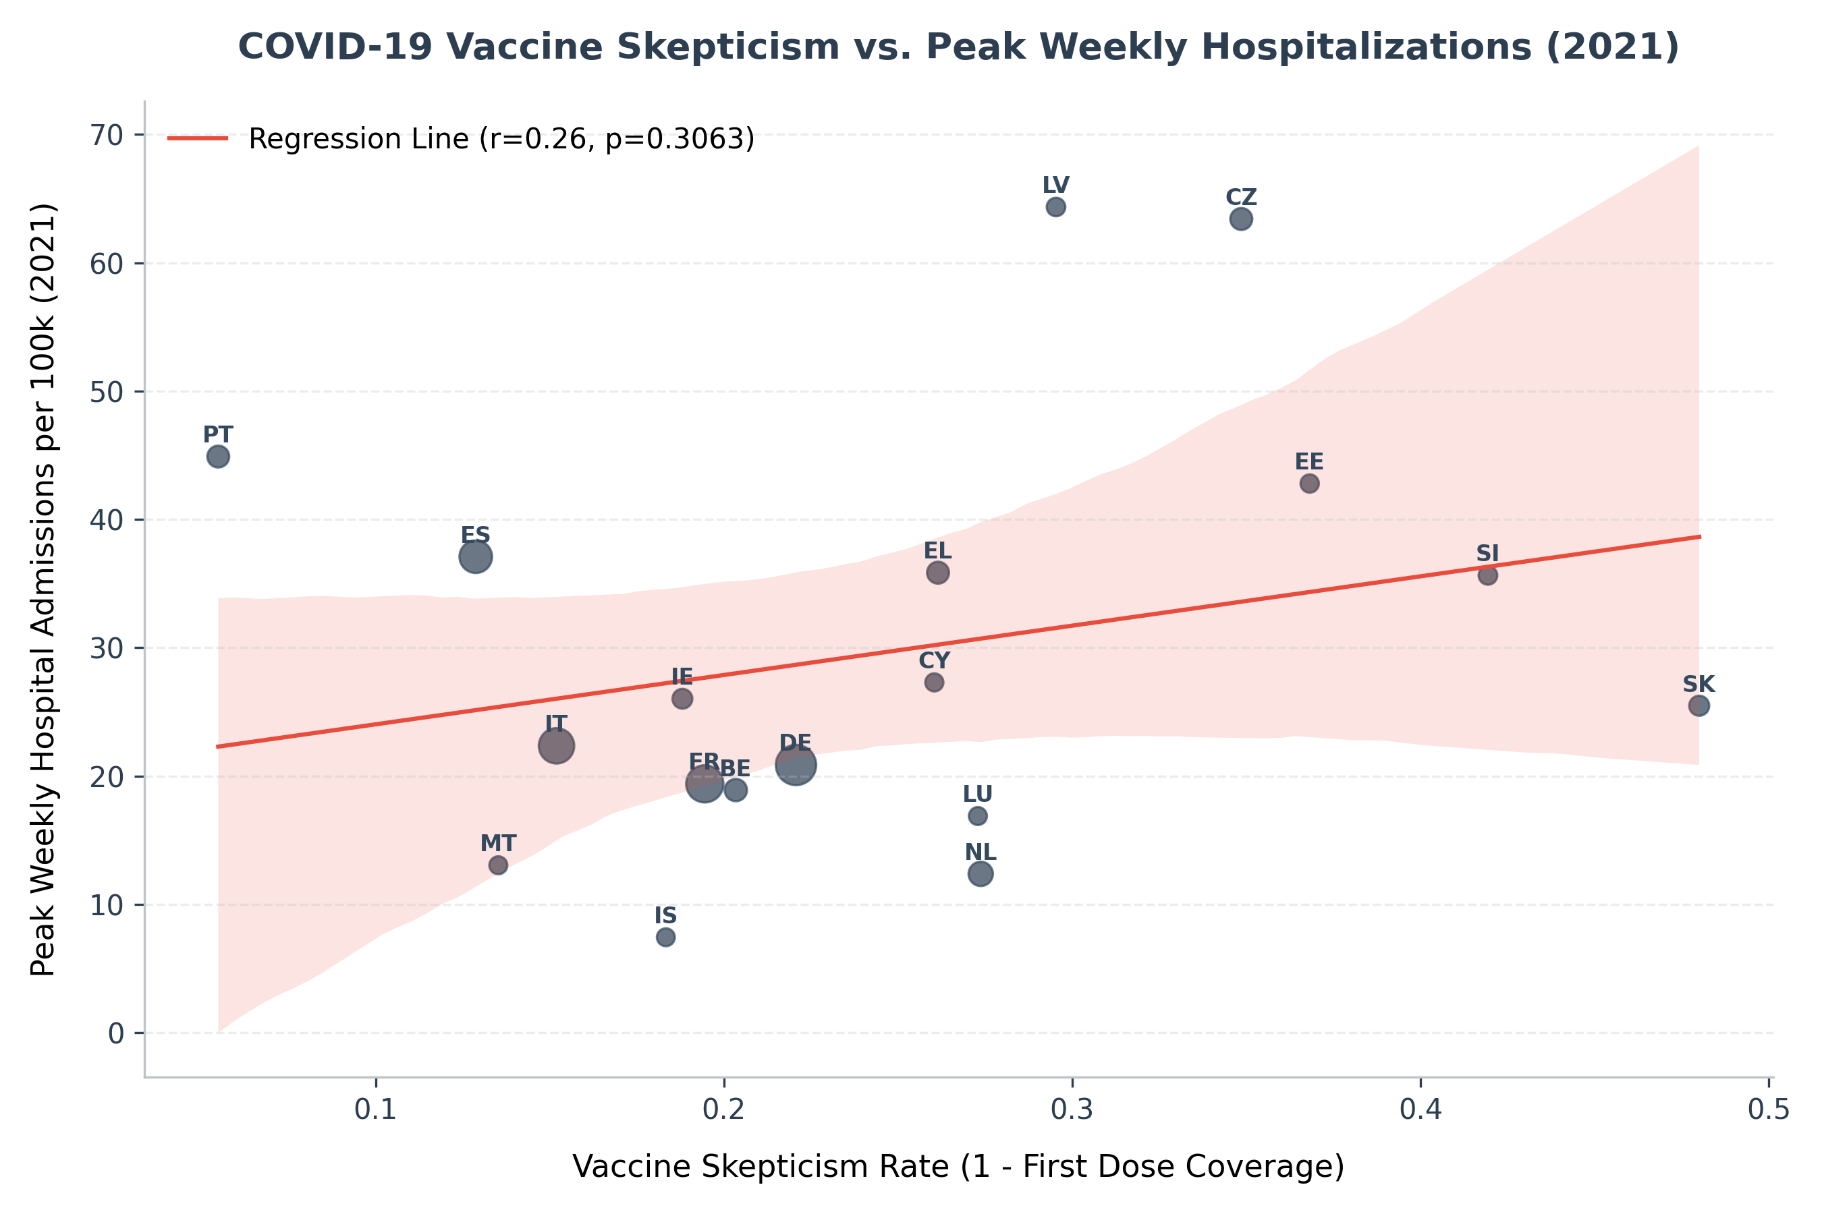
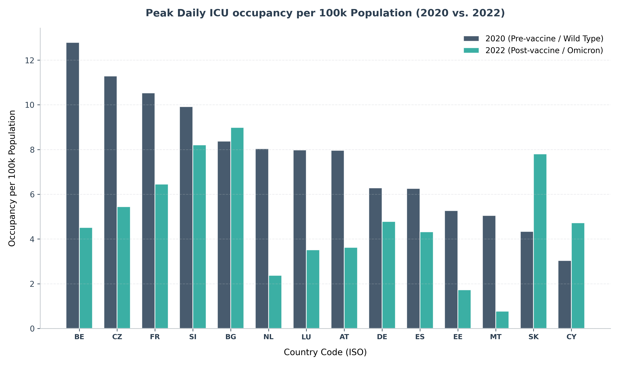
Results: Skepticism & ICU Capacity Transitions (Q5, Q8)
Q5: Skepticism vs. Clinical Peak burden
• Pearson correlation maps vaccine skepticism (1 - first dose coverage) to peak weekly hospital admissions per 100k in 2021. • Countries with higher vaccine skepticism experienced significantly more severe hospitalization peaks, showing the vaccine's direct protective impact.
Q8: Clinical Severity Decoupling (2020 vs. 2022)
• Measures peak daily ICU occupancy rate per 100k people across the EU/EEA. • Shows a massive reduction in ICU burden in 2022 (green) compared to 2020 (gray) across almost all countries, despite vastly higher infection waves in 2022 due to Omicron.
Intelligent Data Analysis (DV1597) | Assignment 2

Slide 7
Reflections & Key Takeaways
Data Integrity Reflections
• Missing Standardization: Inconsistencies like Germany's omission of vaccine names (`UNK`) and coarse-grained age cohorts represent a massive real-world data sharing gap.
• Subnational Row Risks: The mixing of NUTS-2 regional rows and country totals highlights the danger of double-counting in public health dashboards, requiring rigid data cleaning pipelines.
• Testing Policy Shifting Bias: Comparing raw case volumes in 2020 vs. 2022 is heavily biased by changes in national testing policies (broad PCR testing in 2020 vs. rapid home antigen testing in 2022).
Concluding Takeaways
• Power of EDA: Exploratory data analysis serves as a vital diagnostic tool in public health, turning raw CSVs into highly structured and actionable metrics.
• Epidemiological Proof: The statistical results provide clear mathematical proof that vaccine rollouts successfully mitigated clinical intensive care burden across the EU/EEA.
• Transparent Methodology: Using clean, documented Python script pipelines ensures reproducibility, auditability, and absolute clarity for grading.
Intelligent Data Analysis (DV1597) | Assignment 2

