Slide 1
FINAL YEAR PROJECT · PRESENTATION 01
Nizam-e-Qanoon
نظامِ قانون
Pakistan’s Intelligent Legal Solution
A legal mobile application for everyone within Pakistan’s court jurisdiction.
Bilal Ahmad · Muhammad Ammar · Muzammil Idrees · Wali Mohammad Khan
2023162 2023375 2023481 2023756
Advisor: Dr. Muhammad Hanif
Co Advisor: Ahsan Shah
GIKI · Faculty of Computer Science and Engineering
01

Slide 2
MOTIVATION · JUSTIFICATION · ETHICAL IMPACT
PEOPLE | LAW | TECHNOLOGY
How a small incident revealed a bigger legal gap
A real experience that became the motivation for Nizam-e-Qanoon
SDG ALIGNMENT
SDG 16 · Access to Justice
SDG 4 · Legal Education
SDG 10 · Inclusive Access
GIKI → Islamabad
Travelling for an event
vendor discussion
Lawyer Friend
We discussed the incident
with a lawyer friend
01
02
03
04
Stopped & Challaned
Police stopped us over
rear-window tint
The Realisation
We were blind to the law
we were expected to follow
If we struggled to understand the law, how would an ordinary citizen know their rights?
Accessible Law
Informed Citizens
Responsible AI
legal awareness
better decisions
support, not replacement
NIZAM-E-QANOON | FINAL YEAR PROJECT
FROM ONE INCIDENT TO A SOURCE-GROUNDED LEGAL PLATFORM
02

Slide 3
PROBLEM UNDERSTANDING
LAW | INFORMATION | TRUST
The real problem: legal information overload
Need: Reliable + Intelligent
Legal Platform
Our lawyer friend helped us see that the gap is not only for citizens — it affects the whole legal ecosystem.
2.26M
pending cases in Pakistani courts
High volume creates pressure across the justice system
Law & Justice Commission / Dawn, 2024
58%+
legal hallucination risk in public LLMs
Generic AI can produce unsupported legal answers and fake legal references
Dahl et al., Journal of Legal Analysis, 2024
Complex
laws, precedents and case history
Lawyers and judges must connect statutes, cases, facts and procedures under time pressure
Project observation + legal consultation
Backlog + legal complexity + AI hallucination risk → the need for a verified, source-grounded legal platform
NIZAM-E-QANOON | FINAL YEAR PROJECT
03

Slide 4
PROPOSED PRODUCT
APP FEATURE MAP
What users can do in the app
Nizam-e-Qanoon
BASE LAYER · Structured legal database from official Pakistani sources
نظامِ قانون
01
LEGAL LIBRARY SEARCH
Laws + Constitution
02
AI LEGAL ASSISTANT
Natural-language queries
Pakistan’s mobile legal access platform.
Built around official laws, not unsupported AI answers.
03
LATEX DOCUMENT BUILDER
Official templates
04
MOCK TRIAL PRACTICE
Courtroom scenarios
One verified corpus powers all four services.
Source-backed • bilingual • practical
04

Slide 5
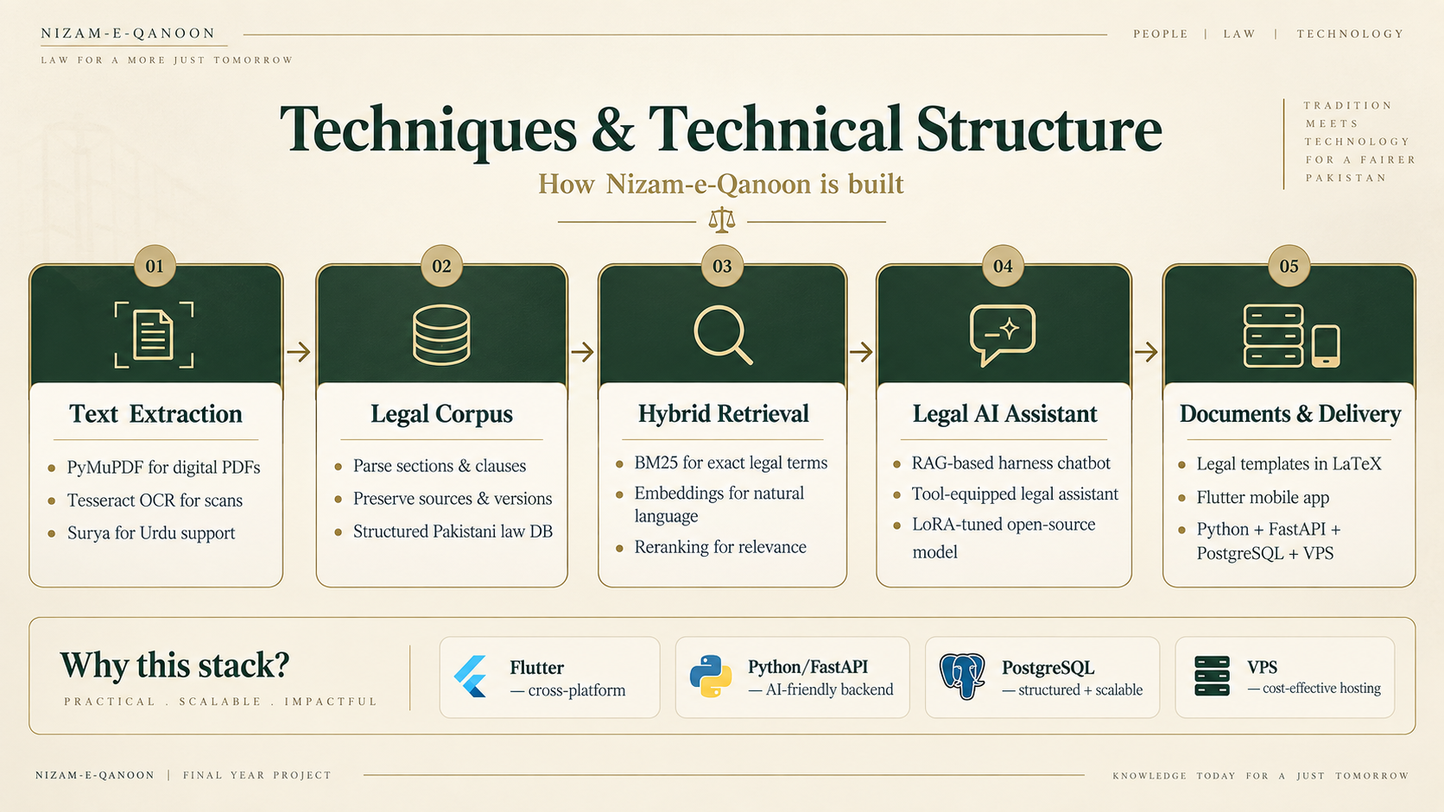
PostgreSQL → SQLite Sync — offline law pack
05

Slide 6
SDLC WORKFLOW · LAYER-WISE DEVELOPMENT
ITERATIVE | INCREMENTAL | VERIFIED
SDLC — From Legal Sources to Mobile App
Build the foundation first, verify each layer, then move to the next.
DATA FOUNDATION
AI + SERVICES + DELIVERY
1
Official Sources
2
Extract + OCR
3
Clean + Segment
4
Index + Embed
Extract PDFs / HTML from official Pakistani law sites.
PyMuPDF for digital PDFs; Tesseract + Surya for scans and Urdu.
Normalize text and parse Acts into sections, clauses and schedules.
Make law searchable using BM25 and semantic embeddings.
source documents
text + page anchors
structured legal corpus
retrieval-ready data
5
Legal AI Layer
6
Backend + APIs
7
Flutter App
Use RAG and a planned LoRA-adapted legal model.
Python / FastAPI handles business logic, services and integration.
Cross-platform mobile UI for search, assistant, docs and offline law.
source-grounded assistant
service layer
user-facing app
L1–L2 foundation built
AI layers planned next
PostgreSQL → SQLite offline sync
VPS deployment target
Verification gated
Layer gate before moving forward: implement → test with real data → verify citations, dates and security → review → next layer
NIZAM-E-QANOON | FINAL YEAR PROJECT
BUILT LAYER BY LAYER — FROM CORPUS TO USER APP
06

Slide 7
High-level workflow · all users
What each user opens, and what they walk away with.
User opens Nizam-e-Qanoon
start / end
step
decision
What does the user need?
needs a document
needs an answer
wants to practice
CITIZEN OR LAWYER
Opens Document Factory
ANY USER · INCLUDING THE BENCH
Opens Legal Chatbot
LAWYER
Opens Courtroom Simulation
Describes the dispute in plain Urdu or English
asks a question
reviews an appeal
Picks a decided case, or generates a new one
Asks in plain language; the corpus is searched
Feeds in the lower-court record for a summary
AI extracts the facts · Python writes the law
Argues in 3D against an AI judge and AI counsel
Authorities, statutes and reasoning cross-checked
Enough legal evidence?
Court-ready plaint (PDF)
Confirm · Modify · Set aside
Verdict + feedback
YES
NO
Cited answer
Abstain safely
Three surfaces, four journeys — all grounded in one verified corpus
Nizam-e-Qanoon · Presentation I
07

Slide 8
LITERATURE REVIEW · EXISTING SYSTEMS
TOOLS | GAPS | OPPORTUNITY
What already exists, and what each one leaves open
Five systems we studied. Each solves part of the problem; none closes the whole gap.
Pakistan Code
PakistanLawSite
PakLawSite
Govt. repository · free
PLD Publishers · since 2002
Pakistani legal AI · bilingual · freemium
900+ federal statutes (Criminal 69, Civil 147, Family 22, Labour 41).
Most complete case-law database: PLD, SCMR, CLC, YLR and more, 1,200+ essays.
AI chat over 659+ laws and about 193,000 judgments, plus lawyer booking and paid drafting.
Gap: no semantic search, no Urdu interface, no offline mode, scanned PDFs not searchable.
https://pakistancode.gov.pk
Gap: raw text with no AI interpretation.
https://www.pakistanlawsite.com
Gap: low number of judgments and precedents, and incomplete Pakistani law code behind it.
https://www.paklawsite.com
Harvey / Casetext
Wakeel.org
Global enterprise legal AI
Found in our own search
Harvey valued at $8B; Casetext bought by Thomson Reuters for $650M.
Free tier, Urdu + English, Android/iOS, advocate-reviewed, aimed partly at citizens.
Gap: US/UK law only, $1,000+/month, no Urdu. Still 17–34% hallucination on US law.
https://www.harvey.ai
https://www.legal.io/legal-software/198/Casetext
Gap: no simulation or practice mode, and incomplete coverage of laws.
https://play.google.com/store/apps/details?id=pk.digit.aiwakeel
None of these combine simple access, Urdu, verified sources, offline use and court-ready documents.
NIZAM-E-QANOON | FINAL YEAR PROJECT
08

Slide 9
RELATED SYSTEMS COMPARISON
FEATURES | COVERAGE | FIT
Feature comparison: where Nizam-e-Qanoon fits
The same seven checks applied to every system we reviewed.
System | Pak law | AI | Urdu | Source gate | Offline | Documents | Primary user
Pakistan Code | ✓ | — | Limited | n/a | — | — | public / legal
PakistanLawSite | ✓ | — | Limited | n/a | — | — | lawyers
PakLawSite | partial | ✓ | ✓ | unclear | — | drafting | citizens + lawyers
Wakeel.org | ✓ | ✓ | ✓ | claimed | — | templates | citizens + legal users
Harvey / Casetext | — | ✓ | — | partial | — | ✓ | US law firms
Generic LLMs | weak | ✓ | ✓ | — | — | drafting | everyone
Nizam-e-Qanoon (planned) | ✓ | ✓ | ✓ | ✓ | ✓ | ✓ | citizens + legal users
“unclear” = not publicly documented; “claimed” = stated on the product’s own site, not independently tested; “n/a” = no AI generation to gate. Our row shows the proposed design; features are not all built yet.
The real gap: simple access + Urdu/English + verified Pakistani sources + useful outputs in one system.
NIZAM-E-QANOON | FINAL YEAR PROJECT
09

Slide 10
POTENTIAL USERS
CITIZENS | LAWYERS | JUDGES | STUDENTS
Four real users, four different needs
Who Nizam-e-Qanoon is built for — and how many of them there are in Pakistan.
251M
200K+
~4,000
150+
citizens; about 150M already on mobile broadband
enrolled advocates; Punjab alone about 130K
judges carrying 2.3M pending cases
law colleges under HEC and Pakistan Bar Council
Common citizens
Lawyers
Judges
Law students
“What law applies to my situation?”
“Can I trust the references?”
“Is this summary traceable?”
“How do I learn law practically?”
Simple Urdu or English explanation, a cited answer and the next step. Works offline.
Source-linked summaries, proper legal language and faster research.
Document summaries tied to database-backed references.
Guided examples, scenarios and interactive learning.
PBS census 2023 · PTA indicators 2026
Lawyher.pk baseline report, 2021
Law & Justice Commission of Pakistan, 2024
HEC / Pakistan Bar Council listings
One shared base: verified Pakistani legal corpus + tuned legal intelligence — four entry points.
NIZAM-E-QANOON | FINAL YEAR PROJECT
10

Slide 11
NIZAM-E-QANOON | FINAL YEAR PROJECT
Thank You
for listening to our presentation on Nizam-e-Qanoon
Questions & Answers
We would be happy to take your questions.
END

