Slide 1
CAPSTONE PROJECT — 2026
BidIntel AI
Enterprise bid intelligence workspace for professional bid analysis, response drafting, and governance controls.
By Rameez Wasif • Bilal Ahmed • Ammar Murtaza

Slide 2
THE CHALLENGE
Bidding on RFPs is a Manual Gamble
Firms in IT, development, and advisory burn thousands of hours parsing dense tender documents — only to be disqualified by hidden clauses or mismatched technical weightage.
Thousands of Manual Hours
Hidden Poison-Pill Clauses
Gut-Feel Bid/No-Bid Calls
Spent parsing complex RFPs that may not even be winnable — a colossal drain on team capacity before a single word is written.
Buried deep in documents, these clauses derail bids before submission — invisible to teams under time pressure.
Decisions made without evidence waste team capacity on unwinnable pursuits and starve competitive bids of attention.

Slide 3

TARGET MARKET
Who It's For
Built for bid teams that need to scale their bidding footprint without scaling overhead.
IT Services Firms
Development Consultancies
Corporate & Financial Advisory
P@SHA / PSEB members and software houses bidding on international digital transformation projects where technical scoring is complex and unforgiving.
Firms competing for World Bank, ADB, and USAID tenders where eligibility rules are ruthless and disqualification is one missed clause away.
Global firms — McKinsey, EY, Deloitte and peers — managing complex public-sector and multi-national bids across jurisdictions.

Slide 4
CORE PRODUCT
Our Solution
BidIntel AI scouts, scores, and audits every tender. Upload an RFP and your draft response — get a Win Probability Score, flagged risks, and a project-grounded AI workspace in under a minute.
Parse
Score
Extract gates, criteria, evidence requirements, and submission rules from any RFP PDF.
Compare draft response against evaluation criteria, grounded in your knowledge base.
Detect
Decide
Surface poison-pill clauses that create legal or commercial disqualification risk.
Calculate deterministic Win Probability across conservative, expected, and optimistic scenarios.

Slide 5

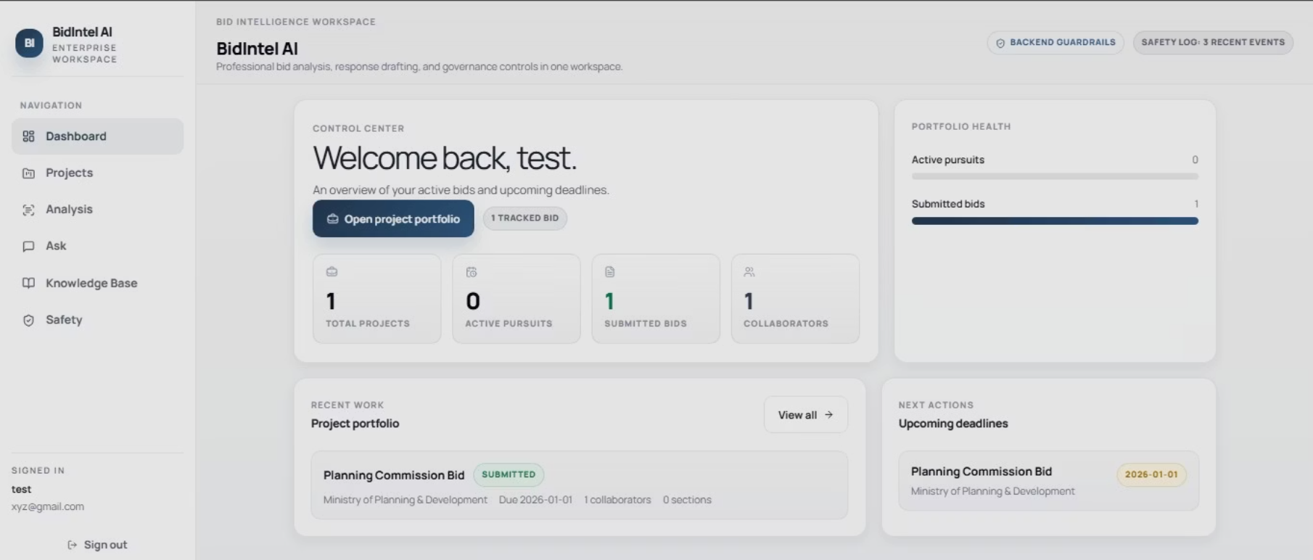
PRODUCT WALKTHROUGH — 1 OF 3
Dashboard
Control Centre
A single-pane view of the entire bid portfolio — active pursuits, submitted bids, collaborators, and upcoming deadlines all in one place.
Portfolio health at a glance
Active project counts
Upcoming submission deadlines
Collaborator activity feed
The Control Centre gives bid managers a single-pane view of their entire portfolio: active pursuits, submitted bids, collaborators, and upcoming deadlines. No more spreadsheets, no more missed submissions.

Slide 6
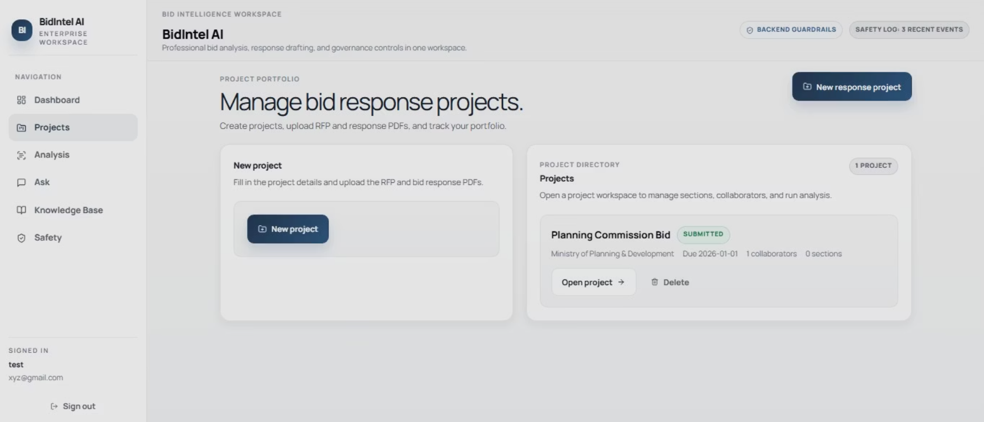
PRODUCT WALKTHROUGH — 2 OF 3
Project Workspace
Single Source of Truth
One workspace per bid — no scattered files, no version confusion.
Upload RFP and response PDFs
Invite collaborators by role
Track all artefacts in one place
New project creation in seconds
Every bid lives inside a project. Upload the RFP and your draft response PDFs, invite collaborators, and the workspace becomes the single source of truth for that pursuit.

Slide 7
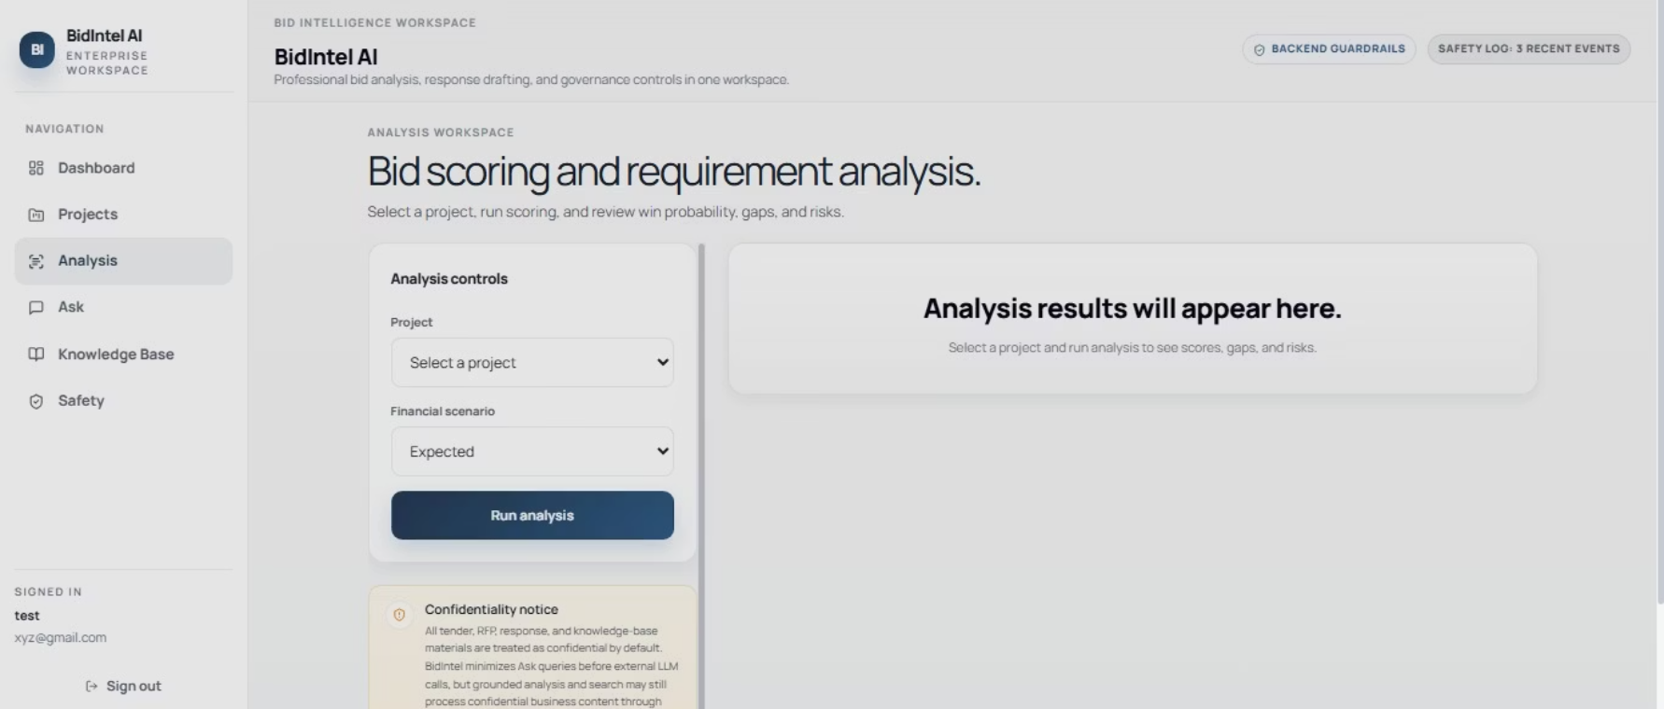
PRODUCT WALKTHROUGH — 3 OF 3
Analysis & Scoring
Live Analysis Engine
Results stream in as they are computed — no waiting for a batch job to finish.
Project selector
Financial scenario picker
Live streaming results
Criteria-by-criteria breakdown
Flagged risks surfaced inline
Pick a project, choose a financial scenario (conservative / expected / optimistic), and run the analysis. Results stream in live: Win Probability Score, criteria-by-criteria breakdown, and flagged risks.

Slide 8






ARCHITECTURE
How It Works: The Pipeline
From PDF upload to grounded recommendation in five stages.
Ingest
PyMuPDF with optional Tesseract OCR fallback for scanned PDFs
Parse
Groq LLM extracts structured criteria, gates, and poison pills
Retrieve
ChromaDB + LlamaIndex pulls relevant evidence from response and KB
Score
Batch evaluation of every criterion against retrieved evidence
Decide
Win Probability calculated across three financial scenarios
Output: Win Probability Score, criteria-by-criteria breakdown, poison pill alerts, and a grounded AI chat workspace.

Slide 9
ENGINEERING
Tech Stack
A pragmatic stack chosen for speed of iteration and grounded retrieval.
Layer
Technology
Frontend
React 18, TypeScript, Vite, Tailwind, TanStack Query
Backend
FastAPI, Python, SQLite
LLM
Groq chat completions
Embeddings
SentenceTransformers all-MiniLM-L6-v2
Vector Store
ChromaDB (persisted on disk)
Retrieval
LlamaIndex + Chroma
Auth
JWT (HS256) with PBKDF2 password hashing
Streaming
Server-Sent Events for live analysis updates
PDF Extraction
PyMuPDF with optional Tesseract OCR fallback

Slide 10
CAPABILITIES
What We Built: Six Capabilities
1
Structured RFP Parsing
Gates, criteria, checklist signals, evidence requirements, poison pills, and submission rules extracted from any PDF.
2
Response Scoring
Draft response evaluated against extracted criteria using Groq + retrieval from your knowledge base.
3
Poison-Pill Detection
Flags clauses creating legal or commercial disqualification risk before they sink your submission.
4
Win Probability Score
Deterministic WPS across conservative, expected, and optimistic scenarios with full evidence trail.
5
Grounded AI Workspace
Project-level chat assistant grounded in RFP, response artefacts, and company knowledge base.
6
Reusable Knowledge Base
Upload CVs, certifications, capability statements, and past proposals once — reuse forever across all bids.

Slide 11

SCORING ENGINE
The Win Probability Score
Three scenarios. Deterministic math. Full evidence trail.
42%
65%
78%
Conservative
Expected
Optimistic
Worst-case assumption on every uncertain criterion. The floor of your bid.
Central estimate using best-evidence matching. Use this for go/no-go decisions.
Favourable interpretation where evidence is ambiguous. The ceiling of your bid.
✅ Recommendation: BID WITH MITIGATION — Strong eligibility match, two critical gaps identified, no blocking poison pills detected.

Slide 12
GOVERNANCE
Responsible AI & Governance
Every score, every flag, every chat answer can be traced back to a source document. Backend guardrails, safety logs, and confidentiality controls are built in.
Retrieval-First Generation
Deterministic Scoring Math
Confidentiality by Default
The LLM is constrained to retrieved evidence from RFP, response, and KB. No free-form hallucination.
WPS calculation is rule-based. Same inputs always produce the same score — fully auditable.
All tender, RFP, response, and KB materials treated as confidential. Queries minimised before external LLM calls.
Safety Operations Dashboard
Human-in-the-Loop
Live monitoring of PII redactions, unsafe-output fallbacks, prompt-injection detections, and audit events.
BidIntel makes recommendations. The bid manager makes the call. AI augments — it does not replace — human judgement.

Slide 13
Thank You
Rameez Wasif
Bilal Ahmed
Ammar Murtaza
github.com/bilalahmedss/BidIntel-AI

