Slide 1
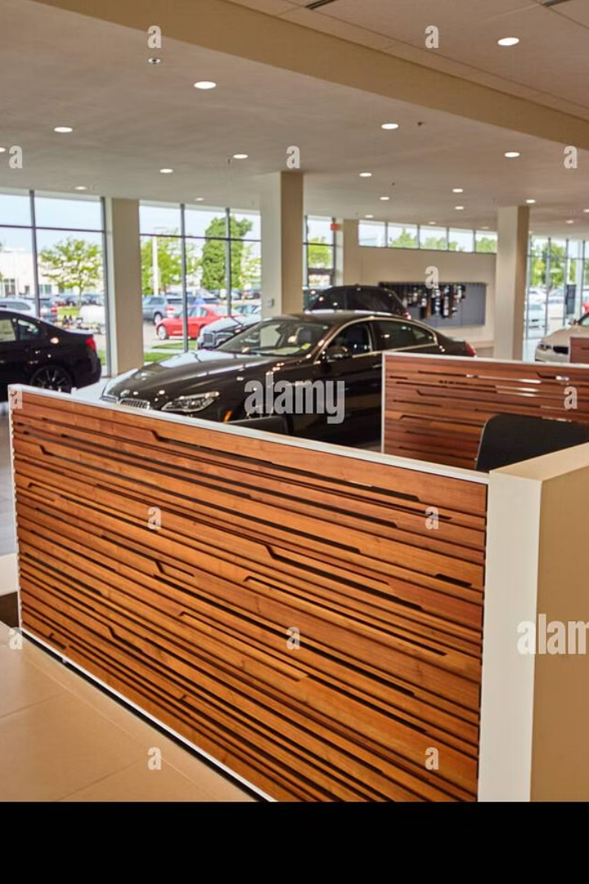

ApexAutos – Car Dealership Management System
A semester project for our Database Management
Systems course.
Muhammad Talha 241890 .
Muhammad Bilal 241917 .

Slide 2

Project Objective: Streamlining Dealership Operations
Centralised Data
Consolidate all dealership information into one system.
Enhanced Efficiency
Automate key processes to improve operational speed.
Accurate Reporting
Generate reliable insights for informed decision-making.

Slide 3
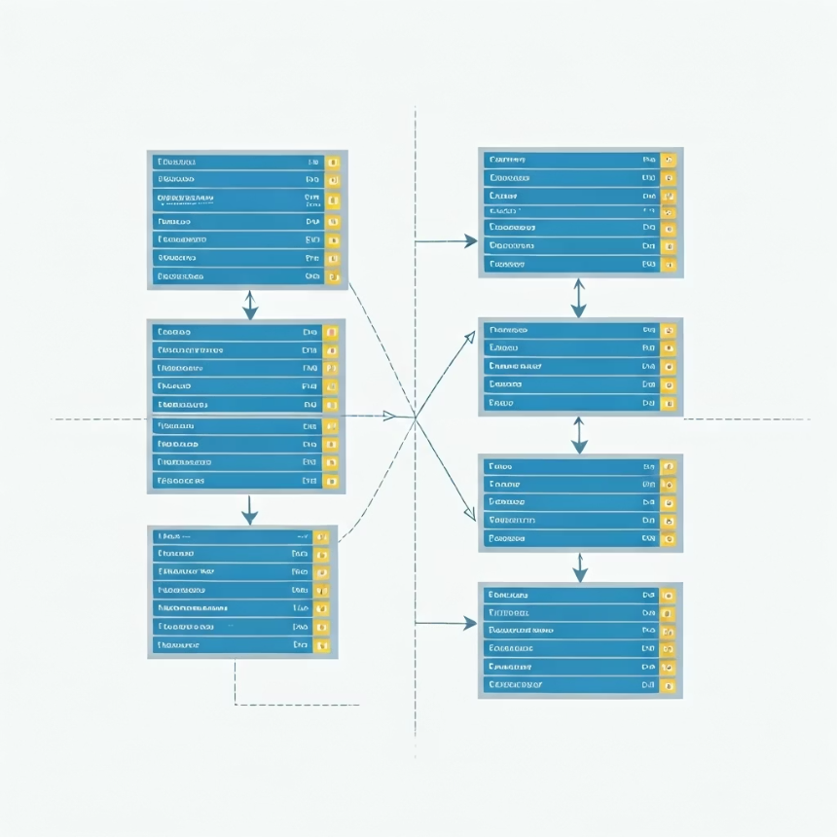
Database Design: Normalisation and Schema Overview
NORMALIZATION (1NF)
Achieved First Normal Form (1NF) by ensuring that all attributes in a table contain only atomic
(indivisible) values. It removes repeating groups and organizes data into structured rows and columns.
Eliminates duplicate columns.
Ensures each field holds only one value.
Creates a clear tabular format.
NORMALIZATION (2NF)
Achieved Second Normal Form (2NF) by removing partial dependencies. All non-key attributes now
fully depend on the entire primary key.
Builds on 1NF structure.
Removes partial data dependencies.
Improves relational integrity.
NORMALIZATION (3NF)
Achieved Third Normal Form (3NF) to eliminate data redundancy. It also improved data
integrity and efficiency.
Reduces data duplication.
Enhances data consistency.
Simplifies database maintenance.
Our schema ensures a logical and well-structured database for optimal performance.

Slide 4
Main Entities and Their Attributes
Users
Branches
Cars
UserID, Username, Password, Role, BranchID
BranchID, Name, Location, ContactInfo
CarID, Make, Model, Year, Price, StockStatus, BranchID
Customers
Sales
CustomerID, Name, Address, Phone, Email
SaleID, CarID, CustomerID, UserID, SaleDate, SalePrice
These core entities form the backbone of our dealership management system.

Slide 5
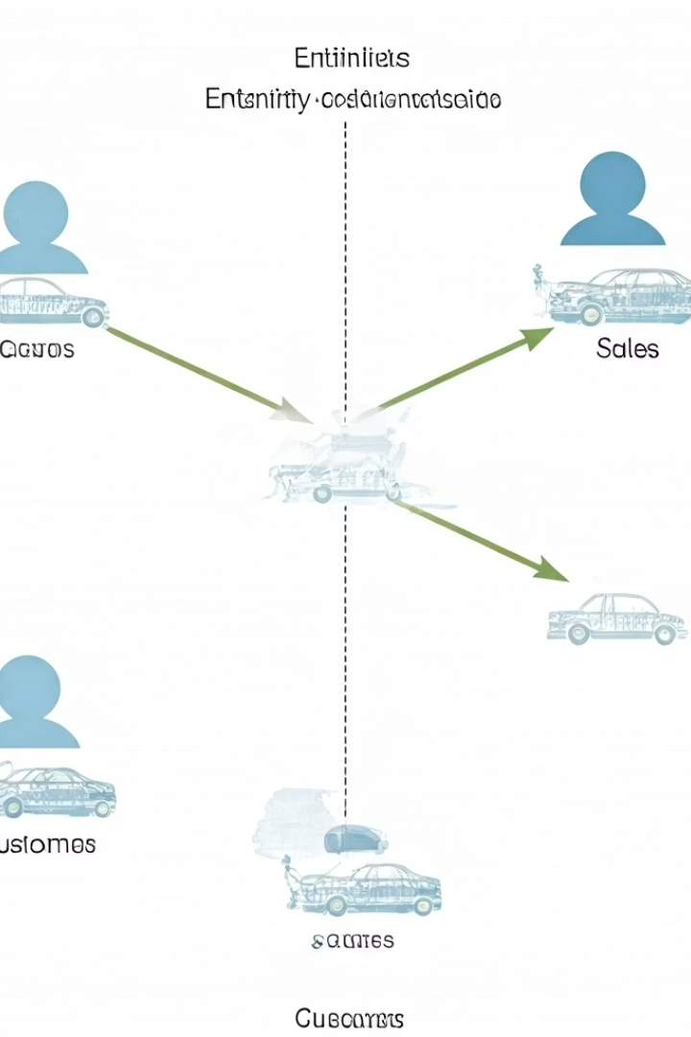
Entity-Relationship Diagram (ERD)
A visual representation of the database structure.
Shows entities (tables) and their relationships.
Helps in understanding how data is connected.
Includes attributes, primary keys, and foreign keys.
Useful for designing and planning databases effectively.

Slide 6
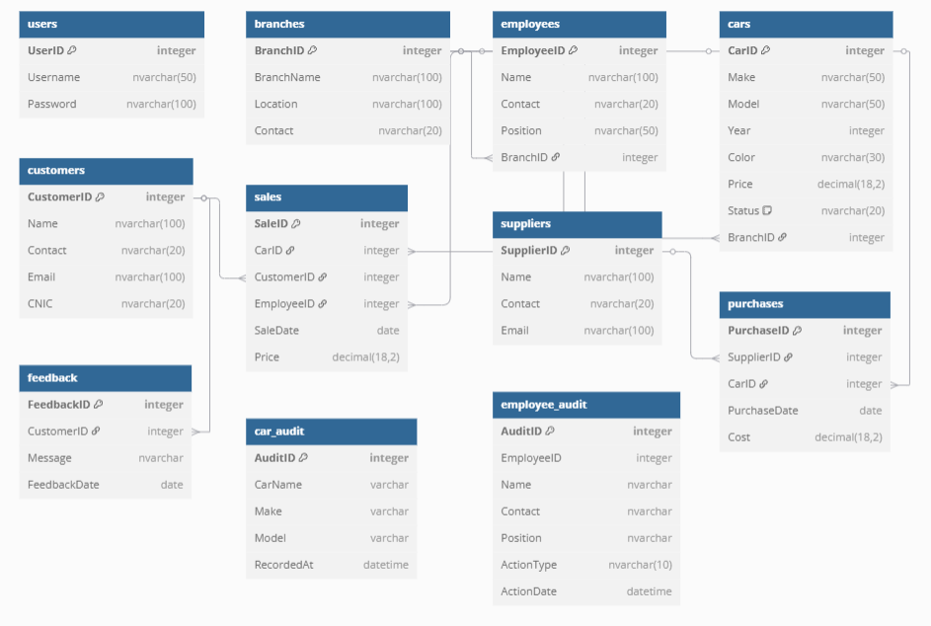

Slide 7
Relationships Explained: 1-to-Many and 1-to-1
One-to-Many (1:M)
One-to-One (1:1)
A single Branch can have multiple Cars. A single Customer can make multiple Sales.
Each Sale has one specific Car. Each User belongs to one specific Branch.
Branch to Cars
Sale to Car
Customer to Sales
User to Branch

Slide 8
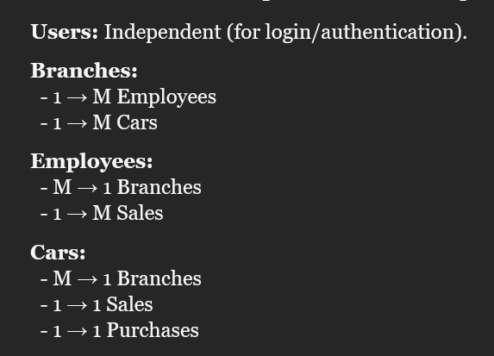
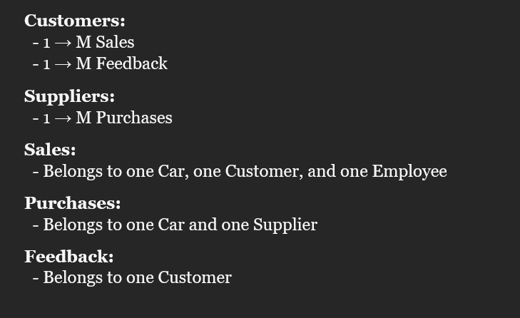
Branches: Manage Employees and Cars (1-to-Many).
Employees: Work at one Branch, handle multiple Sales.
Cars: Assigned to one Branch, linked to one Sale and one
Purchase.
Customers: Make multiple Sales and provide Feedback.
Suppliers: Supply cars via Purchases.
Sales: Connects Car, Customer, and Employee.
Purchases: Links Car and Supplier.
Feedback: Tied to a single Customer.

Slide 9
Triggers and Audit Tables
Car Sales Audit Trigger
Employee Delete Audit Trigger
Records details of each car sale into CarSalesAudit table. Captures SaleID, CarID, SaleDate, and OldPrice.
Logs employee deletions into EmployeeAudit table. Records UserID, Username, Role, and DeleteDate.
CarSalesAudit
Tracks car sales for historical analysis.
AuditID, SaleID, CarID, SaleDate, OldPrice
EmployeeAudit
Maintains a log of deleted employee records.
AuditID, UserID, Username, Role, DeleteDate
Triggers ensure data integrity and provide detailed audit trails for critical operations.

Slide 10
Conclusion & Future Enhancements
Achievements
Key Benefits
Future Enhancements
Centralised database for ApexAutos
Improved data consistency, reduced redundancy
User-friendly graphical interface
Robust normalisation (1NF, 2NF, 3NF)
Payment gateway integration
Automated processes, saving time
Advanced analytics (sales, inventory)
Streamlined dealership operations
Informed decision-making
Clear entity relationships, audit trails
Vehicle service/maintenance module
Thank you for your time. We are happy to answer any questions.

