Slide 1
Chip Category Strategy Review
Customer Insights, Trial Store Results & Recommendations for the Next Half-Year Plan
Prepared for Julia, Category Manager
Prepared by Bilal Ahmad | Quantium Retail Analytics | 27 July 2026

Slide 2
EXECUTIVE SUMMARY
Three moves to grow the chip category this half
01
02
03
Target family segments
Diversify beyond 3 brands
Roll out the trial layout
Older & Young Families spend the most per customer ($36 & $34). Prioritise family-size packs and bundles.
Kettle, Doritos & Smiths drive ~44% of sales. Grow mid-tier brands to reduce concentration risk.
The store trial delivered a statistically significant sales lift in 2 of 3 stores — expand it further.
Quantium | Chip Category Strategy Review
2

Slide 3
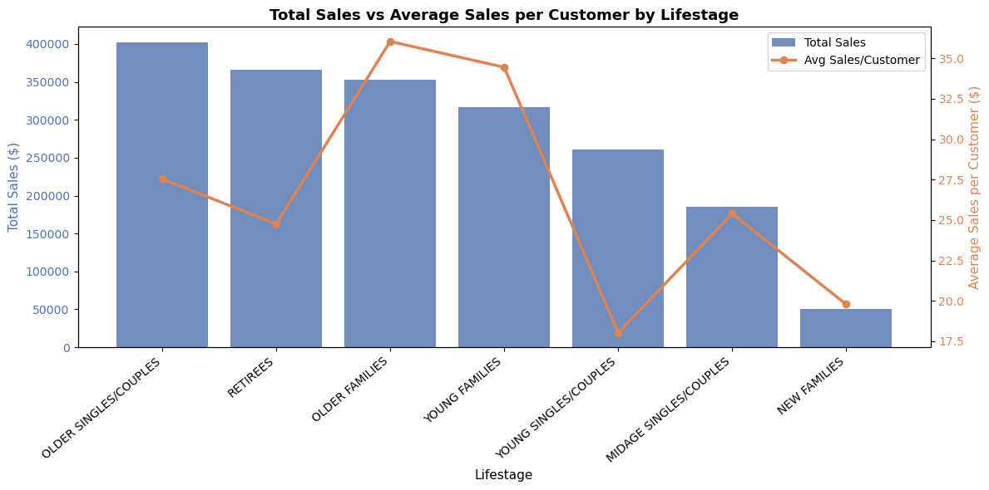
CUSTOMER INSIGHTS · PART 1
Families are the highest-value customers
$36.04
Older Families — avg. sales per customer, the highest of any segment
$34.45
Young Families — 2nd highest, despite a smaller population
Total sales are highest among Older Singles/Couples & Retirees — but that reflects population size, not spend per person.
Quantium | Chip Category Strategy Review
3

Slide 4
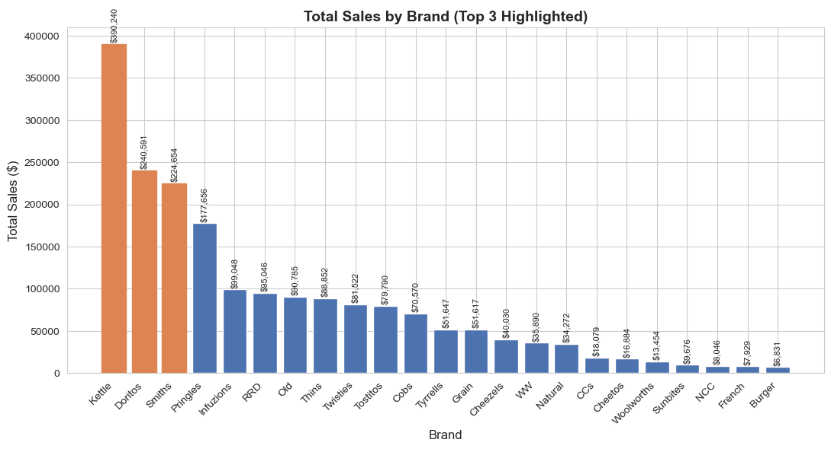
CUSTOMER INSIGHTS · PART 2
Revenue is concentrated in three brands
~44%
of total sales comes from just Kettle, Doritos & Smiths
Risk: a disruption to any one of these brands (supply, pricing, quality) could materially impact overall revenue.
Recommendation: grow shelf space & promotions for mid-tier brands (Infuzions, RRD, Thins, Twisties).
Quantium | Chip Category Strategy Review
4

Slide 5
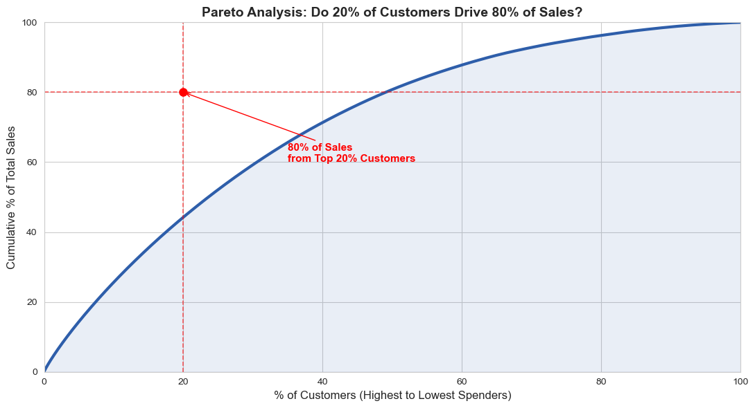
CUSTOMER INSIGHTS · PART 3
Spending is broad-based — there's no VIP tier yet
44.3%
of sales comes from the top 20% of customers (not 80%, as the classic rule assumes)
Opportunity: introduce a loyalty / VIP tier program to retain top spenders and motivate regular customers to spend more.
Quantium | Chip Category Strategy Review
5

Slide 6
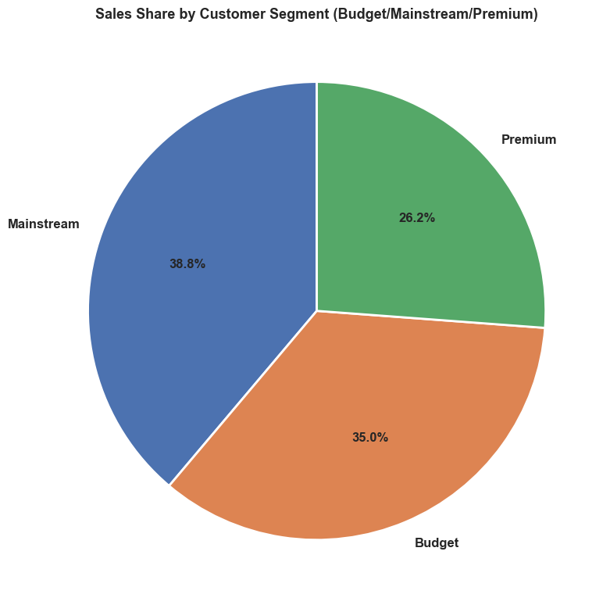
CUSTOMER INSIGHTS · PART 4
Budget shoppers are a core, price-sensitive base
Mainstream
38.8%
Largest share; values convenience and brand recognition
Budget
35.0%
Appears in 3 of the top 5 lifestage segments — strong, consistent demand
Premium
26.2%
Smallest share; more selective, likely values quality/health positioning
Quantium | Chip Category Strategy Review
6

Slide 7
STORE TRIAL RESULTS · OVERVIEW
Testing a new store layout in 3 trial stores
Each trial store (77, 86, 88) was matched to a statistically similar control store, based on pre-trial sales and customer trends. During the trial period (Feb–Apr 2019), we compared trial performance against the scaled control to test for a genuine, significant sales lift.
Store 77
Store 86
Store 88
Trial Store
Trial Store
Trial Store
Control Store
Control Store
Control Store
233
155
237
Quantium | Chip Category Strategy Review
7

Slide 8
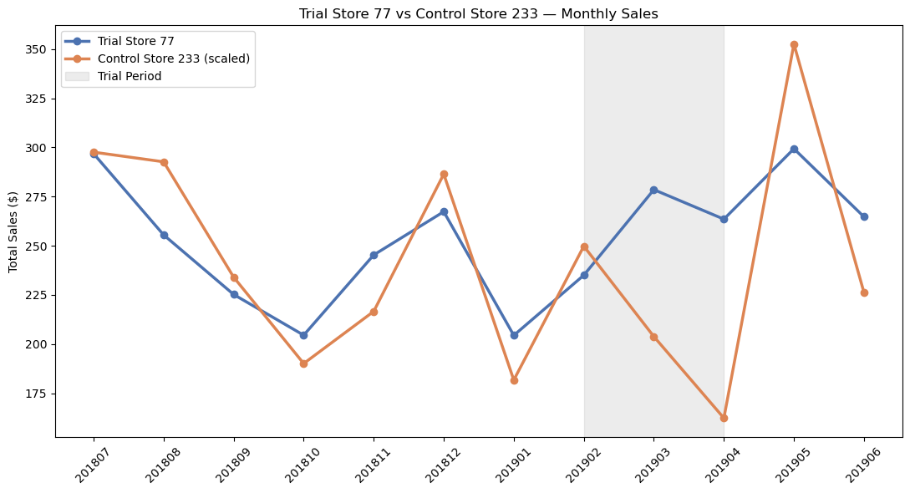
STORE TRIAL RESULTS · STORE 77
A statistically significant sales lift
SIGNIFICANT
Sales exceeded the control store's expected range in 2 of 3 trial months.
March and April both showed strong uplift, driven mainly by higher customer traffic rather than bigger baskets.
Quantium | Chip Category Strategy Review
8

Slide 9
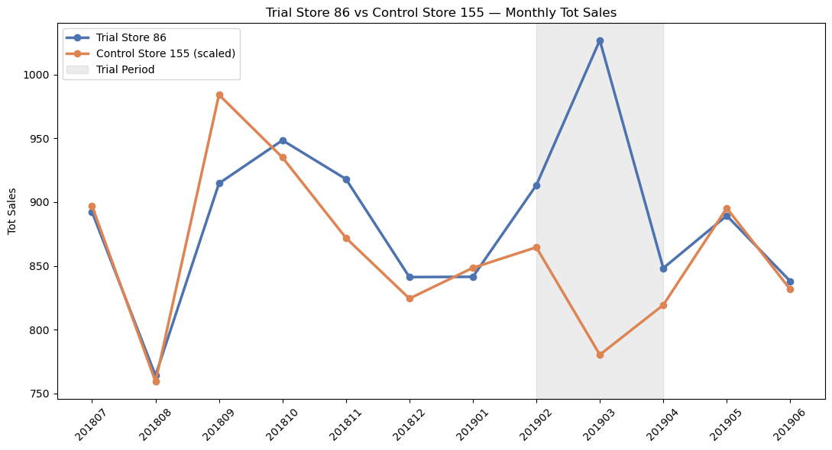
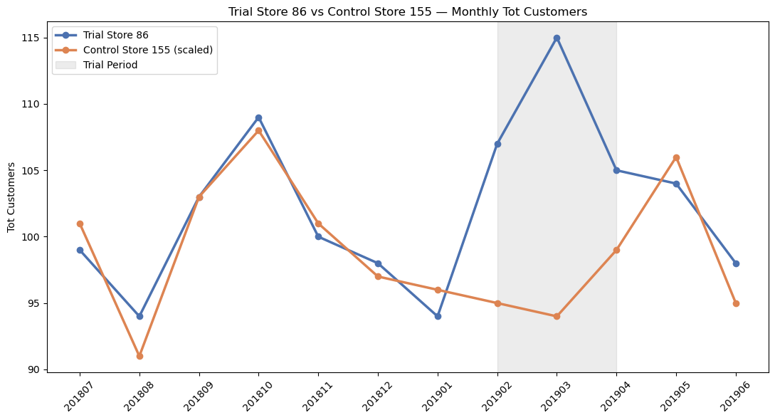
STORE TRIAL RESULTS · STORE 86
More customers, but not enough to lift sales
NOT SIGNIFICANT ON SALES — BUT CUSTOMER GROWTH IS THE CLOSEST RESULT OF THE THREE STORES
Customer counts were consistently higher during the trial, but sales didn't follow — worth checking with the Category Manager whether Store 86's trial used different pricing or promotions than the others.
Quantium | Chip Category Strategy Review
9

Slide 10
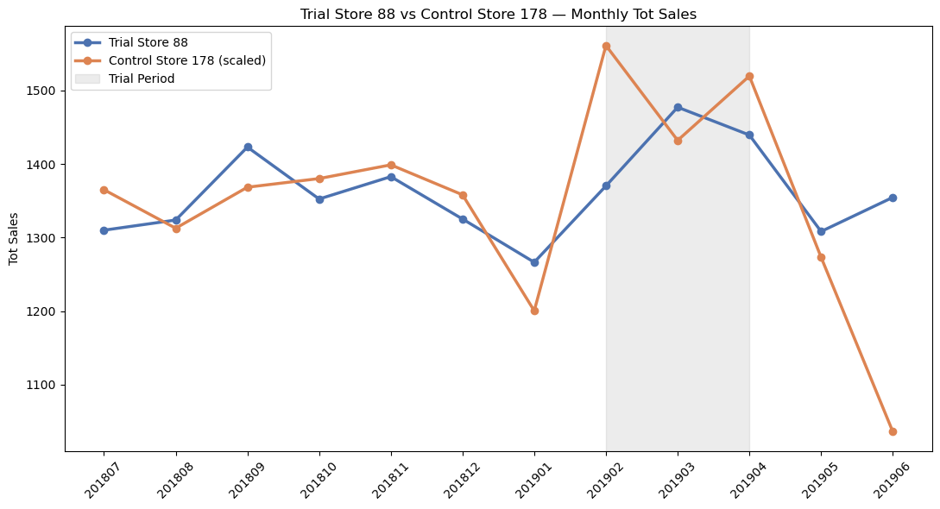
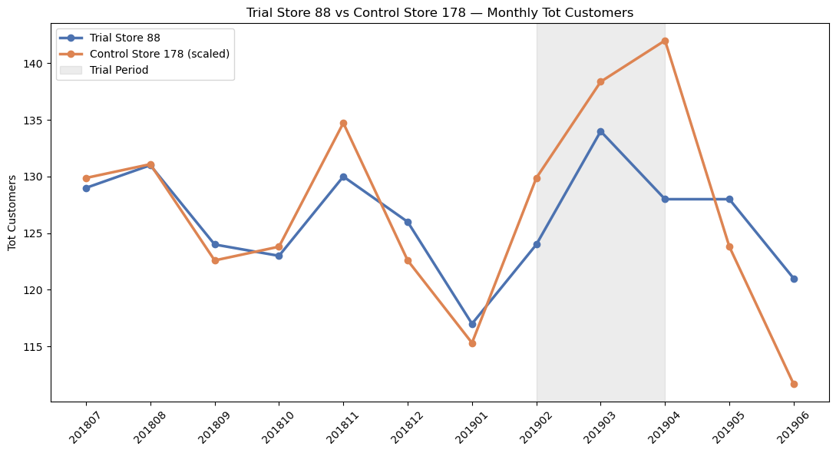
STORE TRIAL RESULTS · STORE 88
A statistically significant sales lift
SIGNIFICANT
Like Store 77, Store 88's sales moved outside the control store's expected range in 2 of 3 trial months — a genuine, not just seasonal, effect of the new layout.
Quantium | Chip Category Strategy Review
10

Slide 11
RECOMMENDATIONS
Next steps for the half-year plan
1
Roll out the trial layout further
Stores 77 and 88 showed a significant, genuine sales lift — expand the layout change to more stores with similar profiles.
2
Investigate Store 86
Customer traffic rose but sales didn't — check with the Category Manager if pricing or promotions differed there before rolling out.
3
Target family segments
Build family-size packs and bundle offers around Older & Young Families, the highest per-customer spenders.
4
Diversify brand support
Grow mid-tier brands alongside Kettle, Doritos & Smiths to reduce reliance on just three brands.
5
Launch a loyalty tier
Spending is broad-based with no natural VIP segment — a tier program can retain and grow top spenders.
Quantium | Chip Category Strategy Review
11

Slide 12
Thank you
Happy to walk through any of these findings in more detail before the client presentation.
Bilal Ahmad | Quantium Retail Analytics

