Slide 1

Coursera Capstone Project The Battle of Neighbourhoods
Submitted by:
Muhammad Bilal

Slide 2
Problem
James is a very good cook and he specializes in Thai food.
He wants to open a new Thai restaurant in Melbourne city.
There are more than 300 suburbs (Neighbourhoods) in Melbourne city.
James does not know in which suburb he should open his new restaurant, so he has a profitable business.

Slide 3
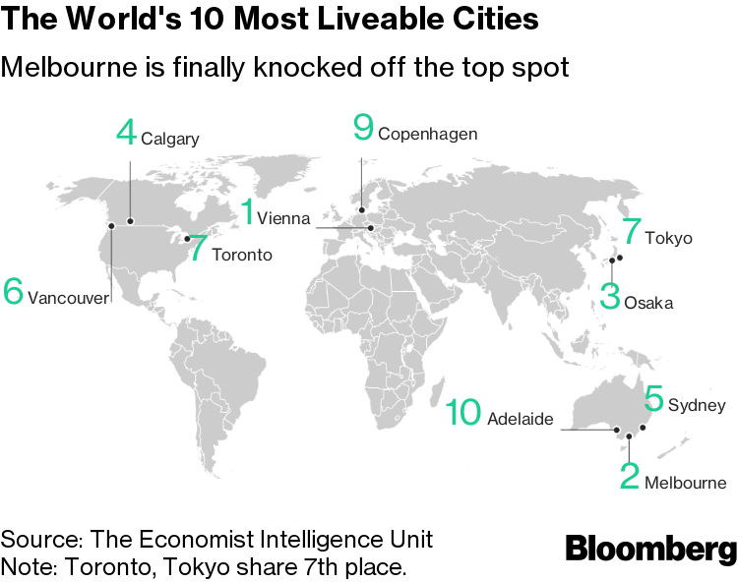
Introduction of Melbourne
Melbourne is one of the world’s most liveable and multicultural cities.
Melbourne is also world-renowned for the quality of its food.

Slide 4
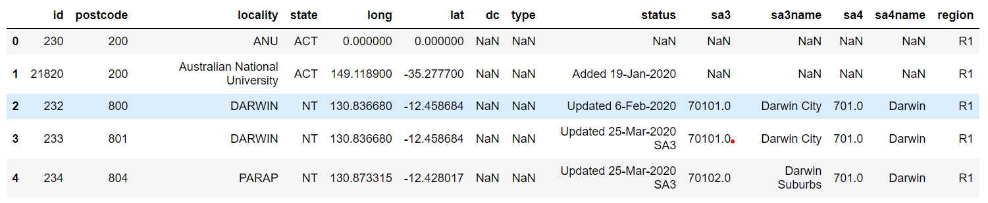
Data acquisition
A geographical data about all the suburbs in all the states of Australia is downloaded from the following URL. https://www.matthewproctor.com/australian_postcodes

Slide 5
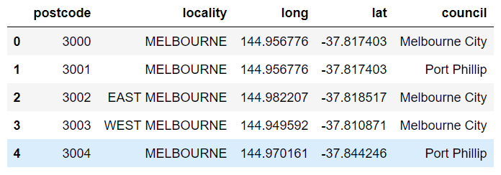
Data Cleaning
The data is cleaned by dropping the unnecessary columns and filter the data for the state of Victoria.

Slide 6
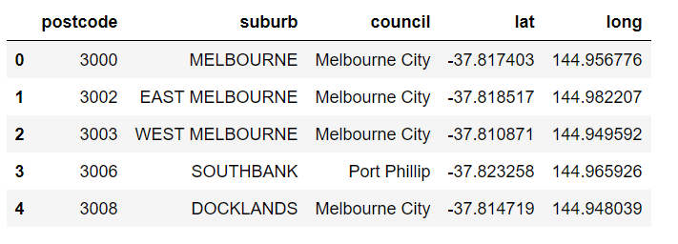
Melbourne Suburbs
The Victoria’s geographic data is sorted out to get a data of suburbs exist only in greater Melbourne area.

Slide 7
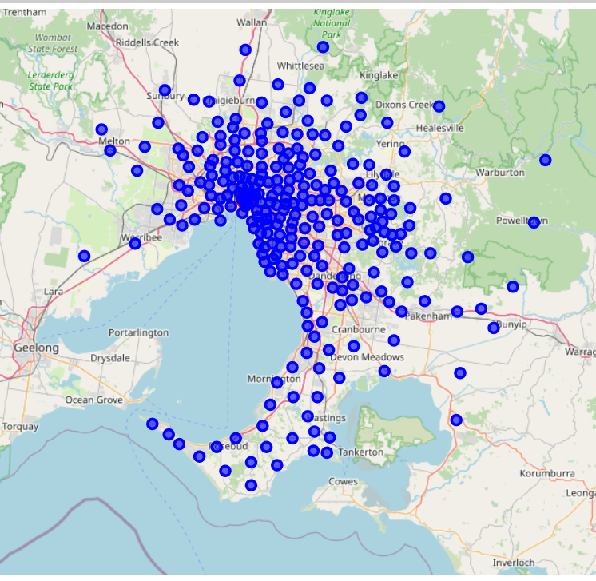
Melbourne Suburbs on Map

Slide 8
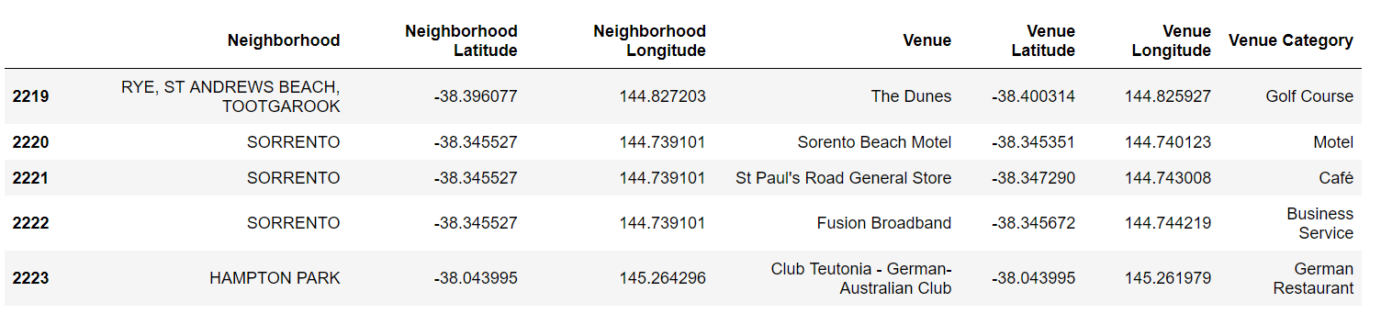
Top venues in Melbourne suburbs
A list of venues is fetched by using Foursquare API.
There are 281 different venues in Melbourne city.

Slide 9
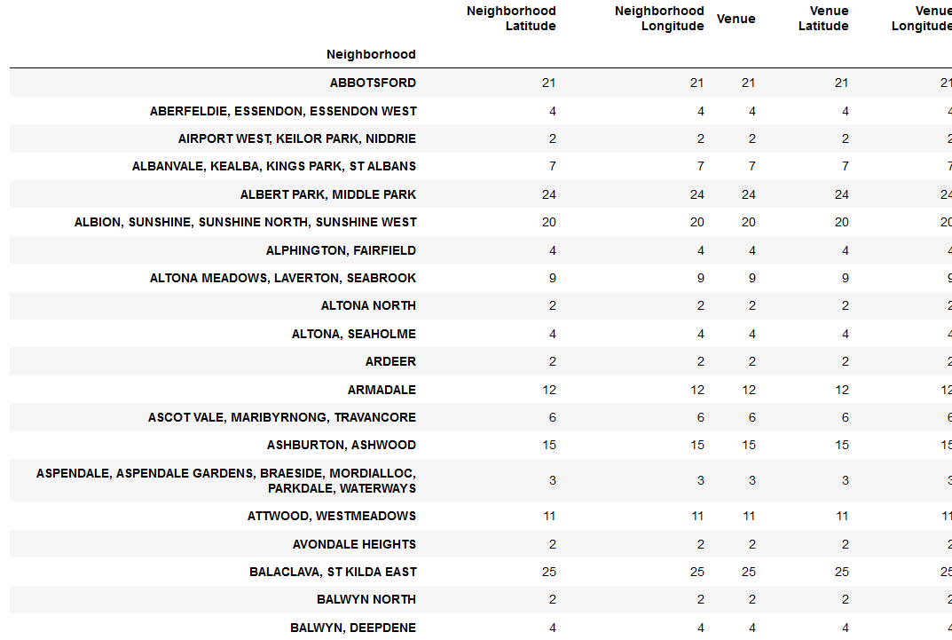
Number of Venues in each suburb

Slide 10
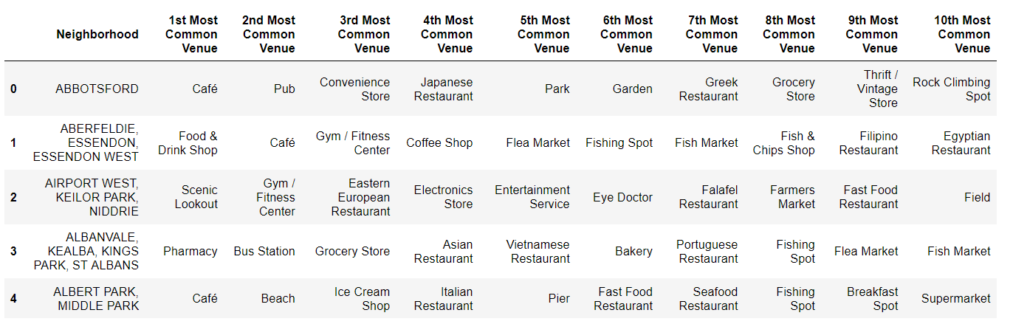
Ten most common venues in suburbs

Slide 11
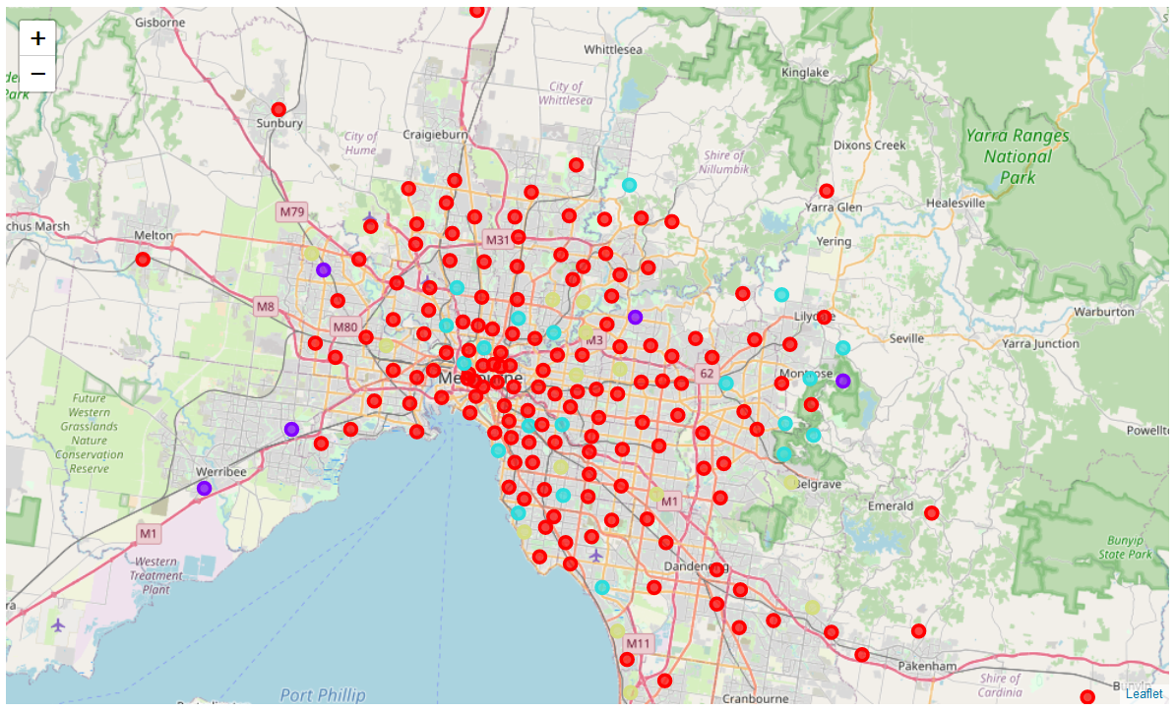
Cluster Analysis
A cluster analysis is done using Scikit-learn library of Python.
Four clusters are developed by clustering the suburbs based on list of venues.
Displayed clustered on map.

Slide 12
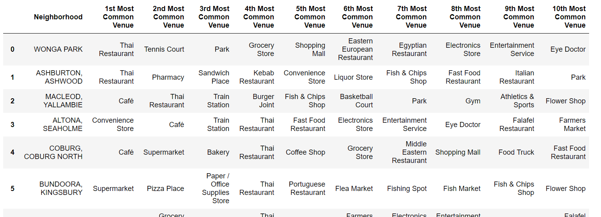
Suburbs having a Thai restaurant in their venues
All the suburbs having Thai restaurants are falling in cluster 1.
There are 19 suburbs having a Thai restaurant in the ten most common venues.

Slide 13
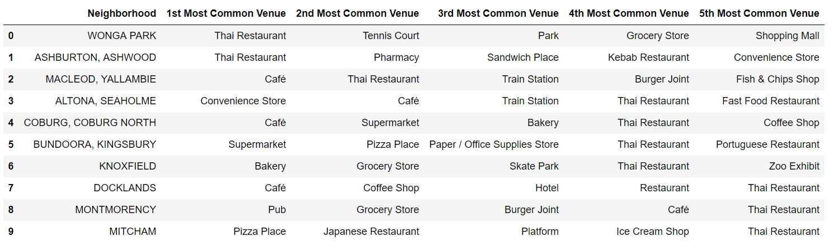

Finalize the Suburbs
There are 10 suburbs having a Thai restaurant is five most common venues.

Slide 14
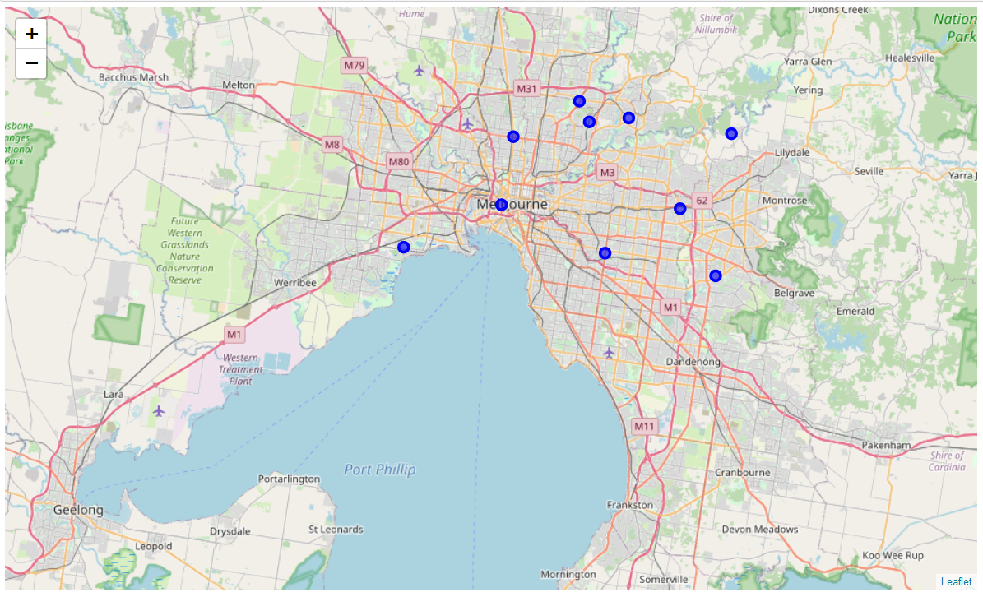
Suburb having a Thai restaurant in their five most common venues

Slide 15
Ranking of Suburbs
Rank | Suburb
1. | DOCKLANDS
2. | ALTONA, SEAHOLME
3. | ASHBURTON, ASHWOOD
4. | MACLEOD, YALLAMBIE

Slide 16
Conclusion
Docklands is ranked first though it has a Thai restaurant a fifth most common venue because it is very near to city center and big businesses have their offices in the city center. People from the other suburbs of the city travel daily to their jobs in the city center. Also, the other most common venues in this suburb are food-related. All these references show that this place has higher customer obtainability.
Altona, Seaholme is ranked second because this place has a beach and a seashore. People love to spend their free time on the beach and during their time on the beach, they like to dine outside. This place will provide James a good opportunity to introduce fine dining to the people.
Ashburton, Ashwood is ranked third because this place has a Thai restaurant as the first most common venue. This indicates that people in these suburbs love Thai food and would give a try to a new Thai food place.
Macleod, Yallambie is ranked fourth because they are making another cluster with Bundoora, Kingsbury, and Montmorency. This indicates that the Thai population lives around these areas and they love to enjoy their traditional food.

