Slide 1
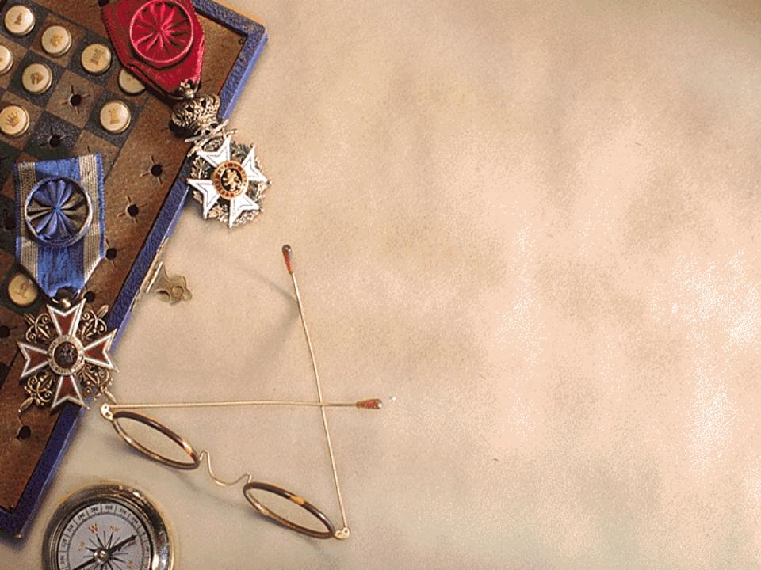
Dr. Phil's Test
*Dr. Phil scored 55. He did this test on Oprah -- she got 38.)

Slide 2
Some folks pay a lot of money to find this stuff out. Read on, this is very interesting!
Don't be overly sensitive!
It’s pretty accurate & it only takes about 2 minutes.

Slide 3
Take this test for yourself and send it to your friends including the person who sent it to you.
The person who sent it placed their score in the SUBJECT box.
Please do the same before forwarding to
your friends.

Slide 4
Answers are for who you are now...... not who you were in the past.
Have a pen or pencil and paper ready.
This is a real test given by the
Human Relations Dept. at many of the major corporations today. It helps them
get better insight concerning their employees and prospective employees.

Slide 5
There are 10 simple questions. So... grab a pencil and paper, keep track of your letter answers.
Make sure to change the subject of the
e-mail to read YOUR total score.
When you are finished, forward this to everyone you know, and also send it to the person who sent this to you.

Slide 6
Number your paper 1 to 10.
Continue to begin test

Slide 7
1. When do you feel at your best?
a) in the morning
b) during the afternoon and early evening
c) late at night

Slide 8
2. You usually walk.....
a) fairly fast, with long steps
b) fairly fast, with little steps
c) less fast head up, looking the world in the face
d) less fast, head down
e) very slowly

Slide 9
3. When talking to people, you...
a) stand with your arms folded
b ) have your hands clasped
c) have one or both your hands on your hips or in pockets
d) touch or push the person to whom you are talking
e) play with your ear, touch your chin or smooth your hair

Slide 10
4. When relaxing, you sit with...
a) your knees bent with your legs neatly side by side
b) your legs crossed
c) your legs stretched out or straight
d) one leg curled under you

Slide 11
5. When something really amuses you, You react with...
a) a big appreciated laugh
b) a laugh, but not a loud one
c) a quiet chuckle
d) a sheepish smile

Slide 12
6. When you go to a party or social gathering, you...
a) make a loud entrance so everyone notices you
b) make a quiet entrance, looking around for someone you know
c) make the quietest entrance, trying to stay unnoticed

Slide 13
7. When you're working or concentrating very hard, and you're interrupted, you...
a) welcome the break
b) feel extremely irritated
c) vary between these two extremes

Slide 14
8. Which of the following colors do you like most?
a) Red or orange b) black
c) yellow or light blue d) green
e) dark blue or purple f) white
g) brown or gray

Slide 15
9. When you are in bed at night, in those last few moments before going to sleep, you lie...
a) stretched out on your back
b) stretched out face down on your stomach
c) on your side, slightly curled
d) with your head on one arm
e) with your head under the covers

Slide 16
10. You often dream that you are...
a) falling
b) fighting or struggling
c) searching for something or
somebody
d) flying or floating
e) you usually have dreamless sleep
f) your dreams are always pleasant

Slide 17
POINTS:
1. (a) 2 (b) 4 (c) 6
2. (a) 6 (b) 4 (c) 7 (d) 2 (e) 1
3. (a) 4 (b) 2 (c) 5 (d) 7 (e) 6
4. (a) 4 (b) 6 (c) 2 (d) 1
5. (a) 6 (b) 4 (c) 3 (d) 5 (e) 2

Slide 18
continue.
6. (a) 6 (b) 4 (c) 2
7. (a) 6 (b) 2 (c) 4
8. (a) 6 (b) 7 (c) 5 (d)4 (e) 3 (f) 2 (g) 1
9. (a) 7 (b) 6 (c) 4 (d) 2 (e) 1
10. (a) 4 (b) 2 (c) 3 (d) 5 (e) 6 (f) 1

Slide 19
Now add up the total number of points.

Slide 20
OVER 60 POINTS
Others see you as someone they should "handle with care." You're seen as
vain, self-centered and one who is extremely domineering. Others may
admire you, wishing they could be more like you, but don't always trust you,
hesitating to become too deeply involved with you.

Slide 21
51 TO 60 POINTS
Others see you as an exciting, highly volatile, rather impulsive personality; a natural leader, one who's quick to make decisions, though not always the right ones. They see you as bold and adventuresome, someone who will try anything once; someone who takes chances and enjoys an adventure. They enjoy being in your company because of the excitement you radiate.

Slide 22
41 TO 50 POINTS
Others see you as fresh, lively, charming, amusing, practical and always interesting; someone who's constantly in the center of attention, but sufficiently well-balanced not to let it go to their head. They also see you as kind, considerate, and understanding; someone who'll always cheer them up and help them out.

Slide 23
31 TO 40 POINTS
Others see you as sensible, cautious, careful and practical. They see you as clever, gifted, or talented, but modest. Not a person who makes friends too quickly or easily, but someone who's extremely loyal to friends you do make and who expect the same loyalty in return. Those who really get to know you realize it takes a lot to shake your trust in your friends, but equally that it takes you a long time to get over it if that trust is ever broken.

Slide 24
21 TO 30 POINTS
Your friends see you as painstaking and fussy. They see you as very cautious, extremely careful, a slow and steady plodder. It would really surprise them if you ever did something impulsively or on the spur of the
moment, expecting you to examine everything carefully from every angle and then usually decide against it. They think this reaction is caused partly by your careful nature.

Slide 25
UNDER 21 POINTS
People think you are shy, nervous, and indecisive, someone who needs looking
after, who always wants someone else to make the decisions and who doesn't want to get involved with anyone or anything! They see you as a worrier who always sees problems that don't exist. Some people think you're boring. Only those who know you well know that you aren't.

Slide 26
Now forward this to all your friends, don’t forget to put your score in the subject box.
-Dr.Phil

