Slide 1
Pointer this
class thispc
{
public:
void set(int a, int b, int c);
void print() const;
thispc updateXYZ();
thispc(int a = 0, int b = 0, int c = 0);
private:
int x;
int y;
int z;
};

Slide 2
void thispc::set(int a, int b, int c)
{
x = a;
y = b;
z = c;
}
void thispc::print() const
{
cout << "x = " << x
<< ", y = " <<
<< ", z = " << z << endl;
}
thispc thispc::updateXYZ()
{
x = 2 * x;
y = y + 2;
z = z * z;
return *this;
}

Slide 3
int main()
{
thispc object1(3, 5, 7);
thispc object2;
cout << "Object 1: ";
object1.print();
object2 = object1.updateXYZ();
cout << “Update sonrasi: ";
object1.print();
cout << "Object 2: ";
object2.print();
return 0;
}

Slide 4
Vektör Type
the size of a vector object can grow and shrink during program execution. Therefore, you do not need to be concerned with the number of data elements. When you declare a vector object, you must specify the type of the element the vector object stores.
#include <vector>

Slide 5
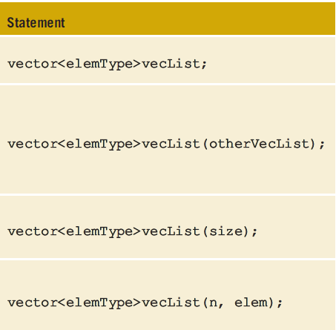
Vektör Tanımlama
vector<int> List;
vector<int> List(10);

Slide 6
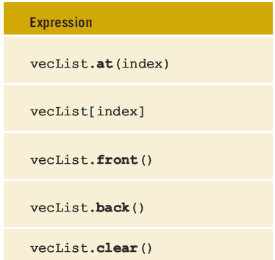
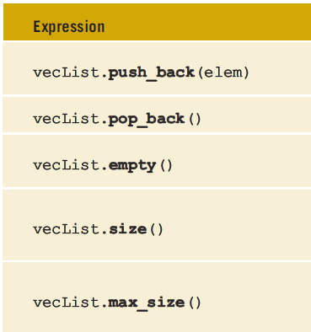

Slide 7
vector<int> intList;
intList.push_back(34);
intList.push_back(55);
intList = {34, 55}
vector<int> intList(5);
for (int j = 0; j < 5; j++)
intList[j] = j;

Slide 8
vector<int> intList;
intList.push_back(13);
intList.push_back(75);
intList.push_back(28);
intList.push_back(35);
intList.resize(10);
intList.resize(intList.size() + 10);

Slide 9
vector<string> classList;
classList.push_back("Nisha");
classList.push_back("Tony");
classList.push_back("Bobby");
classList.push_back("Peter");
for (unsigned int i = 0; i < classList.size(); i++)
cout << classList[i] << " ";
cout << endl;

Slide 10
Sınıf Friend Function
class s
{
friend void two(/*parameters*/); // only prototype
private:
int x; …
};
void two(/*parameters*/)
{
…
}

Slide 11
class testClass
{
public:
void print() const;
testClass();
testClass(int, int);
testClass(int, int, double);
testClass(double, char);
private:
int x;
int y;
double z;
char ch;
};

Slide 12
testClass::testClass()
{
x = 0;
y = 0;
z = 0;
ch = '*';
}
testClass::testClass(int tX, int tY)
{
x = tX;
y = tY;
z = 0;
ch = '*';
}

Slide 13
testClass::testClass(int tX, int tY, double tZ)
{
x = tX;
y = tY;
z = tZ;
ch = '*';
}
testClass::testClass(double tZ, char tCh)
{
x = 0;
y = 0;
z = tZ;
ch = tCh;
}

Slide 14
void testClass::print() const
{
cout << "x = " << x << ", y = " << y << ", z = " << z
<< ", ch = " << ch << endl;
}
testClass one;
testClass two(5, 6);
testClass three(5, 7, 4.5);
testClass four(4, 9, 12);
testClass five(3.4, 'D');

Slide 15
class listType
{
public:
bool isEmptyList();
bool isFullList();
int search(int searchItem) const;
void insert(int newElement);
void remove(int removeElement);
void destroyList();
void printList();
listType();
private:
int list[1000];
int length;
};

Slide 16
class AA
{
public:
void print()const;
int sum();
AA();
int AA(int, int);
private:
int x;
int y;
};
class CC
{
public;
void set(int, int);
void print()const;
CC();
CC(int, int);
bool CC(int, int);
private:
int u;
int v;
};
class BB
{
int one;
int two;
public:
bool equal() const;
print();
BB(int, int);
}

Slide 17
sınıf kuyruk
100 elemanlı dizi
dizi baslangıc degisken
dizi bitis/ilerleme degisken
constructor
destructor
eleman ekle
elemaneris

Slide 18
sınıf string
100 elemanlı karakter dizisi
constructor string setleyen
+ operator overloading
= operator overloading
strcpy(x,y);
strcat(x,y);

