Slide 1

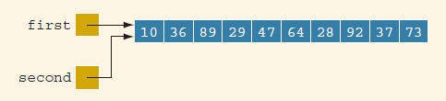
Shallow Copy , Deep Copy
int *first;
int *second;
first = new int[10];
second = first;

Slide 2


delete [] second;
second = new int[10];
for (int j = 0; j < 10; j++)
second[j] = first[j];

Slide 3
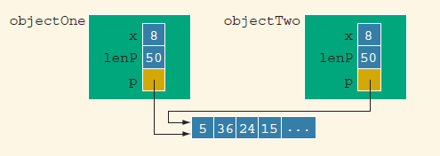
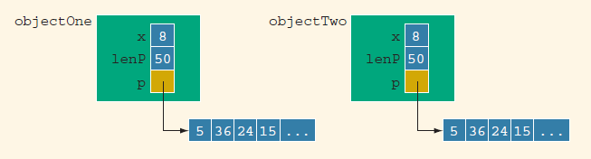

Slide 4
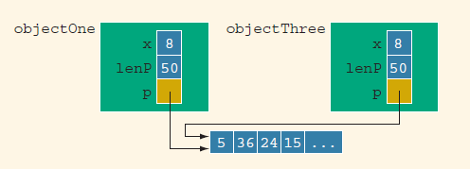
Copy Constructor
When declaring a class object, you can initialize it by using the value of an existing object of the same type. For example, consider the following statement:
pointerDataClass objectThree(objectOne);

Slide 5
Whenever the copy constructor needs to be executed, the system would execute the definition provided by us, not the one provided by the compiler. Therefore, for the class pointerDataClass, we can overcome this shallow copying problem by including the copy constructor in the class
When the function destroyList exits, the formal parameter paramObject goes out of scope, and the destructor for the object paramObject deallocates the memory space pointed to by paramObject.p. However, this deallocation has no effect on objectOne.
className(const className& otherObject);

Slide 6
class cl
{
public:
char* stored;
cl(char* str );
cl(cl& another );
~cl();
};
cl::cl(char* str )
{
stored = new char[strlen(str) + 1 ];
strcpy( stored, str );
}
cl::cl( cl& another )
{
stored = new char[strlen(another.stored) + 1];
strcpy( stored, another.stored );
}
cl::~cl()
{
delete[] stored;
}
main()
{
cl a("selda");
cl b(a); // cl b=a;
a.~cl();
cout<<b.stored;
}

Slide 7
Kalıtım (inheritance) ve Sanal Fonksiyonlar (virtual functions)
class baseClass
{
public:
void print();
baseClass(int u = 0);
private:
int x;
};
class derivedClass: public baseClass
{
public:
void print();
derivedClass(int u = 0, int v = 0);
private:
int a;
};

Slide 8
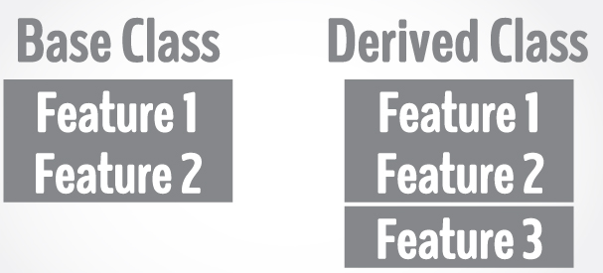
Kalıtım (inheritance) ve Sanal Fonksiyonlar (virtual functions)
Inheritance is one of the key features of Object-oriented programming in C++. It allows user to create a new class (derived class) from an existing class (base class).
The derived class inherits all the features from the base class and can have additional features of its own.

Slide 9

If you want to add a new feature - eat, you need to implement the same code for each character. This can easily become error prone (when copying) and duplicate codes.
It'd be a lot easier if we had a Person class with basic features like talk, walk, eat, sleep, and add special skills to those features as per our characters. This is done using inheritance.

Slide 10
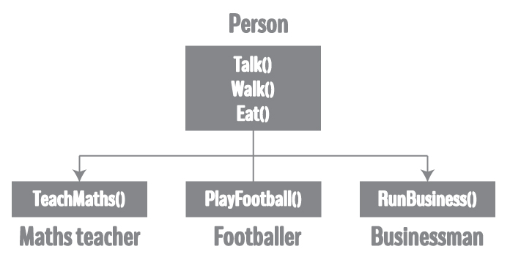
Using inheritance, now you don't implement the same code for walk and talk for each class. You just need to inherit them.

Slide 11
Miras Alma (inheritance)
class Person
{
... .. ...
};
class MathsTeacher : public Person
{
... .. ...
};
class Footballer : public Person
{
.... .. ...
};

Slide 12
class Person
{
public:
string profession;
int age;
Person (){profession="unemployed"; age=16;}
void display()
{
cout << "My profession is: " << profession << endl;
cout << "My age is: " << age << endl;
walk();
talk();
}
void walk() { cout << "I can walk." << endl; }
void talk() { cout << "I can talk." << endl; }
};

Slide 13
class MathsTeacher : public Person
{
public:
void teachMaths()
{ cout << "I can teach Maths." << endl; }
};
class Footballer : public Person
{
public:
void playFootball()
{ cout << "I can play Football." << endl; }
};
main()
{
MathsTeacher teacher;
teacher.profession = "Teacher";
teacher.age = 23;
teacher.display();
teacher.teachMaths();
Footballer footballer;
footballer.profession = "Footballer";
footballer.age = 19;
footballer.display();
footballer.playFootball();
}

Slide 14
Sanal Fonksiyonlar (virtual function)
class baseClass
{
public:
void print();
baseClass(int u = 0);
private:
int x;
};
class derivedClass: public baseClass
{
public:
void print();
derivedClass(int u = 0, int v = 0);
private:
int a;
};

Slide 15
void baseClass::print()
{
cout << "In baseClass x = " << x << endl;
}
baseClass::baseClass(int u)
{
x = u;
}
void derivedClass::print()
{
cout << "In derivedClass : ";
baseClass::print();
cout << "In derivedClass a = " << a << endl;
}
derivedClass::derivedClass(int u, int v): baseClass(u)
{
a = v;
}
void callPrint(baseClass& p)
{
p.print();
}

Slide 16
baseClass one(5); //Line 1
derivedClass two(3, 15); //Line 2
one.print(); //Line 3
two.print(); //Line 4
cout << "*** Calling the function "<< "callPrint ***" << endl; //Line 5
callPrint(one); //Line 6
callPrint(two); //Line 7

Slide 17
Sanal Fonksiyonlar (virtual function)
class baseClass
{
public:
virtual void print(); //virtual function
baseClass(int u = 0);
private:
int x;
};

Slide 18
sekil sınıf
iki degisken
degisken setleme fonksiyonu
alan hesaplama fonksiyonu
Ucgen sınıfı : sekil sınıfından miras alacak
Alanhesaplama
Kare sınıfı : sekil sınıfından miras alacak
alanhesaplama
Main
Sekil sınıf pointer
Ucgen nesne
Kare nesne
Pointer=ucgen nesne
Ucgenalan hesaplama
Pointer=kare nesne
Karealan hesaplama

Slide 19
Sınıf X
2 degisken
Kullanıcıdan degisken alma
Degiskenleri ekrana yazdırma
Sınıf Y : X’ten miras alacak
Degisken
Degiskeni donduren fonk
Degiskene miras alınan degiskenlerin carpımını atama
Sınıf Z: Y’den miras alacak
Xsınıfının iki degiskenine deger setlemesi yapacak

