Slide 1
ProofRun
Practical application testing
with repairs you approve
An AI software QA workspace powered by IBM Bob
IBM Bob 2.0 Hackathon September 2026
Notes:
0–8 seconds. ProofRun is an AI software QA workspace powered by IBM Bob. It tests a running application and proposes repairs that I approve. Continue to the problem and then show the actual application. Design reference: earlier ProofRun-pitch-v2.pptx, retaining Arial, 16:9 and the cream/green palette.

Slide 2
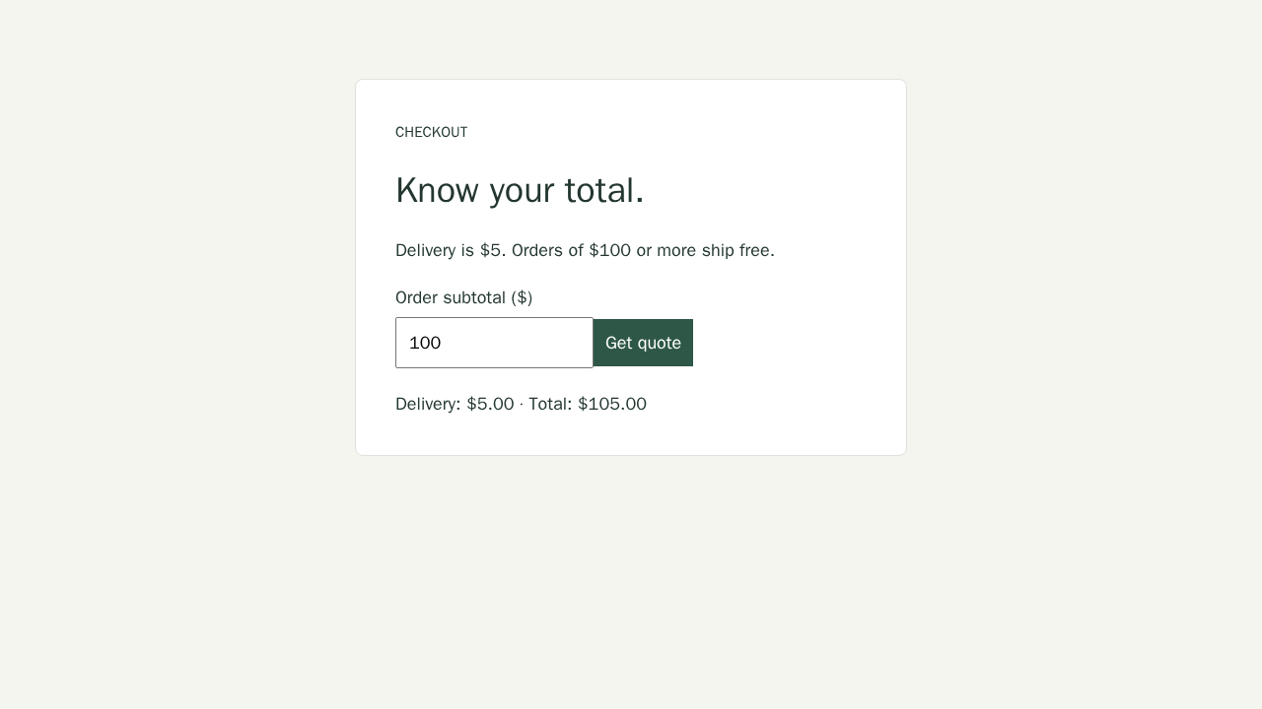
The missed user journey
Existing unit tests pass.
Exactly $100 still pays delivery.
Documented delivery
$0
Observed delivery
$5
Deliberately seeded checkout fixture. Real browser capture.
Notes:
8–18 seconds. A passing unit suite can miss a documented boundary. This is the deliberately faulty bundled Shipping Service, not a production customer. Orders at $100 should ship free. Actual API and browser tests found the delivery charge. Evidence: examples/shipping-service/README.md and docs/evidence/checkout-before.png. Show the real failing test in the application after this slide.

Slide 3
One testing workspace
01
02
03
Understand the project
Observe real execution
Approve and verify
Bob reads bounded source context and proposes setup and practical checks.
Docker runs HTTP, browser or CLI workflows and records the triggering inputs.
Review diffs, approve pending fixes, then rerun the original tests once.
The report preserves requests, logs, expected results and observed outcomes.
Notes:
18–30 seconds, followed by the live product. I provide the folder. Bob explains its purpose and proposes the environment and practical checks. Docker executes the software and collects observations. I review source diffs and explicitly approve the remaining batch. Main repair action applies compatible pending proposals and starts one unchanged verification run. Sources: PROJECT.md, src/qa/engine.ts, src/qa/docker.ts, src/qa/fixes.ts. Bob cannot directly execute unrestricted host commands.

Slide 4

A repair with repeatable evidence
A documented boundary
subtotal > 100
subtotal >= 100
Explicit approval changes the managed copy.
The original project stays untouched.
Unchanged saved checks verify the repair and reveal regressions.
Notes:
Use after the live Issues/diff/approval interaction. The fix changes the boundary condition from subtotal > 100 to subtotal >= 100. Screenshot is a real capture after explicit approval on the managed audit copy. The original example remains deliberately faulty. The application preserves the original tests and checks for regressions. Sources: docs/evidence/checkout-after.png and docs/evidence/live-audit-verification.json. This earlier audit retest took 68.2 seconds; label compression if you use that recording. Your current generated set and elapsed time may differ.

Slide 5
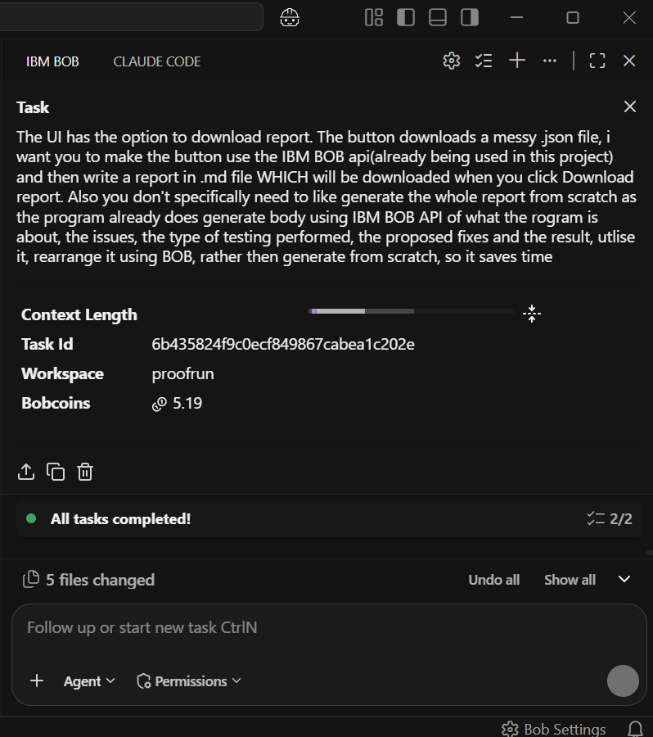
IBM Bob in development and execution
Bob IDE
A completed development task improved
the readable Markdown report download.
Bob Shell with an inference key
Project understanding, test proposals,
failure analysis and source diffs.
Docker handles execution separately.
Notes:
79–85 seconds, or use as an appendix while the video remains focused on the live app. During development I used Bob IDE to improve the Markdown report-download workflow. The authentic task summary shows the ProofRun workspace, 2/2 tasks complete, five files changed and 5.19 Bobcoins. Do not claim this screenshot documents other tasks. Runtime: src/qa/bob.ts invokes Bob Shell Ask mode with BOBSHELL_API_KEY held on the server. It disables file/edit/execute/MCP/skill/subagent tools. Bob explains source, generates tests, diagnoses observed evidence, proposes patches and formats the report. Screenshot: bob_sessions/proofrun_task01_markdown_report_summary.png. Official usage guidance: https://lablab-ibm-bob-2-hackathon-guide.s3.us.cloud-object-storage.appdomain.cloud/index.html

Slide 6
Measured verification
Checkout checks | Before approval | After repair
Passed | 9 / 11 | 11 / 11
Failed | 2 / 11 | 0 / 11
New regressions | Not applicable | 0
40 orchestration regression tests passed
Live checkout evidence and fixture orchestration results are separate measurements.
Notes:
85–90 seconds or leave this slide visible behind the closing narration. These measurements describe the labelled checkout fixture and a separate orchestration suite. Historical real Bob + Docker + Chromium audit: 11 saved checks, 9 passing and 2 failing before repair; 11 passing and 0 failing after approval; 0 regressions, contracts unchanged. Current orchestration suite: 40 automated tests pass using explicit fixture reasoning with actual owned HTTP and child process execution. It is not 40 live AI-generated checks. Sources: docs/evidence/live-audit-verification.json and docs/evidence/current-regression-verification.json. Keep unsupported repositories and bounded coverage visible on the appendix.

Slide 7
Supported scope
Configured Linux runtimes
Reported coverage gaps
Web/API applications and CLI programs.
Browser checks capture actual user interactions.
Disposable databases when supported.
Private infrastructure and native apps
need execution adapters or fixtures.
Undocumented behavior remains uncertain.
Every finding retains evidence. Every source change requires approval.
Local developer tool. Bounded coverage. No claim to certify arbitrary software.
Notes:
Appendix. Not required in the 90-second narration. Source intake accepts varied extensions and repository structures, up to 2,000 files and 128 MB. Runtime execution depends on server-configured trusted Linux images. Supported runtime categories include Node/TypeScript, Python, Go, Rust, Java, .NET, Ruby, PHP and C/C++. Desktop/mobile/hardware/private services require adapters or fixtures. AI source context is bounded. Root-cause claims are inferences. No guarantee of finding every defect. Startup/incomplete/environment failures are not passes. Container isolation shares the host kernel; run unknown code on a dedicated execution host. Setup: SETUP.md.

