Slide 1

Customer Behavior ETL & Analytics
Transforming raw data into actionable insights for retail success.

Slide 2
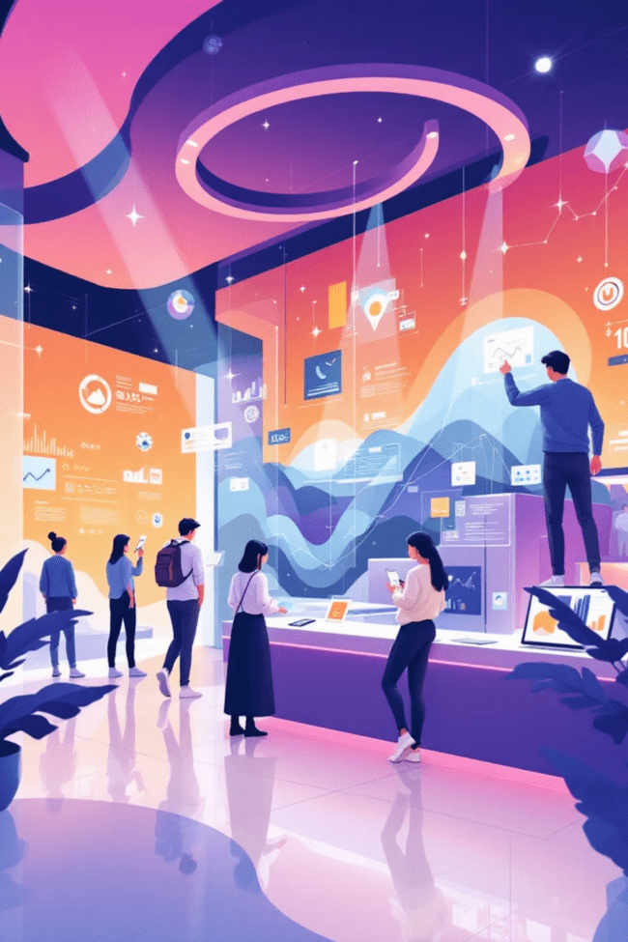




Executive Summary
ETL Solution
Business Intelligence
End-to-end data processing.
Understand shopping behavior.
Actionable Insights
Guide marketing & product decisions.

Slide 3
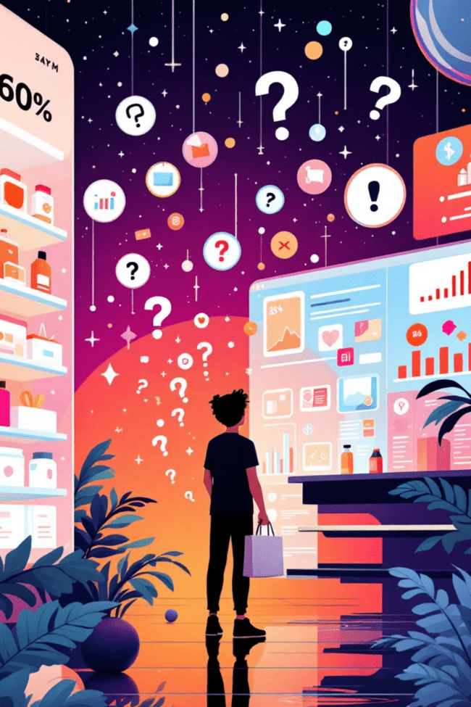
Problem Statement
Retail company seeks to understand customer shopping behavior to improve sales and loyalty.
Key Factors
Discounts, reviews, seasons, shipping, payment methods.
Consumer Decisions
Uncover drivers of purchases and repeat behavior.

Slide 4
Data Overview
Detailed customer-level transaction data for descriptive and behavioral analysis.
Demographics
Purchase Behavior
Age, gender.
Product, category, amount.
Discounts & Promos
Reviews & Ratings
Applied offers.
Customer feedback.
Shipping Prefs
Historical Purchases
Delivery choices.
Repeat behavior.

Slide 5



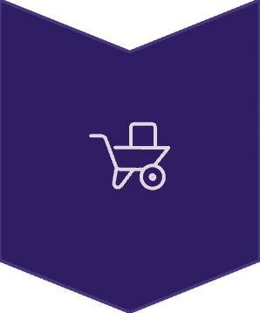
ETL Process Overview
Extract (Python)
Raw data import, inspection, identify issues.
Transform (Python)
Clean, handle missing values, feature engineer.
Load (SQL)
Export enriched data, load into SQL DB.

Slide 6
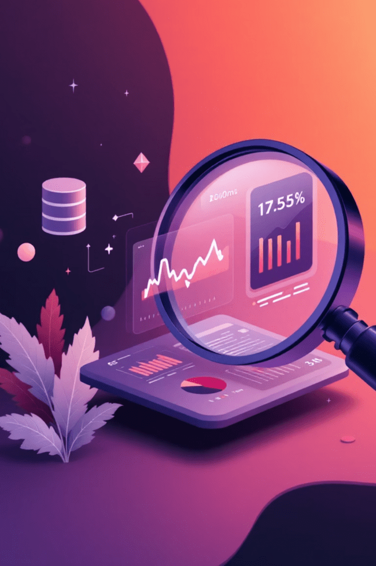

Key Business Insights (SQL)
1
Revenue by Gender
Compare revenue contribution.
2
High-Value Discount Users
Identify price-insensitive customers.
3
Top Rated Products
Promote high-rated items.
4
Shipping Type vs Spend
Analyze spending by shipping preference.

Slide 7
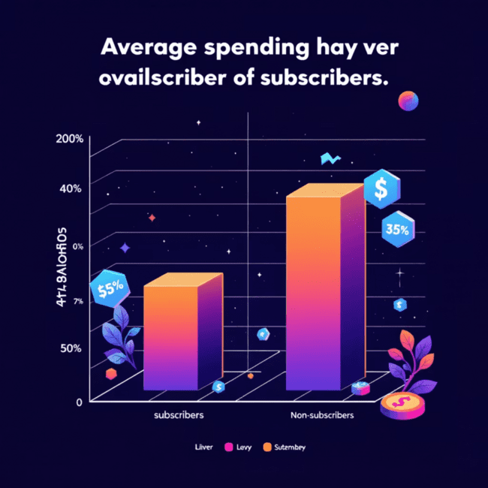
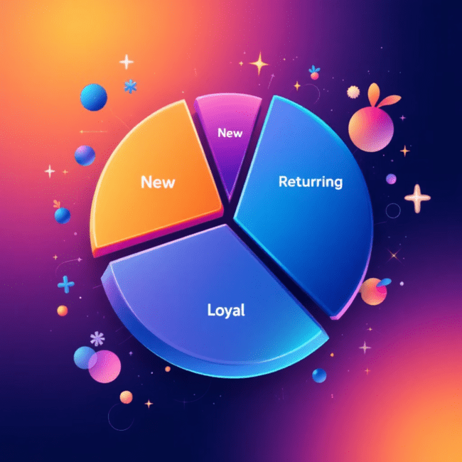
Subscription & Segmentation
Subscription Impact
Customer Segmentation
Subscribers vs. non-subscribers: similar spend, non-subscribers higher total revenue.
New, Returning, Loyal segments for personalized marketing.

Slide 8

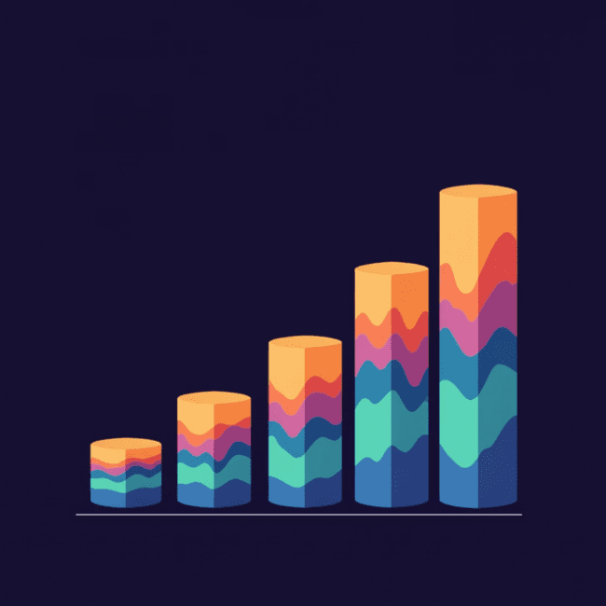
Repeat Buyers & Age Group Revenue
Repeat Buyers & Subscriptions
Revenue by Age Group
Repeat buyers often non-subscribers: missed conversion opportunity.
Identify high-contributing age groups for targeted marketing. Senior citizens contributed most to the revenue

Slide 9
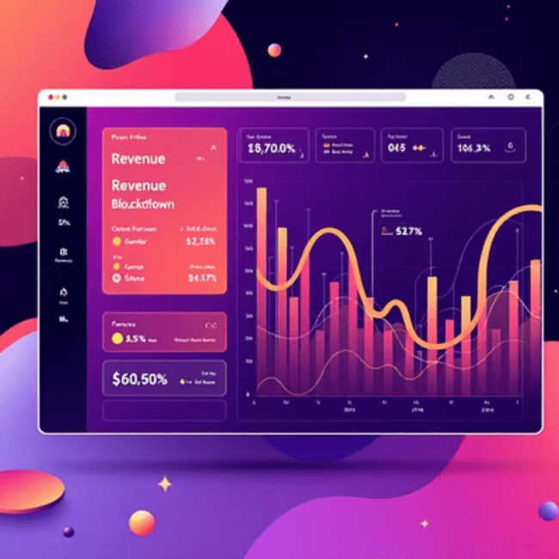
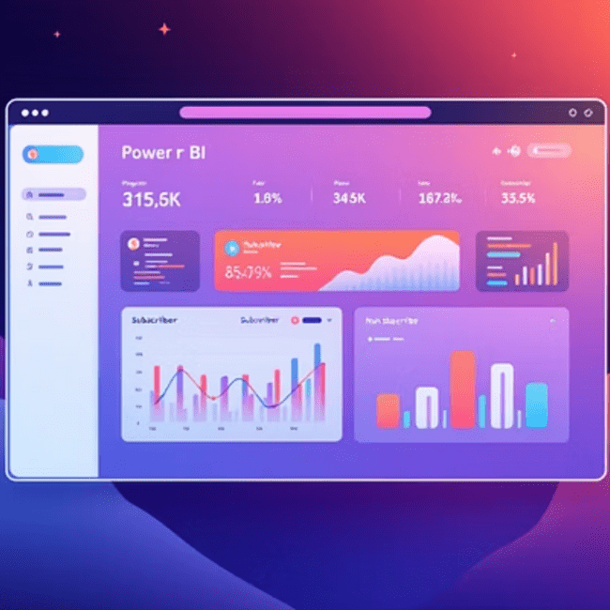
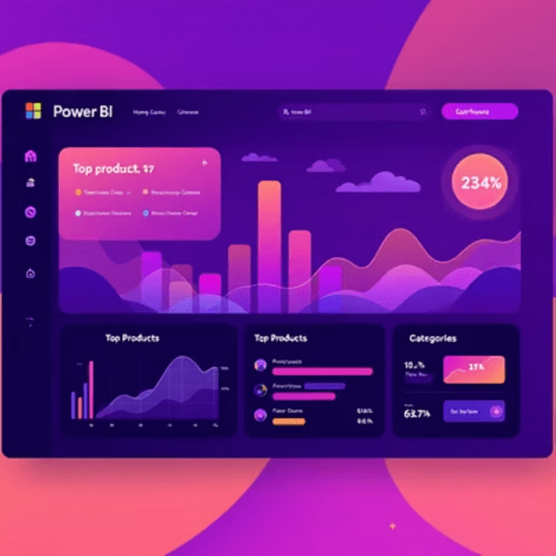
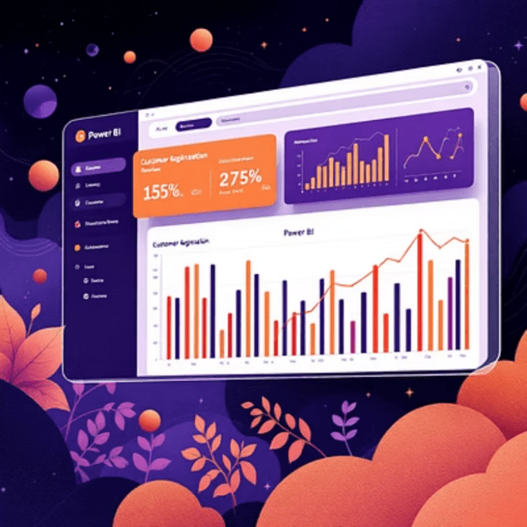
Power BI Dashboard
Interactive visualizations for data-driven decision-making.

Slide 10
Key Insights & Recommendations
1
Revenue Drivers
Volume over subscription status.
2
Discount Effectiveness
Targeted promotions boost revenue.
3
Product Performance
High-rated products for promotions.
4
Conversion Opportunity
Convert repeat buyers to subscribers.
5
Demographic Targeting
Refined marketing by age/gender.

