Slide 1
Pakistan E-commerce Market Data
Institute
Institute of Emerging Careers
Program
Data Analytics
Taught by
Syed Afroz Pasha
Presented by
Bilal Ibrahim Sethi

Slide 2
Agenda
Why This Dataset?
Introduction
DASHBOARD DESIGN & COMPONENTS
Data Overview
OBJECTIVES
Dashboard Visualization
Key Insights
RECOMMENDATIONS

Slide 3
Why This Dataset?
Future Trends
I chose this dataset because understanding e-commerce trends is crucial for anticipating the future of retail.
Regional Focus
This dataset is valuable as it specifically targets the Pakistani e-commerce market, offering localized insights.
Local Expertise
It was collected and developed by Pakistani data scientist Zeeshan-ul-Hassan Usmani, who gathered data directly from merchants, ensuring high relevance to the local context.
Consumer Insights
This dataset helps us gain a deep understanding of consumer behavior within Pakistan’s e-commerce industry.

Slide 4
Introduction
The dataset represents the largest retail e-commerce orders dataset from Pakistan, compiled from a diverse array of e-commerce merchants across the country.
It provides a detailed view of the e-commerce landscape in Pakistan, capturing comprehensive information about online transactions and customer behaviors.
By analyzing this dataset, we can gain valuable insights into the trends and dynamics shaping Pakistan's rapidly growing e-commerce sector, helping to inform strategies for optimizing online retail performance and understanding consumer preferences in this emerging market.

Slide 5
Key terms & concepts
Product Price Range
Economic Products: Products priced below 50,000.
Moderate Products: Products priced between 50,000 and 200,000.
Premium Products: Products priced above 200,000.
Customer Engagements
Top Tier Clients: Customers who have placed more than 10 orders.
Standard Customers: Customers who have placed between 5 and 10 orders.
Occasional Customers: Customers who have placed between 1 and 4 orders.
Payment Categories
Bank Transfers: Payments via direct bank channels. (Examples: Internet banking, MCB Lite, Bank Alfalah, UBL Credit Card)
Online Payment Gateways: Payments through online platforms. (Examples: MyGateway, APG, Easypay MA, Easypay, PayAxis)
Cash Payments: Payments made in cash at delivery.
Voucher: Payments using vouchers. (Examples: JazzVoucher, Easypay Voucher)
Others: Miscellaneous payment methods. (Examples: JazzWallet, Product Credit, Customer Credit, Finance Settlement & others)

Slide 6
…
Product Categories
Appliances: Household electrical items. (Examples: Air Conditioner, Energy Saver Fan)
Beauty and Grooming: Personal care products. (Examples: Hair Dryer, Skincare Set)
Books: Reading materials. (Examples: Novels, Educational Books)
Computing: Tech devices and accessories. (Examples: Laptop, Mouse)
Entertainment: Hobbies and media items. (Examples: LED TV, Audionic Max Speaker)
Health and Sports: Fitness and health products. (Examples: Yoga Mat, Weights)
Home and Living: Household items and décor. (Examples: Sofa, Bed Sheets)
Kids and Baby: Products for children and infants. (Examples: Baby Stroller, Toys)
Men's Fashion: Men's clothing and accessories. (Examples: Shirt, Wallet)
Mobiles and Tablets: Smartphones and accessories. (Examples: iPhone, Tablet Case)
Others: Miscellaneous items. (Examples: Gift Box, mix Items)
School and Education: Educational supplies. (Examples: Notebooks, Stationery)
Soghaat: Traditional sweets. (Examples: Dates with Cashew, Sohan Halwa)
Superstore: Grocery and household items. (Examples: Spices, Mango Chutney)
Women's Fashion: Women's clothing and accessories. (Examples: Dress, Handbag)

Slide 7
Dashboard Design & Components
Design Approach
The design is crafted to be clear and communicative, incorporating elements that support informed and measured decision-making.
Visual Elements
Cards, Slicers, Line, Chart, Pie Chart, Stacked Bar Chart, Stacked Column Chart, Tree map
Tools Used
Power BI, Excel & MySQL
Analytical Focus Areas
Sales Analysis, Customer Analysis & Product Category Analysis
Features
Page Navigation, Filters, Zoom In & Out
Dashboard Type
Analytical Dashboard

Slide 8
Data Overview
Geographical Focus
Industry
Pakistan
E-Commerce
Unit of Analysis
Source of data
Orders Level/All Time
Various merchants
Records & Columns
Time Period
July 2016 to August 2018
584,525 & 21
Key Variables
Order Status, Order No, Order Date, Price, Order Total, Quantity Ordered, Category, Discount, Payment Method, Customer Since, Customer ID

Slide 9
Objectives
1
2
Evaluate Overall Sales Trends
Assess Order Characteristics
Analyze overall sales performance to identify key patterns and uncover growth opportunities within specific product categories.
Examine order size, product count per order, and purchasing behavior across various product categories.
3
4
Impact of Discounts on Sales
Analyze Payment Method Preferences
Analyze how discounts influence sales volume and determine which categories respond most or least effectively to discounts.
Investigate customer payment method preferences across different product categories and price ranges.
5
6
Customer Engagement Analysis
Order Completion and Behavior
Assess customer engagement levels—occasional, standard, and top-tier—across various categories, particularly in relation to discounts & others.
Evaluate order completion rates and behaviors, focusing on differences across product categories, price ranges, and customer segments.

Slide 10
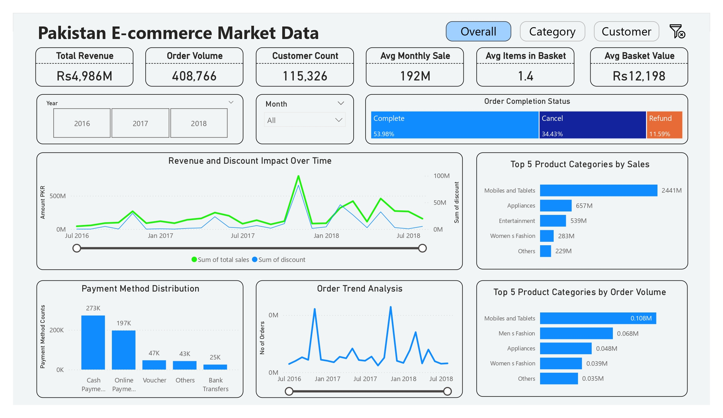
Dashboard Visualization

Slide 11
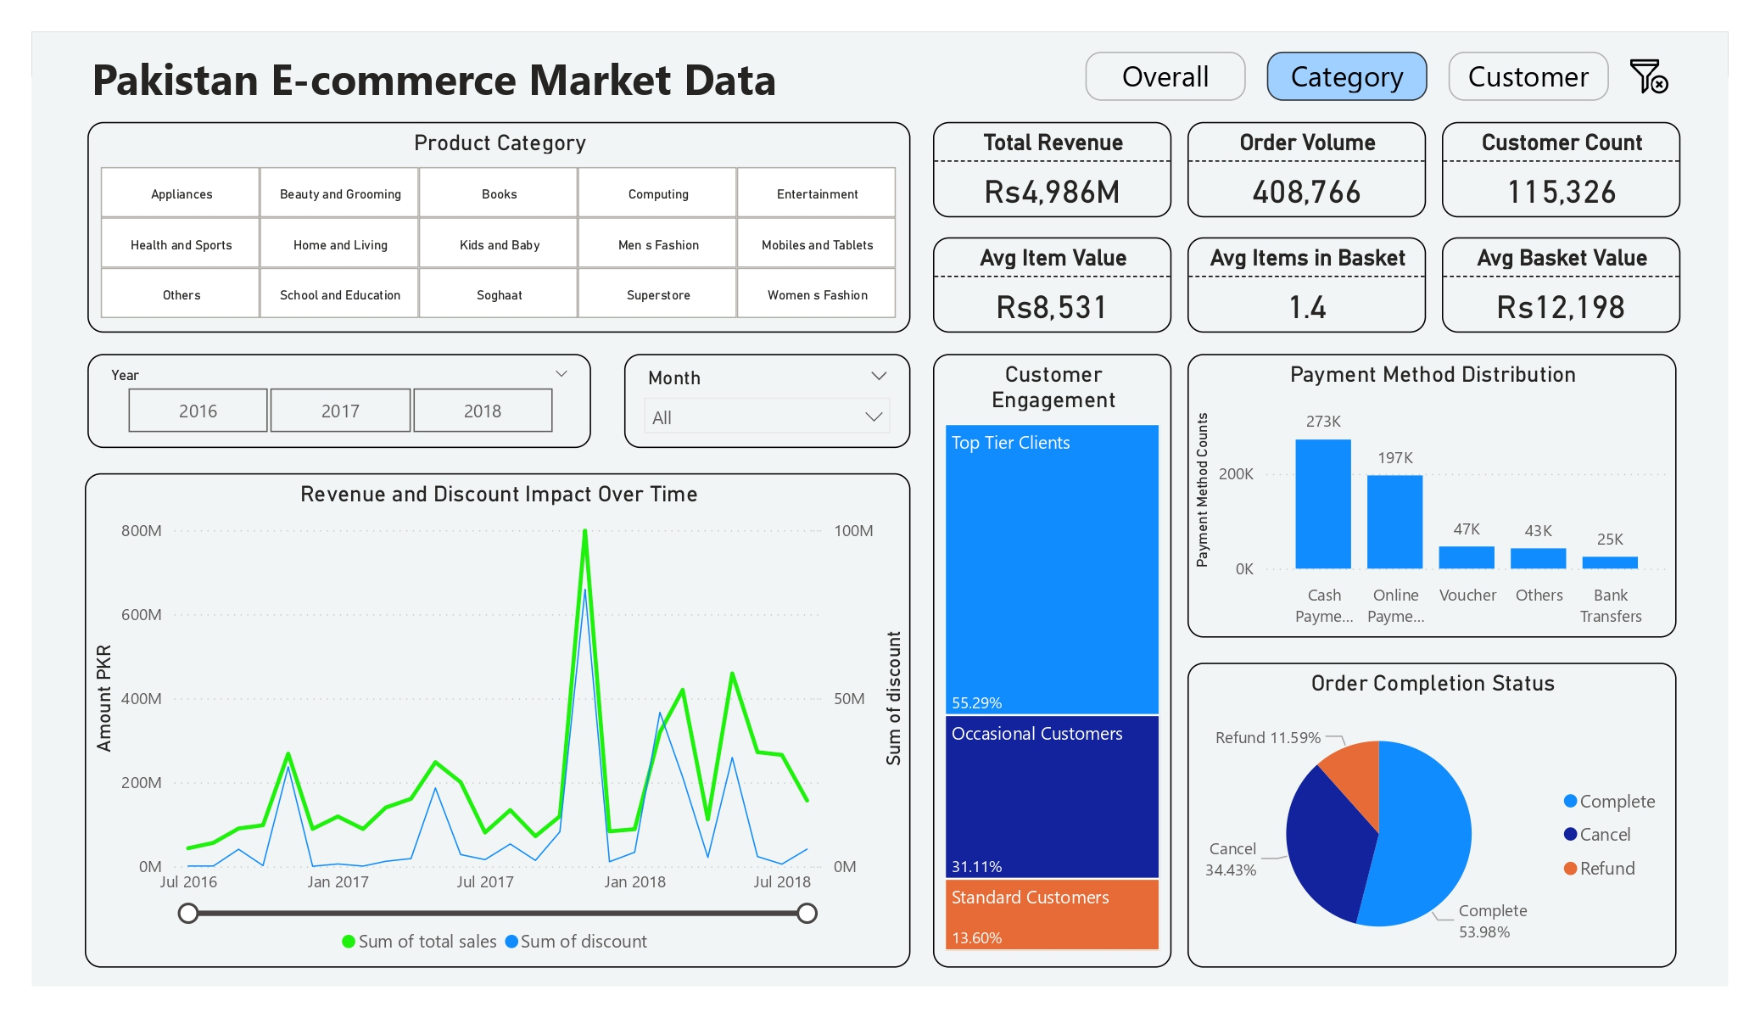
…

Slide 12
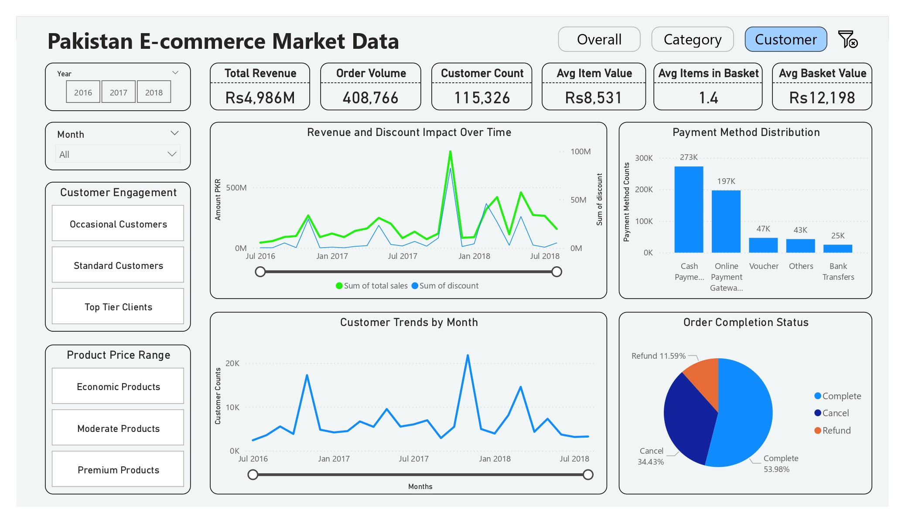
…

Slide 13
Key Insights
Sales Dynamics and Customer Behavior
Offering discounts increases sales across all product categories.
Retailers are hesitant to offer discounts on "Kids and Baby" and "School & Education" categories, indicating either a stable demand without discounts or concerns about margin impacts.
Sales across most categories are primarily driven by top-tier customers, who are loyal and frequent purchasers.
The Books category is an exception, with occasional customers contributing the most to sales, suggesting different buying behavior for this category.
Occasional and standard customers are more sensitive to discounts, showing a higher likelihood of making purchases during promotions.
Top-tier customers, who are consistent purchasers, are less influenced by discounts, indicating their purchasing decisions are driven by other factors like brand loyalty or product necessity.
Product and Payment Preferences
The highest sales and number of orders are seen in the categories of Mobile & Tablets, Appliances, Men's Fashion, and Entertainment.
Moderate-priced range products experience higher cancellation rates compared to economic-priced products.
Online payments are preferred for categories such as Appliances, Computing, Entertainment, Mobile & Tablets, and Superstore items. Cash payments are more common for all other categories.
Economic price range products are predominantly purchased using cash, whereas moderate price range products have a mix but tend towards online payments.
Premium products have no order completions; all orders in this category have been canceled and refunded.

Slide 14
recommendation
Targeted Discounts: Focus discounts on categories where they are most effective. For categories like "Kids and Baby" and "School & Education," consider alternative promotions to maintain margins.
Loyalty Programs: Strengthen loyalty programs for top-tier customers with personalized rewards, focusing on retention rather than just discounts.
Convert Occasional Buyers: Design targeted marketing campaigns to convert occasional customers into more frequent buyers, especially in categories like Books.
Reduce Cancellation Rates: Reevaluate the pricing and value proposition of moderate-priced products. Improve product descriptions and customer service to minimize cancellations.
Promote Online Payments: Encourage online payments in popular categories with incentives like discounts or cashback, while maintaining cash options for economic-priced products.
Premium Products Strategy: Revise the pricing and value proposition for premium products to better align with customer expectations.

Slide 15
Thank you

