Slide 1
Term Project
By: Klea Kojku, Sureya Ahmed, Bilal Shahid

Slide 2
Introduction
Rationale for the Study
This study investigates the impact of Alpelisib dosing, scheduling, and the addition of endocrine therapy on treatment outcomes among breast cancer patients. Alpelisib, a PI3K inhibitor, has shown efficacy in treating hormone receptor-positive, HER2-negative breast cancer subtypes. By examining different dosing regimens and therapy combinations, we aim to identify factors that improve clinical outcomes, potentially guiding personalized treatment approaches.
Treatment outcomes for breast cancer can be influenced by both dosing patterns and the addition of combination therapies. Understanding the roles of Alpelisib dosage, scheduling, and co-administration with endocrine therapy could improve clinical benefits, help manage side effects, and inform treatment protocols for improved patient care.
Objective
Hypothesis (Impact of Endocrine Therapy):
Null Hypothesis (H₀): The addition of endocrine therapy to Alpelisib does not significantly affect treatment outcomes (e.g., weeks on study or best response).
Alternative Hypothesis (H₁): The addition of endocrine therapy to Alpelisib significantly affects treatment outcomes

Slide 3
Method Section (cont.)
Population of Interest
The study population includes breast cancer patients with HR+/HER2- subtypes receiving Alpelisib treatment. Inclusion criteria ensure participants have measurable disease and are treated with Alpelisib, with or without concurrent endocrine therapy.
Variables of Interest
Exposure Variables:
Alpelisib Dose (mg): The specific dose of Alpelisib administered (e.g., 250 mg, 300 mg).
Alpelisib Scheduling: Dosing patterns such as intermittent (7/7, 5/2) or continuous.
Endocrine Therapy: Use of endocrine agents like Letrozole or Exemestane alongside Alpelisib.
Outcome Variables:
Clinical Benefit: A binary measure indicating whether the patient experiences clinical benefit (yes or no).
Treatment Best Response: Categorical response measures, including outcomes like stable disease, partial response, or disease progression.
Weeks on Study: Total duration a patient remains engaged in treatment, measured in weeks.
Covariates:
Mutation Count: Number of mutations per patient.

Slide 4
Method Section (cont.)
Study Design:
This retrospective cohort study utilizes simple random sampling to explore relationships between dosing patterns, therapy combinations, and clinical outcomes. Although retrospective in nature, subgroup analyses and adjustments for covariates aim to mitigate bias and improve validity.
Sample Size:
The dataset includes 122 patients who received Alpelisib, distributed across various dosing schedules and therapy combinations. Statistical analyses will ensure adequate representation of each subgroup (e.g., dose levels and therapy status). Given the dataset size:
Statistical tests will account for the dataset's relatively moderate size, ensuring the robustness of the findings.
Detailed descriptive statistics and exploratory analyses will provide insights before conducting inferential analyses.

Slide 5
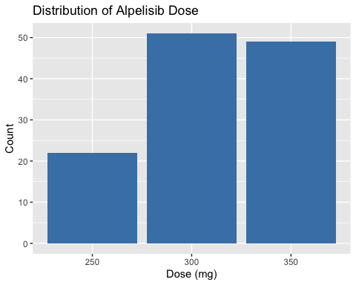

Slide 6
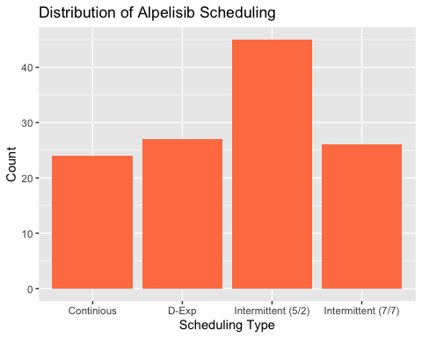

Slide 7
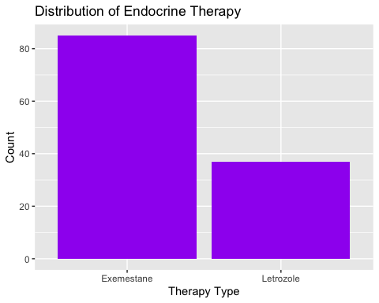

Slide 8
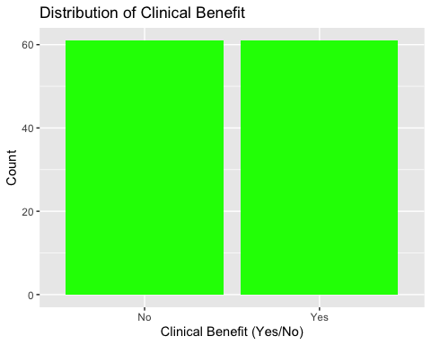

Slide 9
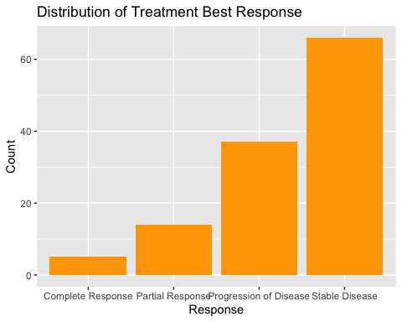

Slide 10
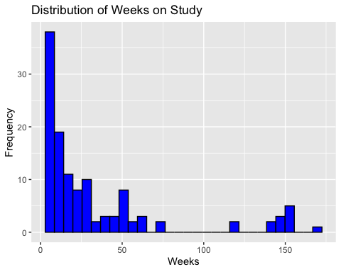

Slide 11
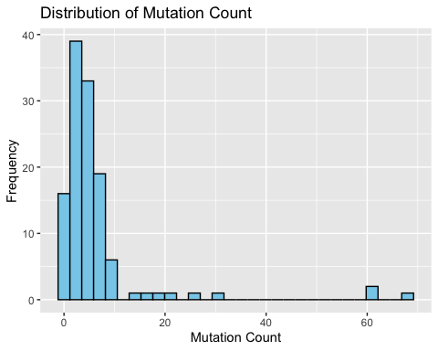

Slide 12
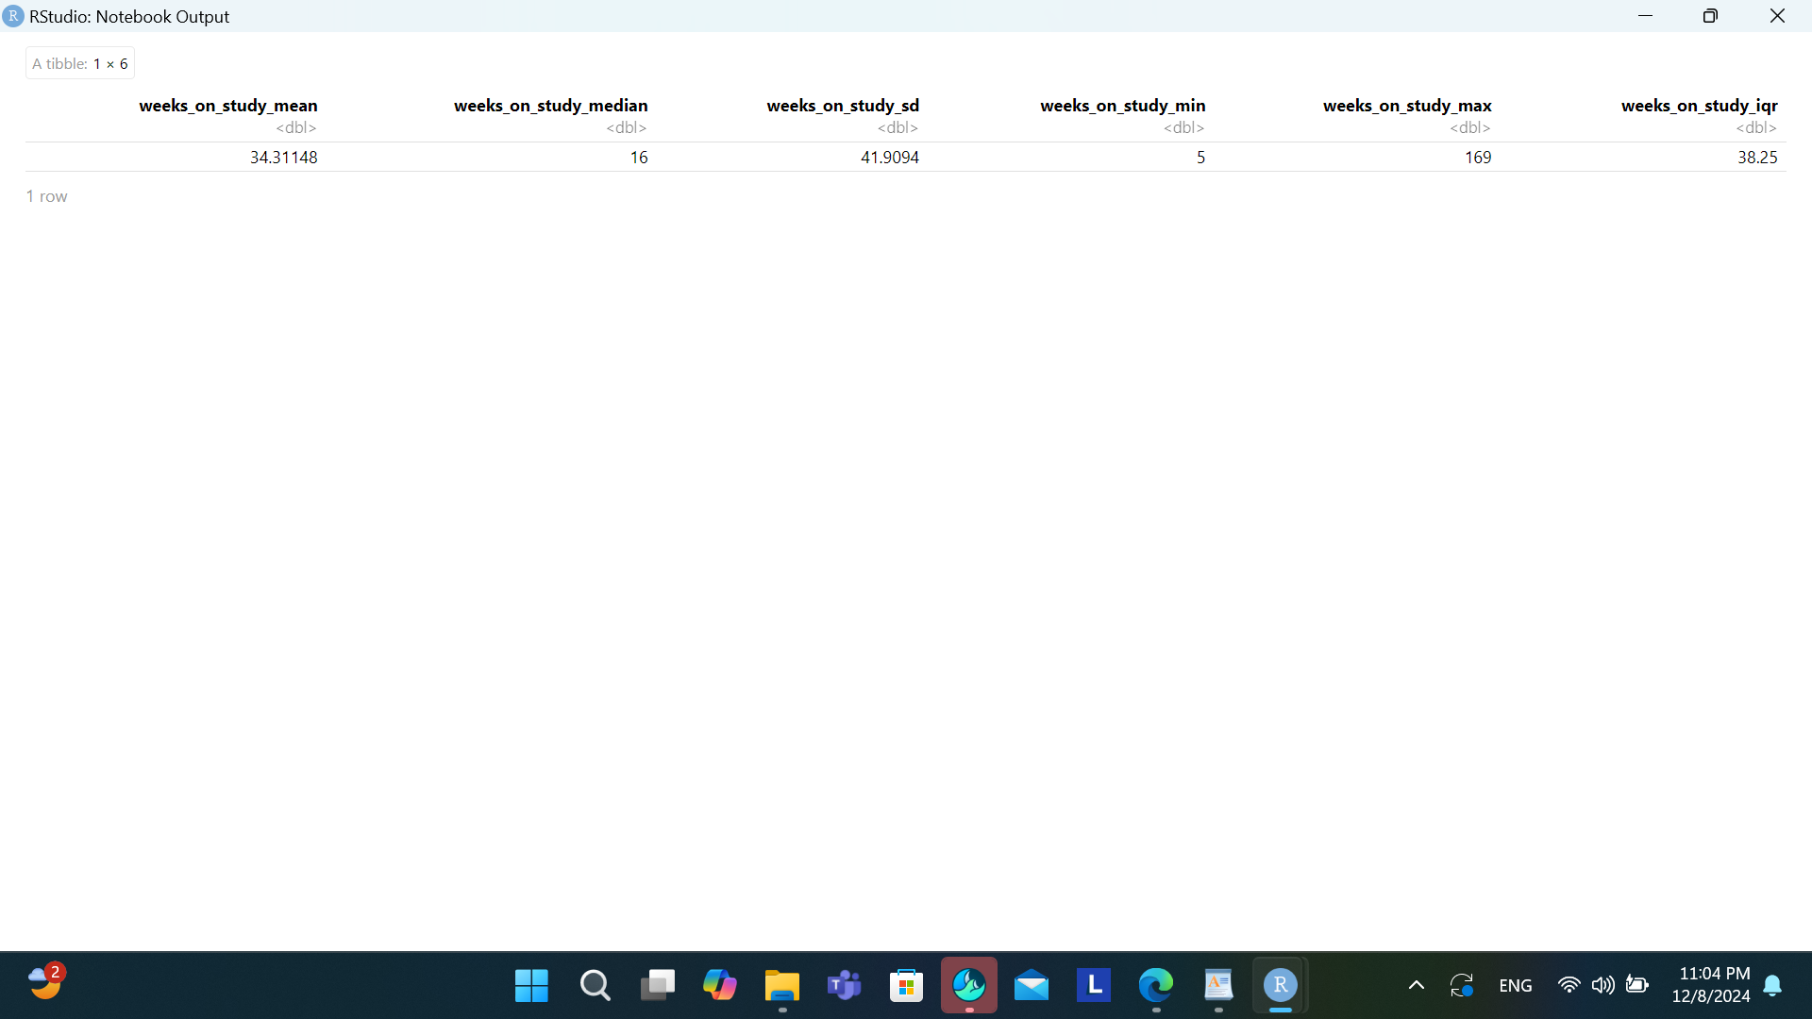
Descriptive Statistics for Weeks on Study

Slide 13
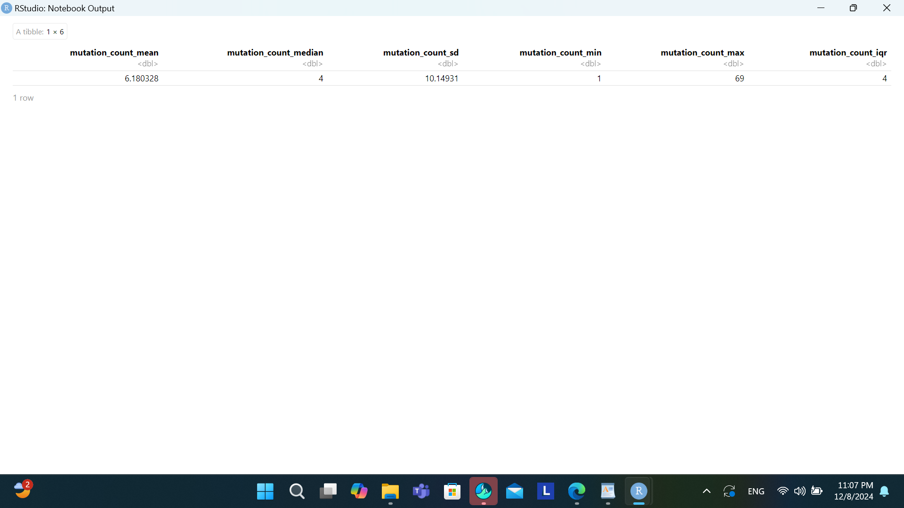
Descriptive Statistics for Mutation Count

Slide 14
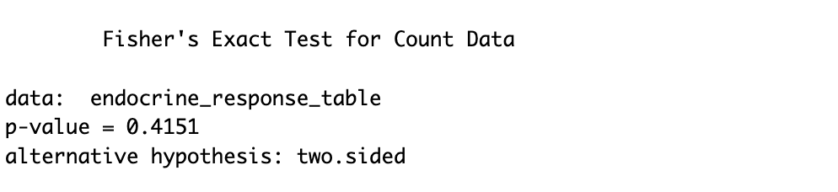
Fisher's Exact Test Output

Slide 15
Interpretation of Fisher's Exact Test Results
Key Results:
p-value:
The p-value of 0.4151 is greater than the significance level (α=0.05).
This means that there is no statistically significant association between Endocrine Therapy and Treatment Best Response in the dataset. In other words, the type of endocrine therapy used (e.g., Letrozole vs. Exemestane) does not significantly affect the treatment response.
Notes:
Conclusion:
Since the p-value is larger than 0.05, we fail to reject the null hypothesis that suggests no association between endocrine therapy and treatment response.
This suggests that the choice of endocrine therapy might not be a major factor influencing the treatment response in your sample.

Slide 16
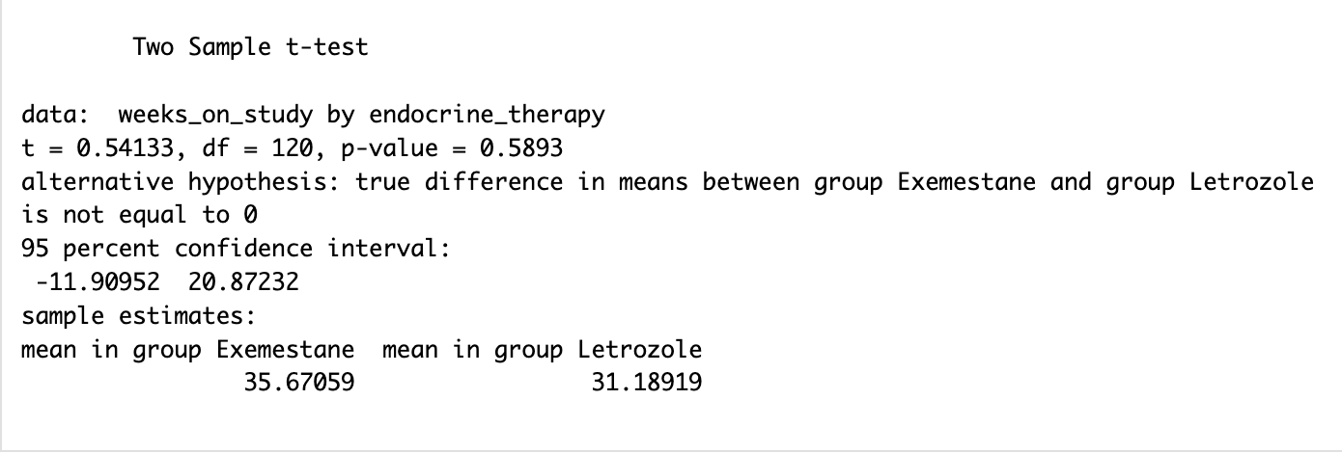
Two Sample t-test Output

Slide 17
Interpretation of Two-Sample t-Test Results
Key Results
p-value (0.58930):
This means there is no statistically significant difference in the mean weeks on study between the Exemestane and Letrozole endocrine therapy groups.
95% Confidence Interval:
The confidence interval ranges from −11.91 to 20.87 which includes 0. This further supports the conclusion that the difference in means is not statistically significant.
The interval indicates that the true mean difference between the groups could lie anywhere within this range, including no difference (0).
Mean Values:
The observed mean weeks on study for Exemestane is 35.67, and for Letrozole, it is 31.19. However, the difference (35.67−31.19=4.48) is not statistically significant.
Notes:
Conclusion:
The results suggest that Endocrine Therapy (Exemestane vs. Letrozole) does not have a significant impact on the mean weeks on study in this sample.
The difference in observed means may be due to random variation rather than a true effect
Next Steps:
Adjust for Covariates:
Perform a regression analysis to adjust for other variables (e.g., Alpelisib Dose, Mutation Count, TMB) that may influence treatment duration.

Slide 18
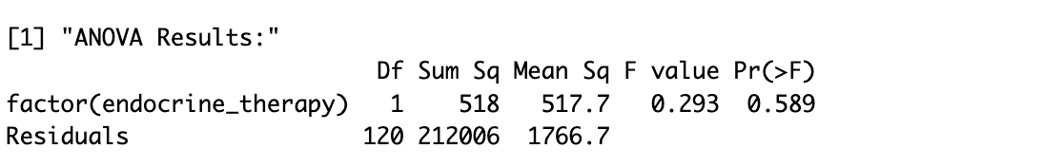
ANOVA Output

Slide 19
Interpretation of ANOVA Results
Key Results:
p-value (0.589):
The p-value is greater than the common significance level (α=0.05).
This means we fail to reject the null hypothesis (H0), which states that there is no significant difference in Weeks on Study between the levels of Endocrine Therapy (e.g., Exemestane vs. Letrozole).
F-statistic (0.293):
A small F-value indicates that the variability between groups (due to Endocrine Therapy) is small relative to the variability within groups (residuals).
Sum of Squares:
The between-group variability (518) is very small compared to the residual variability (212,006), suggesting that Endocrine Therapy explains very little of the total variability in Weeks on Study.
Notes:
Conclusion:
The ANOVA results indicate that Endocrine Therapy does not significantly impact Weeks on Study. The observed differences between groups could likely be due to random variation.

Slide 20
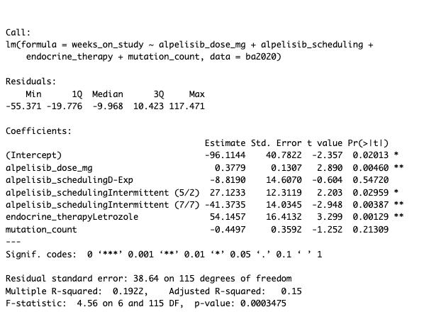
MLRM Output

Slide 21
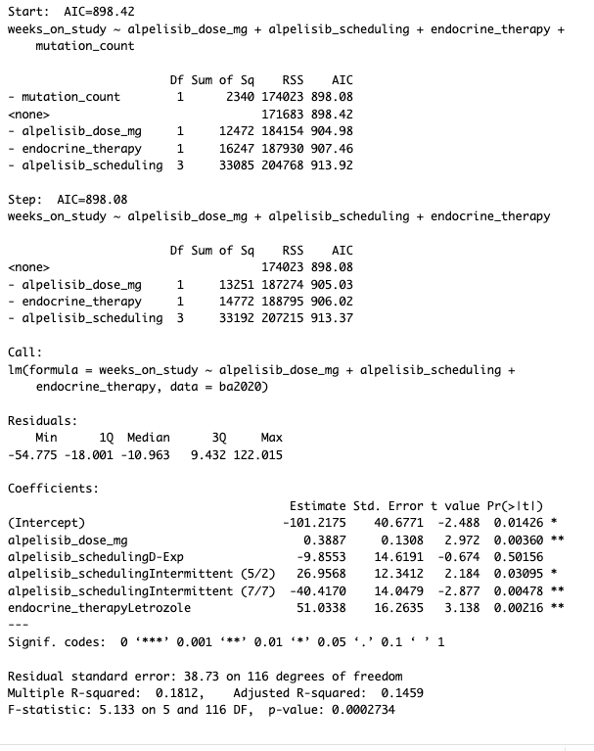

Slide 22
Interpretation of Stepwise Regression Results
Stepwise Process
Initial Model (AIC = 898.42): Included predictors: Alpelisib Dose, Alpelisib Scheduling, Endocrine Therapy, and Mutation Count.
Final Model (AIC = 898.08): Excluded Mutation Count due to its minimal contribution to the model
(Sum of Squares = 2340).

Slide 23
Part 1 - Model Overview
This linear regression model evaluates the relationship between Weeks on Study and the predictors:
Alpelisib Dose (mg)
Alpelisib Scheduling (reference: Continuous scheduling)
Endocrine Therapy (reference: Exemestane)
The goal is to assess the contribution of these predictors to the variability in treatment duration (Weeks on Study) while interpreting the model's fit and assumptions.

Slide 24
Part 2 - Residuals
Residuals Summary:
Minimum: −54.775
1st Quartile (Q1): −18.001
Median: −10.963
3rd Quartile (Q3): 9.432
Maximum: 122.015
Interpretation:
Residuals represent the difference between observed and predicted values.
The spread of residuals indicates some outliers (e.g., 122.015) or extreme deviations, suggesting the model may not perfectly capture all factors influencing treatment duration.

Slide 25
Part 3 - Coefficients
Each coefficient represents the expected change in Weeks on Study for a one-unit increase in the predictor, holding other variables constant.
Intercept (−101.2175):
Baseline value of Weeks on Study when all predictors are at their reference levels (Continuous Scheduling, Exemestane therapy, and 0 Alpelisib Dose).
Significant (p=0.01426).
Alpelisib Dose (0.3887):
For every 1 mg increase in Alpelisib Dose, Weeks on Study increases by 0.39 weeks.
Statistically significant (p=0.00360).
Interpretation: Alpelisib Dose is a significant positive predictor of treatment duration, suggesting higher doses may enhance treatment persistence.
Alpelisib Scheduling:
D-Exp (−9.8553):
Associated with a reduction of 9.86 weeks compared to Continuous Scheduling.
Not statistically significant (p=0.50156).
Intermittent (5/2) (26.9568):
Associated with an increase of 26.96 weeks compared to Continuous Scheduling.
Statistically significant (p=0.03095).
Intermittent (7/7) (−40.4170):
Associated with a reduction of 40.42 weeks compared to Continuous Scheduling.
Statistically significant (p=0.00478).
Interpretation:
Scheduling patterns significantly influence treatment duration:
Intermittent (5/2) improves persistence.
Intermittent (7/7) shortens treatment duration.
D-Exp shows no significant difference from Continuous Scheduling.
Endocrine Therapy (Letrozole) (51.0338):
Letrozole is associated with a significant increase of 51.03 weeks compared to Exemestane.
Statistically significant (p=0.00216).
Interpretation: Letrozole is a significant predictor of longer treatment duration.

Slide 26
Part 4 - Model Performance
Residual Standard Error: 38.73
The average deviation of observed values from predicted values.
Suggests variability in treatment duration not explained by the model.
Multiple R2: 0.1812 and Adjusted R2:0.1459
The model explains about 14.59% of the variability in Weeks on Study, after accounting for the number of predictors.
Indicates a modest fit; additional variables may improve explanatory power.
F-statistic: 5.133, p=0.0002734
The model is statistically significant overall, indicating that at least one predictor significantly affects Weeks on Study.

Slide 27
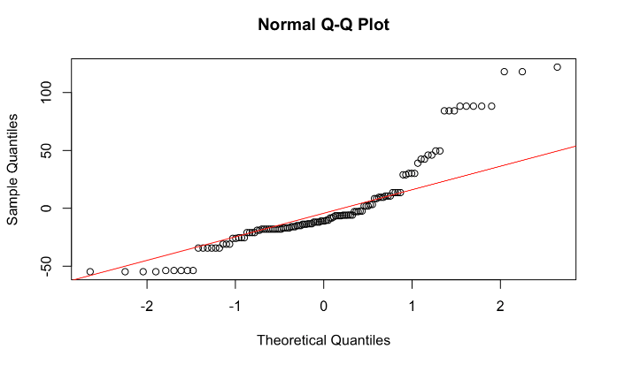
Notes:
Normality of Residuals:
The Q-Q plot compares residuals against a normal distribution.
The residuals largely align with the diagonal line, suggesting approximate normality.
Deviations at the tails may indicate mild outliers or skewness.

Slide 28
Interpretation
While the Q-Q plot indicates minor deviations from normality at the tails, the central portion of the residuals aligns well with the theoretical quantiles.
This suggests that the normality assumption is reasonably met for the linear regression model.

Slide 29
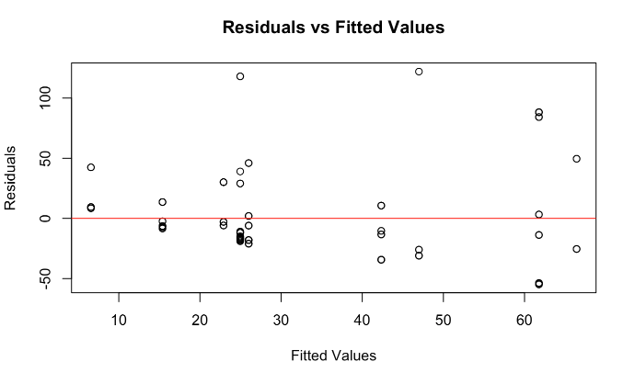

Slide 30
Interpretation
The plot shows some mild heteroscedasticity and potential outliers, but the overall pattern does not suggest severe violations of model assumptions.

Slide 31
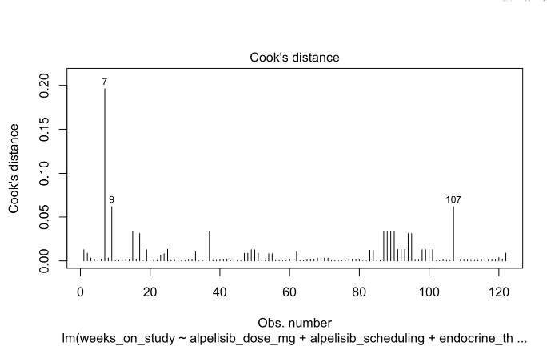

Slide 32
Interpretation
The Cook’s Distance plot indicates that observations 7, 9, and 107 are influential. Investigating these points and possibly addressing their impact through robust regression or exclusion can ensure the validity of your model's results.

Slide 33

VIF Output

Slide 34
Multicollinearity Check
VIF Values:
Alpelisib Dose: 1.36
Alpelisib Scheduling: 1.34
Endocrine Therapy: 2.13
All VIF values are below 5, indicating no severe multicollinearity.

Slide 35
Conclusion
Hypothesis:
The addition of endocrine therapy to Alpelisib significantly affects treatment outcomes (e.g., weeks on study or best response).
Findings:
Weeks on Study: No significant difference was observed in the mean weeks on study between endocrine therapies (Exemestane and Letrozole) based on t-tests and ANOVA. However, multiple linear regression indicated that Letrozole is associated with significantly longer weeks on study compared to Exemestane when controlling for other factors.
Best Response: No significant association between endocrine therapy and treatment best response was found.
The hypothesis is partially supported: while Letrozole improves weeks on study in the regression model, no association was observed for other treatment outcomes.

Slide 36
Discussion
Generalization to Population of Interest:
Expected Outcomes: The significant positive effect of Letrozole on weeks on study aligns with previous findings, suggesting that endocrine therapy choice can influence treatment duration. This finding could generalize to the broader population of patients receiving Alpelisib therapy, provided the study population is representative.
Unexpected Findings: The lack of significant association with treatment best response was unexpected. This may suggest that endocrine therapy primarily influences treatment duration rather than clinical response.
What Went Wrong?
Sample Size: A relatively small sample size may have limited the ability to detect subtle effects or interactions.
Unaccounted Variables: Factors such as patient age, tumor characteristics, and prior therapies might confound the relationship between endocrine therapy and treatment outcomes.
Measurement Limitations: Treatment best response is a categorical variable that may lack the granularity needed to detect nuanced effects.

Slide 37
Major Difficulties
Data Quality: Some variables (e.g., mutation count, TMB) contained missing or invalid entries, complicating analysis and limiting their inclusion in models.
Model Limitations: Despite stepwise regression, the low Adjusted R2R^2R2 indicates that significant predictors explain only a small fraction of the variability in weeks on study.
Categorical Outcome Analysis: Challenges in fitting appropriate models for categorical outcomes like best response, especially with small group sizes, reduced statistical power.

Slide 38
Limitations of the Study
Small Sample Size: Reduces generalizability and the ability to detect small but meaningful effects.
Missing Covariates: Lack of data on key patient-level variables (e.g., age, comorbidities) that could influence treatment outcomes.
Cross-Sectional Design: The lack of longitudinal data limits causal inference.
Outcome Measures: "Weeks on Study" may not fully capture clinical benefit or long-term effectiveness.

Slide 39
Recommendations for Future Studies
Improve Data Quality: Ensure complete and accurate data collection, particularly for key covariates like genetic markers and clinical history.
Increase Sample Size: A larger sample would improve statistical power and generalizability.
Include Longitudinal Outcomes: Use follow-up data to assess outcomes like progression-free survival or overall survival.

Slide 40


