Slide 1

Selenium for Automation
Automation with Bilal Shahzad

Slide 2




Trainer
https://www.linkedin.com/in/bilalshahzad139/
https://www.facebook.com/LearningInUrduCentre/
https://www.youtube.com/c/LearnInUrdu139
http://learninginurdu.pk
@bilalshahzad

Slide 3
Agenda
CI vs. CD vs. CD
What is Browser Automation
What is Selenium
Use Selenium with C#
Data Scraping using Selenium
UI Automated Testing
Selenium with NUnit

Slide 4
Our Ultimate Objective
Every manual operation in delivery pipeline needs to be evaluated to determine if it can be automated.
Notes:
https://www.seleniumhq.org/

Slide 5
CI vs. CD vs. CD
Continuous Integration (CI): A DEV practice to integrate code into a shared repository several times a day. Automated Tests are run on every integration.
Continuous Delivery (CD): Continuous delivery is an extension of CI to make sure that you can release new changes to your customers quickly in a sustainable way.
Continuous Deployment (CD): With this practice, every change that passes all stages of your production pipeline is released to your customers. There's no human intervention.
Notes:
https://www.seleniumhq.org/

Slide 6
What is Browser Automation?
(Browser) Automation is
A program/script emulates what you do manually (e.g. open a URL, filling form, clicking on a button)
Automation can save lot of time.
Demo of Browser Automation
Notes:
https://www.seleniumhq.org/

Slide 7
What is Selenium?
Selenium automates browsers. That's it! What you do with that power is entirely up to you.
Primarily, it is for automating web applications for testing purposes, but is certainly not limited to just that.
Open Source, Free of Cost
Latest version is 3.x
Notes:
https://www.seleniumhq.org/

Slide 8
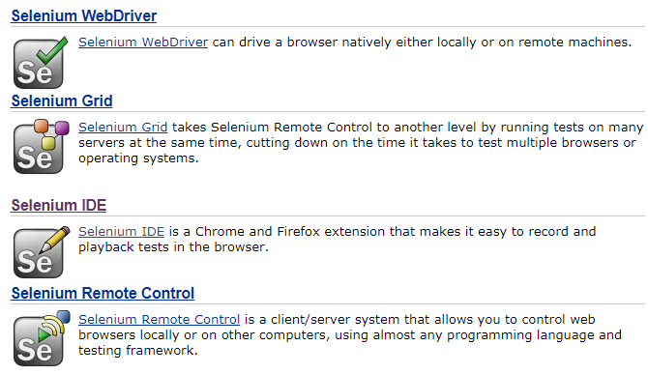
Selenium Projects
Notes:
https://www.seleniumhq.org/projects/

Slide 9
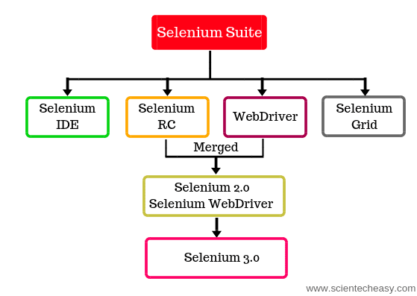
Selenium Projects
Notes:
https://www.seleniumhq.org/projects/

Slide 10
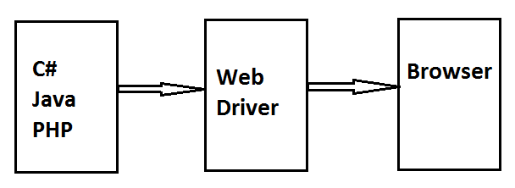
Selenium WebDriver
Notes:
https://www.seleniumhq.org/about/platforms.jsp#browsers

Slide 11
Platforms supported by Selenium
Firefox, Internet Explorer, Safari, Opera, Chrome,
Microsoft Windows, Apple OS X, Linux
C#, Haskell, Java, JavaScript, Objective-C, Perl, PHP, Python, R, Ruby
Notes:
https://www.seleniumhq.org/about/platforms.jsp#browsers

Slide 12
Task 1 – Install Packages
Visual Studio 2015+, C#
Create a new Project (e.g. Console)
Add following packages
Install-Package Selenium.Support -Version 3.141.0
It will also install Selenium.WebDriver
Install-Package Selenium.Chrome.WebDriver -Version 2.45.0
Add Namespaces
OpenQA.Selenium
OpenQA.Selenium.Chrome
Create Driver Object
IWebDriver driver = new ChromeDriver()
Open a URL (http://www.google.com)
driver.Navigate().GoToUrl(url)

Slide 13
Task 2 – Type & Search
This is extension of Task 1
Goal: Once Google is opened, Type some query in it and press enter to see results
FindElement Method
By class
By.ClassName
By.CssSelector
By.Id
By.Name
By.TagTagName
By.Xpath
SendKeys() function

Slide 14
Task 3 – Data Scraping
This is extension of Task 2
Goal: Once search results are available, Extract information from web page & print it on console (or save in file etc.)
Inspect page results & understand the DOM structure
Check which By class method you should use here to extract what

Slide 15
Exercise – Data Scraping
Goal: Take some input from user & search it on https://pakistanistores.com
Inspect page results & understand the DOM structure
Extract search results and print them on console.
Product Image
Description
Price
Site Name (Source)

Slide 16
Pause.. Step towards UI Testing
Think about a (simple) test case of your web application.
How will you automate this test case?

Slide 17
What is next?
Use this Learning to perform Automated UI Testing
Doing Automated UI testing with Nunit + Selenium
What is Selenium IDE?

Slide 18
Part 2 – UI Automated Testing
Demo of Sample Web Application
Login Verification
New Record Creation
Show All Records
Headless Browser
UI Automated Testing with Selenium + Nunit
Introduction to Xpath
Introduction to Selenium IDE
Notes:
https://github.com/bilalshahzad139/SeleniumUIAutomation/Unit Testing

Slide 19
Task 1 – Login Verification
Goal: Validate if Login/Password is working properly
Notes:
https://github.com/bilalshahzad139/SeleniumUIAutomation/Unit Testing

Slide 20
Task 2 – Login Verification - Admin
Goal: Validate if Login/Password is working properly and if it is Admin user.
Notes:
https://github.com/bilalshahzad139/SeleniumUIAutomation/Unit Testing

Slide 21
Task 3 – New Product Creation
Goal: Perform action to create new product and verify if it is saved successfully.
Notes:
https://github.com/bilalshahzad139/SeleniumUIAutomation/Unit Testing

Slide 22
Task 4 – Show All Verification
Goal: Perform action to see all products and see if products are appearing.
Notes:
https://github.com/bilalshahzad139/SeleniumUIAutomation/Unit Testing

Slide 23
Headless Browser
A headless browser is a web browser without a graphical user interface.
Examples:
PhanthomJS
HtmlUnitDriver
ChromeDriver with Headless Chrome
Chrome Headless
Running Chrome without chrome
Chrome v60.0 >
ChromeOptions option = new ChromeOptions();
option.AddArgument("--headless");
var driver = new ChromeDriver(option);
Notes:
https://github.com/bilalshahzad139/SeleniumUIAutomation/Unit Testing

Slide 24
Task 5 – Selenium with NUnit
Create New Class Library Project
Add NUnit Package
Install-Package NUnit -Version 3.11.0
Install “NUnit Test Adapter 3” Extension (If it is missing)
Go to Tools -> Extensions & Updates -> Click “Online” and search for “Nunit”
Install-Package Selenium.Support -Version 3.141.0
Install-Package Selenium.Chrome.WebDriver -Version 2.45.0
[TestFixture], [Test], [Setup], [TearDown]
Notes:
https://github.com/bilalshahzad139/SeleniumUIAutomation/Unit Testing

Slide 25
Introduction to XPath (XML Path)
XPath is a query language for selecting nodes from an XML document.
Find Input element where name is “rlz”
//input[@name="rlz"]
Find Input element which has name attribute
//input[@name]
Notes:
https://www.w3schools.com/xml/xml_xpath.asp

Slide 26
Selenium IDE
https://www.seleniumhq.org/selenium-ide/
Open source record and playback test automation for the web
Available as Chrome Extension & Firefox Plugin
It requires no additional setup other than installing the extension on your browser.
Command Line Runner for Selenium IDE is available

Slide 27
Selenium IDE - Demo
Check how to Record & Play

Slide 28
One Second
Mark your Attendance
https://docs.google.com/forms/d/e/1FAIpQLSfJRkcw5CyOyzsmEUbvef5RDtcZKl4PnU8b3X52EV2n4abF0g/viewform
Feedback
https://docs.google.com/forms/d/e/1FAIpQLSeopkMnvGegk-4xDqju26PGaXLl0L19Mte45lbKW1qCm-yBuA/viewform
Material
https://docs.google.com/spreadsheets/d/1LaeIrpanrKKeEkBIPPCWbbqnP8loNnm7RjlgVe1T61Y/edit#gid=999102021

Slide 29


Slide 30
Thank You

