Slide 1
Developing Chrome Extensions
By
Learning In Urdu (learninginurdu.pk)

Slide 2
Find us online
http://learninginurdu.pk/
https://www.facebook.com/LearningInUrduCentre/
https://www.youtube.com/c/LearnInUrdu139

Slide 3
Agenda
Introduction of Chrome Extensions
Demo of Installing & Uninstalling an extension
Manifest.json file
Content Scripts
Browser Action, Popup
External API (AJAX) Calling in Popup
Chrome APIs (chrome.*)
Background Script/page
Page Action
Message Passing
Options Page, Override Page
Publishing

Slide 4
Introduction
Extensions are small software programs that can modify and enhance the functionality of the Chrome browser.
You write them using web technologies such as HTML, JavaScript, and CSS.
Extensions have little to no user interface.
Extensions bundle all their files into a single file that the user downloads and installs.
Publishing on Chrome Web Store
Notes:
https://developer.chrome.com/extensions

Slide 5
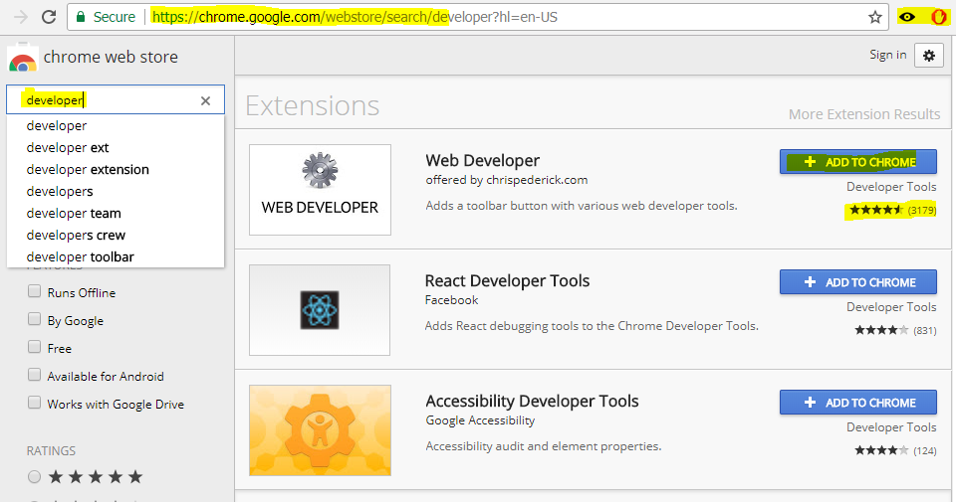

Slide 6
Demo
Installing a chrome extension (notepad, web developer)
Disabling/uninstalling a chrome extension

Slide 7
Getting Started
https://developer.chrome.com/extensions
https://developer.chrome.com/extensions/overview
https://developer.chrome.com/extensions/getstarted

Slide 8
Major Components
Manifest.json
Actions
Browser Action
Page Action
Content Scripts
Pages
Background Pages
Event Pages
UI Pages
Chrome APIs (chrome.*)
Permissions

Slide 9
Demo - Extension 1
Objective: Create a very basic extension
Manifest.json is the main file which holds all the configuration of extension.
Notes:
https://developer.chrome.com/extensions/manifest

Slide 10
Content Scripts
Standard JavaScript files which are injected in the web pages.
These can access the DOM of the web page and can modify the DOM.
These run in ‘Isolated worlds’. They can’t access JavaScript variables declared in page JavaScript or in any other content script.
They can communicate with web pages by using “access” to shared DOM.
You may also inject ‘content scripts’ programmatically.
https://developer.chrome.com/extensions/content_scripts

Slide 11
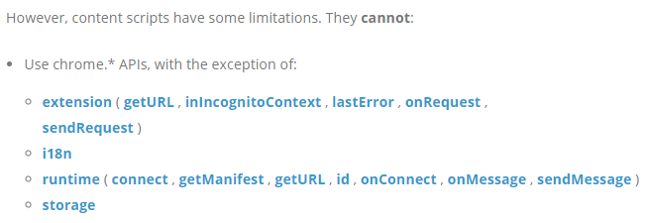
Content Scripts

Slide 12
Demo - Extension 2
Objective: Understanding of content script files in extension.

Slide 13
Actions
Browser Action
Button outside address bar.
When extension is relevant to most of the pages.
Page Action
Button outside address bar. (it also used to be inside address bar)
When extension icon should be available depending the page.
Each extension can have at most one browser action or page action.
An HTML can be set to show as popup when action button is clicked.

Slide 14
Demo - Extension 3
Objective: Understanding of Browser Action & Popup

Slide 15
Demo – Extension 4
Objective: Understand how to access external APIs (e.g. AJAX call)

Slide 16
Chrome APIs
chrome.* APIs
Synchronous vs. Asynchronous
We’ll explore
chrome.windows
chrome.tabs
chrom.storage
chrome.notifications

Slide 17
Demo – Extension 5
Objective: Understanding of Chrome APIs

Slide 18
Background Pages
A common need for extensions is to have a single long-running script to manage some task or state.
Background page (an invisible page) is an HTML page that runs in the extension process.
It exists for the lifetime of your extension, and only one instance of it at a time is active. (exception is in incognito case)

Slide 19
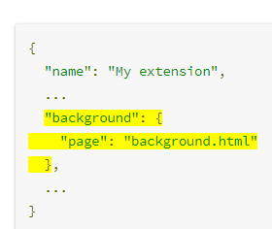
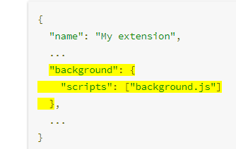
Background Pages
You may provide detail of ‘background page’ or ‘background scripts’ in menifest.js
If you don’t mention page, a background page will be generated by the extension system that includes each of the files listed in the scripts property.

Slide 20
Background Pages
Two types Background Script
Persistent Background Pages
Always open in background
Event Pages
opened and closed as needed..
Unless you absolutely need your background page to run all the time, prefer to use an event page.
https://developer.chrome.com/extensions/background_pages

Slide 21
Demo – Extension 6
Objective: Understanding of Background Scripts

Slide 22
Demo – Extension 7
Objective: Understanding of Page Actions

Slide 23
Message Passing
Content Script can’t access variables or functions of background script and vice versa.
But DOM is shared between them
Storage is shared between them
Chrome APIs provide us a mechanism through which we can pass message from content script to background script or vice versa.
Message passing can be done
Inside an extension
Between two extensions
Between an extension and a web page

Slide 24
Demo – Extension 8
Objective: Understanding of Message Passing

Slide 25
UI Pages
Extensions can contain ordinary HTML pages that display the extension's UI. For example
A browser action can have a popup
Option page to set options for extension
Another type of special page is the override page
You can use tabs.create or window.open() to display any other HTML files that are in the extension.
The HTML pages inside an extension have complete access to each other's DOMs, and they can invoke functions on each other.

Slide 26
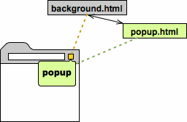

Slide 27
Demo – Extension 9
Objective: Understanding of Options Page and Override Page

Slide 28
Deployment/Hosting
Packaged file (.crx)
You can prepare this file from chrom://extensions
You will get .pem file. You will need this private key file when you will update your extension.
Hosting
Chrome Web Store dashboard
On your own server
Through GPO for your enterprise

Slide 29
Quiz

Slide 30
Question # 1
Question: An extension wants to interact with a page (which user has loaded and this page is not part of extension), What should user do?
Answer: Use Content Scripts

Slide 31
Question # 2
Question: Can I inject multiple scripts in a web page?
Answer: Yes

Slide 32
Question # 3
Question: Can I inject different content scripts to different pages?
Answer: Yes

Slide 33
Question # 4
Question: Can a content script access variables declared in other content scripts or in page?
Answer: No, a content script works in isolated world.

Slide 34
Question #
Question: Can I inject content script programmatically (once page is loaded)?
Answer: Yes, you can do that.

Slide 35
Question # 5
Question: How do you handle your extension own logic (e.g. store some data in local storage, handling extension options)?
Answer: You can do that by using background pages or background scripts.

Slide 36
Question # 6
Question: Can Background page/script access user loaded page DOM? And what should it do if it want to make some change in user page?
Answer: No, It can’t access user loaded page. It can tell content script (by using message passing) and content script can do that.

Slide 37
Question # 7
Question: Can content script access members declared in background page/script?
Answer: No, it cannot. But content script can send a message to background page/script by using Message Passing system.

Slide 38
Question # 8
Question: Can I make AJAX call to some external API in my extension?
Answer: Yes, you can do that. You will have to take care of Cors.

Slide 39
Question # 9
Question: Extension is a compressed package. Can I get this package of any extension available in chrome store and decompress it to see its content?
Answer: Yes, you can do that. Check http://crxextractor.com/

Slide 40
References
https://developer.chrome.com/extensions
https://developer.chrome.com/extensions/manifest

Slide 41
Thank You

