Slide 1
Intro to Containerization with Docker
Bilal Shahzad

Slide 2
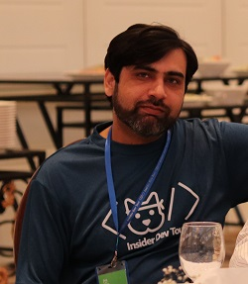
Trainer
Bilal Shahzad
Agilist/Architect/Teacher/Blogger/YouTuber
Working in IT Industry since 2003
MVP (Microsoft Most Valuable Professional)
MCT (Microsoft Certified Trainer)

Slide 3
How to Contact
https://www.linkedin.com/in/bilalshahzad139/
https://www.facebook.com/LearningInUrduCentre/
https://www.youtube.com/c/LearnInUrdu139
http://learninginurdu.pk
@bilalshahzad

Slide 4
Agenda
Background
Docker Installation
Docker Basic Concepts
Playing with nginx
Understanding Volumes
Push & Save an Image
Playing with Node & MySQL
Playing with PHP
Playing with dotnet core
Playing with .NET Framework applications
Q&A

Slide 5
Before Virtualization
Single OS per Machine
Software & Hardware tightly coupled
Running multiple applications on same machine may creates conflicts
Mostly Per App Per Machine
Inflexible & costly
Bare-metal Servers
For single purpose and without virtualization

Slide 6
Virtualization
It refers to the act of creating a virtual version of something
In Computing, virtualization is “abstraction” of computer resources.
Giving illusion that X (e.g. OS) is running on real hardware
Some Types
Server Virtualization (e.g. Virtual Machines)
Desktop Virtualization
Application Virtualization
Memory
Storage
Data
Network
We can say that almost everything in cloud is virtualized.

Slide 7
Virtualization
Hypervisor
A software that creates & runs virtual Machines (VMs).
VMWare, Oracle VirtualBox, Hyper-V
Benefits of Virtualization
Better usage of resources
Separation of Concern
Easy to setup, backup & destroy

Slide 8
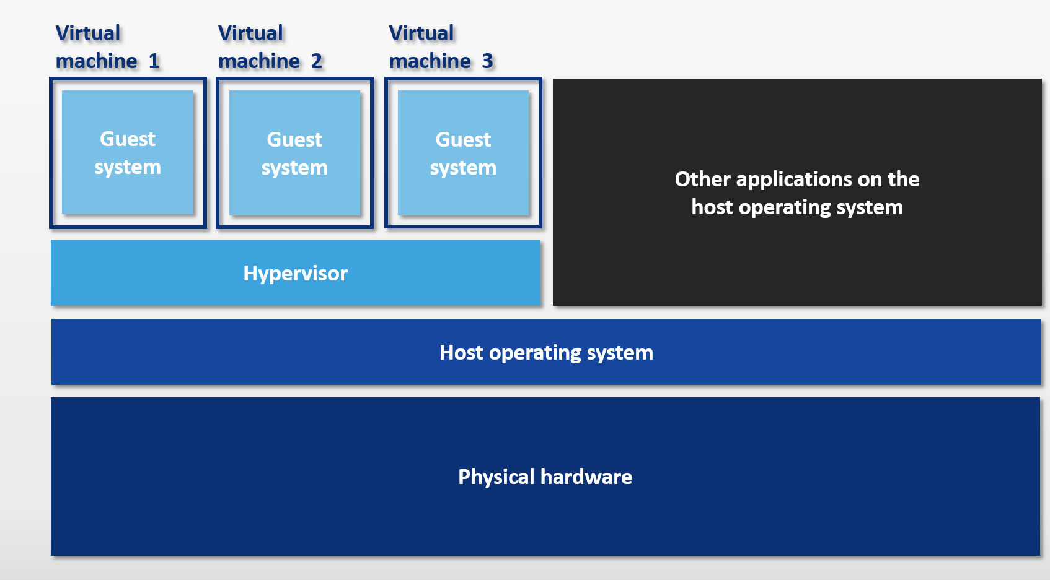
Virtualization
Notes:
Note: Image is copied from Internet

Slide 9
Containerization
It is another level of virtualization
Host kernel is shared
Container contains only required file system instead of full OS.
Container contains everything to run an application.
Container runs through some container engine
Docker is a such runtime

Slide 10
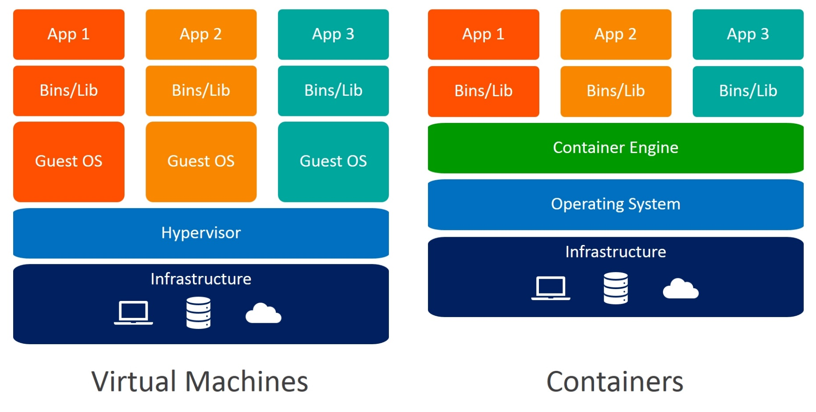
Virtualization vs. Containerization
Notes:
Note: Image is copied from Internet

Slide 11
Intro to Docker
Docker Inc.
https://www.docker.com/
Docker is a set of platform as a service products that use OS-level virtualization to deliver software in packages called containers.
Written in GO.
Initial Release date: March 20, 2013.
Container Runtime (like Hypervisor in VMs world)

Slide 12
Docker Components
Docker components
sudo docker version
docker cli
docker engine
Linux Containers
Docker started with Linux containers
Linux as Docker Host
Windows Containers
Requires Windows OS as Docker Host
Image vs. Container
Container Registry (e.g. DockerHub)

Slide 13
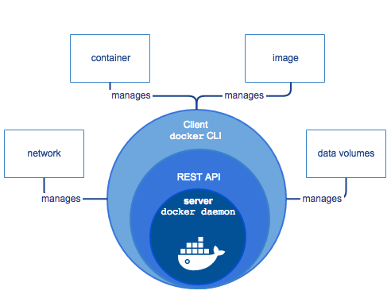
Components
Notes:
Note: Image is copied from Internet (docker website)

Slide 14
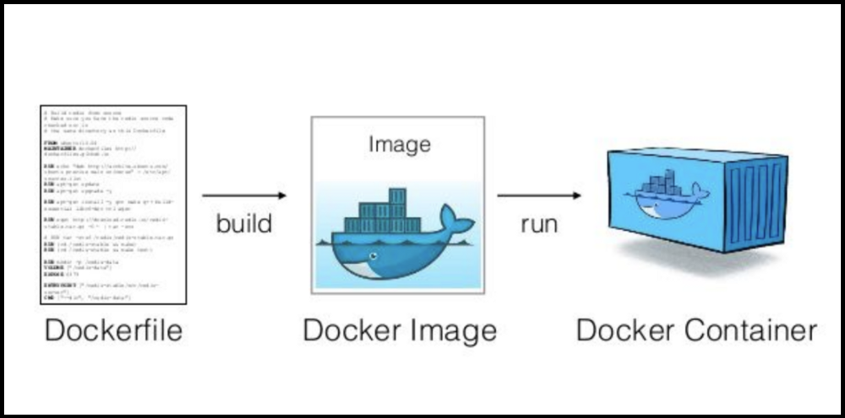
Image vs. Container
Notes:
Note: Image is copied from Internet

Slide 15
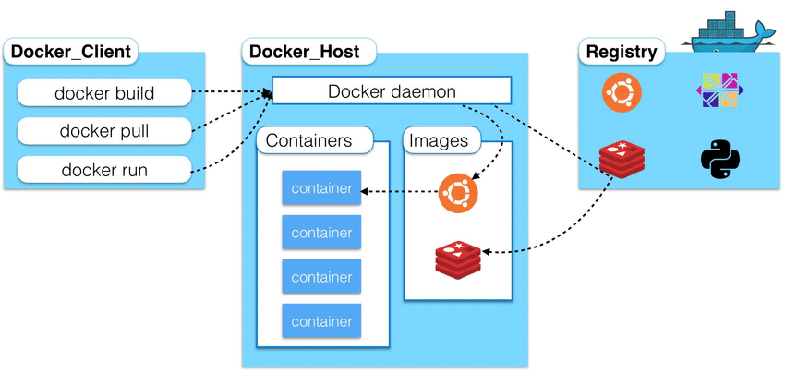
High Level Overview
Notes:
Note: Image is copied from Internet

Slide 16
Docker Installation - Linux
Docker on Linux
Community Version
Enterprise Version
Detailed way to install
https://docs.docker.com/get-docker
Quick way to Install
Open https://get.docker.com/ and get commands to execute
curl -fsSL https://get.docker.com -o get-docker.sh
sh get-docker.sh
sudo usermod -aG docker <youruser>
Check if docker is installed & daemon running
sudo docker version
Notes:
https://docs.docker.com/get-docker
https://get.docker.com/

Slide 17
Docker-compose Installation - Linux
docker-compose
Compose is a tool for defining and running multi-container docker applications.
Installation
sudo curl -L "https://github.com/docker/compose/releases/download/1.27.4/docker-compose-$(uname -s)-$(uname -m)" -o /usr/local/bin/docker-compose
sudo chmod +x /usr/local/bin/docker-compose
Check If installation is completed successfully
docker-compose version
Note: If it doesn’t work after installation, try creating a soft link
sudo ln -s /usr/local/bin/docker-compose /usr/bin/docker-compose
Notes:
https://docs.docker.com/compose/
https://docs.docker.com/compose/install/

Slide 18
Docker Installation - Windows
Docker on Windows/Mac
Docker Desktop is Community Version for Windows/Mac
Windows Server 2016+ has support for Enterprise Version
Check requirements
https://docs.docker.com/docker-for-windows/install/
Download & Install
https://hub.docker.com/editions/community/docker-ce-desktop-windows/
It may ask for restart
Check if docker is installed & daemon running
Open PowerShell and run command
“docker version”
Note: Docker Desktop contains
Docker Engine, Docker CLI Client, Docker Compose, Kubernetes

Slide 19
Before Demos
You should have some interest & knowledge of Linux (or any CLI)
Containers work in a sandbox (black box) environment.
As a creator, you need to “expose” ports
As a user, you need to map “exposed” ports.
Storage Management in Containers
Some understanding of Networking

Slide 20
Dome 1 (Pull & Run)
Pull an image and store in docker cache
docker pull nginx:latest
To check available images
docker image ls
Run container with a name and expose port 80 on 8081 in detached mode (-d)
docker run --name mywebserver -d -p 8081:80 nginx:latest
Stop container
docker container stop mywebserver
Stop & remove a container
docker container rm -f mywebserver

Slide 21
Dome 2
Agenda: Understanding that docker writeable layer is temporary

Slide 22
Dome 3
Agenda: How to use volumes to persist docker data

Slide 23
Dome 4
Agenda: Create your own nginx image with content inside it

Slide 24
Dome 5
Agenda: Create Image & push to docker hub

Slide 25
Dome 6
Agenda: Save & Load Image from a file

Slide 26
Dome 7
Agenda: Playing with a node application without docker

Slide 27
Dome 8
Agenda: Playing with node application but using docker image for Node Environment

Slide 28
Dome 9
Agenda: Package node app in a docker image

Slide 29
Dome 10
Agenda: Install MySQL & connect from workbench

Slide 30
Dome 11
Agenda: Connect NodeJS app container with Mysql container

Slide 31
Dome 12
Agenda: Connect NodeJS app with Mysql container

Slide 32
Dome 13
Agenda: Run containers with user defined network (instead of default)
Notes:
https://docs.docker.com/network/bridge/https://docs.docker.com/network/bridge/

Slide 33
Dome 14
Agenda: Use docker-compose to start web & db
Notes:
https://docs.docker.com/network/bridge/https://docs.docker.com/network/bridge/

Slide 34
Dome 15
Agenda: Run PHP-Apache container for development
Notes:
https://docs.docker.com/network/bridge/https://docs.docker.com/network/bridge/

Slide 35
Dome 16
Agenda: Setup PHp/Apache/MySQL Dev Env using docker-compose
Notes:
https://docs.docker.com/network/bridge/https://docs.docker.com/network/bridge/

Slide 36
Dome 17
Agenda: Discussion on dotnet & Windows containers
Notes:
https://docs.docker.com/network/bridge/https://docs.docker.com/network/bridge/

Slide 37
Dome 18
Agenda: Just create image using sdk:5.0 as base image + WORKDIR
Notes:
https://docs.docker.com/network/bridge/https://docs.docker.com/network/bridge/

Slide 38
Dome 19
Agenda: Build & run dotnet code after going inside container
Notes:
https://docs.docker.com/network/bridge/https://docs.docker.com/network/bridge/

Slide 39
Dome 20
Agenda: Create image with published content
Notes:
https://docs.docker.com/network/bridge/https://docs.docker.com/network/bridge/

Slide 40
Dome 21
Agenda: Create image for .NET Framework with published content
Notes:
https://docs.docker.com/network/bridge/https://docs.docker.com/network/bridge/

Slide 41
Bonus Demo
Agenda: Check quickly what is gitpod
https://gitpod.io/
Notes:
https://docs.docker.com/network/bridge/https://docs.docker.com/network/bridge/

Slide 42
FAQs
Is Docker only runtime for containers?
No, there are many others now. For example https://containerd.io/
What is Kubernetes?
Containers orchestrator
What is Moby Project?
https://mobyproject.org/

Slide 43

Last but not the least

Slide 44
Links
For Feedback
https://tinyurl.com/y634lxbb
For Helping Material
https://github.com/bilalshahzad139/first-step-towards-professional-career

Slide 45


Slide 46
What is Next?
Automation & DevOps

Slide 47
How to Contact
https://www.linkedin.com/in/bilalshahzad139/
https://www.facebook.com/LearningInUrduCentre/
https://www.youtube.com/c/LearnInUrdu139
http://learninginurdu.pk
@bilalshahzad

Slide 48
Thank You

