Slide 1
Git for Students - FYP
Bilal Shahzad

Slide 2
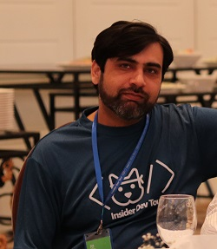
Trainer
Bilal Shahzad
Agilist/Architect/Teacher/Blogger/YouTuber
17+ Years of Professional Experience
MVP (Microsoft Most Valuable Professional)
MCT (Microsoft Certified Trainer)

Slide 3
How to Contact
https://www.linkedin.com/in/bilalshahzad139/
https://www.facebook.com/LearningInUrduCentre/
https://www.youtube.com/c/LearnInUrdu139
http://learninginurdu.pk
@bilalshahzad

Slide 4
Agenda
Version Control System
Introduction to Git
Introduction to Github
Introduction to GitFlow
FYP & Best Practices
Q&A

Slide 5
What is Version Management?
We all manage different versions of our files e.g. By creating copy of the file/folder and appending timestamp or numbers
In case something goes wrong, we dump the current version and use the last stable version
Cons:
Takes extra space
Hard to find changes between different versions
Hard to manage/merge changes if multiple people are working on same files/folders on their machines
What about backup?

Slide 6
Version Control System/Software
Manage different versions (snapshots) of your content
Provide option to see differentials
Change Tracking (Who made which change and when)
Help you in merging the changes if multiple people are working
It may allow you to store all changes + change history on some server. No need to worry if you lose your local content.
Other names
Version Management Software
Source Code versioning
Source Control Management (SCM)

Slide 7
Version Control System (cont…)
Local
Example: RCS
Centralized
A Server – Client Model
One user can work on an item by “locking” the item on server.
Change tracking/history is mainly done on server.
Examples: SVN (Subversion), TFS
Distributed
Each person works on its own local copy (as it is working on main repository). Changes are merged later. Server may also be used.
Examples: Git, Mercurial

Slide 8
Introduction to “git”
Distributed Version Control System
Free & Open Source
Primarily used for source code management but it can be used for any sets of files.
Created by Linus Torvalds in 2005.
Command line tool. But there are tools available with UI e.g. TortoiseGit, SourceTree
Major Design Goals
Distributed
Performance
Data Integrity

Slide 9
How you work with Git?
Step 1: Create Repository
Working directory
Step 2: Make Some changes
Add/Edit/Delete files etc.
Step 3: Move your changes to “Staging”
Changes become track-able
Step 4: Create Snapshot of your “Staged” Changes by “Commit”
Step 5: Repeat from Step 2

Slide 10
Installation of Git
Install Git
https://git-scm.com/downloads
It will install Git + Git UI + Git Bash
Install TortoiseGit
https://tortoisegit.org/download/
Notes:
https://www.youtube.com/watch?v=o5CtzVFVL4s&list=PL0kdOcU3HXGJeUEle0HbN2D6NHQff-vMv&index=3&ab_channel=LearnInUrdu
https://www.youtube.com/watch?v=tpxfXKHrJtA&list=PL0kdOcU3HXGJeUEle0HbN2D6NHQff-vMv&index=12&ab_channel=LearnInUrdu

Slide 11
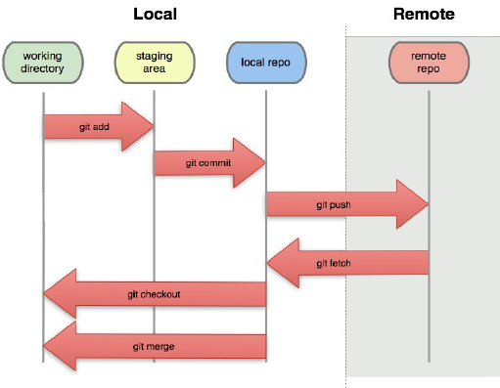

Slide 12
Demo 1
Create a Local Repository
Add Files
Commit
Revert
Log & Differential
master branch
Creating New branches
Switch to branch
Merge a branch to other branch

Slide 13
Remote Repository Manager
Git comes with “Git Server” for remote repositories
We’ve some Web-based Git repository hosting services.
Github (https://github.com/)
GitLab (https://about.gitlab.com/)
BitBucket (https://bitbucket.org/)

Slide 14
Github
A hub of open source projects.
Public & Private git Repositories
It offers its basic services free of charge
Advanced professional and enterprise services are commercial
Microsoft acquired Github in October 2018.

Slide 15
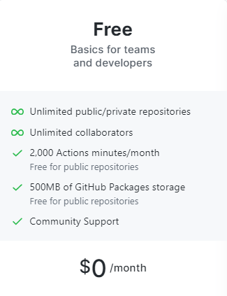

Slide 16
Demo2 - Github
Create a Remote Repository
Clone it
Add Files
Commit & Push
Pull & Fetch
master branch
Creating New branches
Switch to branch
Merge a branch to other branch
.gitignore

Slide 17
Demo 3
What is GitFlow
What is PULL Request
Merge changes using Pull Request
Conflict Resolution

Slide 18
Other Github Features
Issues
Label
Milestones
Projects
Public & Private Repositories
Wikis

Slide 19
MD (Markdown) Files
Markdown is a lightweight markup language with plain-text-formatting syntax
It is often used for formatting readme files
But you may do more with this
Famous sites provides formatting support using MD syntax

Slide 20
Gist
https://gist.github.com
To Manage/Share small snippets
At Backend, It manages content in a repository

Slide 21
Github Pages
https://pages.github.com/
One page per Project
One personal page per account

Slide 22
Github Actions
https://github.com/features/actions
To automate different actions in github

Slide 23
GitHub Student Developer Pack
https://education.github.com/benefits
https://education.github.com/pack
Applying for a student developer pack
https://docs.github.com/en/free-pro-team@latest/github/teaching-and-learning-with-github-education/applying-for-a-student-developer-pack

Slide 24
FYP Management - Branching
Create a Repository for your FYP.
You may create more for different sub projects if any.
You will have master/main as default branch.
Create develop branch from master/main
Then create feature branches from develop.
A person will work on her feature branch and then will create Pull Request (PR) to merge her changes to develop branch.

Slide 25
FYP Management - Issues
Create issues for your product backlog
Images, Links etc. can be added in Issues.
Other issues can be mentioned by prefixing # sign
A person can be mentioned by prefixing @ sign
Create labels to categorize issues type, status etc.
Use milestone feature for sprints

Slide 26
Best Practices - Commit
A commit should be single purpose & meaningful.
Add proper comments with commit.
Don’t commit generated files.
Add them in gitignore.
It is very common mistake to miss ‘adding’ new files in ‘tracking’.
Newly created files don’t become part of tracking automatically.

Slide 27
Best Practices - Commit
Don’t commit & push your production secret keys (e.g. login, passwords in connection strings)
Don’t commit/push temporary configuration changes e.g. web.config
Make sure you commit & push your work before leaving your system.

Slide 28
Best Practices - Branching
Try to work on your separate feature branch
Giving meaningful name to branch.
feature/signup-screen
feature/Issue-1234-signup
Don’t stay away from ‘develop’ branch for too long.
Either merge your changes to develop as soon as possible or pull develop in your feature branch.

Slide 29
Best Practices – Pull Request
Create Pull Request for Review.
Add Proper summary, links in PR
Mention Github Issue # in Summary
Assign Reviewer
Check & Resolve Conflicts
Try to get your PR accepted as soon as possible. Ping the person, get feedback & fix it.
Check PRs created by other team members to learn what is done so far

Slide 30
Best Practices - Github
Create MD files for documentation purpose.
For example ReadMe.MD to give introduction of project, how to setup etc.
For knowledge base
Use Github actions to automate things
(e.g. deployment, code analysis, email notifications)
Create Github site/page for your Project repository
Use gists to create small snippets for yourself or for team or for future.

Slide 31
Best Practices - Other
Use some tool for team communication e.g. Slack is good option
Research & Use Mockups tool to create rough mockup
Always look if someone has done the same work in Open Source community.
Look for other open source projects on Github to learn how community contributes to an Open Source Project.

Slide 32
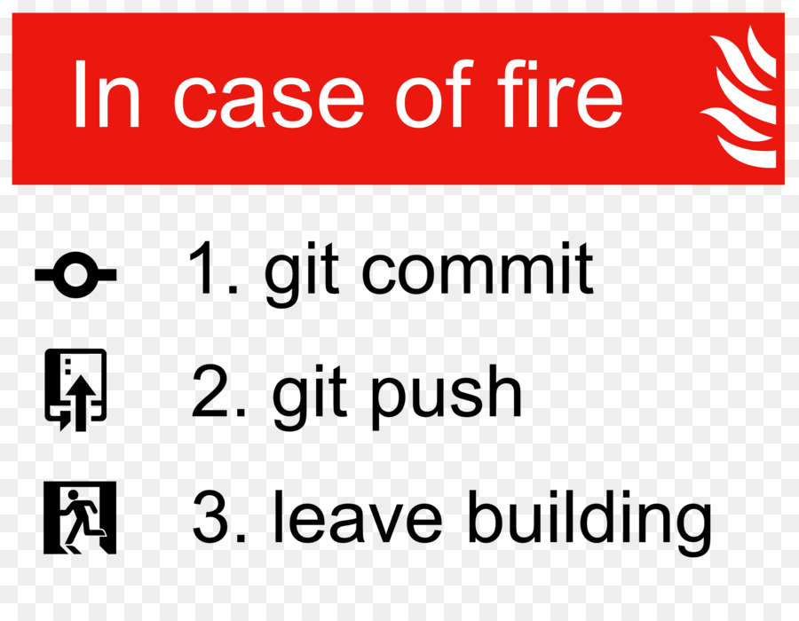

Slide 33
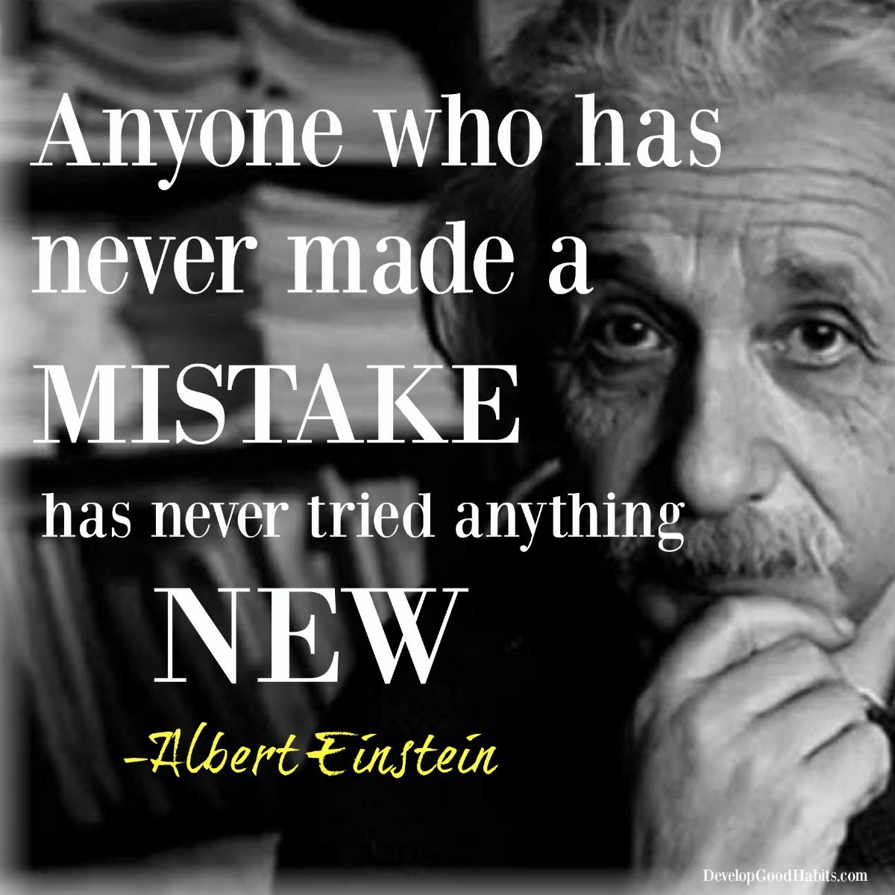

Slide 34


Slide 35


Slide 36


Last but not the least

Slide 37
Feedback Form
https://docs.google.com/forms/d/e/1FAIpQLSeM3q8_zAuE99lqYa-jXdvZEQKNUkSrGGBWfY8J9b9YBtTCWw/viewform

Slide 38


Slide 39
What is Next?
Introduction to JIRA for Students – FYP
https://www.atlassian.com/try/cloud/signup?bundle=jira-software&edition=free
Automation & DevOps

Slide 40
How to Contact
https://www.linkedin.com/in/bilalshahzad139/
https://www.facebook.com/LearningInUrduCentre/
https://www.youtube.com/c/LearnInUrdu139
http://learninginurdu.pk
@bilalshahzad

Slide 41
Thank You

