Slide 1
Intro to Containerization with Docker
Bilal Shahzad

Slide 2
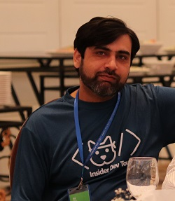
Trainer
Bilal Shahzad
Agilist/Architect/Teacher/Blogger/YouTuber
17+ Years of Professional Experience
MVP (Microsoft Most Valuable Professional)
MCT (Microsoft Certified Trainer)

Slide 3
How to Contact
https://www.linkedin.com/in/bilalshahzad139/
https://www.facebook.com/LearningInUrduCentre/
https://www.youtube.com/c/LearnInUrdu139
http://learninginurdu.pk
@bilalshahzad

Slide 4
Agenda
Background of Virtualization
Introduction to Docker
Image vs. Container
Docker Registry (e.g. Docker Hub)
Q&A

Slide 5
Background
Before Virtualization
Single OS per Machine
Software & Hardware tightly coupled
Running multiple applications on same machine may creates conflicts
Inflexible & costly infrastructure

Slide 6
Virtualization
Virtualization is “abstraction” of computer resources.
Giving illusion that X (e.g. OS) is running on real hardware
Types
Server Virtualization
Desktop Virtualization
Application Virtualization
Memory
Storage
Data
Network

Slide 7
Docker
Docker Inc.
https://www.docker.com/
Docker is a set of platform as a service products that use OS-level virtualization to deliver software in packages called containers.
Written in GO.
Initial Release date: March 20, 2013.

Slide 8
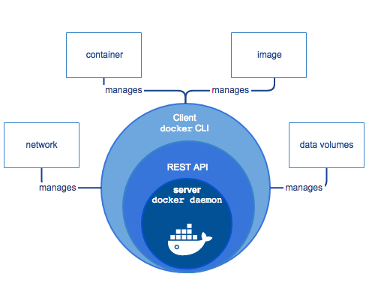
Components
Notes:
Note: Image is copied from Internet (docker site)

Slide 9
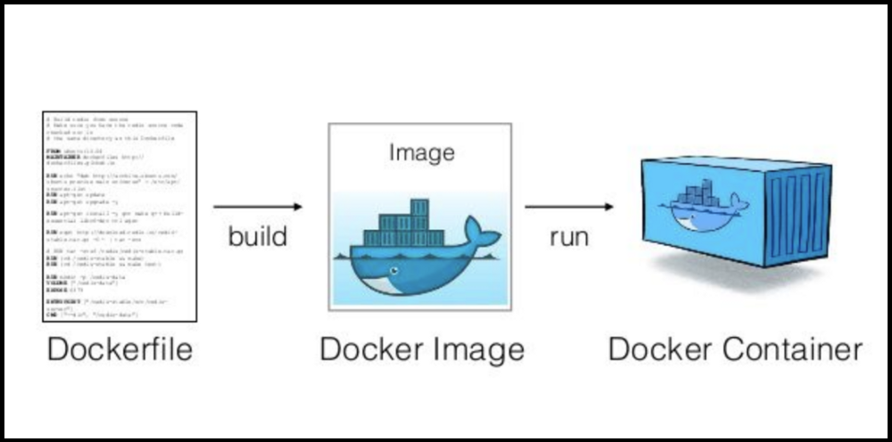
Image vs. Container
Notes:
Note: Image is copied from Internet

Slide 10
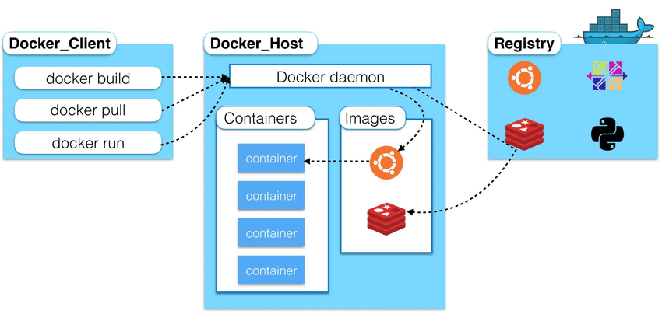
High Level Overview
Notes:
Note: Image is copied from Internet

Slide 11
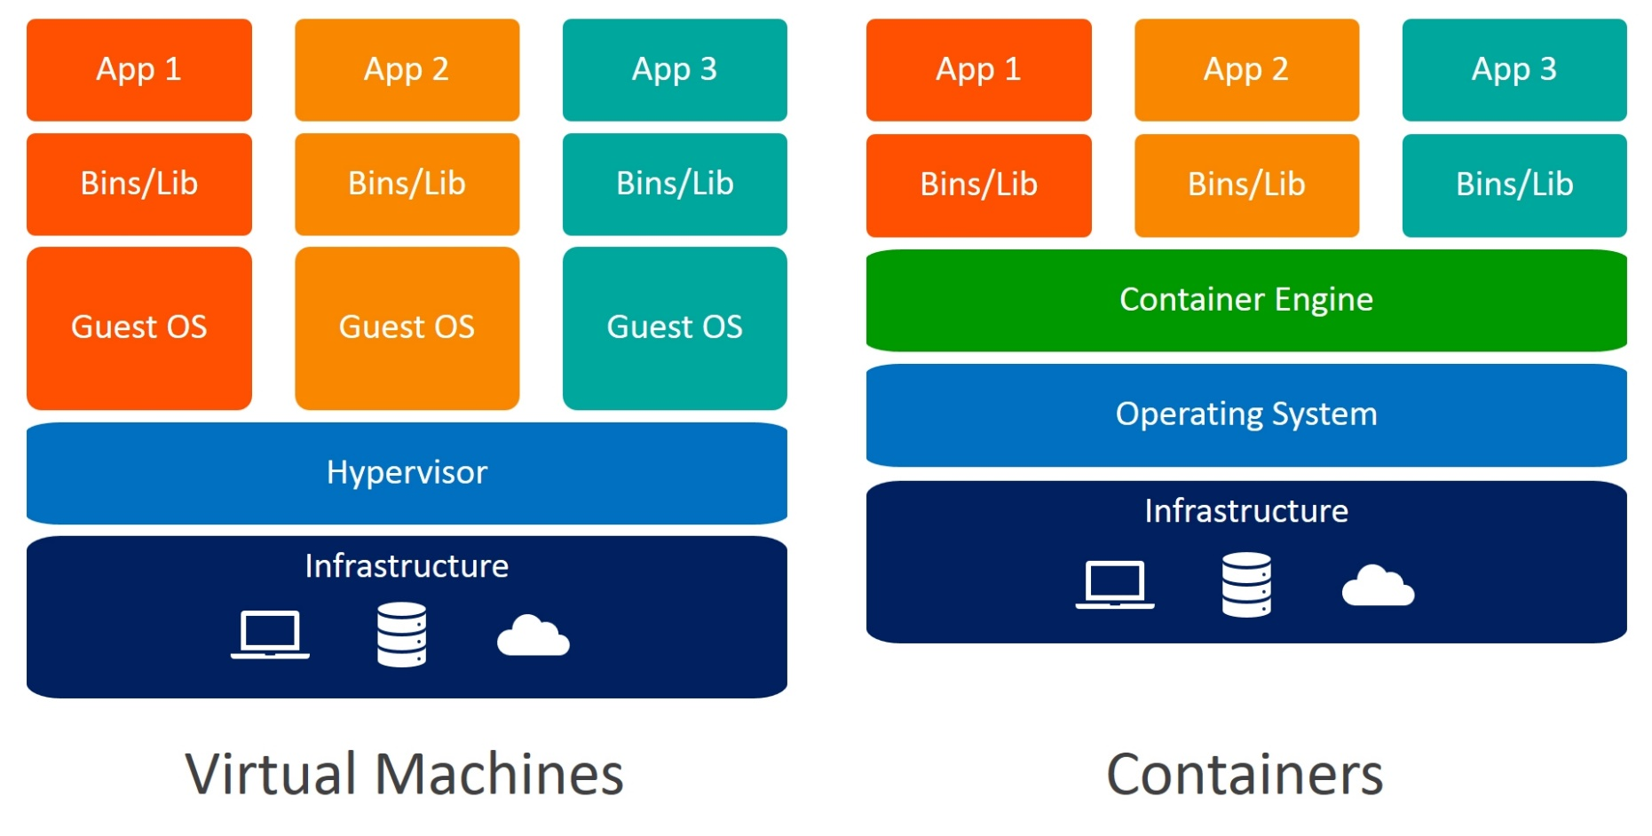
Virtualization vs. Containerization
Notes:
Note: Image is copied from Internet

Slide 12
Docker Installation
https://docs.docker.com/get-docker/
Docker for Linux
Community Version
Enterprise Version
Docker Desktop for Windows
Community Version (Windows 10)
Windows Server 2016+
Docker Desktop for Mac

Slide 13
Before Demos
You should have some interest & knowledge of Linux (or any CLI)
Containers work in a sandbox (black box) environment.
As a creator, you need to “expose” ports
As a user, you need to map “exposed” ports.
Containers don’t store things permanently (automatically). You need to mount the volumes with host.
Some understanding of Networking

Slide 14
Dome 1 (Pull & Run)
Pull an image and store in docker cache
docker pull nginx:latest
To check available images
docker image ls
Run container with a name and expose port 80 on 8081 in detached mode (-d)
docker run --name mywebserver -d -p 8081:80 nginx:latest
Stop container
docker container stop mywebserver
Stop & remove a container
docker container rm -f mywebserver

Slide 15
Dome 2
Agenda: Understanding that docker writeable layer is temporary

Slide 16
Dome 3
Agenda: How to use volumes to persist docker data

Slide 17
Dome 4
Agenda: Create your own nginx image with content inside it

Slide 18
Dome 5
Agenda: Create Image & push to docker hub

Slide 19
Dome 6
Agenda: Save & Load Image from a file

Slide 20
Dome 7
Agenda: Playing with a node application without docker

Slide 21
Dome 8
Agenda: Playing with node application but using docker image for Node Environment

Slide 22
Dome 9
Agenda: Package node app in a docker image

Slide 23
Dome 10
Agenda: Install MySQL & connect from workbench

Slide 24
Dome 11
Agenda: Connect NodeJS app container with Mysql container

Slide 25
Dome 12
Agenda: Connect NodeJS app with Mysql container

Slide 26
Dome 13
Agenda: Run containers with user defined network (instead of default)
Notes:
https://docs.docker.com/network/bridge/https://docs.docker.com/network/bridge/

Slide 27
Dome 14
Agenda: Use docker-compose to start web & db
Notes:
https://docs.docker.com/network/bridge/https://docs.docker.com/network/bridge/

Slide 28
Dome 15
Agenda: Run PHP-Apache container for development
Notes:
https://docs.docker.com/network/bridge/https://docs.docker.com/network/bridge/

Slide 29
Dome 16
Agenda: Setup PHp/Apache/MySQL Dev Env using docker-compose
Notes:
https://docs.docker.com/network/bridge/https://docs.docker.com/network/bridge/

Slide 30
Dome 17
Agenda: Discussion on dotnet & Windows containers
Notes:
https://docs.docker.com/network/bridge/https://docs.docker.com/network/bridge/

Slide 31
Dome 18
Agenda: Just create image using sdk:5.0 as base image + WORKDIR
Notes:
https://docs.docker.com/network/bridge/https://docs.docker.com/network/bridge/

Slide 32
Dome 19
Agenda: Build & run dotnet code after going inside container
Notes:
https://docs.docker.com/network/bridge/https://docs.docker.com/network/bridge/

Slide 33
Dome 20
Agenda: Create image with published content
Notes:
https://docs.docker.com/network/bridge/https://docs.docker.com/network/bridge/

Slide 34
Dome 21
Agenda: Create image for .NET Framework with published content
Notes:
https://docs.docker.com/network/bridge/https://docs.docker.com/network/bridge/

Slide 35
Bonus Demo
Agenda: Check quickly what is gitpod
https://gitpod.io/
Notes:
https://docs.docker.com/network/bridge/https://docs.docker.com/network/bridge/

Slide 36
FAQs
Is Docker only runtime for containers?
No, there are many others now. For example https://containerd.io/
What is Kubernetes?
Containers orchestrator
What is Moby Project?
https://mobyproject.org/

Slide 37
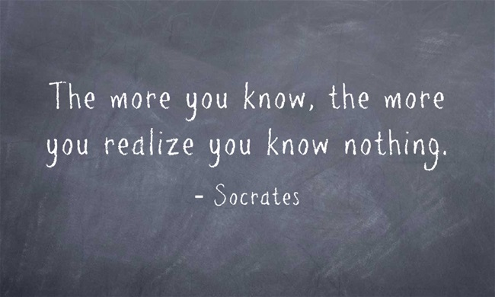
Last but not the least

Slide 38
Links
For Feedback
https://tinyurl.com/y634lxbb
For Helping Material
https://github.com/bilalshahzad139/first-step-towards-professional-career

Slide 39
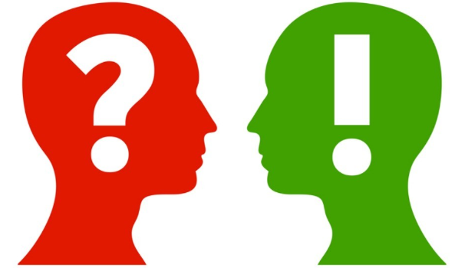

Slide 40
What is Next?
Automation & DevOps

Slide 41
How to Contact
https://www.linkedin.com/in/bilalshahzad139/
https://www.facebook.com/LearningInUrduCentre/
https://www.youtube.com/c/LearnInUrdu139
http://learninginurdu.pk
@bilalshahzad

Slide 42
Thank You

