Slide 1
Introduction to GitHub Actions
Bilal Shahzad

Slide 2

Me
Bilal Shahzad
Agilest/Architect/Teacher/Blogger/YouTuber
MVP (Microsoft Most Valuable Professional)
MCT (Microsoft Certified Trainer)

Slide 3
How to Contact
https://www.linkedin.com/in/bilalshahzad139/
https://www.facebook.com/LearningInUrduCentre/
https://www.youtube.com/c/LearnInUrdu139
http://learninginurdu.pk
@bilalshahzad

Slide 4
Agenda
What is DevOps
CI vs. CD vs. CD
GitHub Actions
Components of GitHub Actions
Demos
Q&A

Slide 5
DevOps
DevOps is a set of practices that combines software development (Dev) and IT operations (Ops). It aims to shorten the systems development life cycle and provide continuous delivery with high software quality.
DevOps is complementary with Agile software development; several DevOps aspects came from the Agile methodology.

Slide 6
DevOps
Key is Automation!
Find ways to execute things from CLI

Slide 7
CI vs. CD vs. CD
Continuous Integration (CI): A DEV practice to integrate code into a shared repository several times a day. Automated Tests are run on every integration.
Continuous Delivery (CD): Continuous delivery is an extension of CI to make sure that you can release new changes to your customers quickly in a sustainable way.
Continuous Deployment (CD): With this practice, every change that passes all stages of your production pipeline is released to your customers. There's no human intervention.

Slide 8
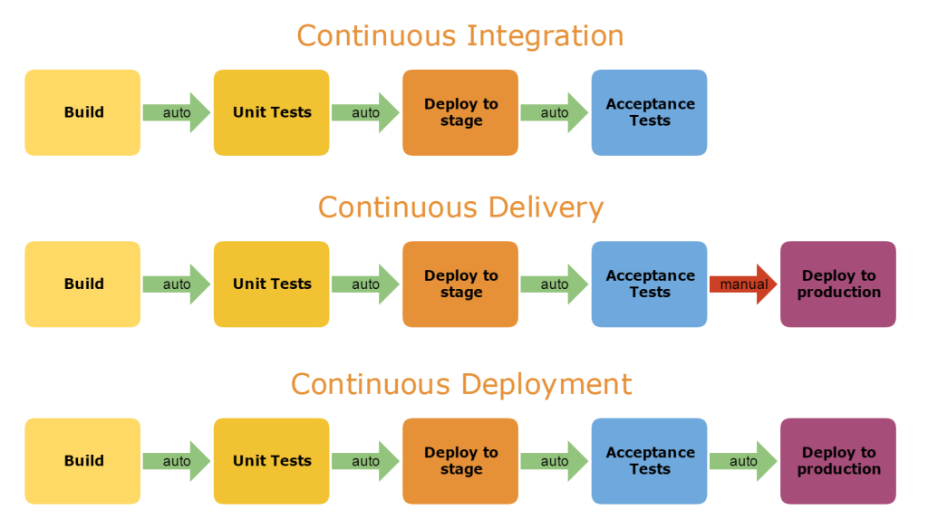
CI vs. CD vs. CD

Slide 9
GitHub Actions
Integrated CI/CD in GitHub
Linux, macOS, Windows, ARM, and containers
GitHub Actions supports Node.js, Python, Java, Ruby, PHP, Go, Rust, .NET, and more. Build, test, and deploy applications in your language of choice.
Built in secret store
Free for Public Repositories
Notes:
https://github.com/marketplace?type=actions

Slide 10
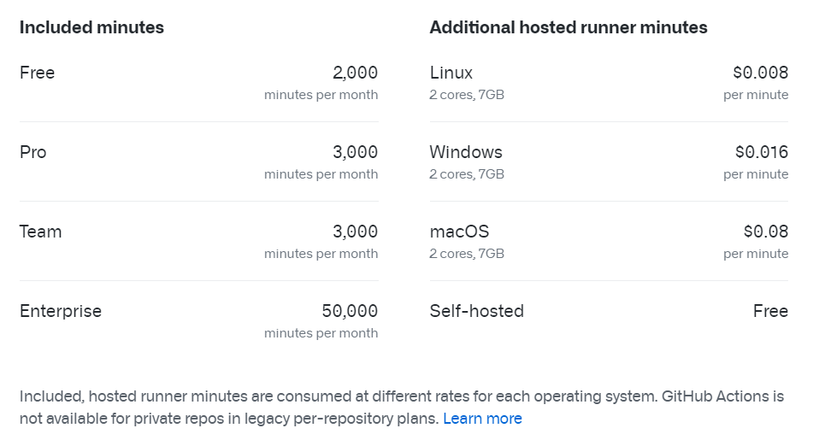
Private Repositories

Slide 11
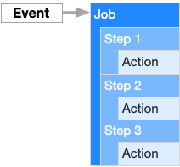
GitHub Actions
Help you automate tasks
Event-driven, meaning that you can run a series of commands after a specified event has occurred.
Notes:
https://github.com/marketplace?type=actions

Slide 12
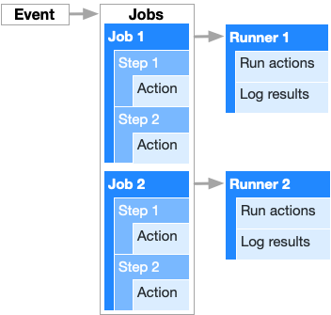
Components of GitHub Actions
Notes:
https://github.com/marketplace?type=actions

Slide 13
Components of GitHub Actions
Workflows
Events
Jobs
Steps
Actions
Runners
Notes:
https://github.com/marketplace?type=actions

Slide 14
Workflows
Workflows are made up of one or more jobs and can be scheduled or triggered by an event.
We create workflows in YML files
Notes:
https://github.com/marketplace?type=actions

Slide 15
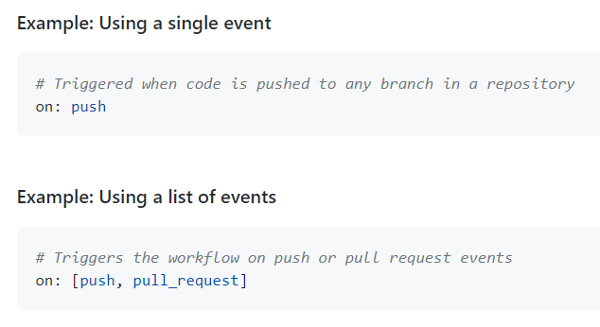
Events
An event is a specific activity that triggers a workflow.
Notes:
https://github.com/marketplace?type=actions

Slide 16
Jobs
A set of steps that execute on the same runner.
By default, a workflow with multiple jobs will run those jobs in parallel.
You can also configure a workflow to run jobs sequentially.
Notes:
https://github.com/marketplace?type=actions

Slide 17
Steps
A step is an individual task that can run commands in a job.
A step can be either an action or a shell command.
Each step in a job executes on the same runner, allowing the actions in that job to share data with each other.
Notes:
https://github.com/marketplace?type=actions

Slide 18
Actions
Actions are standalone commands that are combined into steps to create a job.
Actions are the smallest portable building block of a workflow.
You can create your own actions, or use actions created by the GitHub community.
Thousands of Actions in GithHub Marketplace
To use an action in a workflow, you must include it as a step.
Notes:
https://github.com/marketplace?type=actions

Slide 19
Runners
A runner is a server that has the GitHub Actions runner application installed
You can use a runner hosted by GitHub, or you can host your own.
A runner listens for available jobs, runs one job at a time, and reports the progress, logs, and results back to GitHub.
GitHub-hosted runners are based on Ubuntu Linux, Microsoft Windows, and macOS, and each job in a workflow runs in a fresh virtual environment.
Notes:
https://github.com/marketplace?type=actions

Slide 20
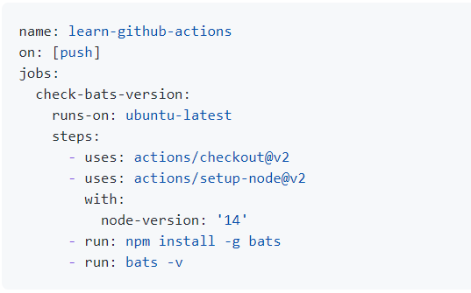
Sample workflow
Notes:
https://github.com/marketplace?type=actions

Slide 21
Demo 1
Creating a new workflow

Slide 22
Demo 2
A simple workflow to print NPM Version
https://github.com/bilalshahzad1392/GHActionsRepo1
myfirstworkflow.yml

Slide 23
Demo 3
Push & pull_request event
workflow_dispatch event
Executing single line & multi line commands
https://github.com/bilalshahzad1392/GHActionsRepo1
secondworkflow.yml

Slide 24
Demo 4
Schedule Event
https://github.com/bilalshahzad1392/GHActionsRepo1
scheduled-workflow.yml

Slide 25
Demo 5
Execute workflows based on changes in specific files/paths
https://github.com/bilalshahzad1392/GHActionsRepo1
paths-workflow.yml

Slide 26
Demo 6
Executing a workflow for Deployment
Build, Create Artifacts
Deploy in Azure
Check Secrets
Show Environment -> Enable approval for deployment
https://github.com/bilalshahzad1392/dotnet5
main_mytestappforgh.yml

Slide 27
Demo 7
Executing a workflow for Pull Requests
Build & Test dotnet core application
https://github.com/bilalshahzad1392/dotnet5
Pr-verify.yml

Slide 28
Demo 8
Workflow for NodeJS application
Deployment in Azure
https://github.com/bilalshahzad1392/nodejs-docs-hello-world
Pr-verify.yml

Slide 29


Slide 30
References
https://docs.github.com/en/actions/learn-github-actions/understanding-github-actions
https://docs.github.com/en/actions/learn-github-actions/workflow-syntax-for-github-actions
https://docs.github.com/en/actions/learn-github-actions/events-that-trigger-workflows

Slide 31
Thank You

