Slide 1
TypeScript
Learn TypeScript with Bilal Shahzad
21/10/19

Slide 2




Trainer
16+ Years of Professional Experience
Teacher/Blogger/YouTuber
Multiple Certifications
Awarded with MVP & MCT awards Multiple times
Manage LearningInUrdu.pk

Slide 3

How to Contact
https://www.linkedin.com/in/bilalshahzad139/
https://www.facebook.com/LearningInUrduCentre/
https://www.youtube.com/c/LearnInUrdu139
http://learninginurdu.pk
@bilalshahzad

Slide 4
Agenda
Quick overview of ECMAScript
Introduction to Typescript
Data Types
Variables Declaration
Interfaces
Classes, Inheritance, Access Modifiers
Functions, Arrow Function

Slide 5
Prerequisites
Install VS Code or any other editor of your choice
Install Latest Version (LTS) of NodeJS
https://nodejs.org/en/download/
Should have basic understanding of JavaScript and OOP

Slide 6
ECMAScript or ES - Background
Scripting Language Specification
Created to Standardize JavaScript
JavaScript is the best-known implementation of ES
While JavaScript is compatible with ES, it provides additional features
ES First Appeared in 1997.
JavaScript came in 1995 and became ECMA compliant in 1997.

Slide 7
ECMAScript or ES - Versions
Since 2015, naming of versions is standardized. Every year, a new version is coming.
5th Version or ES5 or (ECMAScript 2009)
6th Version or ES6 or (ECMAScript 2015)
7th Version or ES7 or (ECMAScript 2016)
8th Version or ES8 or (ECMAScript 2017)
9th Version or ES9 or (ECMAScript 2018)
10th Version or ES10 or (ECMAScript 2019)
ES.Next is a dynamic name that refers to whatever the next version is at the time of writing

Slide 8
ES5 vs. ES6
Check
https://www.w3schools.com/js/js_versions.asp
https://www.w3schools.com/js/js_es5.asp
https://www.w3schools.com/js/js_es6.asp

Slide 9
Issues with JavaScript
It becomes complex while developing bigger projects.
Trying to achieve “Object Oriented Programming” creates more complexity.
Dynamic Type Checking: Type checking is done at run time. It is error prone.
Static Type Checking (compile time checking)
IDE intellisense support is not good
Which features to use as a developer? ES5 or ES6 or latest?

Slide 10
Improvements?
Introduce Object Oriented features/syntax like we’ve in C# or Java?
Provide Compile time syntax checking?
Better IDE Support?
Use latest ES Features? What if all browsers had not implemented those yet? Or We want to downgrade our code to older ES version?
What if want to have additional features not defined by ES yet?

Slide 11
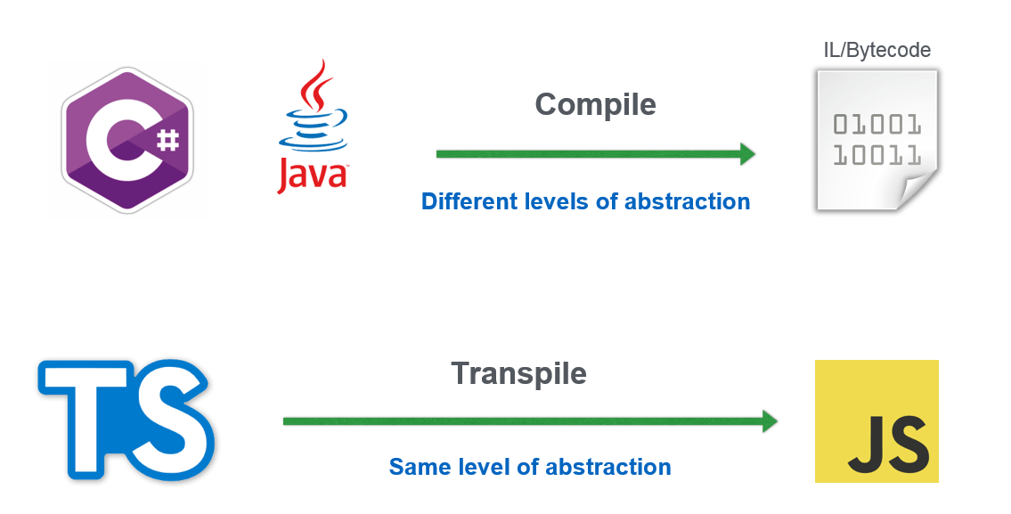
A Solution - Transpiler

Slide 12
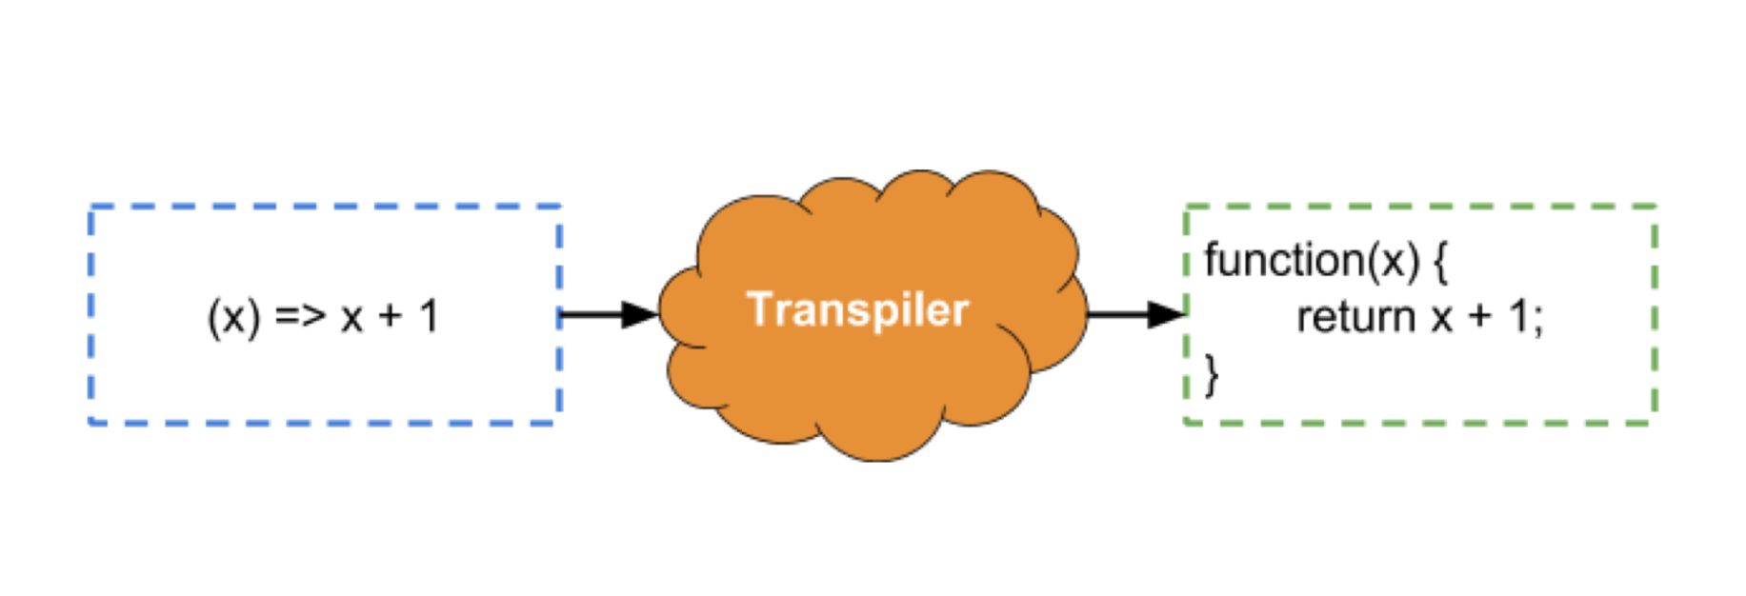
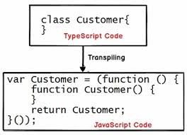
A Solution – Transpiler

Slide 13
TypeScript
Typed Superset of JavaScript
Any Existing JavaScript is valid TypeScript code.
It is a language “extension”
Compiles (Transpiles) to Plain JavaScript
Transpiler: Source to Source Compiler
Open source programming language by Microsoft
Can be used in any JS host (e.g. Browser, NodeJS applications)
First Appeared in 2012. Current Version is 3.6.3
https://www.typescriptlang.org
Many JS Frameworks now supports TypeScript

Slide 14
TypeScript
Data Types, type assertion
var vs. let vs. const
Type checking, Interface
Class, access modifiers, inheritance
Arrow Functions

Slide 15
Installation
Install NodeJS (LTS)
https://nodejs.org/en/
npm install -g typescript
Save file with “.ts” extension
To compile (e.g. first.ts file)
tsc first.ts
tsc -init (to create tsconfig.json)
tsc -w (To Add watcher to automatically compile when TS file changes)
Visual Studio Code
https://code.visualstudio.com/docs/languages/typescript

Slide 16


Slide 17
Thank You

