Slide 1
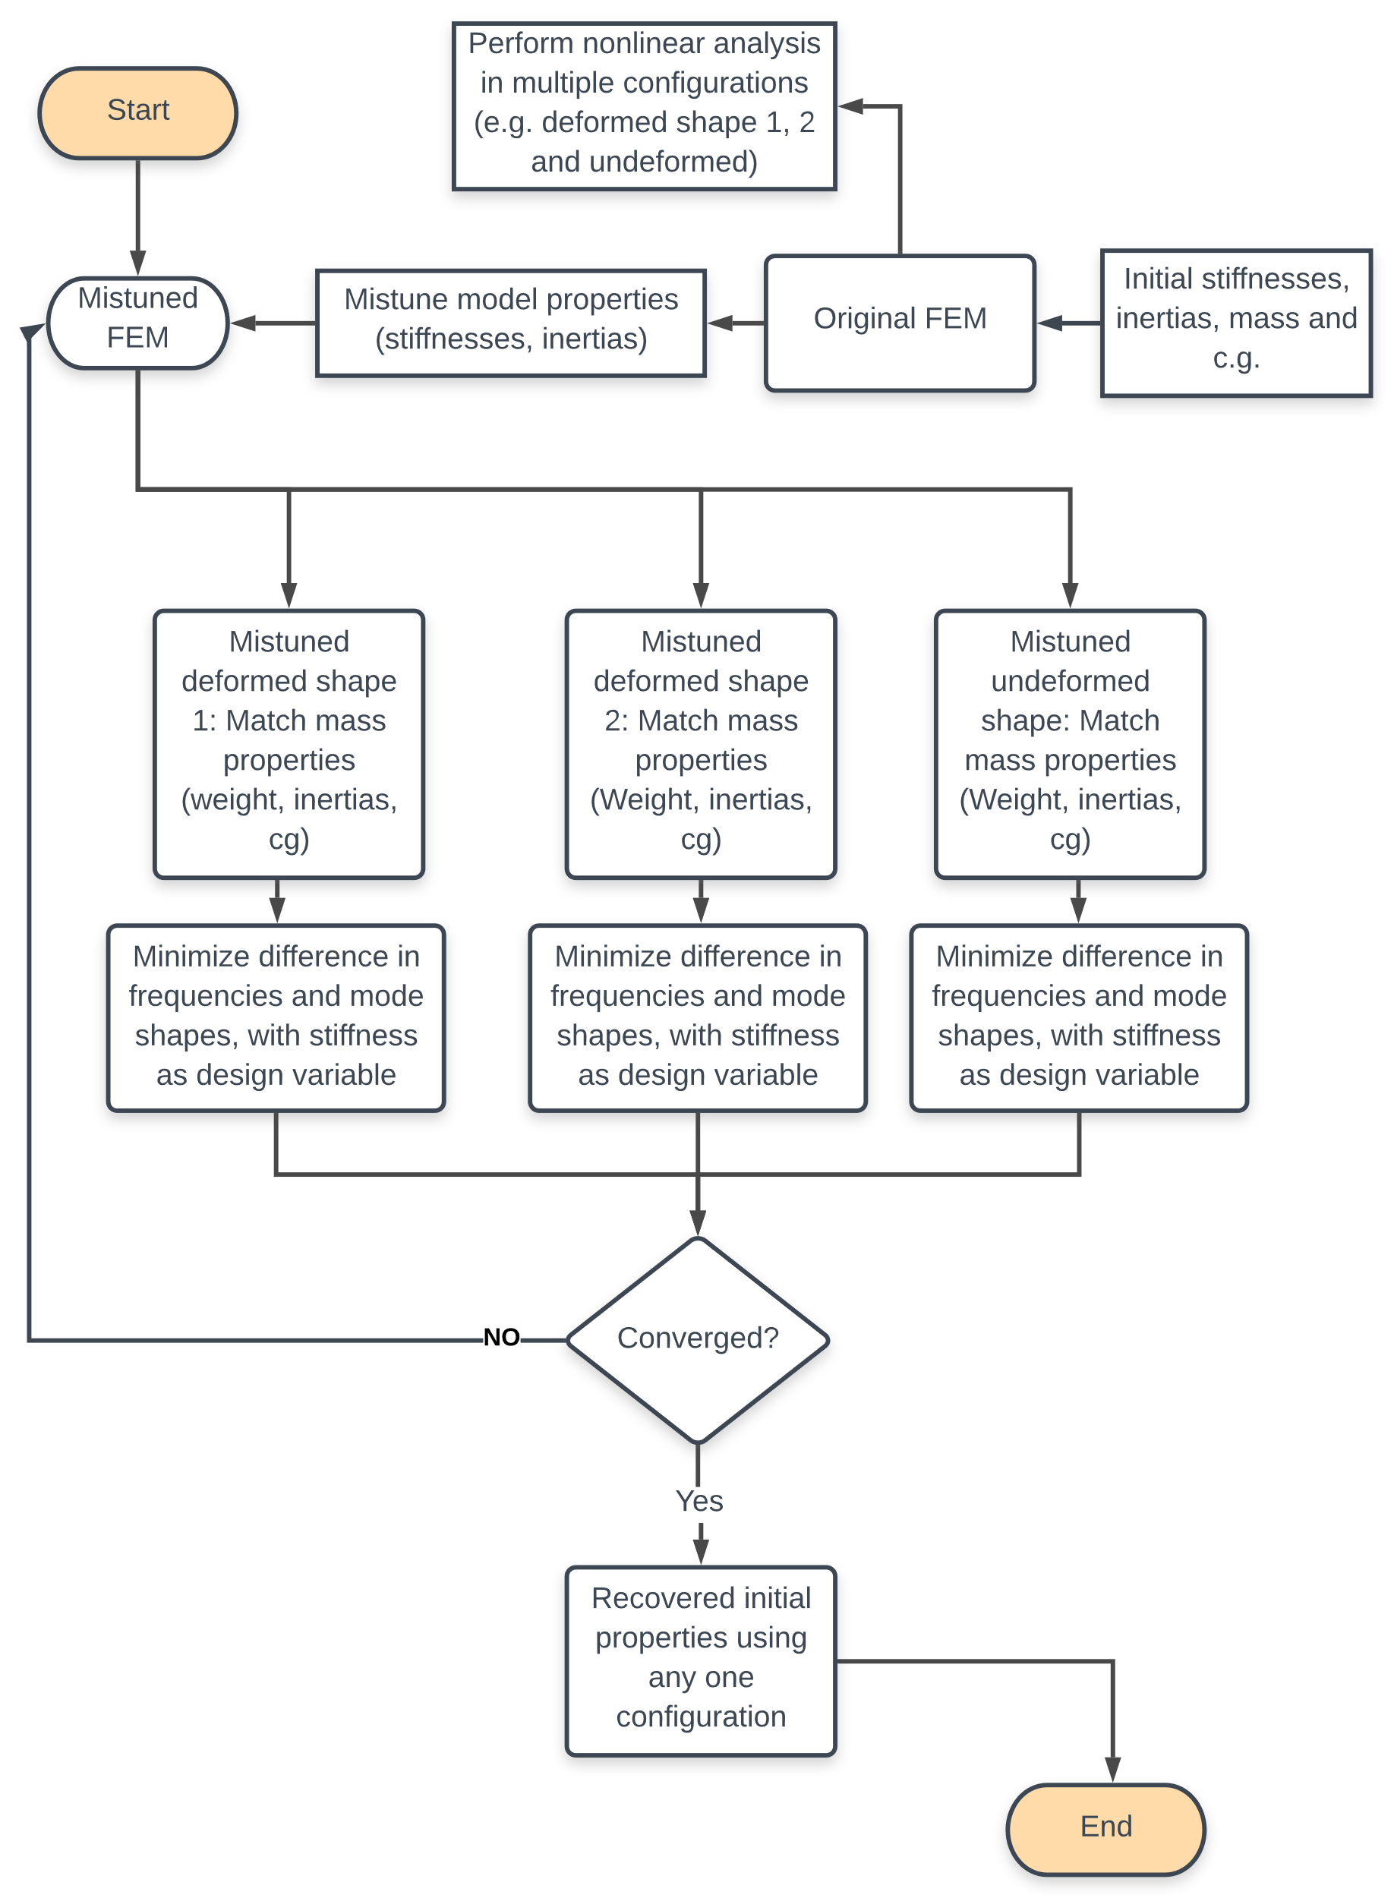
Flowchart: model updating from different deformed configurations
Problem : It is currently not well known how to update FEM of VFA, particularly how many deformed conditions are needed for a geometrically nonlinearly deforming structure
Most structural optimization problems in literature using GVT data use Nastran SOL200
Some use OpenMDAO or genetic algorithms
These are all for non-very flexible structures
Initial claim (and still used here) is that once the model is tuned from any “mistuned” deformed shape using its equivalent original deformed shape as the basis for modes and shapes, the original FEM properties can be recovered
Stage 1
Stage 2

Slide 2
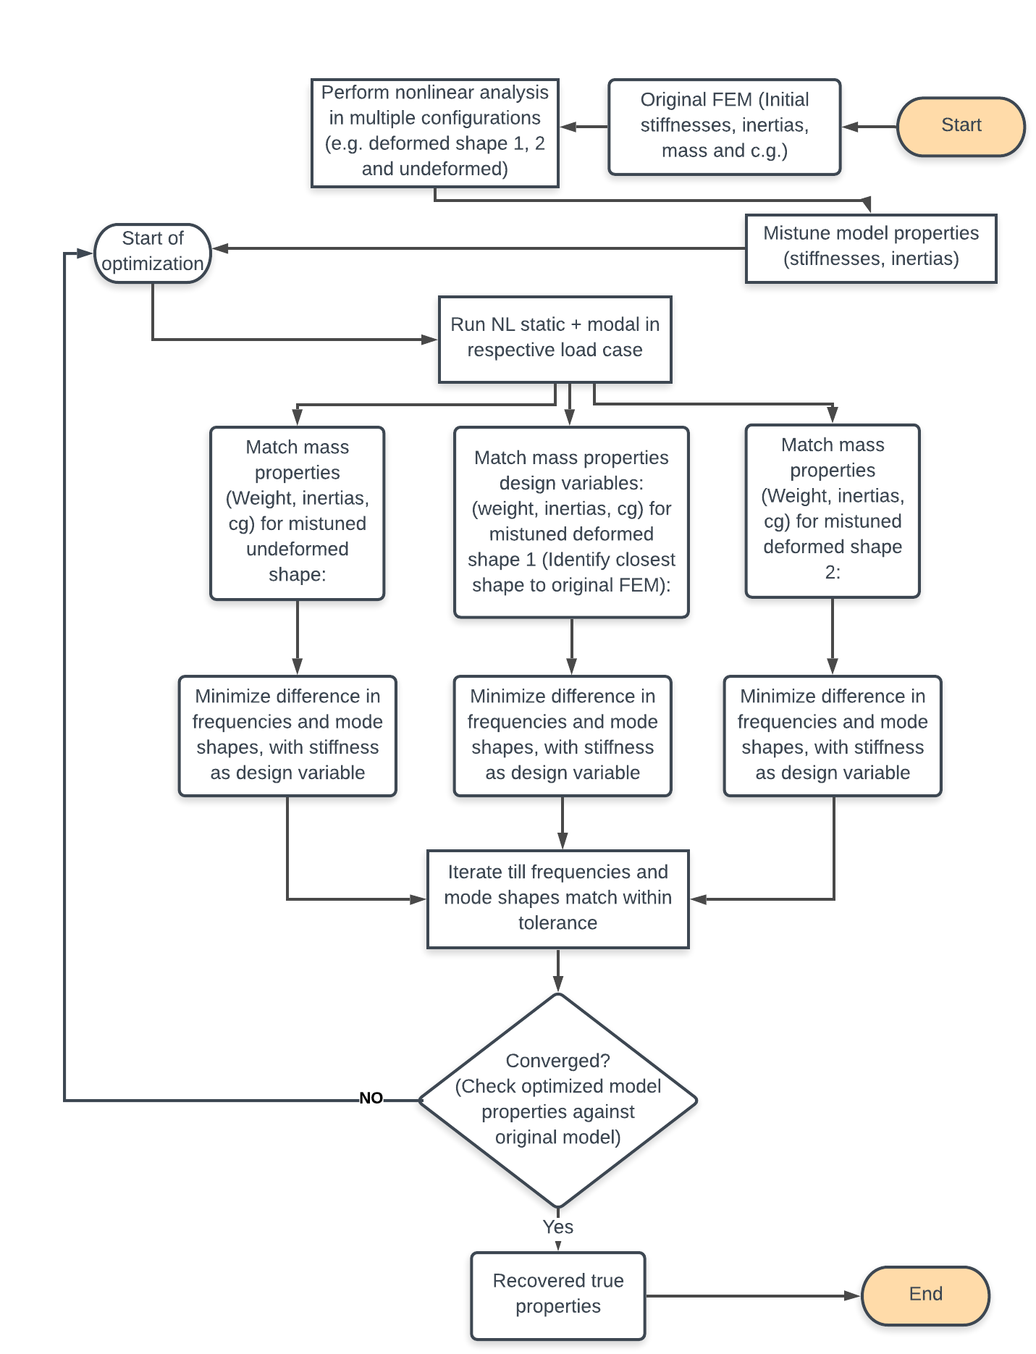
Flowchart: model updating from different deformed configurations
Problem : It is currently not well known how to update FEM of VFA, particularly how many deformed conditions are needed for a geometrically nonlinearly deforming structure
Most current structural optimization problems in literature using GVT data use Nastran SOL200
Some use OpenMDAO or genetic algorithms
These are all for non-very flexible structures
Initial claim (and still used here) is that once the model is tuned from any “mistuned” deformed shape using its equivalent original deformed shape as the basis for modes and shapes, the original FEM properties can be recovered
Stage 1
Stage 2

Slide 3
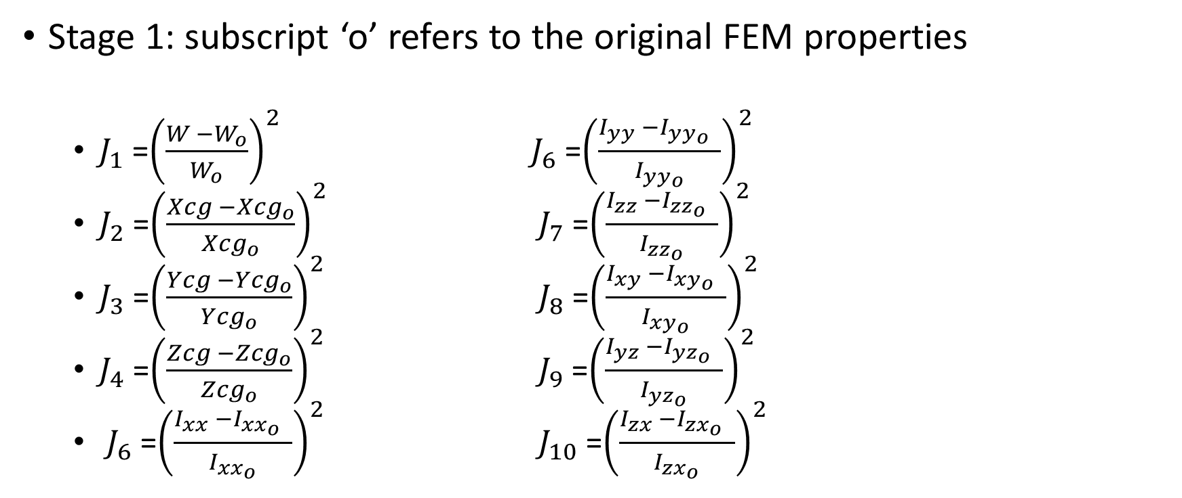
Cost functions to be minimized
Stage 1: subscript ‘o’ refers to the original FEM properties
$J_{1}$ =${\left(\frac{W −W_{o}}{W_{o}}\right)}^{2}$ $J_{6}$ =${\left(\frac{I_{yy} −{I_{yy_{o}}}_{ } }{I_{yy_{o}}}\right)}^{2}$
$J_{2}$ =${\left(\frac{Xcg −{Xcg}_{o}}{{Xcg}_{o}}\right)}^{2}$ $J_{7}$ =${\left(\frac{I_{zz} −{I_{zz_{o}}}_{ } }{I_{zz_{o}}}\right)}^{2}$
$J_{3}$ =${\left(\frac{Ycg −{Ycg}_{o}}{{Ycg}_{o}}\right)}^{2}$ $J_{8}$ =${\left(\frac{I_{xy} −{I_{xy_{o}}}_{ } }{I_{xy_{o}}}\right)}^{2}$
$J_{4}$ =${\left(\frac{Zcg −{Zcg}_{o}}{{Zcg}_{o}}\right)}^{2}$ $J_{9}$ =${\left(\frac{I_{yz} −{I_{yz_{o}}}_{ } }{I_{yz_{o}}}\right)}^{2}$
$J_{6}$ =${\left(\frac{I_{xx} −{I_{xx_{o}}}_{ } }{I_{{xx}_{o}}}\right)}^{2}$ $J_{10}$ =${\left(\frac{I_{zx} −{I_{{zx}_{o}}}_{ } }{I_{{zx}_{o}}}\right)}^{2}$

Slide 4

Stage 2
$J_{11}=\sum_{i=1}^{n}{{\left(\frac{ω_{i} −{ω_{i}}_{o}}{{ω_{i}}_{o}}\right)}^{2}}$ where n is the number of modes to be matched
$J_{12}=\sum_{i=1}^{m}{\sum_{j=1}^{n}{{\left(φ_{ij} −{φ_{ij}}_{o}\right)}^{2}}}$ - like using MAC

Slide 5
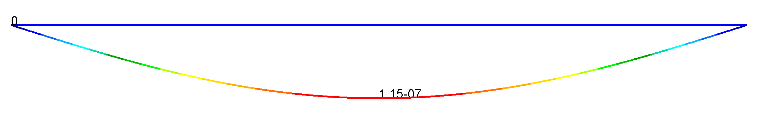
Nl beam 0g

Slide 6
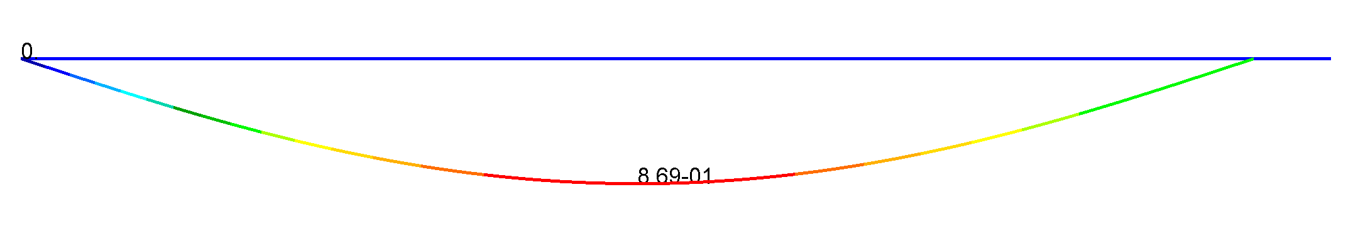
Nl beam 1g

Slide 7
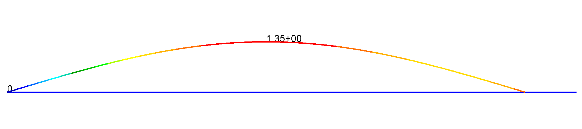
Nl beam -2.5g

Slide 8
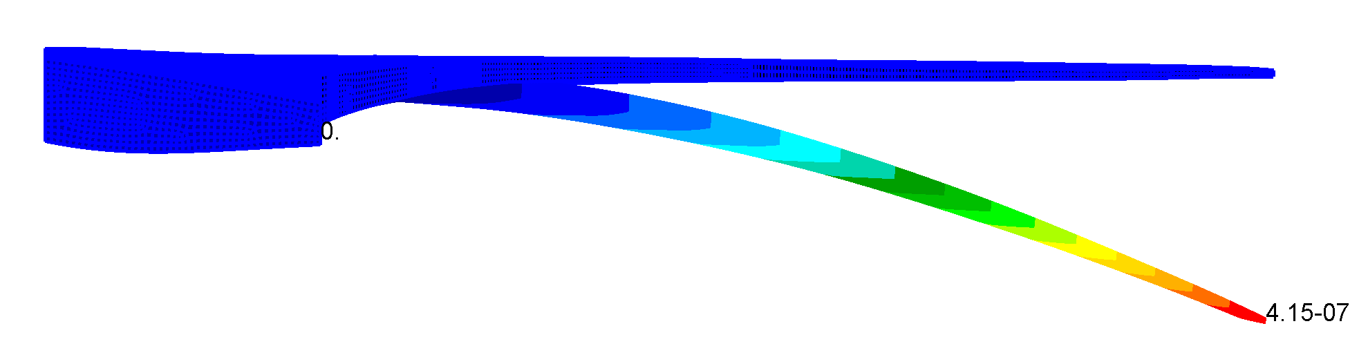
uCRM 10^-6 g

Slide 9
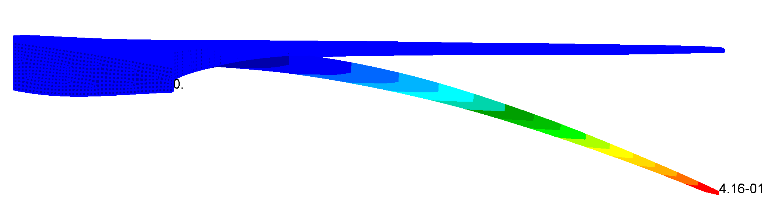
uCRM 1g

Slide 10
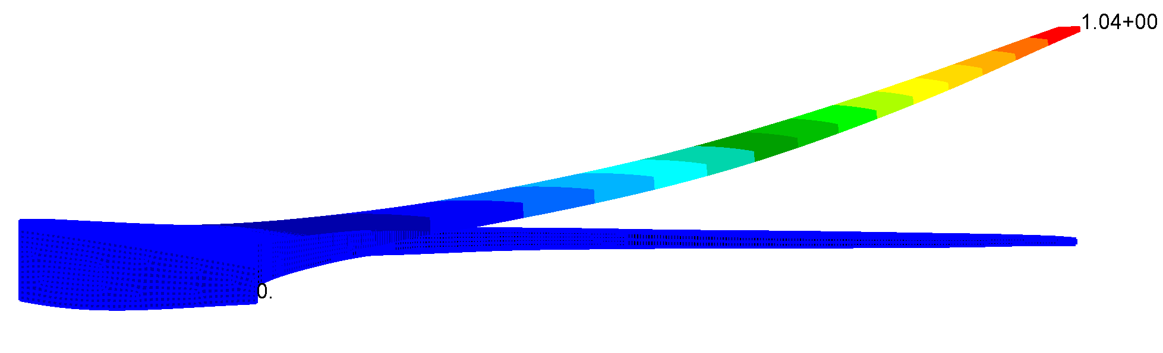
uCRM -2.5g

Slide 11
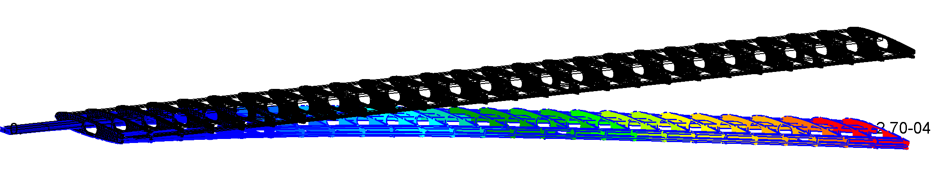
ASE Wing 10^-6 g

Slide 12
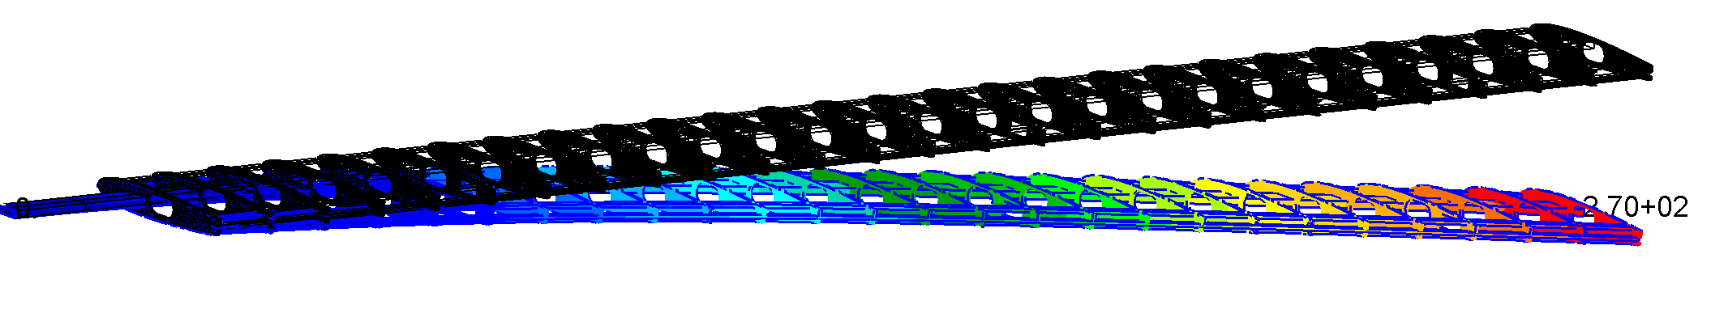
ASE Wing 1g

Slide 13
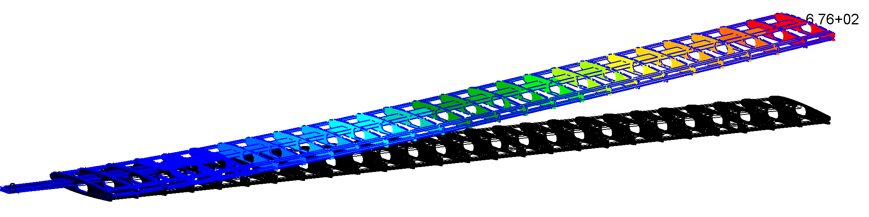
ASE Wing -2.5g

