Slide 1
X-HALE Mass and balance
Winter-Summer 2019

Slide 2
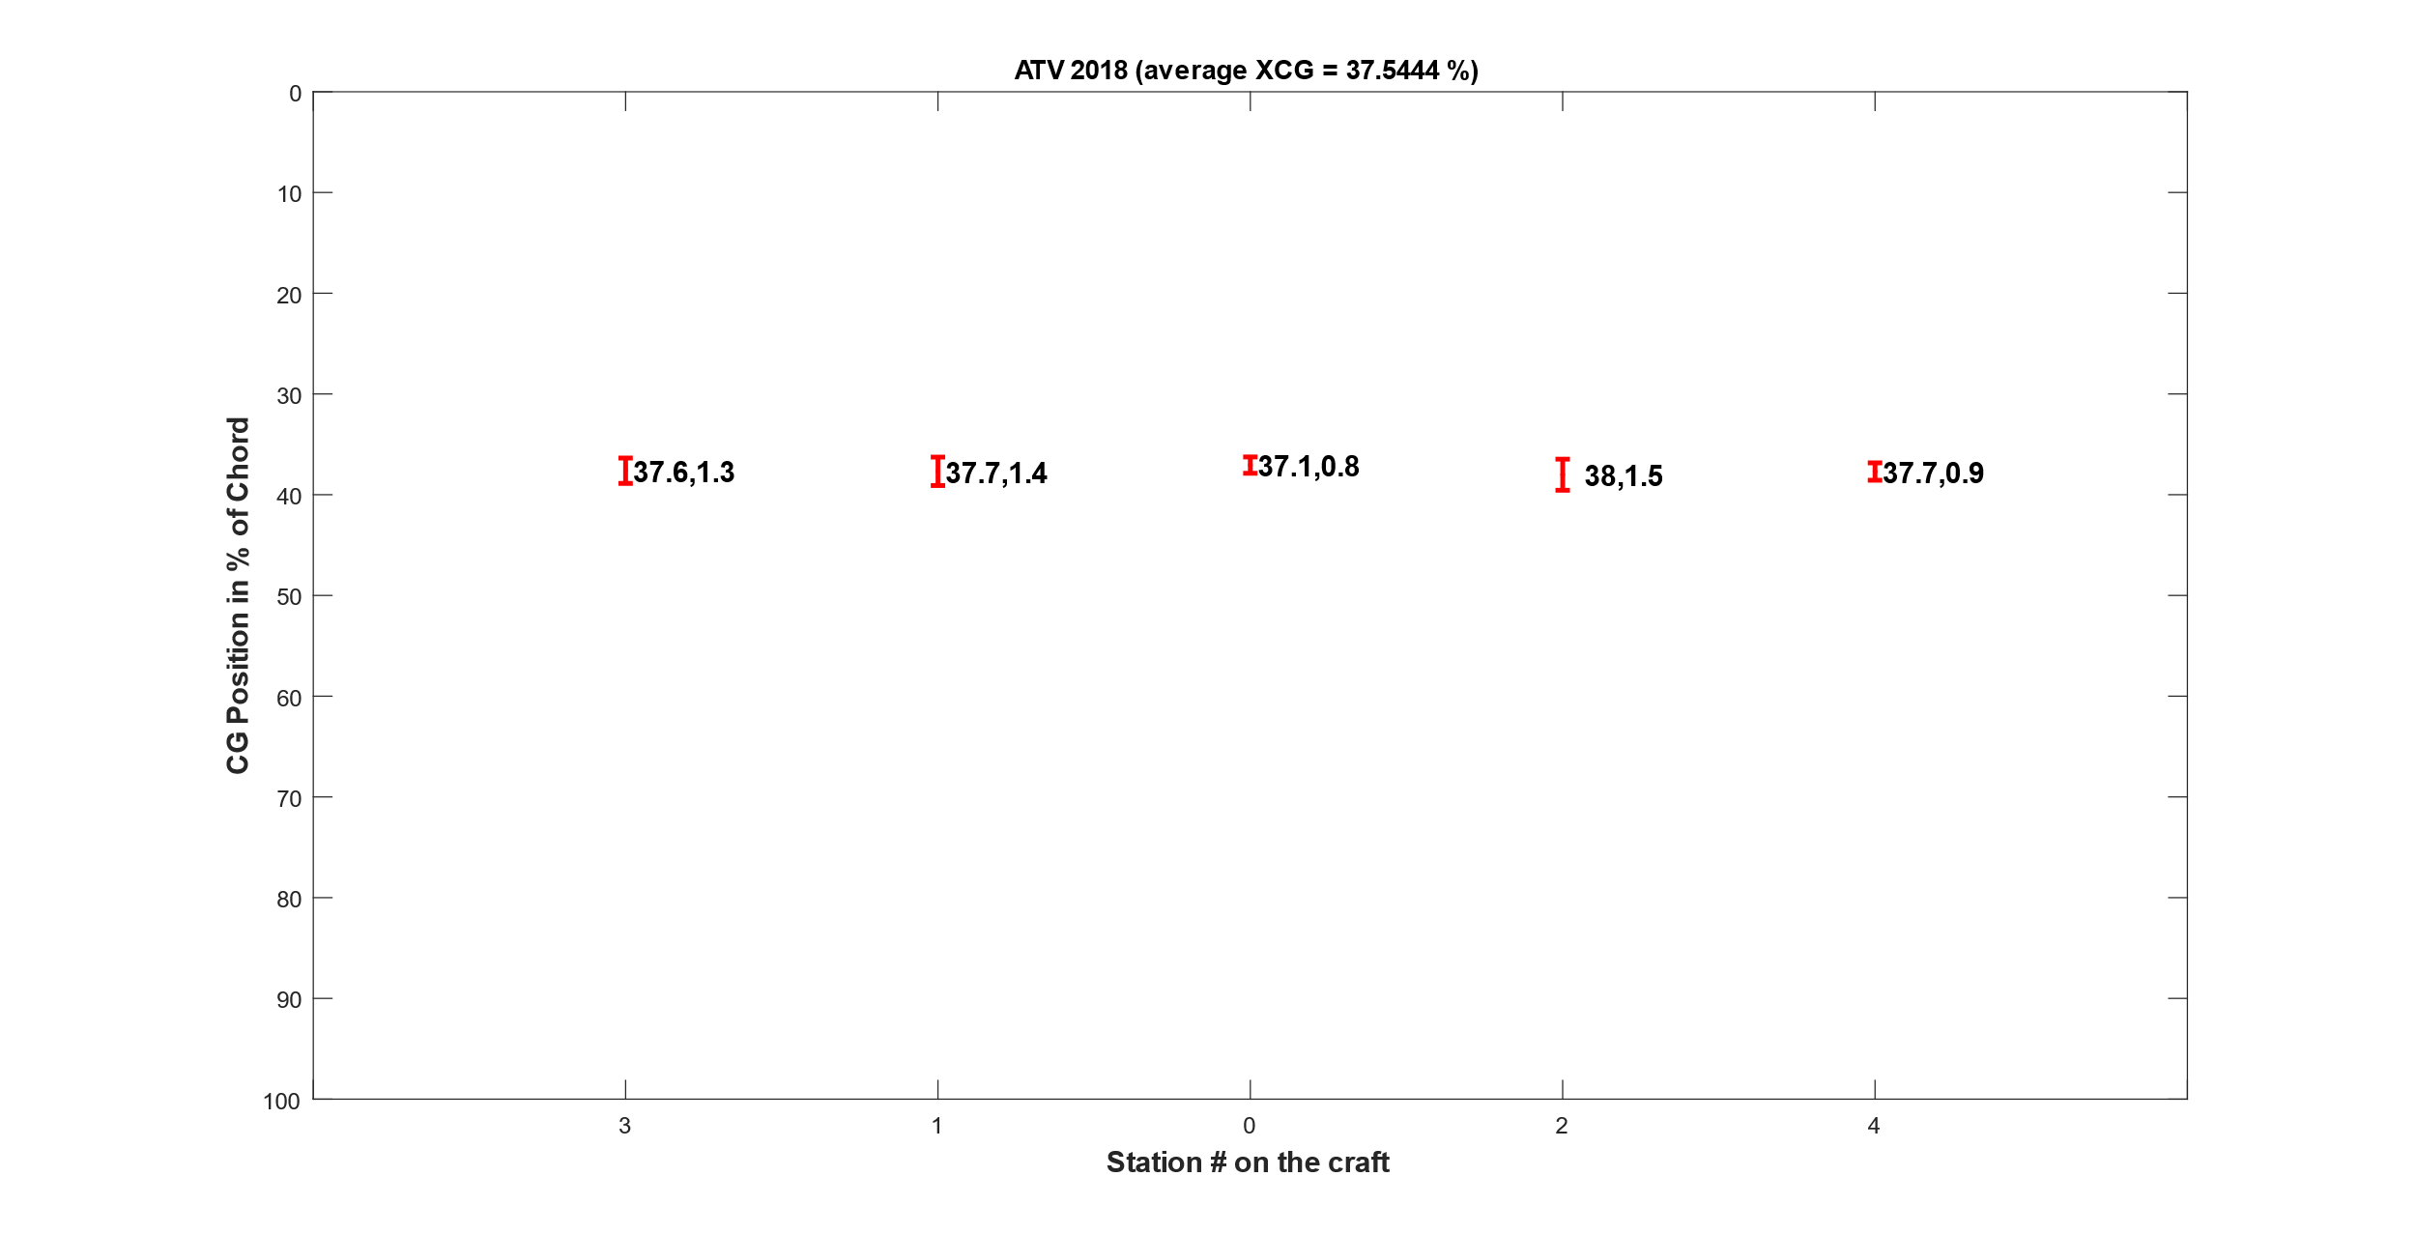
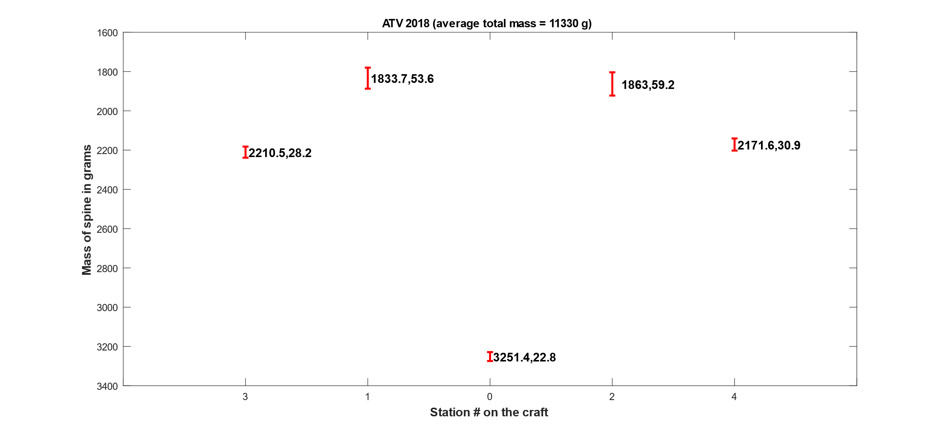
Reference case – ATV (defined in W18)

Slide 3
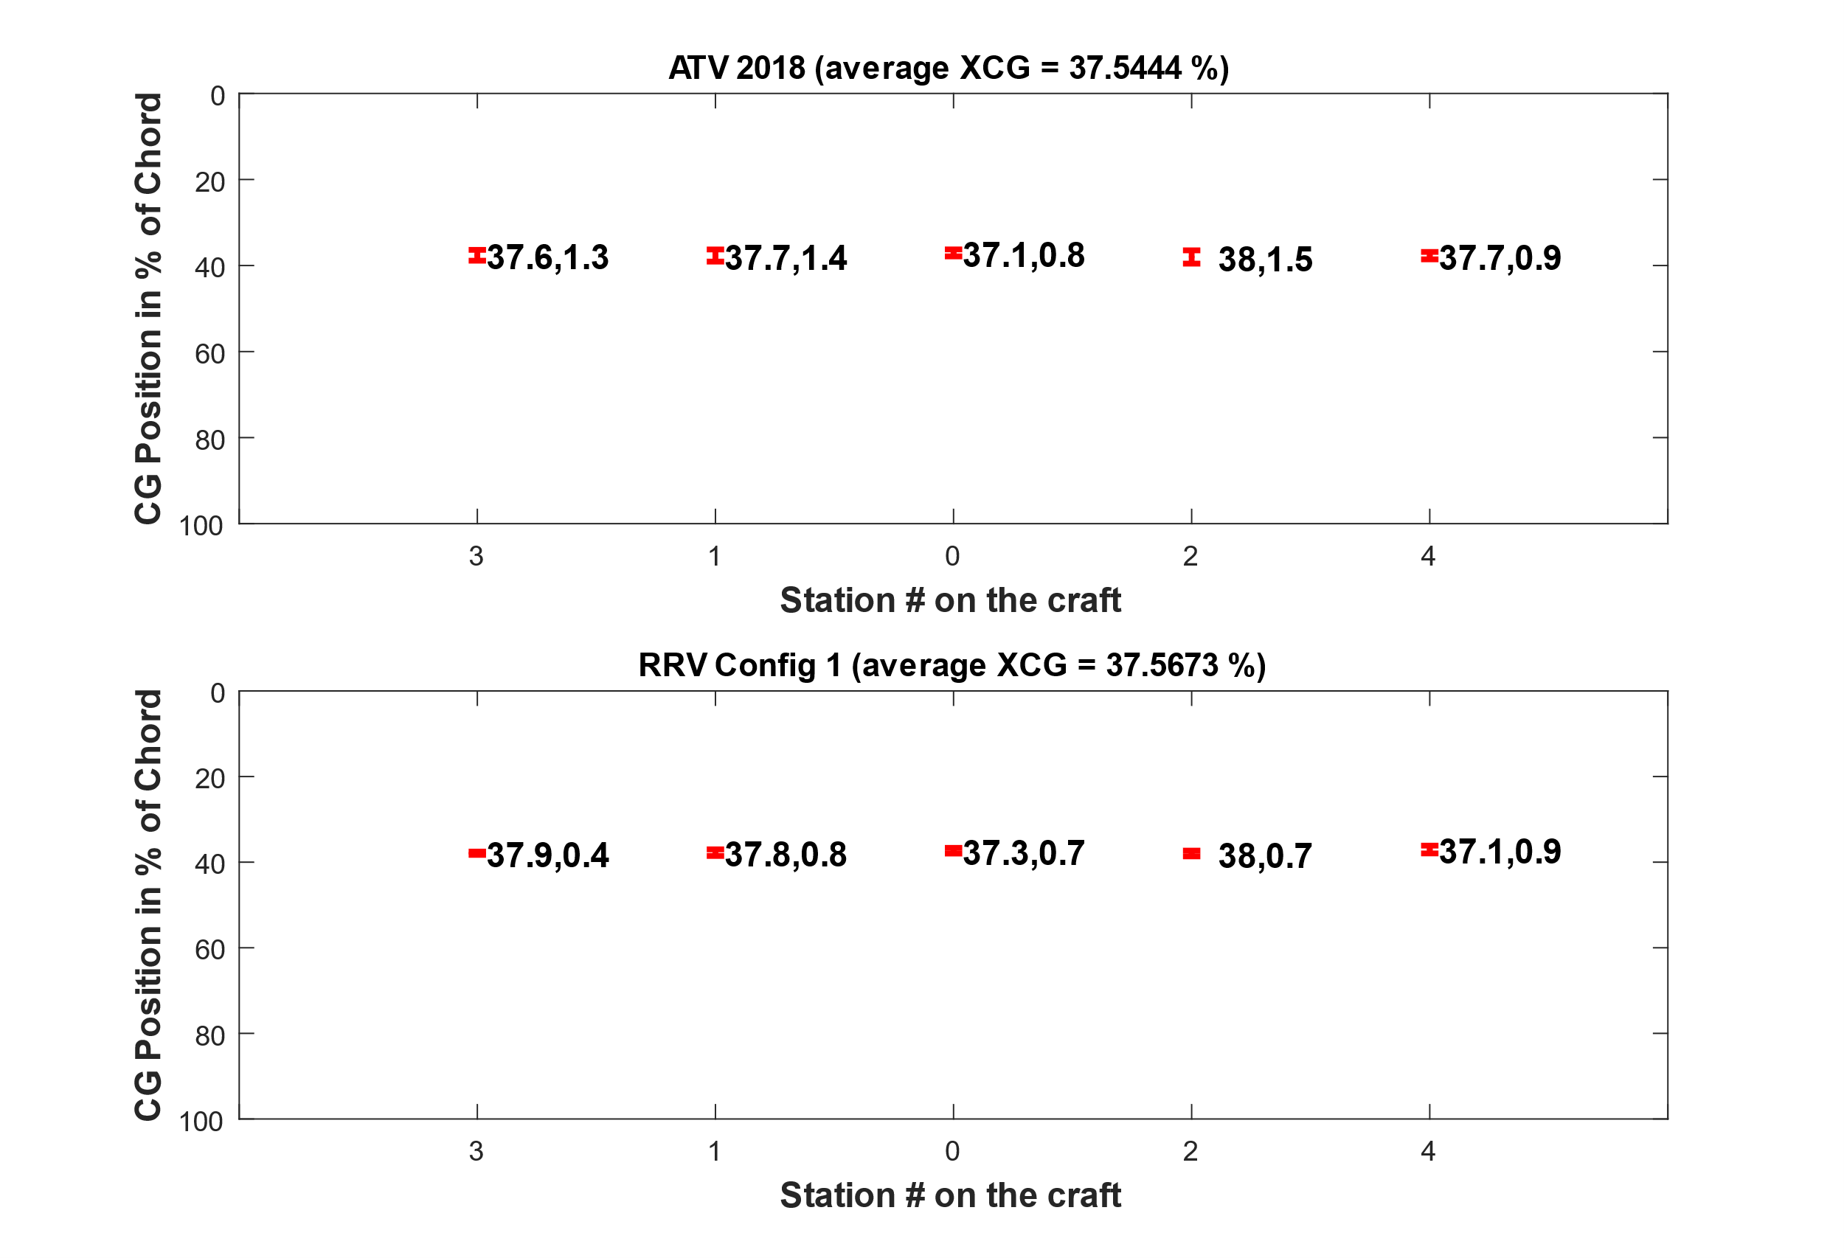
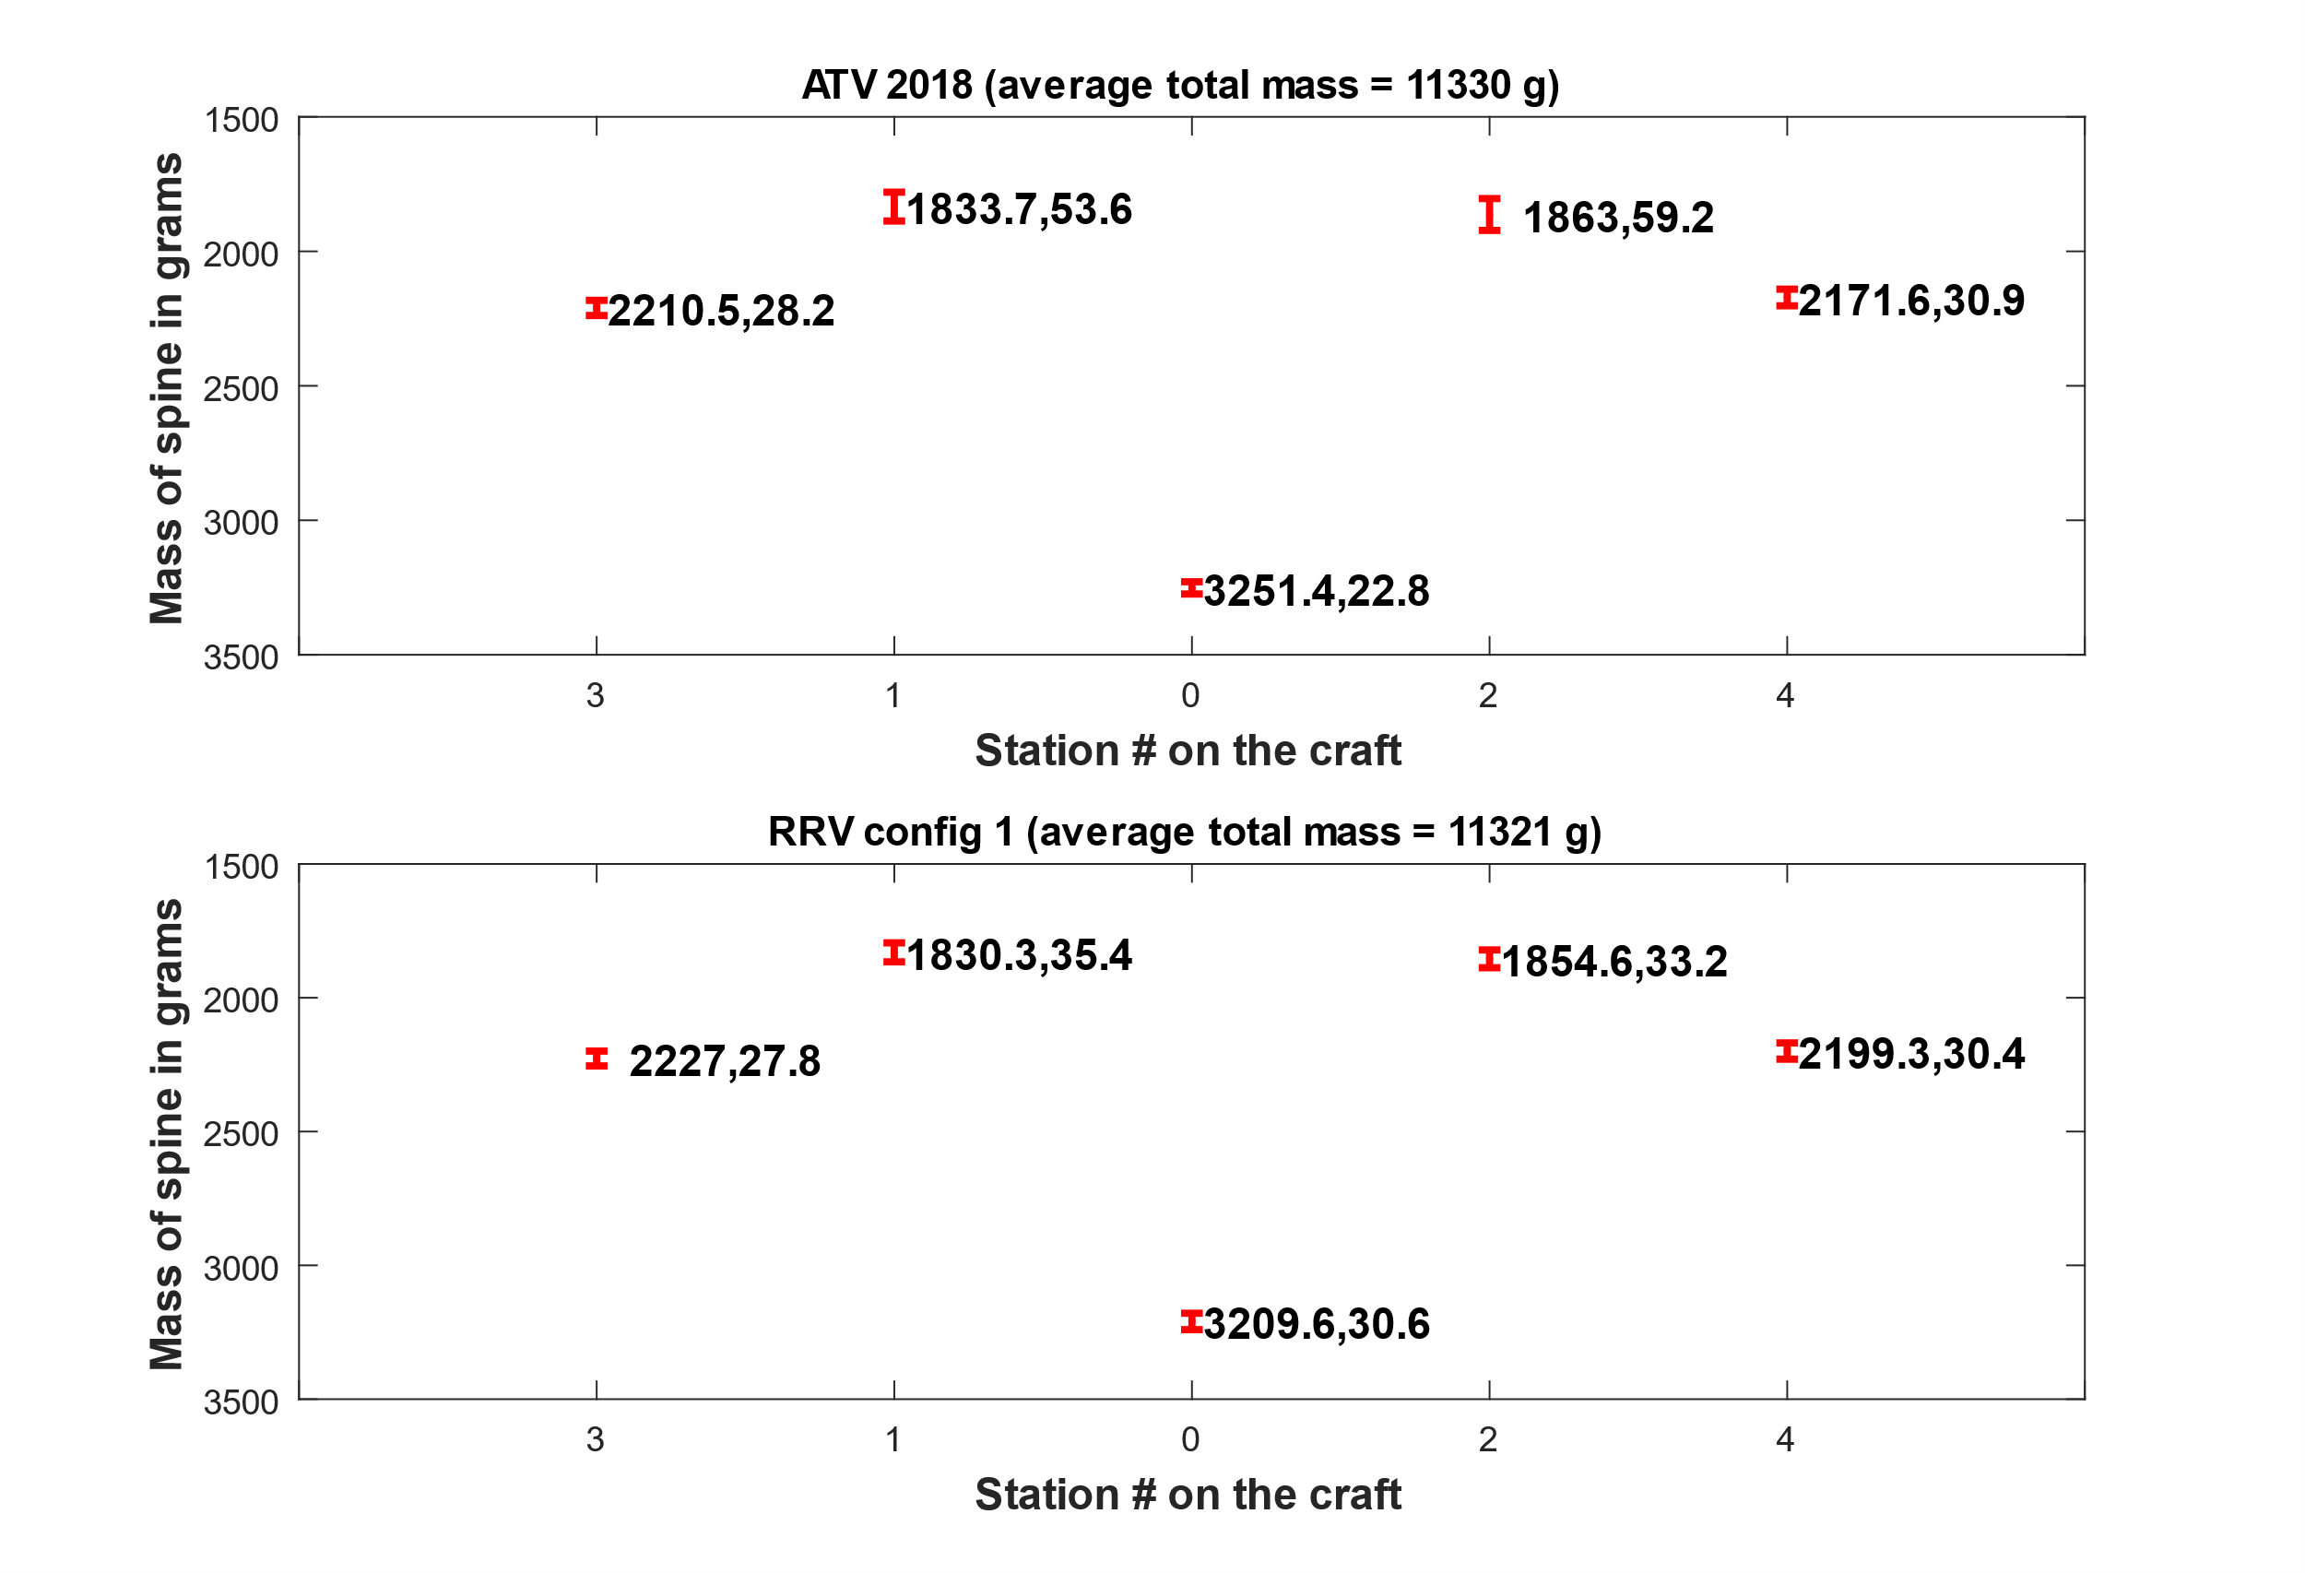
Reference ATV vs. RRV config 1* (W19)
*RRV config 1 refers to the RRV with only ballast mass. No foam blocks or aerodynamic fairings

Slide 4
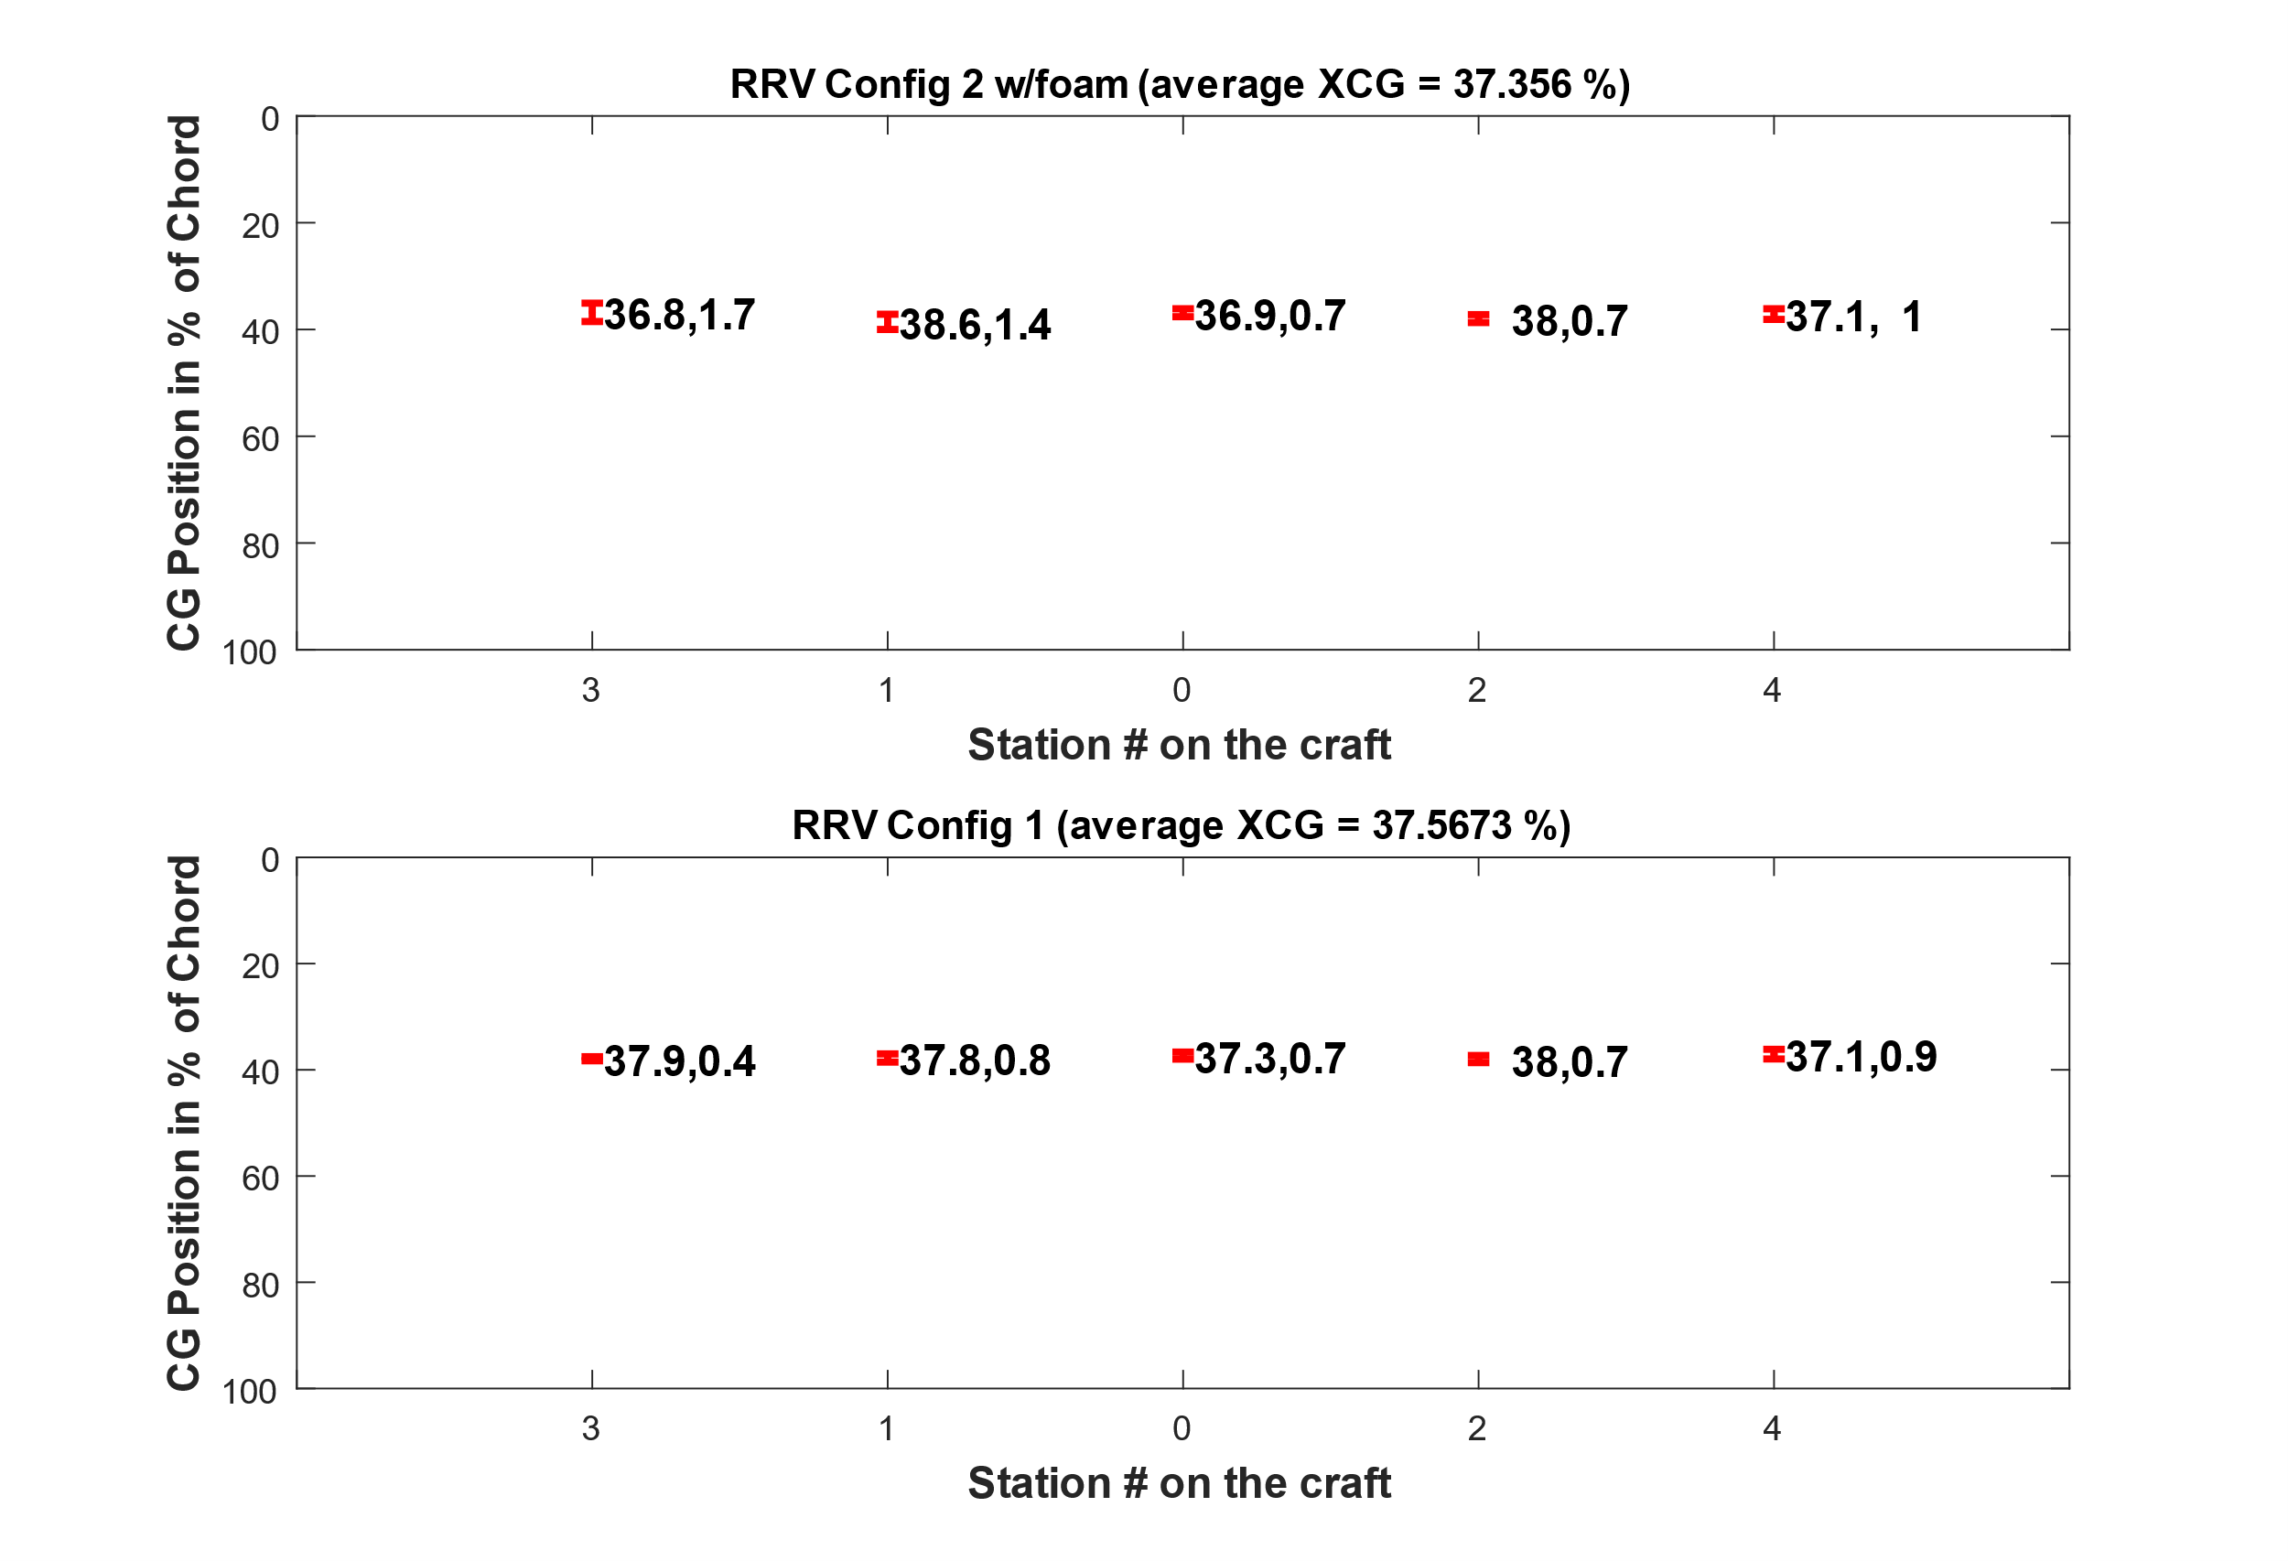
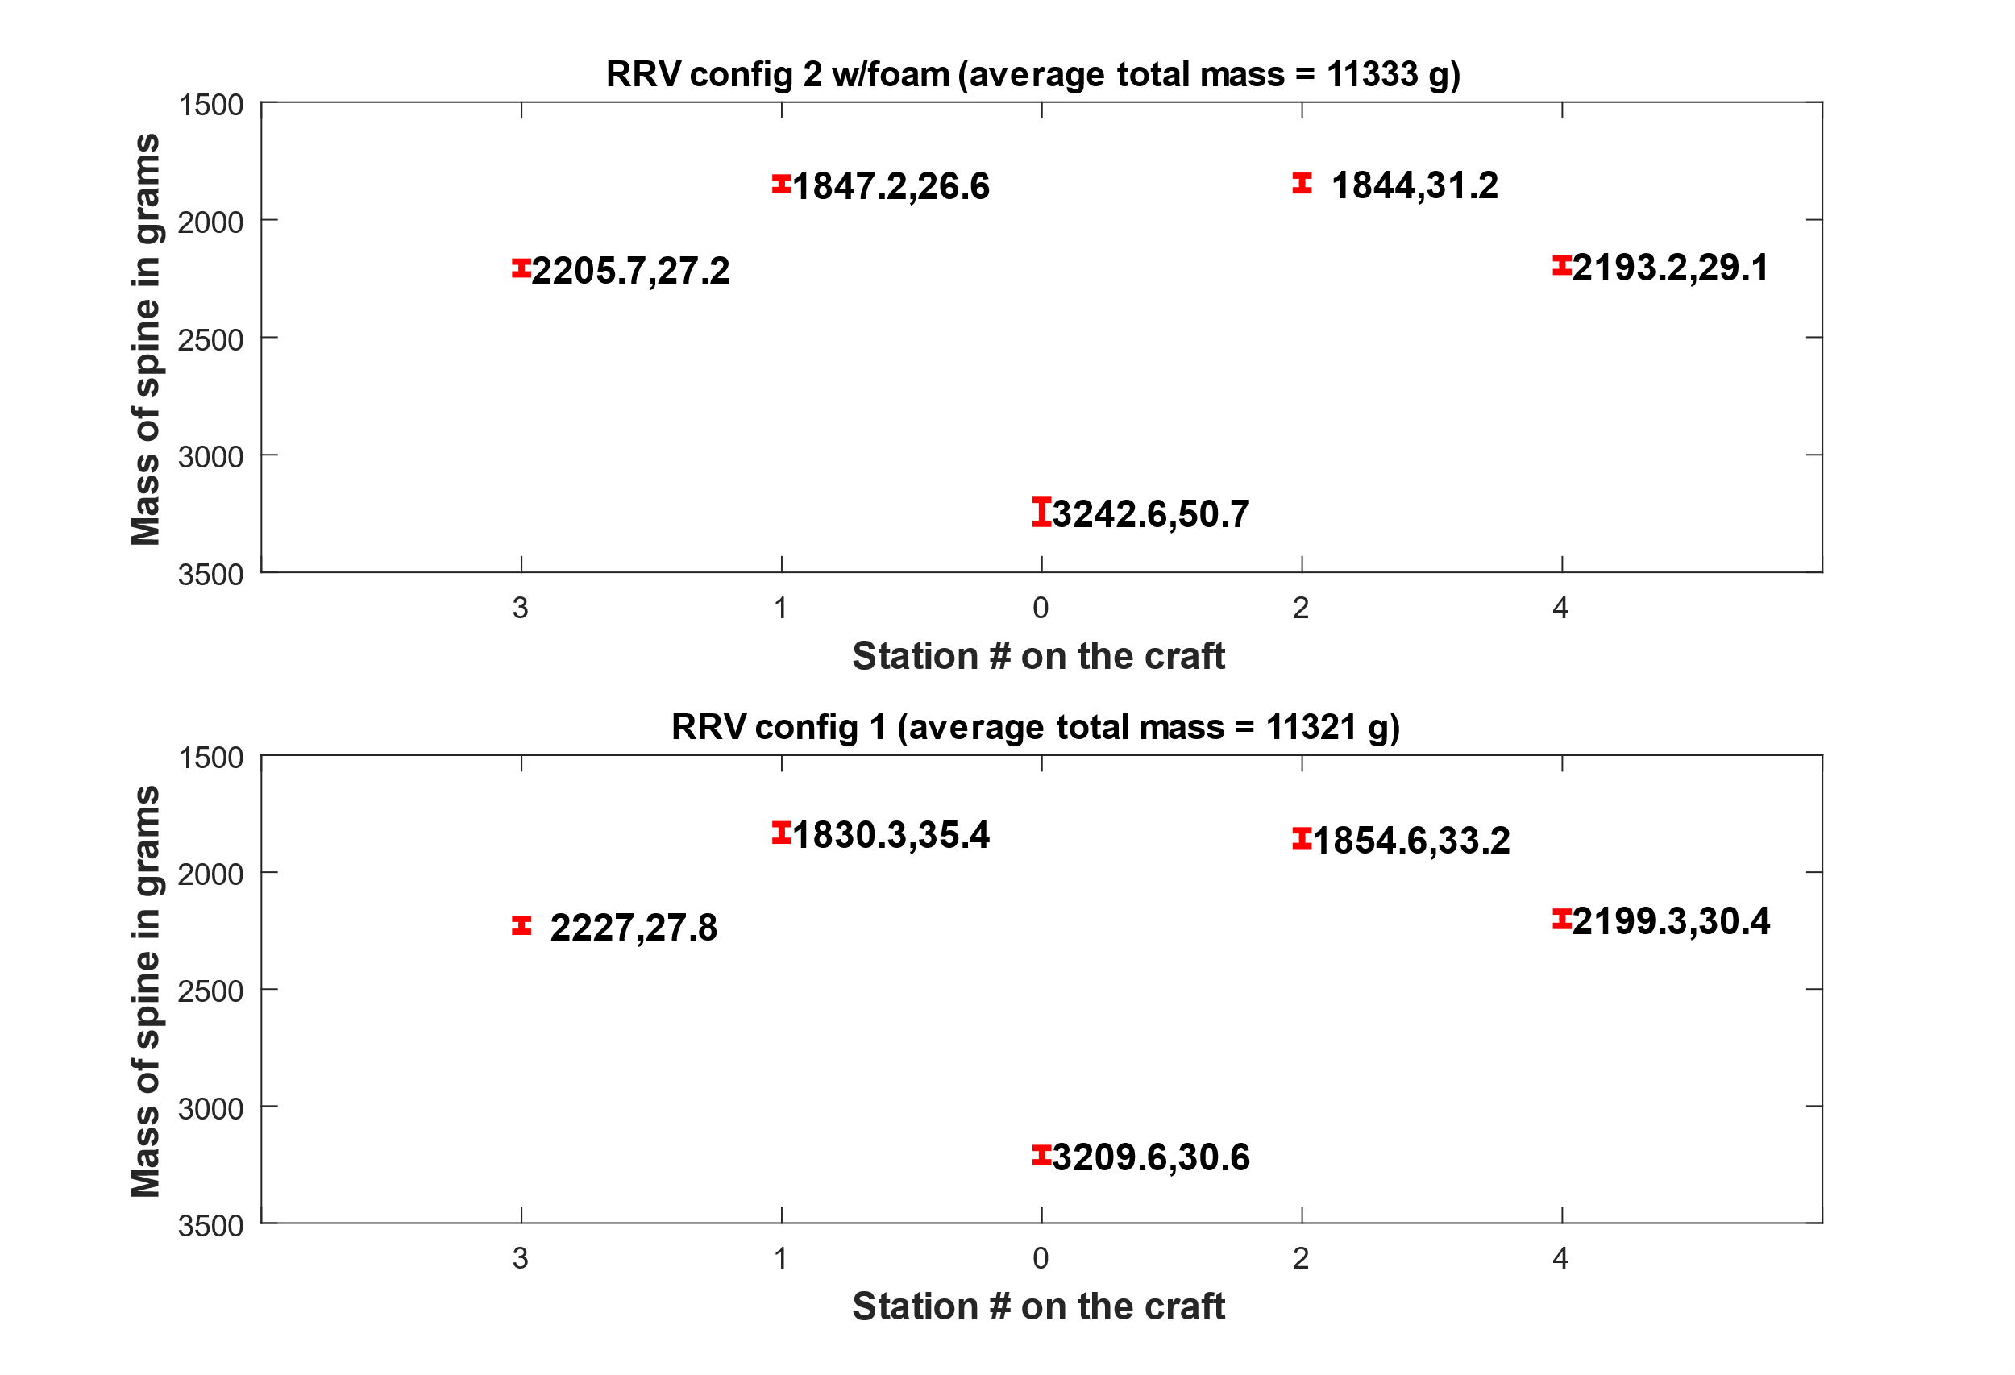
RRV config 1* vs config 2**
*RRV config 1 refers to the RRV with only ballast mass. No foam blocks or aerodynamic fairings
** RRV config 2 refers to the RRV with ballast mass (adjusted to accommodate the foam) and foam blocks to represent the shape of the PCBs on the ATV to bring the two closer in aerodynamic shape

