Slide 1
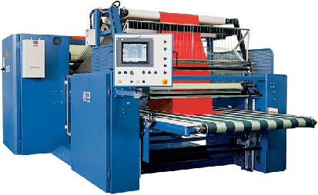
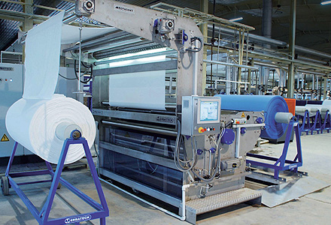
MULTI OBJECTIVE COMBINATORIAL OPTIMIZATION IN SCHEDULING APPLICATIONS
By: Mohammed bilal ansari

Slide 2
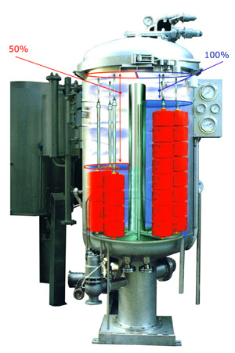
outline
Problem Statement
Problem Formulation
Methodology
Experimental Results
Conclusion

Slide 3
Problem statement
Scheduling jobs on fabric dying machines such that it optimizes multiple objective like setup time, shade consistency, makespan etc.
There are certain constraints that need to be followed to ensure that each job is processed only on one machine.
Certain jobs are not scheduled after certain others to reduce defects and effort to setup the machine.

Slide 4

PROBLEM FORMULATION
Decision Variables
$$φ = \{1, 2, .....n\} ; π = \{1, 2, .....m\}$$
$M ε {\{0,1\}}^{m x n}$
$$M_{j, i} =\left\{\begin{aligned}1, if machine j processes the job i \\ 0, Otherwise\end{aligned}\right.$$
$J ε {\{0,1\}}^{n x n}$
$$J_{i_{1}, i_{2}}=\left\{\begin{aligned}1, if job i_{1} is processed immediately before i_{2} \\ 0, Otherwise\end{aligned}\right.$$

Slide 5
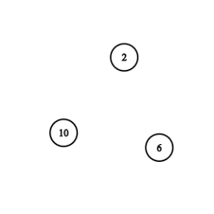
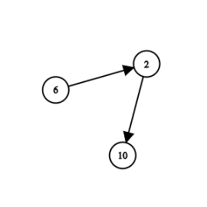

PROBLEM FORMULATION
Formulation as a Graph
$\text{Machine} \text{Vector} \text{Representation}$
M1:
J$\text{ob} \text{Vector} \text{Representation}$
J2(In):
J2(Out):
0 | 1 | 0 | 0 | 0 | 1 | 0 | 0 | 0 | 1
0 | 0 | 0 | 0 | 0 | 1 | 0 | 0 | 0 | 0
0 | 0 | 0 | 0 | 0 | 0 | 0 | 0 | 0 | 0

Slide 6

Objective Functions
Setup times, $f_{st}$
$${\hat{β}}_{total} = \begin{matrix}min \\ M, J\end{matrix} f_{st}\left(M, J\right)= \begin{matrix}min \\ M, J\end{matrix}\sum_{i_{1}, i_{2} ε φxφ}{\left(\left({M_{i_{1}}^{T}M}_{i_{2}}\right)∧{ J}_{i_{1}, i_{2}}\right)}β_{i_{1}, i_{2} }$$
Shade Consistency, $f_{sc}$
$$\begin{matrix}min \\ M, J\end{matrix} f_{sc}\left(M, J\right)=\begin{matrix}min \\ M, J\end{matrix}\left(\sum_{i_{1}, i_{2} ε φxφ}{\left(\left({M_{i_{1}}^{T}M}_{i_{2}}\right)∧{ J}_{i_{1}, i_{2}}\right)}\left|s_{i_{1}}−s_{i_{2}}\right| +\sum_{j ε π}{ \left|\sum_{i ε φ}{M_{ji}}\left(1−M_{j}^{′}{ J}_{i}\right)s_{i}^{g}−\sum_{i ε φ}{M_{ji}}\left(1−M_{j}^{′}J_{i}^{′}\right)s_{i}^{g}\right|}\right)$$
Makespan, $c_{max}$
$$minimize c_{max}$$

Slide 7
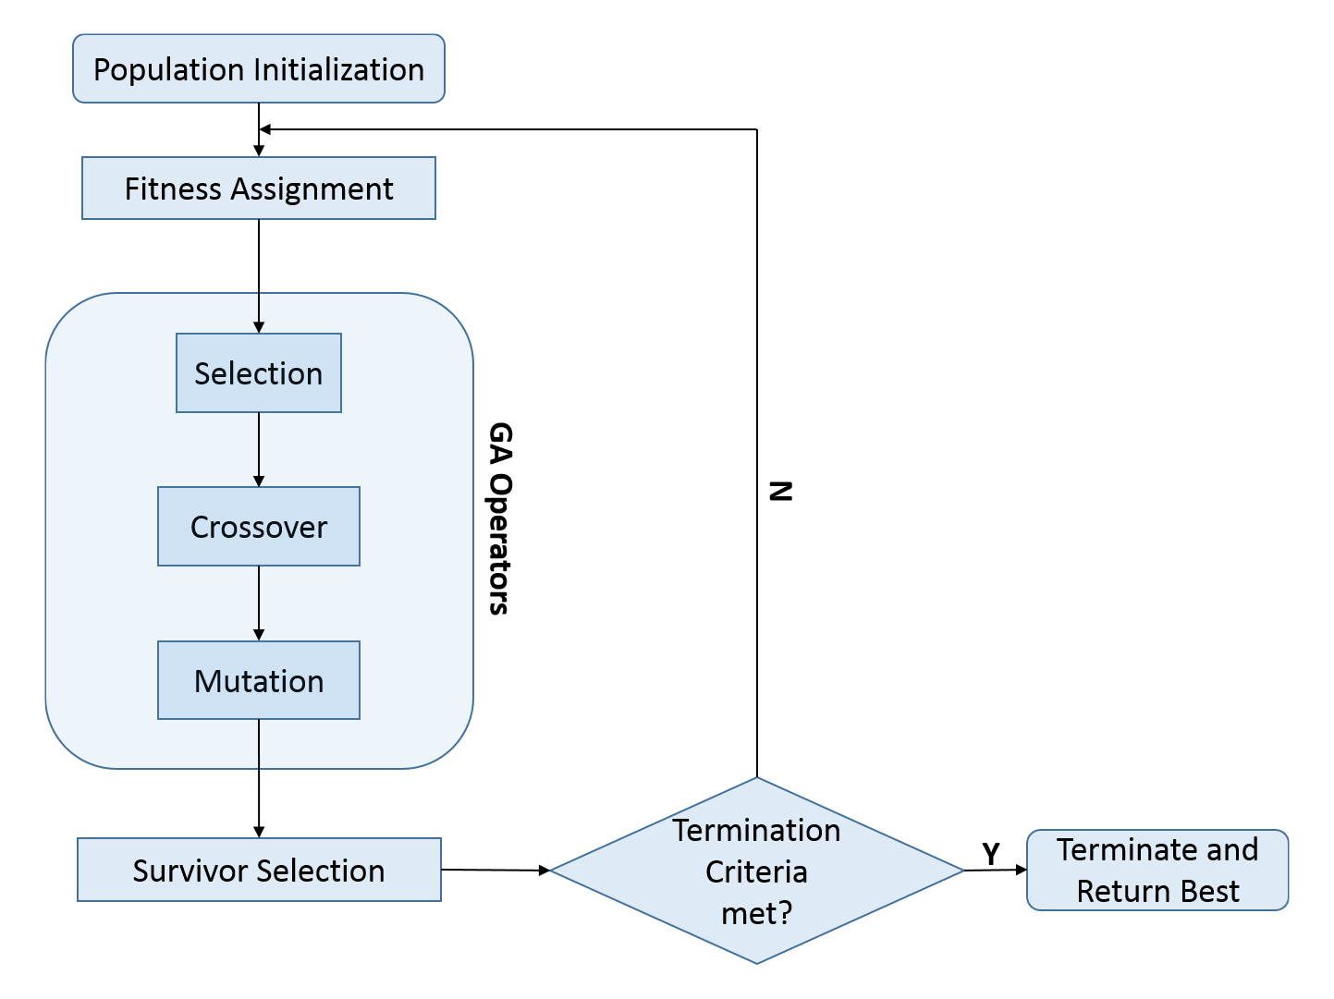
Genetic Algorithm

Slide 8
Initial Population
Heuristic to Construct the Schedule
Let m = 3, n = 8
0 | 0 | 0 | 0 | 0 | 0 | 0 | 0
0 | 0 | 0 | 0 | 0 | 0 | 0 | 0
0 | 0 | 0 | 0 | 0 | 0 | 0 | 0
0 | 0 | 0 | 0 | 0 | 0 | 0 | 0
0 | 0 | 0 | 1 | 0 | 0 | 0 | 0
0 | 0 | 0 | 0 | 0 | 0 | 0 | 0
0 | 0 | 0 | 0 | 0 | 0 | 0 | 0
0 | 0 | 0 | 0 | 0 | 0 | 0 | 0
0 | 0 | 0 | 0 | 0 | 1 | 0 | 0
0 | 0 | 0 | 0 | 0 | 0 | 0 | 1
0 | 0 | 0 | 0 | 0 | 0 | 0 | 0
0 | 1 | 0 | 0 | 0 | 0 | 0 | 0
0 | 0 | 0 | 1 | 0 | 0 | 0 | 0
0 | 0 | 0 | 0 | 0 | 0 | 0 | 0
0 | 0 | 1 | 0 | 0 | 0 | 0 | 0
0 | 0 | 0 | 0 | 0 | 0 | 0 | 0
0 | 0 | 0 | 0 | 0 | 0 | 0 | 0
0 | 0 | 0 | 0 | 0 | 0 | 0 | 0
0 | 0 | 0 | 0 | 0 | 0 | 0 | 0
0 | 0 | 0 | 0 | 0 | 0 | 0 | 0
0 | 0 | 0 | 0 | 0 | 0 | 0 | 0
0 | 0 | 0 | 0 | 0 | 0 | 0 | 0
0 | 0 | 0 | 0 | 0 | 0 | 0 | 0
0 | 0 | 0 | 0 | 0 | 0 | 0 | 0
3 | 5 | 1 | 4 | 2 | 7 | 6 | 8
3 | 5 | 1 | 4 | 2 | 7 | 6 | 8
3 | 5 | 1 | 4 | 2 | 7 | 6 | 8
3 | 5 | 1 | 4 | 2 | 7 | 6 | 8
Step 1: Initialize matrices M and J
Step 2: Assign single job to each machine
Step 3: Assign remaining jobs based on best fit
0 | 0 | 1 | 0 | 0 | 0 | 1 | 0
0 | 1 | 0 | 1 | 1 | 0 | 0 | 1
1 | 0 | 0 | 0 | 0 | 1 | 0 | 0
0 | 0 | 1 | 0 | 0 | 0 | 0 | 0
0 | 0 | 0 | 1 | 1 | 0 | 0 | 0
1 | 0 | 0 | 0 | 0 | 0 | 0 | 0
0 | 0 | 1 | 0 | 0 | 0 | 0 | 0
0 | 0 | 0 | 0 | 1 | 0 | 0 | 0
1 | 0 | 0 | 0 | 0 | 0 | 0 | 0
0 | 0 | 0 | 0 | 0 | 0 | 0 | 0
0 | 0 | 0 | 0 | 0 | 0 | 0 | 0
0 | 0 | 0 | 0 | 0 | 0 | 0 | 0
Matrix M
Matrix J

Slide 9
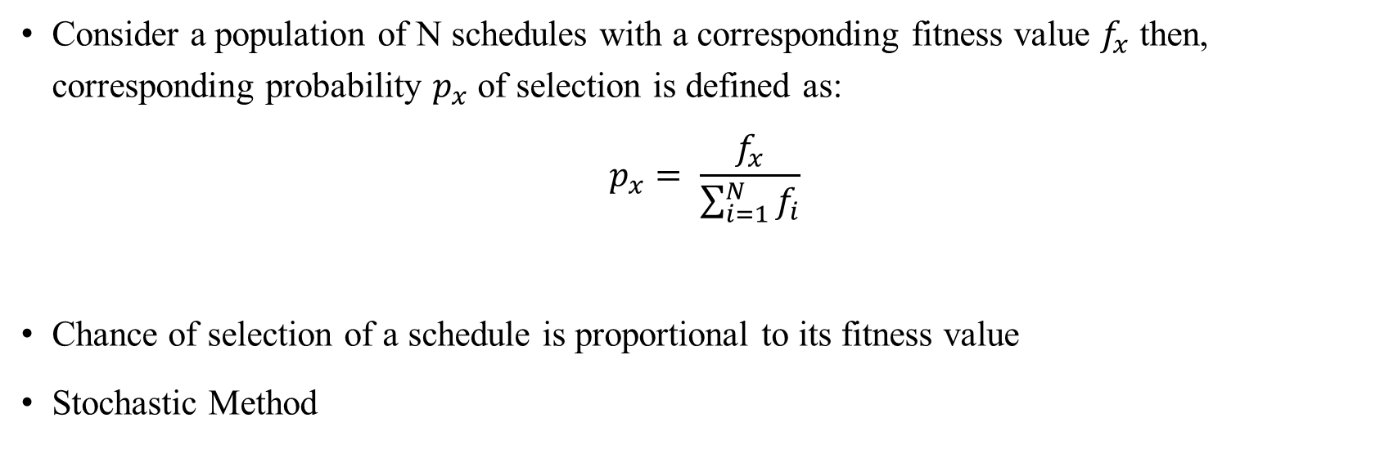
Selection
Roulette Wheel Selection
Consider a population of N schedules with a corresponding fitness value $f_{x}$ then, corresponding probability $p_{x}$ of selection is defined as:
$$p_{x}= \frac{f_{x}}{\sum_{i=1}^{N}{f_{i}}}$$
Chance of selection of a schedule is proportional to its fitness value
Stochastic Method

Slide 10
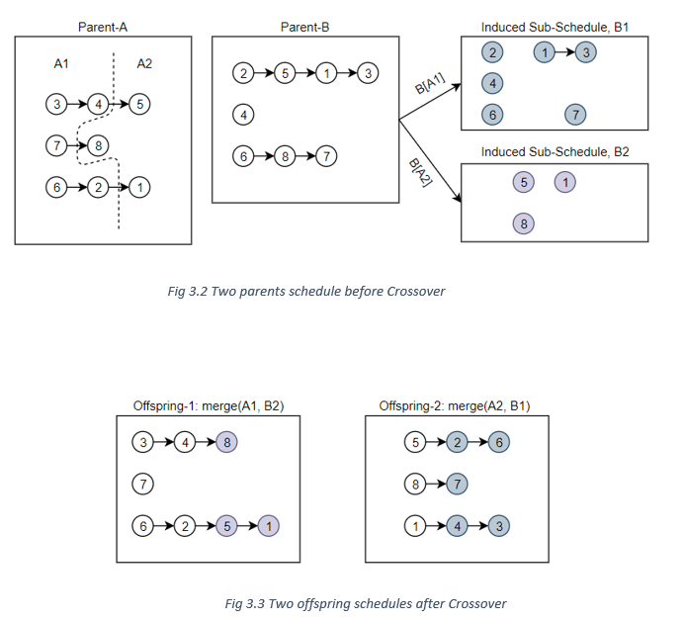
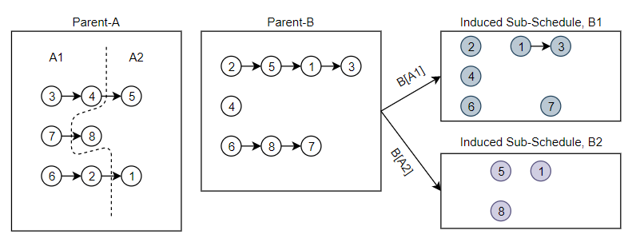
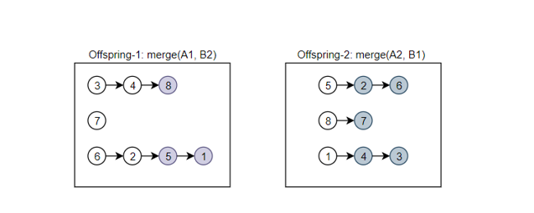
Crossover
Crossover on Schedules A and B
Fig. Two offspring schedules after Crossover
Fig. Two parents schedule before Crossover

Slide 11
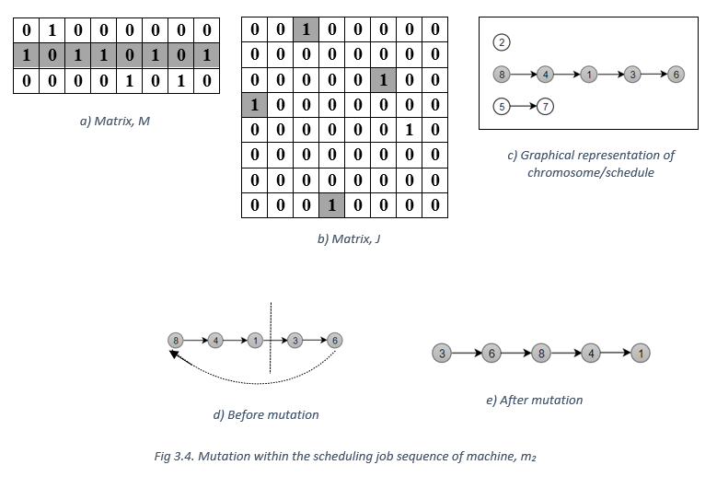
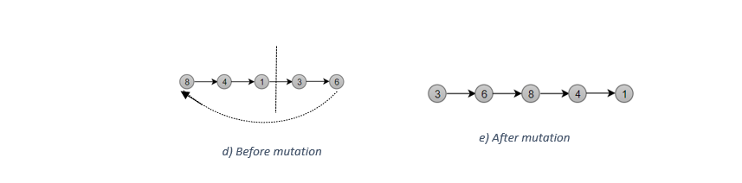
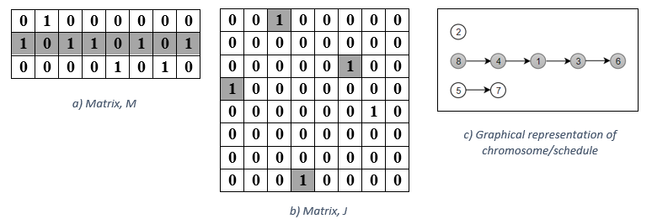
Mutation
Alogrithm1: Within the job sequence of machine

Slide 12
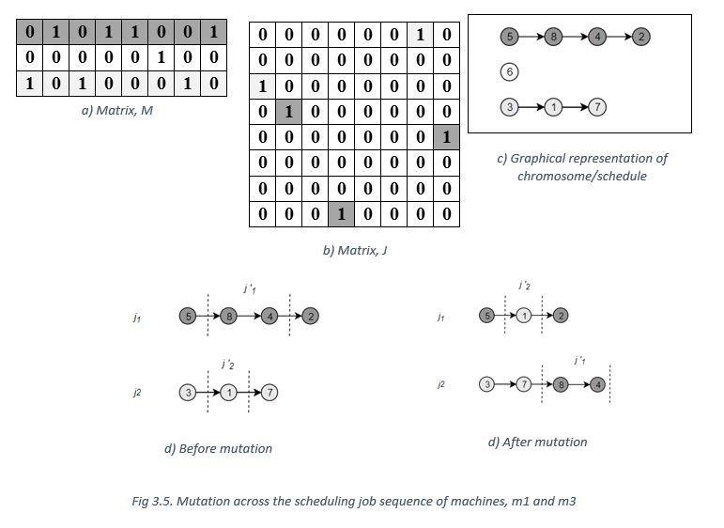
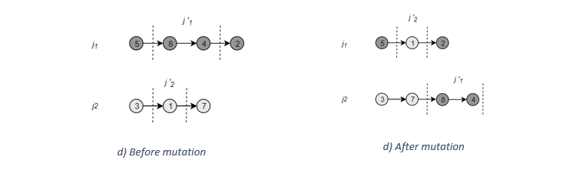
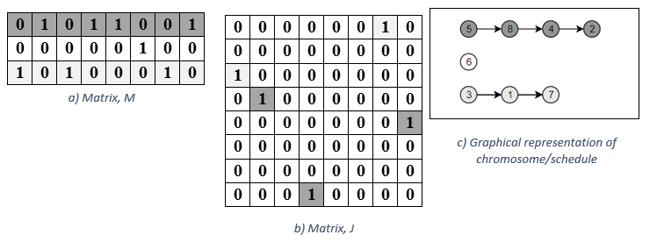
Mutation
Alogrithm2: Across the job sequence of machines

Slide 13
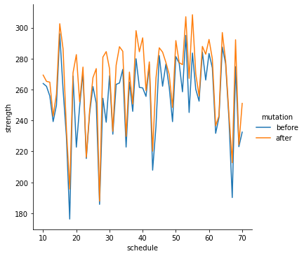
ExperimentaL Results
Change in strength of schedule after mutation

Slide 14
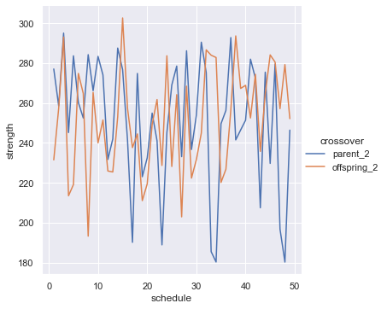
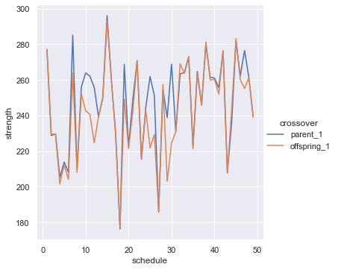
ExperimentaL Results
Change in strength of schedules after crossover

Slide 15
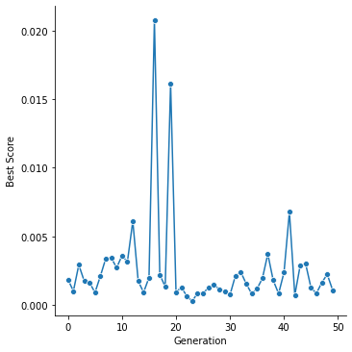
ExperimentaL Results
Best score over the generations

Slide 16
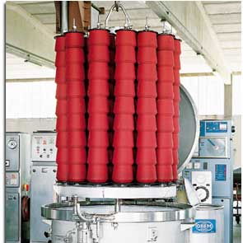
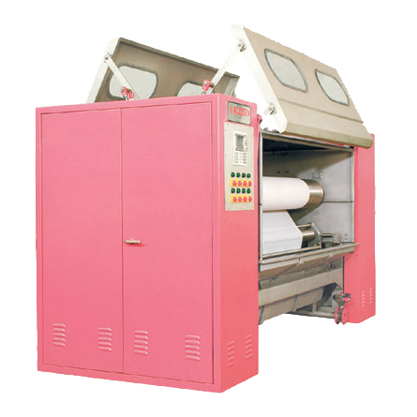
Conclusion
GA based on two-dimensional encoding has been proposed to solve COP for scheduling.
In experimental result, mutation always generates better quality schedule, but crossover operation does not give guarantee of quality.
Further research can be conducted to improve the crossover algorithm which can guarantee that quality of offspring will always be better than parent schedules and considering other objective function like latency etc.

Slide 17


Slide 18

Thank you
Mohammed Bilal Ansari
mohammed_bilal.ansari@etu.uca.fr

