Slide 1
PROJECT-9
AIR QUALITY ANALYSIS AND PREDICTION IN TAMILNADU
PHASE-5
PROJECT DOCUMENTATION AND
SUBMISSION

Slide 2
TEAM MEMBERS
NOORUL MAJHAR M - NM:D83DB97A3E090868AAA41DF07113B191
MOHAMED NOORISHA BILALY- D0D3C8B155E15C1B78442CA6E4FB8B11
MOHAMED WASIM AKRAM- 6B8681356287BCA97984350B34292F21
NAJIMULLA- 1B3E04461E6CA0B9EB94707EFA50D694

Slide 3
ABSTRACT
Abstract. Prediction of air pollution index may help in traffic routing and identifying serious pollutants.
Modeling of the complex relationships between these variables by sophisticated methods in machine learning is a promising field.
The quality of air in Alandur, Chennai is polluted by Particulate Matter (PM2.5) over the years. Reports prove

Slide 4
INTRODUCTION
Technological advancements lead to the emissions of airpollutants over the decades.
Air pollutants such as sulphur dioxide (SO2), nitrogenoxide (Nox), nitric oxide (NO), nitrogen dioxide (NO2), carbon monoxide (CO), Ozone (O3), respirable suspendedparticulates (RSPs) are some of the major airborne pollutants which exerts impact on physical and biological environmen
Chennai, the capital of Tamil Nadu in India is located onthe Coromandel Coast off the Bay of Bengal. It is theeconomic and educational centre of south India

Slide 5
DATA PRE-PROCESSING
Clean and pre-process the collected data. This involves handling missing values, outliers, and ensuring data consistency.
Exploratory Data Analysis (EDA):
Perform EDA to understand the patterns and trends in the air quality data. Visualization techniques can help identify correlations and seasonality.
Model Selection:
Choose suitable machine learning or statistical models for air quality prediction. Time series models like ARIMA or machine learning models like Random Forests and Gradient Boosting are often used.
Prediction:
Use the trained model to make air quality predictions for specific locations in Tamil Nadu.

Slide 6
AIM
The objective of study is to implement air quality prediction
with machine learning algorithes namely logistic regressio
and deep learning techniques such as Neural Network

Slide 7
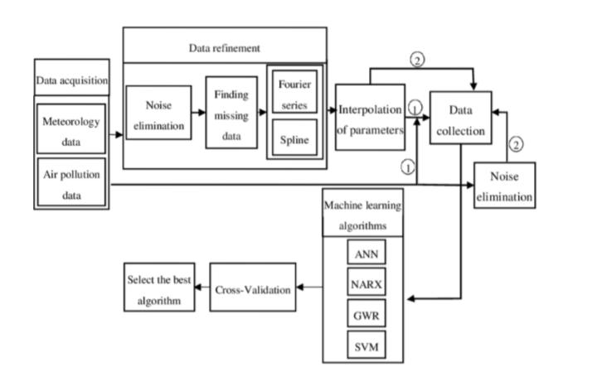
AIR PREDICTION ARCHITECTURE BLACK DIAGRAM

Slide 8
CODE IMPLEMENTATION
Import matplotlib.pyplot as plt
From matplotlib.animation import FuncAnimation
Import random
# Generate some sample air quality data (replace with your own data)
Timestamps = range(1, 11)
Pm25_values = [random.randint(0, 50) for _ in timestamps]
# Initialize the plot
Fig, ax = plt.subplots()
Ax.set_xlim(1, 10)
Ax.set_ylim(0, 50)
Line, = ax.plot([], [], lw=2)
# Function to update the animation at each time step
Def animate(i):
line.set_data(timestamps[:i], pm25_values[:i])
return line,

Slide 9
PREPROCESSING DATASET EXAMPLE: CODE
# importing pandas module for data frame
Import pandas as pd
# loading dataset and storing in train variable
Train=pd.read_csv(‘AQI.csv’)
# display top 5 data
Train.head()

Slide 10
OUTPUT:
PM2.5 AVG PM10 AVG NO2 AVG NH3 AVG SO2 AG CO OZONE AVG
190 131 107 4 42 0 63
188 131 110 4 40 0 62
280 174 155 2 37 0 52
302 181 144 2 39 0 78

Slide 11
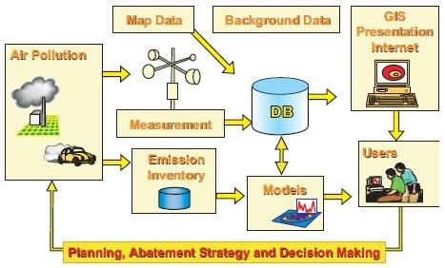
AIR QUALITY ANALYSIS ANIMATION CIRCUIT

Slide 12
PREPROCESSING DATASET
Data Preprocessing:
Clean and preprocess the data to remove any inconsistencies, missing values, and outliers. You may need to handle date and time data, as well as convert categorical variables into numerical representations.
Data Exploration:
Perform exploratory data analysis (EDA) to understand the characteristics of the dataset. Visualizations and summarstatistics can help you identify patterns and trends.
“Feature Engineering Create relevant features that can be used in your air quality prediction model. This might include weather data, geographical coordinates, or historical air quality mmeasurement
Split the Data:
Split your dataset into training, validation, and testing sets. The training set is used to train your model, the validation set is used for tuning hyperparameters, and the testing set is used to evaluate the model's performance.

Slide 13
LOADING DATASET
Data Collection:
Gather historical air quality data for Tamilnadu. You can obtain this data from government agencies, research institutions, or environmental monitoring stations.
Collect meteorological data such as temperature, humidity, wind speed, and wind direction, which can impact air quality.
Exploratory Data Analysis (EDA):
Visualize the data to identify trends, patterns, and correlations. EDA helps in understanding the data and identifying potential factors influencing air quality.
Feature Engineering:
Create relevant features based on domain knowledge. For example, consider lag variables, seasonal patterns, and interactions between variables.
Data Splitting:
Split the dataset into training, validation, and test sets to evaluate the performance of predictive mo

Slide 14
Dataset contains in features
Stn_code : Station code. A code is given to each station that recorded the Data.
Sampling_date: The date when the data was recorded.
State: It represents the states whose air quality data is measured.
Location: It represents the city whose air quality data is measured.
Agency: Name of the agency that measured the data.

Slide 15
DATA EXPLORATION
Let us get some insights about the data — the number of entries in each
column, the type of entry in each column
It represents the type of area where the data was recorded like industrial,
residential, etc.
Let us see how many types of area
NO, because the agency’s name has nothing to do with how much polluted the
state is. Similarly, stn_code is also unnecessary.
It is given in the data description that date

Slide 16
DATA EXPLORATION CODE :
# Rows with missing “types null_data = tn[tn.isnull().any(axis=1)]
null_data.head(20)

Slide 17
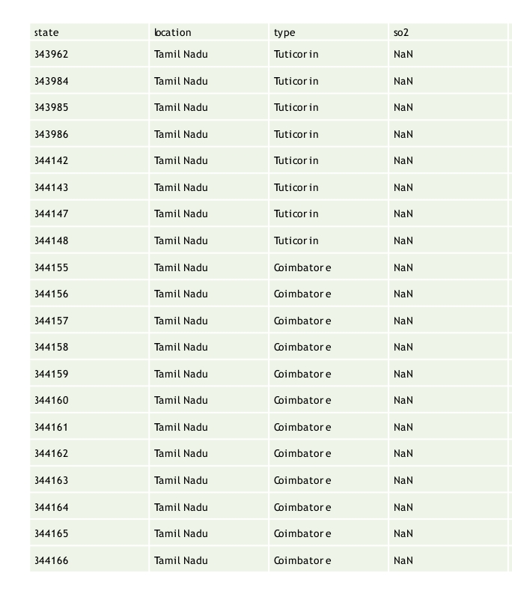
OUTPUT :

Slide 18
DATA VISUALIZATION
Input: datacount =sns.countplot(x =“location”,data = tn); datacount.set_xticklabels(datacount.get_xticklabels(), rotation=90);

Slide 19
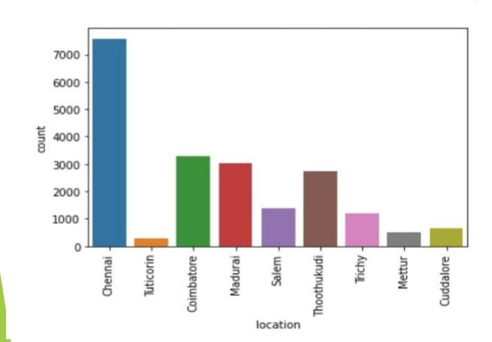
OUTPUT:

Slide 20
CALCULATE IN AIR QUALITY
The AQI is calculated by converting measured pollutant concentrations to a uniform index which is based on the health effects associated with a Pollutant
The health benchmarks used for calculating the AQI are pollutant specific
and are established by the EPA through the National Ambient Air Quality
Standards

Slide 21
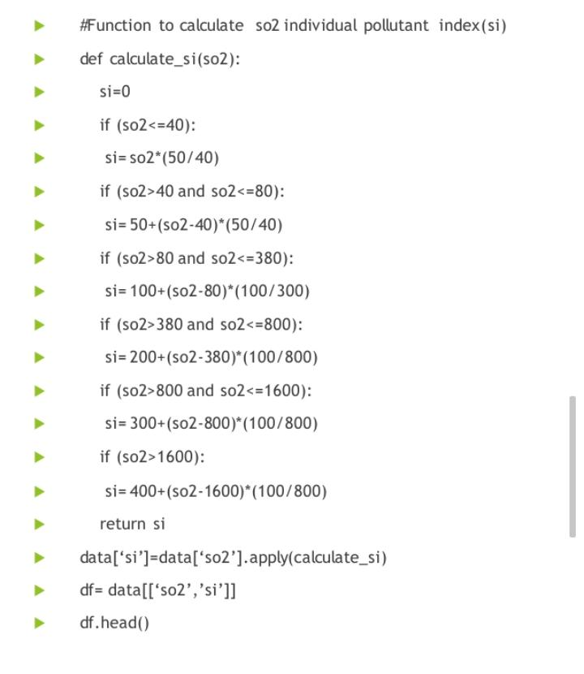
INPUT:

Slide 22
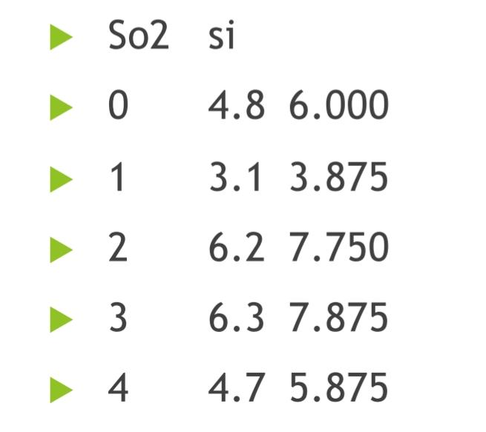
OUTPUT:

Slide 23
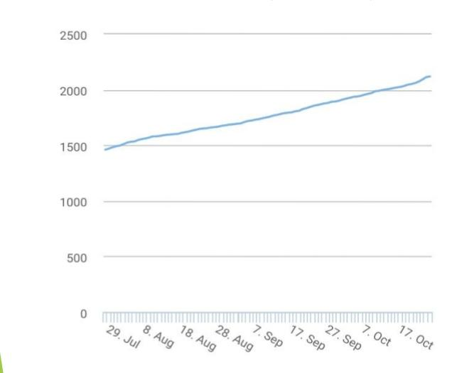
Article Metrics ( level )

Slide 24
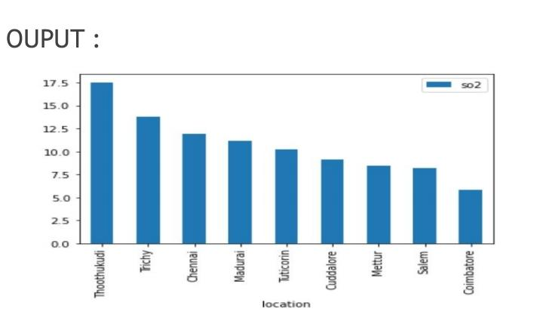
DISTRICT LEVEL PREDICTION
INPUT : CODE
maxso2 = loc.sort_values(by='so2',ascending=False)
maxso2.loc[:,['so2']].head(10).plot(kind='bar'); # Based on average values

Slide 25
Air quality visualization
The graphical display of data – helps us understand the distribution of air
pollutants in the atmosphere. This is hard to do just by looking at a modern
air monitor equipment with its digital display
By combining real-time monitoring data with python programming, one can
easily visualize air monitoring data. Interactive graphs can be created which
makes it easier to check air quality, and increasingly diverse colors can
visually highlight the air quality level. Visualization of data has a resilient
expression (more images and more insightful) than the original data table,
which is favorable for further analysis of data.

Slide 26
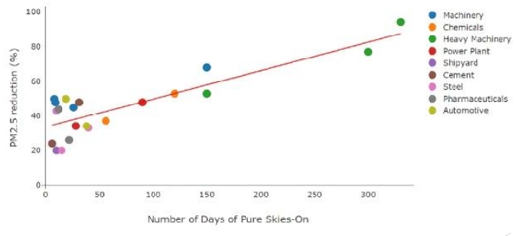
OUTPUT FOR VISUALIZATION:

Slide 27
CONCLUSION
TheproposedapproachforAirqualitypredictionbasedon meteorologicalandhistoricalpollutantdata. usingamodelbasedonthepreviousmeteorologicaldata.MachinelearningalgorithmLogisticregressionisusedfor prediction. results,logisticregressionpredictswithaccuracyof66%

Slide 28
THANK YOU

