Slide 1
APPLIED DATA SCIENCE GROUP-1
PROJECT-9
Air Quality Analysis and Prediction in Tamil Nadu
PHASE-3
Development Part 1

Slide 2
TEAM MEMBERS
NOORUL MAJHAR M - NM:D83DB97A3E090868AAA41DF07113B191
MOHAMED NOORISHA BILALY- D0D3C8B155E15C1B78442CA6E4FB8B11
MOHAMED WASIM AKRAM- 6B8681356287BCA97984350B34292F21
NAJIMULLA- 1B3E04461E6CA0B9EB94707EFA50D694

Slide 3
Introduction:
Air quality is a crucial aspect of environmental health, impacting the well-being of individuals and communities. This project focuses on the development of an Air Quality Analysis and Prediction model using data science techniques in Python. As a student passionate about environmental sciences and data analytics, I embarked on this project to contribute to a cleaner and healthier environment
Loading and Preprocessing Methods:
Import Libraries
Load the Dataset
Explore the Dataset
Handling Missing Data
Data Cleaning
Data Transformation

Slide 4
Feature Engineering
Exploratory Data Analysis (EDA)
Save Preprocessed Dataset
DATASET:
The data is obtained from https://tn.data.gov.in/resource/location-wise-daily-ambient-airquality-tamil-nadu-year-2004
COLUMNS USED :
From Tamil Nadu_Air quality analytics.csv data the following columns are used .
. stn code
. Sampling Date

Slide 5
. State
. City/Town/Village
. Location of agency
. Type of location
. SO2
. NO2
. RSPM/PM10
. PM2.0
Libraries used:
The Python 3 environment comes with many helpful analytics libraries installed and several helpful packages to load.
The essential libraries used in this project are :
• Importing OS (for kaggle inputs)
• Numpy and Pandas libraries

Slide 6
• Matplotlib
• Seaborn
TRAIN AND TEST :
Training the dataset by describe(), isnull().sum(), drop(), show(), and by using k-means algorithm we train the data.
Testing the data by importing sklearn.cluster from k-means with ensuring the plot range and axis labels producing the k value, scattering the data by kmeans.cluster_centers and producing 3D plot.
REST OF THE EXPLANATIONS:
Data Collection
The samples are collected from NAMP stations are analysed for the Respirable Suspended Particulate matter (RSPM) and gaseous pollutants such as Sulphur dioxide(SO2) and Nitrogen dioxides(NO2)

Slide 7
Data analysis
ANOVA (one way), Tukey HSD, and Pearson correlation coefficient (r) were computed using self-coded software on Microsoft Excel 2019 to statistically analyze the collected data.
ALGORITHMS USED
Apply clustering algorithms like K-Means, DBSCAN, or hierarchical clustering to segment customers.
Visualization:
Visualize the customer segments using techniques like scatter plots, bar charts, and heatmaps. Interpretation: Analyze and interpret the characteristics of each customer segment to derive actionable insights for marketing strategies.

Slide 8
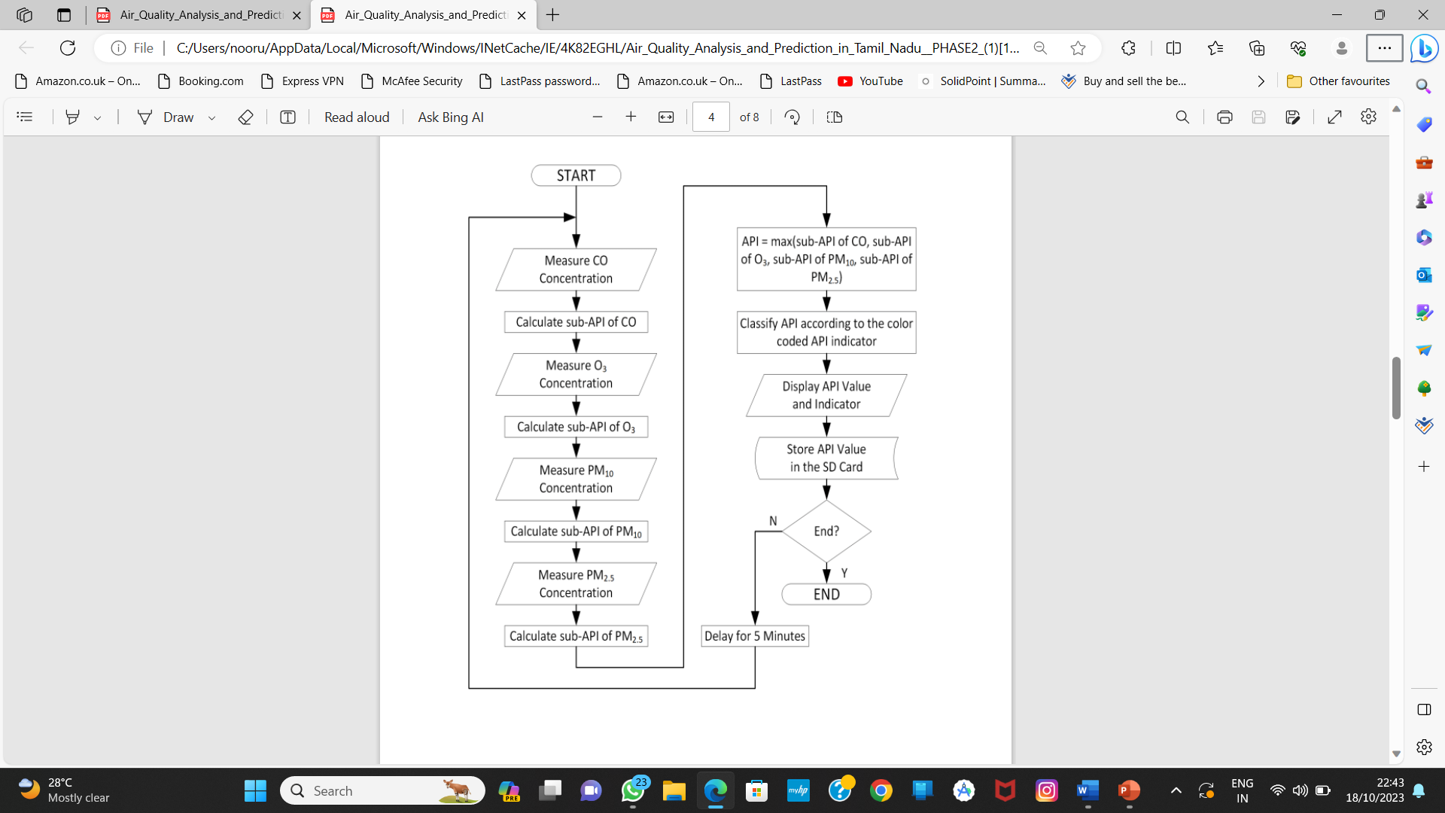
DESIGN AND DATAFLOW
1.Physical data flow diagram:

Slide 9
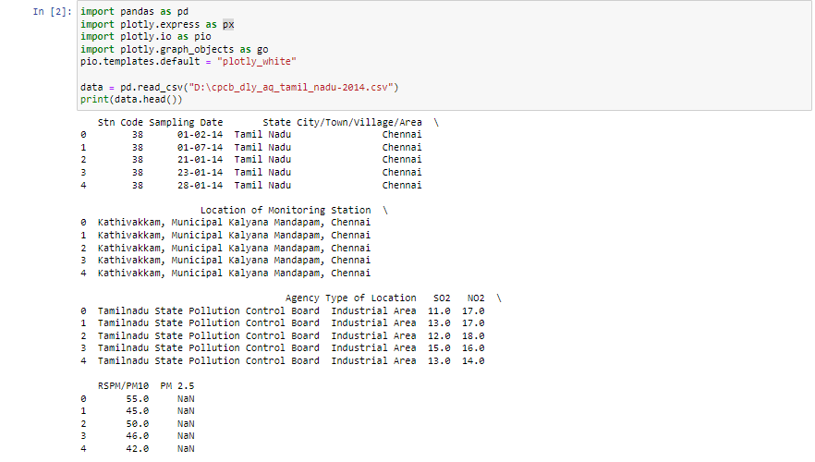
Load the Dataset:
Load your dataset into a Pandas DataFrame. Replace 'your_dataset.csv' with the actual file path or URL of your dataset.
data = pd.read_csv('Example.csv')
If you have a different format (e.g., Excel, JSON), you can use appropriate Pandas functions like pd.read_excel() or pd.read_json().

Slide 10
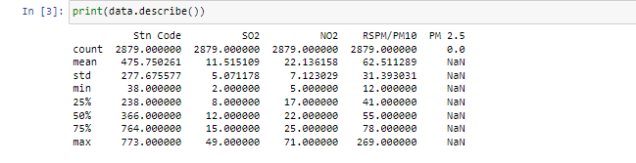
Explore the Dataset:
Begin by getting an overview of your dataset. Check the first few rows, column names, and data types.
Ex:
print(df.head()) # Display the first few rows

Slide 11

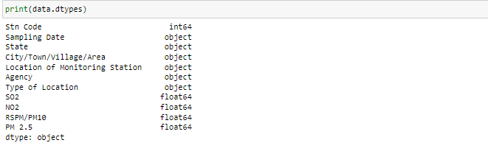
print(df.columns) # List of column names
print(df.dtypes) # Data types of each column

Slide 12
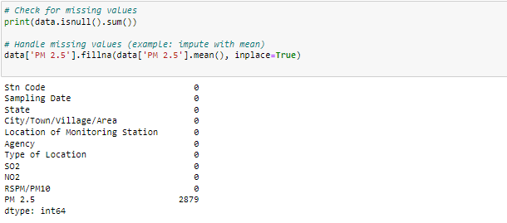
Handling Missing Data:
Identify and handle missing data, which could involve removing rows with missing values or imputing missing values.
# Check for missing values
print(df.isnull().sum())
# Handle missing values (example: impute with mean)
df['column_name'].fillna(df['column_name'].mean(), inplace=True)

Slide 13
Data Cleaning:
Clean the data by addressing any data anomalies, inconsistencies, or outliers.
Data Transformation:
Depending on your project's requirements, you may need to transform the data. This could include converting date columns to datetime objects, encoding categorical variables, or scaling numerical features.
import matplotlib.pyplot as plt
from pandas.api.types import is_string_dtype, is_numeric_dtype
df = pd.read_csv("../input/marketing-data/marketing_data.csv")
df.head()

Slide 14
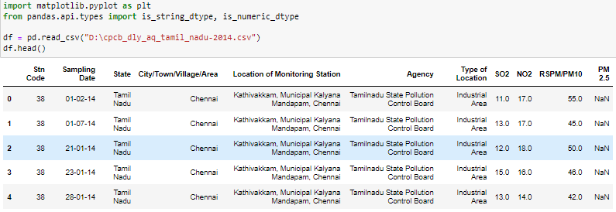
OUTPUT:

Slide 15
Feature Engineering:
Create new features or modify existing ones to improve your dataset's quality.
Exploratory Data Analysis (EDA):
Perform exploratory data analysis using visualizations (e.g., Matplotlib or Seaborn) to gain insights into your data.
Save Preprocessed Dataset:
Once you've completed preprocessing, save the cleaned and transformed dataset to a new file for future use.
df.to_csv('preprocessed_dataset.csv', index=False)

Slide 16
THANK YOU
BY
NOORUL MAJHAR M

