Slide 1

Micro-Credit Defaulter Case
Submitted by:
Bilam Roy

Slide 2
INTRODUCTION
A Microfinance Institution (MFI) is an organization that offers financial services to low income populations. The Microfinance services (MFS) provided by MFI are Group Loans, Agricultural Loans, Individual Business Loans and so on.
They provide micro-credit on mobile balances to be paid back in 5 days.
For the loan amount of 5 (in Indonesian Rupiah), payback amount should be6(in Indonesian Rupiah), while, for the loan amount of 10(in Indonesian Rupiah), the payback amount should be 12(in Indonesian Rupiah).

Slide 3
Purpose of the Project
The purpose of this project is to build a model which can be used to predict in terms of a probability for each loan transaction, whether the customer will be paying back the loaned amount within 5 days of insurance of loan.
It will further help the Microfinance Institution (MFI) to decide for the future investments and improvement in selection of customers.

Slide 4
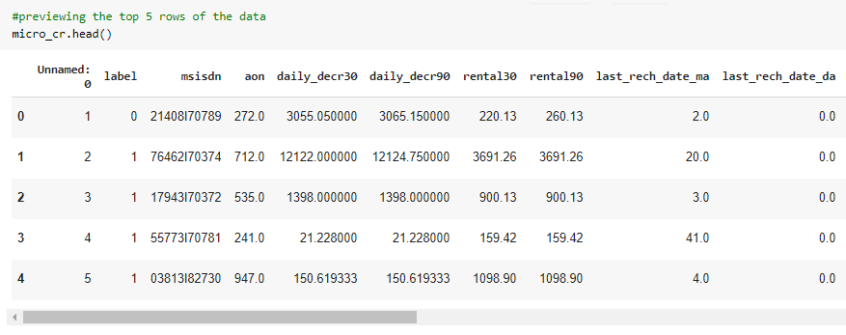
Sample of the Data

Slide 5
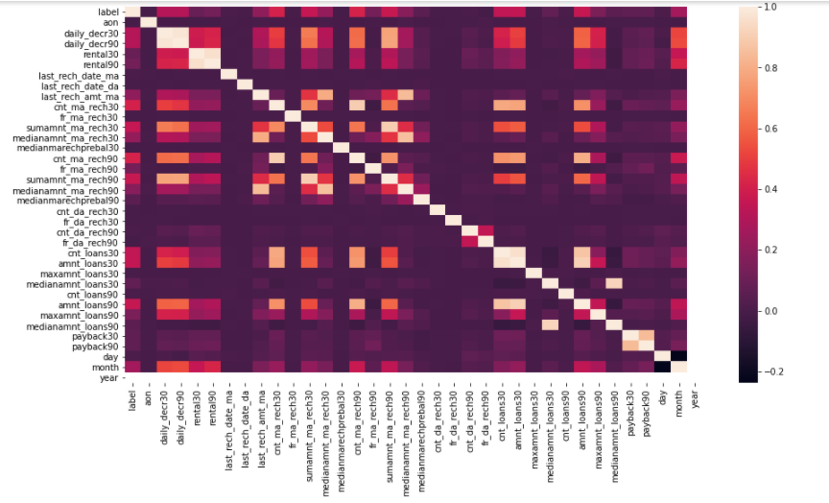
Correlation with each columns

Slide 6
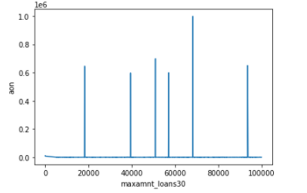
Data Vizualisation
'maximum amount of loan taken by the user in last 30 days'
vs
'age on cellular network in days'

Slide 7
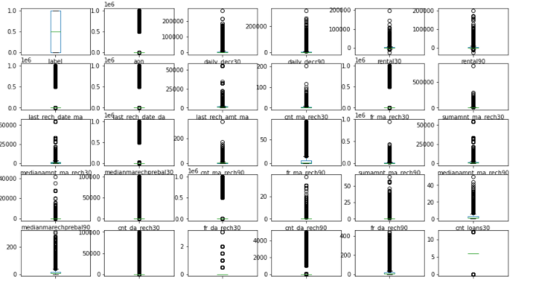
Checking the outliers

Slide 8
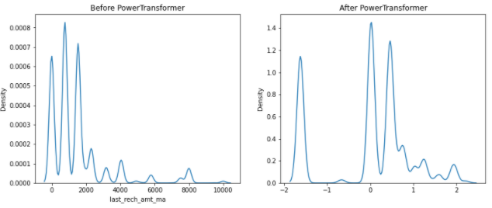
Minimizing the skewness using Power Transformer

Slide 9
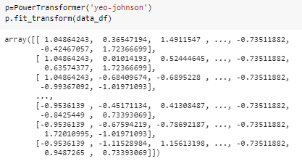

Slide 10
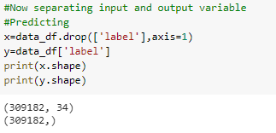
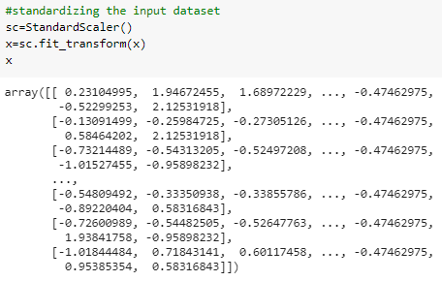
Separating the Input and Output and Standardizing

Slide 11
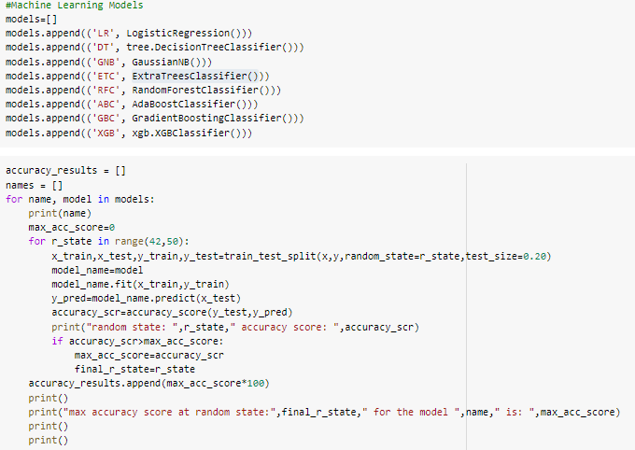
Model Training

Slide 12
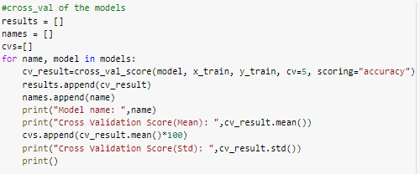
Cross-Validation the Models

Slide 13
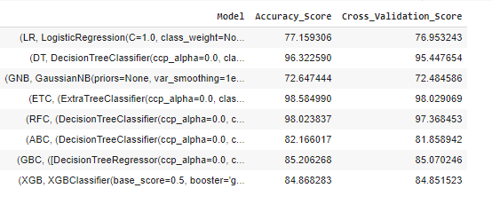
Choosing the Best Model

Slide 14
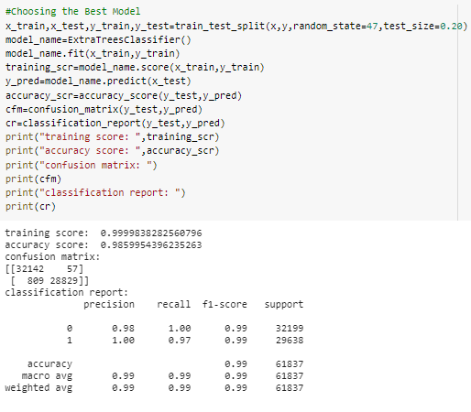

Slide 15
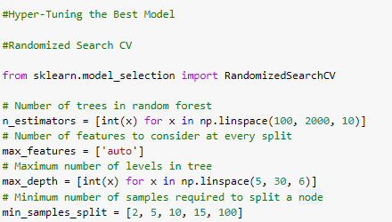
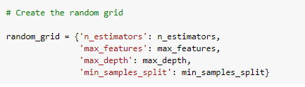
Hyper Parameter Tuning the Model

Slide 16
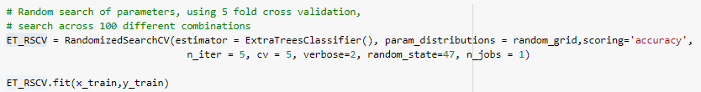
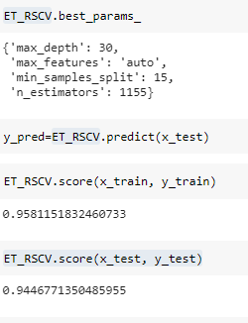
Matrices

Slide 17

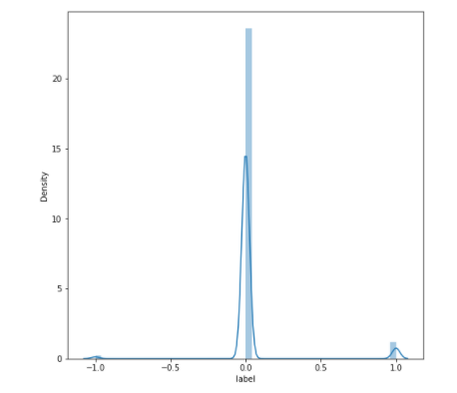

Slide 18
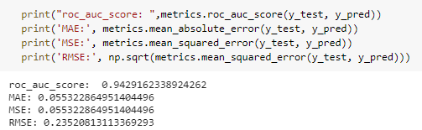

Slide 19
Thank You

