Slide 1
Analyzing Customer Attrition Trends in Credit Card Services
Data Engineer | Virtual Internship
Data Exploration and Visualization

Slide 2
Case Study
The credit card services of a bank are experiencing a growing trend of customer attrition. In this case study, the goal is to identify the issues and determine the profiles of customers who are frequently abandoning their credit card services.
This will enable to pinpoint which customers are likely to churn, facilitating a proactive approach to providing enhanced financial services. The goal is to persuade these customers to reconsider their decision to leave the credit card service.

Slide 3
Business Objective
From the case study provided, the business objectives can be summarized as follows:
Identify the Causes of Customer Attrition
The objective is to understand the reasons behind the increasing trend of customer attrition in the credit card services of the bank.
Customer Profile
Analysis
Create customer profiles that highlight the characteristics of customers who are frequently churning.

Slide 4
Data Exploration

Slide 5
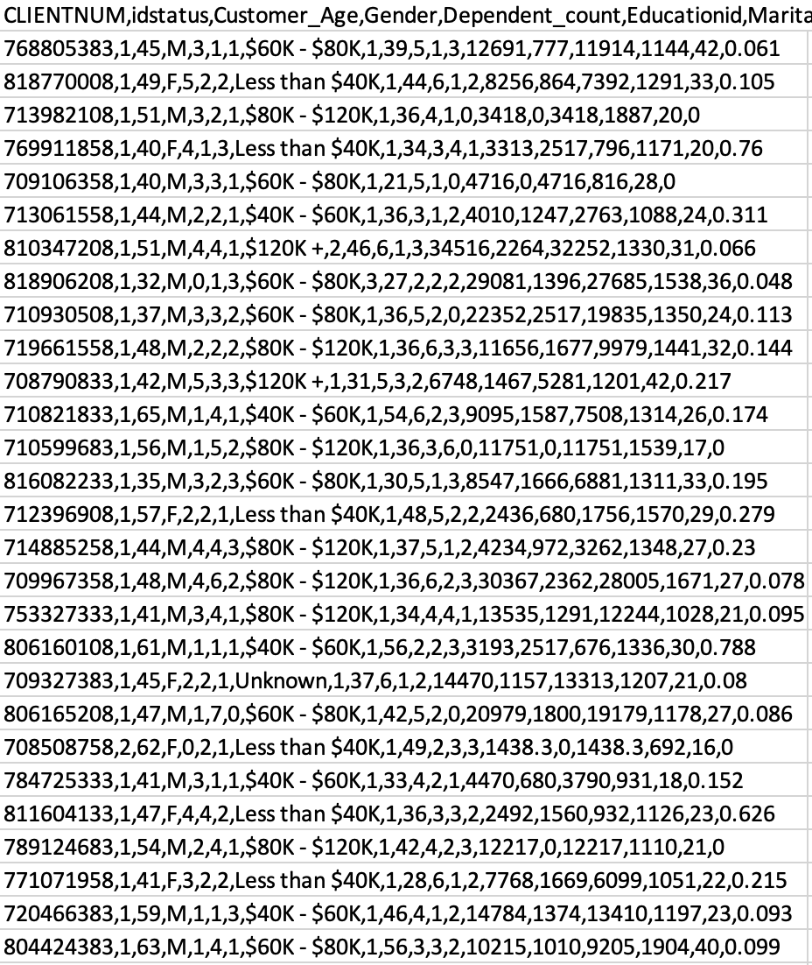
The data provided is in CSV file format and contains over 10,000 records of customer data history. It includes personal information about bank customers as well as their financial information.
Data Preparation
Before the data is ready for use, I applied several data cleansing and data manipulation techniques, including removing missing values, converting CSV files into a relational database format (SQL), and changing incorrect data types of records to ensure they match the appropriate data types.

Slide 6
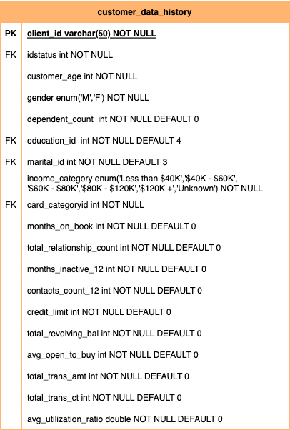
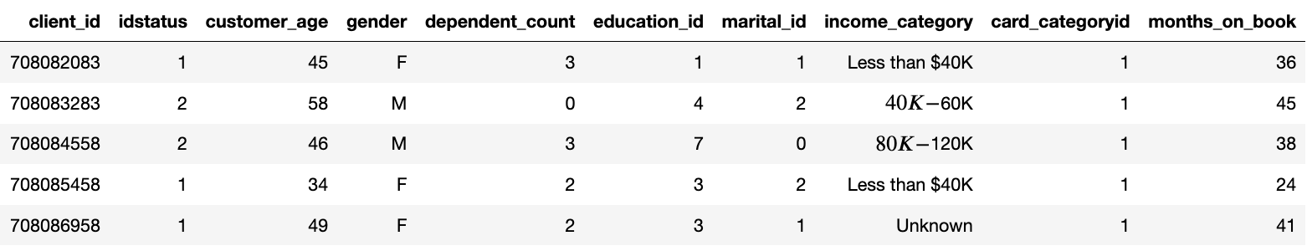
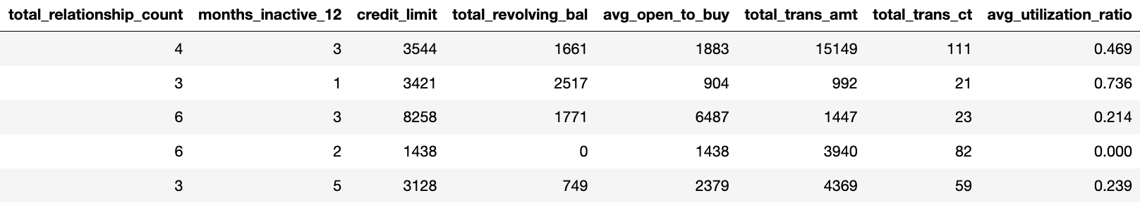
Fact Table
Customer_Data_History
The CSV files were converted into a relational database format. These files contain both personal information about bank customers and their financial data. They serve as fact tables that reference dimension tables through foreign keys. This design minimizes data redundancy.

Slide 7
Fields Description
Client_id: Client ID number
Idstatus: Customer status description
Customer_age: Customer's age
Gender: Customer's gender
Dependent count: Number of dependents for the customer
Educationid: Description of customer's education level
Maritalid: Customer's marital status
Income_category: Customer's income category
Card_categoryid: Type of customer's credit card
Month_on_book: Duration of the customer's relationship with the bank
Relationship_in_count: Total number of products held by the customer
Months_inactive_in_12_month: Number of months of inactivity in the last 12 months
Contacts_Count_12_mon: Total times the bank contacted the customer in the last 12 months
Credit limit: Credit limit
Total Revolving Balance on the Credit Card: Total balance carried over on the credit card
Avg_open_to_buy: Amount available for purchases on the credit card on average in the last 12 months
Total_trans_amt: Total transaction amount
Total_trans_ct: Frequency of transactions
Avg_utilization_ratio: Average credit card utilization ratio

Slide 8
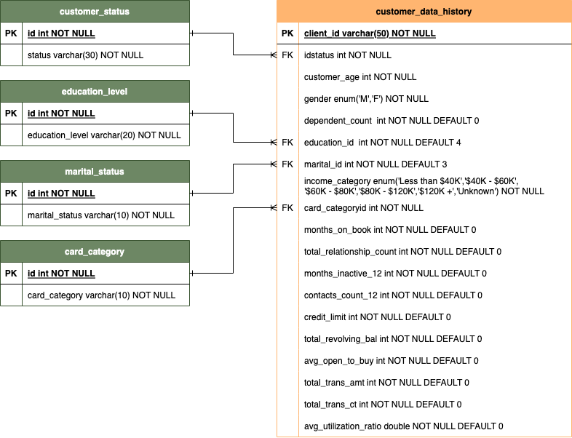
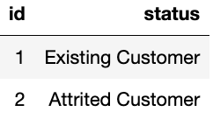
Dimensional Table
Customer_Status
The ‘customer_status' dimension table is a reference table that is referred to by the 'customer_data_history' table. It holds information about customer existing/attrited status and is connected to the 'customer_data_history' table via the 'id' as the primary key.

Slide 9
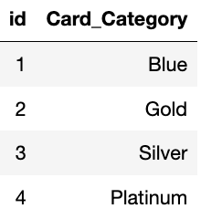
Dimensional Table
Card_Category
The 'card_category' dimension table is a reference table that is referred to by the 'customer_data_history' table. It holds information about customer card categories and is connected to the 'customer_data_history' table via the 'id' as the primary key.

Slide 10
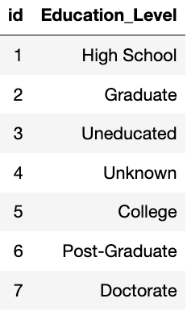
Dimensional Table
Education_Level
The ‘education_level' dimension table is a reference table that is referred to by the 'customer_data_history' table. It holds information about customer education level and is connected to the 'customer_data_history' table via the 'id' as the primary key.

Slide 11
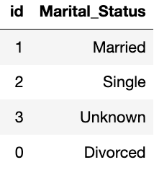
Dimensional Table
Marital_Status
The ‘marital_status' dimension table is a reference table that is referred to by the 'customer_data_history' table. It holds information about customer marital status and is connected to the 'customer_data_history' table via the 'id' as the primary key.

Slide 12
Data Model

Slide 13
Insight Visualization

Slide 14
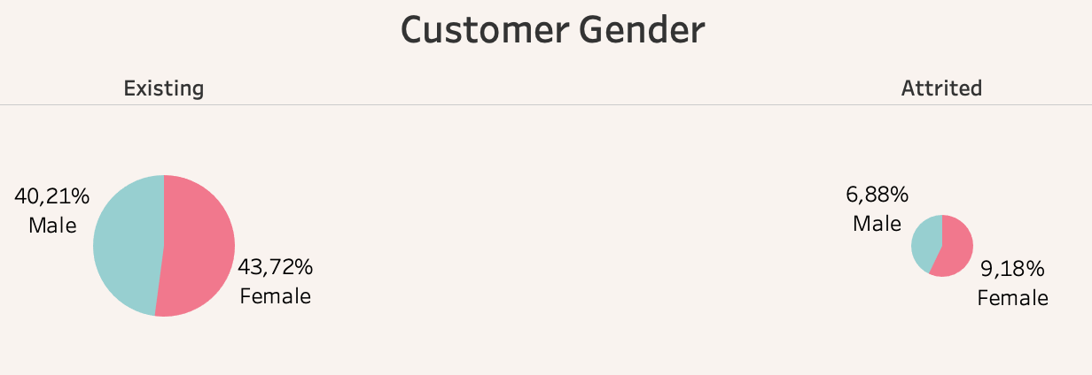
Customer Gender
Existing and Attrited Customer
44% of existing customers are female-dominated, while among attrited customers, females dominate by 9%.

Slide 15
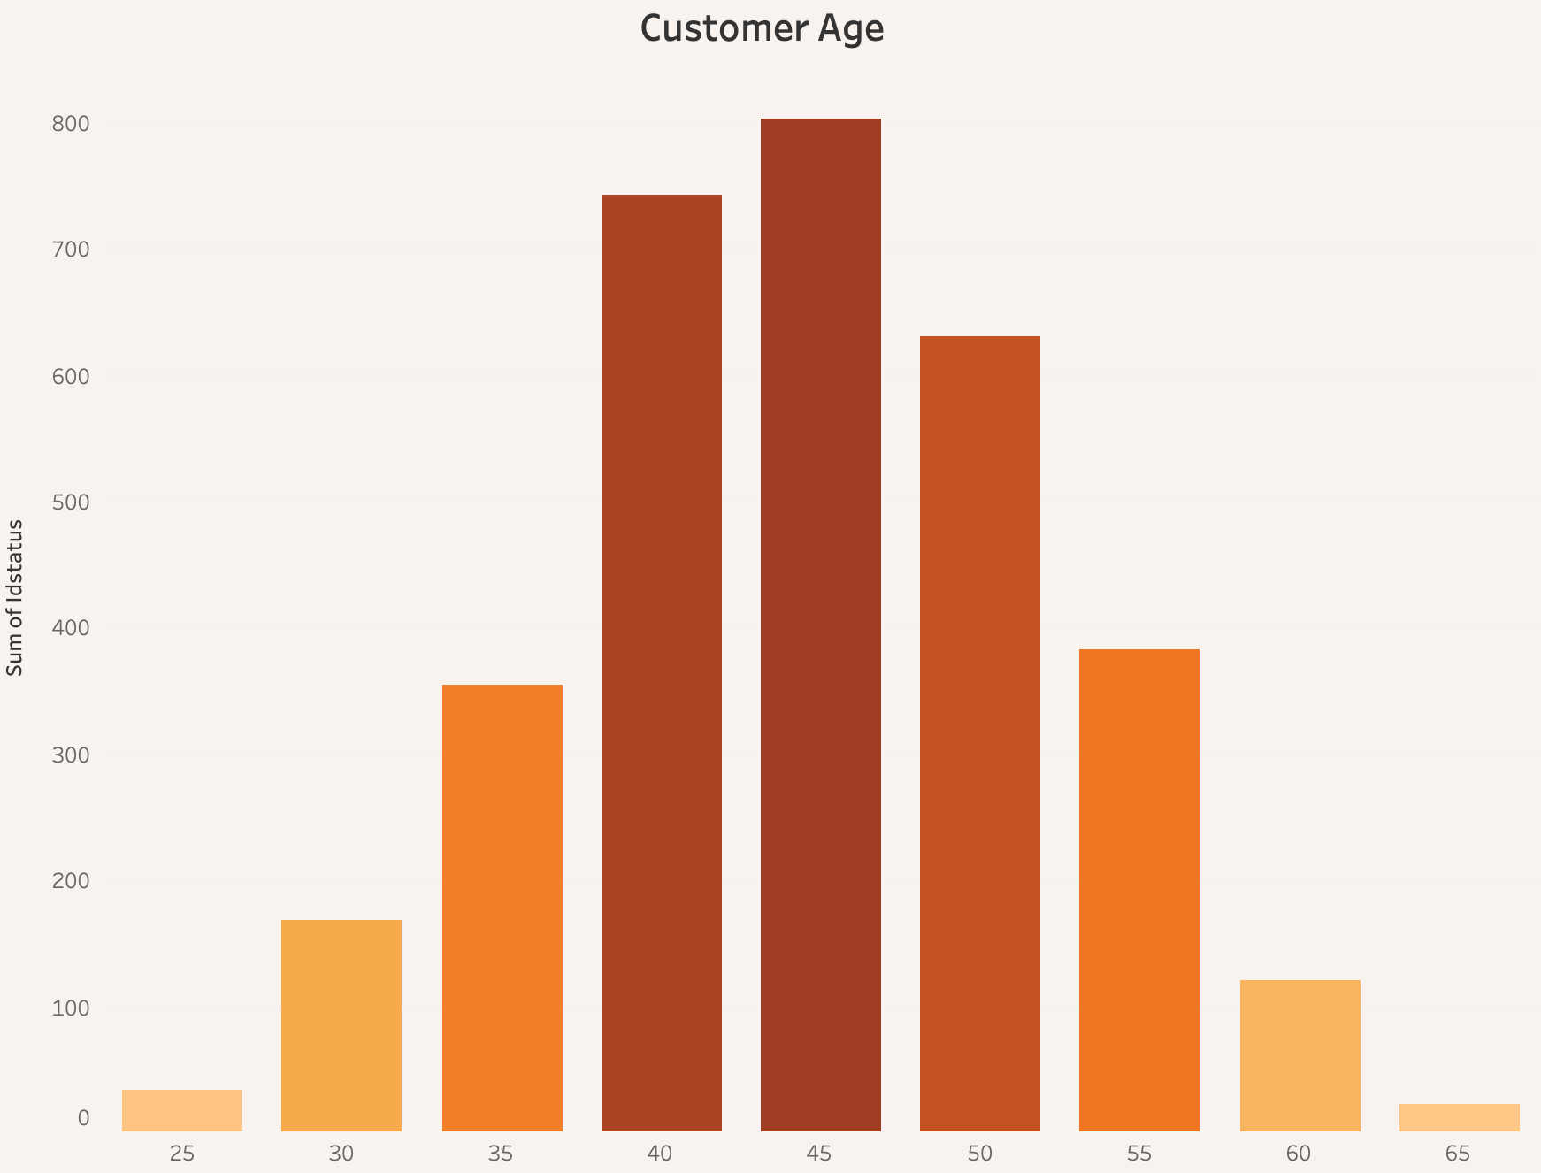
Customer Age
Attrited Customer
The age group that experiences the highest attrition rate in credit card services is typically between 40 and 50 years old.

Slide 16
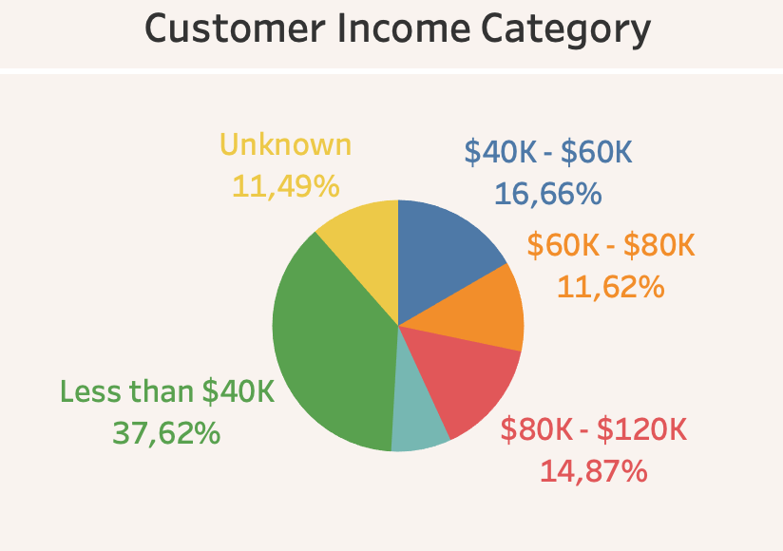
Customer Income Category
Attrited Customer
The customer category most prone to attrition in credit card services consists of those with an income of less than $40,000.

Slide 17
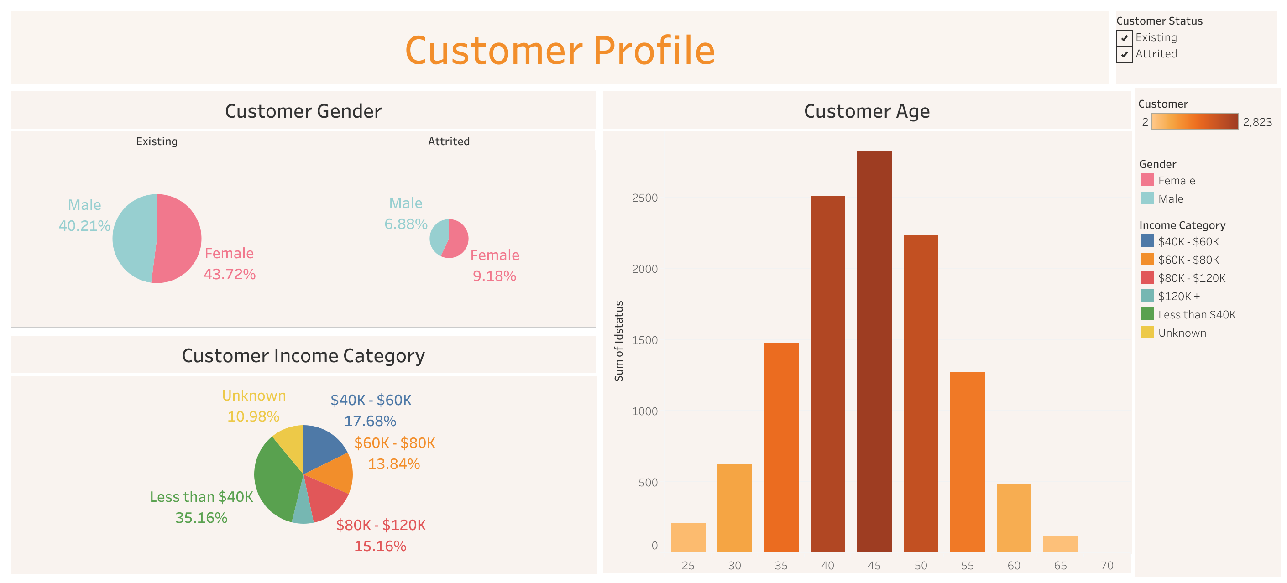
Customer Profile Dashboard
Tableau
See in Tableau Public

Slide 18
Conclusions and Solutions
Approach
Facilitating a proactive approach to providing enhanced financial services to customers who are in their elder age and have an income of less than $40,000.
Income Category and Age
Income category and age are the most significant factors that cause customers to withdraw from credit card services.

Slide 19
Thank You

