Slide 1
Data Engineer Final Project
Data Engineer | Virtual Internship
Shell Scripting, Data Transformation, Data Cleansing

Slide 2
Task
The final project in the Kalbe Nutritionals virtual internship program consists of several tasks and questions that need to be completed, such as creating a shell script to check the availability of a directory, performing data ingestion using Python and SQL, converting raw data into SQL format, executing requested queries, and performing table normalization.

Slide 3
Directory Check
Task 1
Shell Scripting

Slide 4
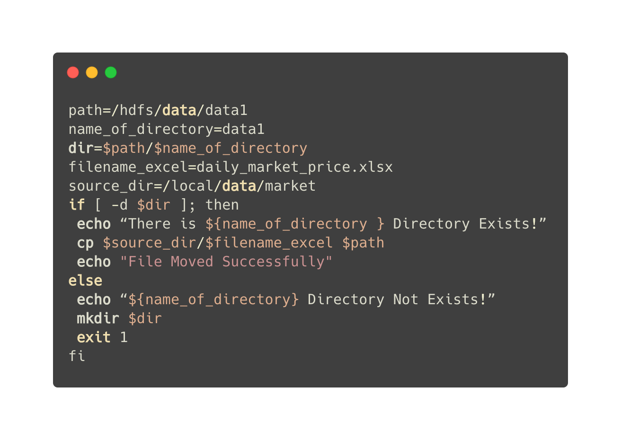
Create a bash shell script to check whether directory exists inside a given path.

Slide 5
Python to SQL
Task 2
Python

Slide 6
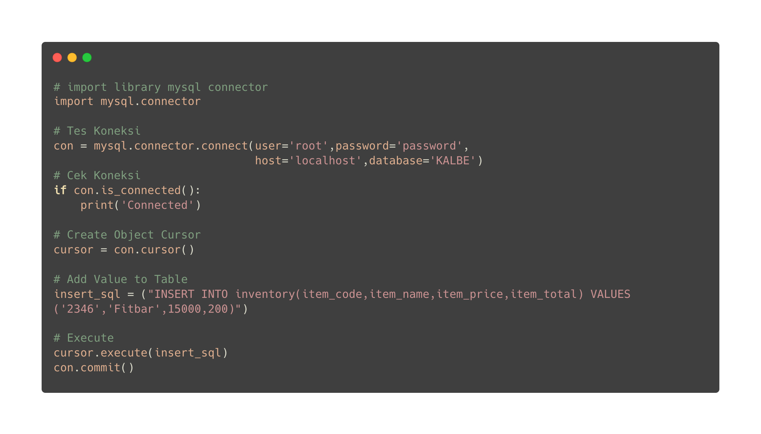
Insert data to inventory table in KALBE database from Python to MySQL

Slide 7
Inventory Table
Task 3
MySQL DDL & DML

Slide 8
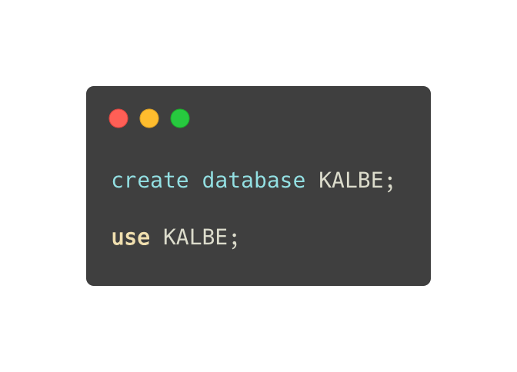
Create a database with ‘KALBE’ as the name.

Slide 9
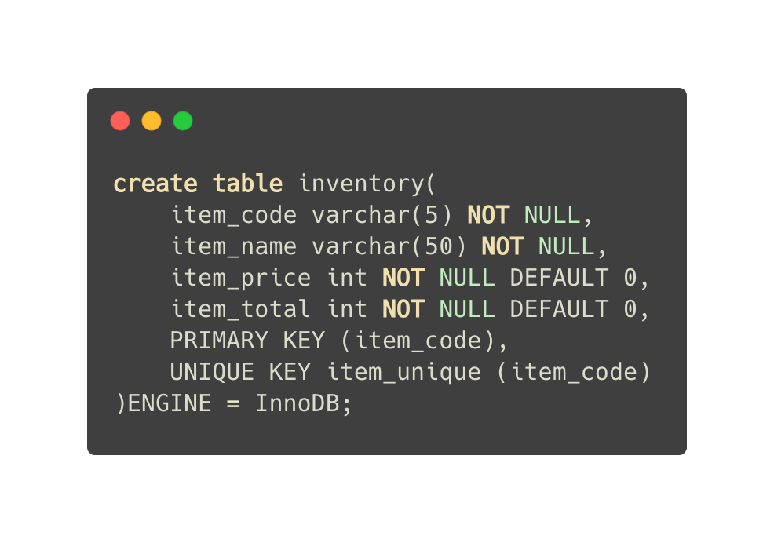
Inside the database, create a table with the name ‘Inventory’, with columns Item_code, Item_name, Item_price, and Item_total.

Slide 10
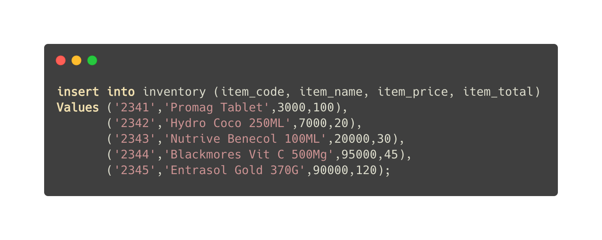
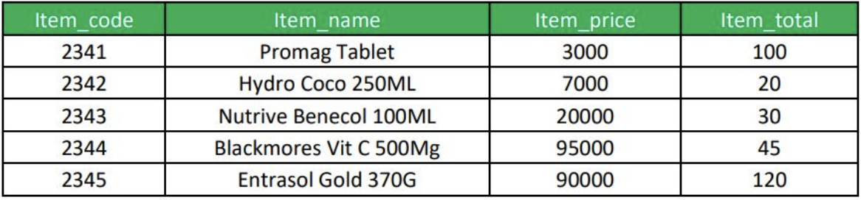
Insert below data into the table:

Slide 11
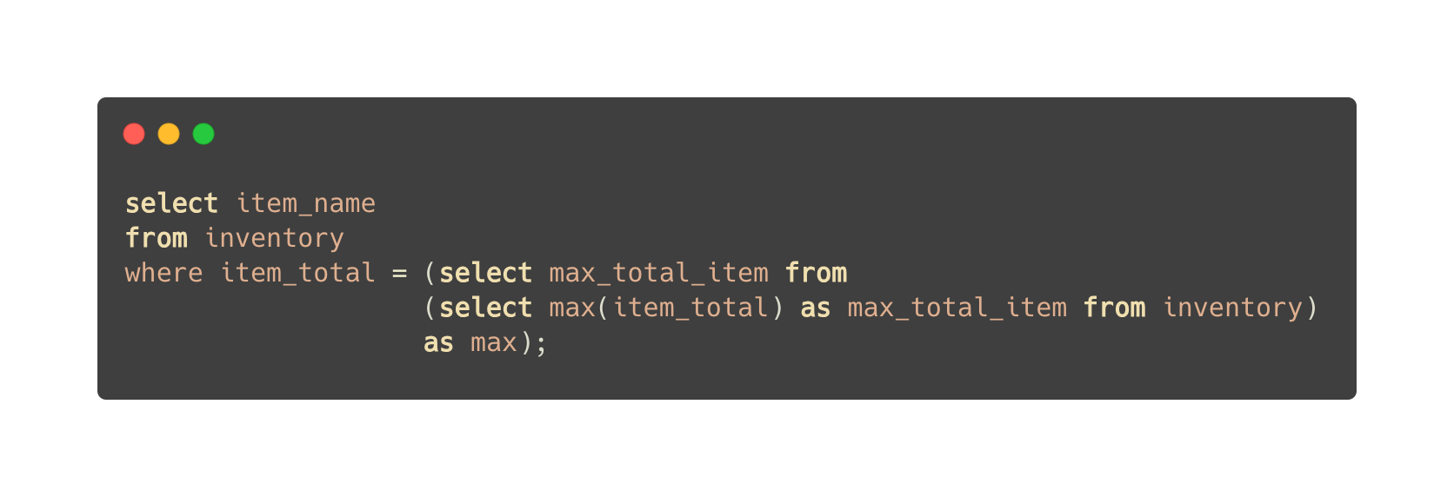
Show Item_name that has the highest number in Item_total.

Slide 12
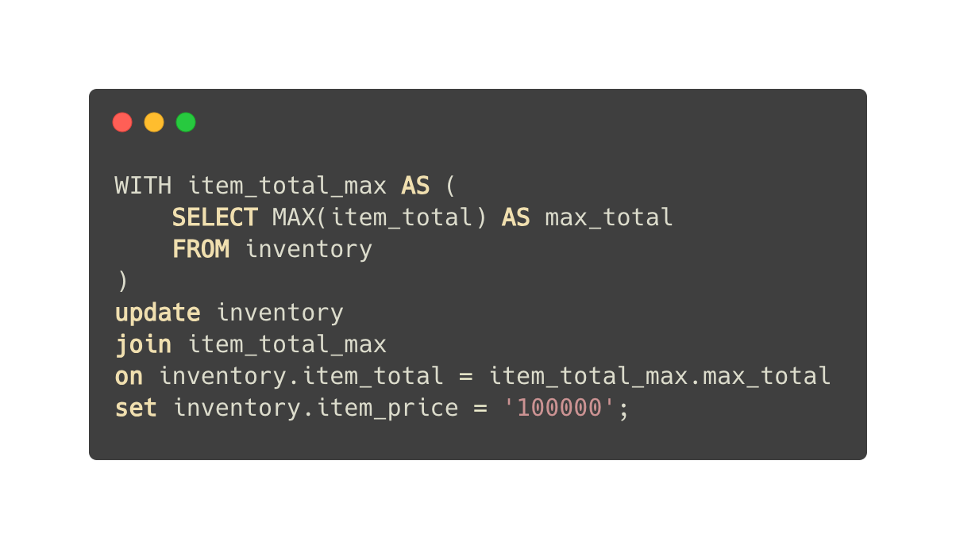
Update the Item_price of the output of question bullet.

Slide 13
What will happen if we insert another Item_name with Item_code of 2343 into the table?
It cannot be performed because the 'item_code' field already contains an item with the code '2343,' and this field has a unique constraint that prevents the addition of new records with the same value.

Slide 14
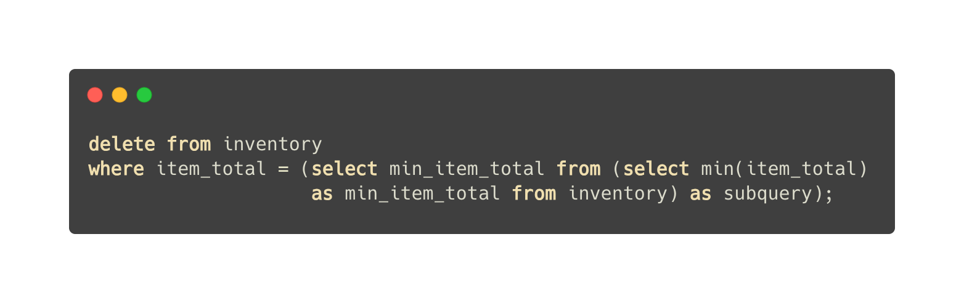
Delete the Item_name that has the lowest number of Item_total.

Slide 15
Customer Orders Table
Task 4
MySQL DML

Slide 16
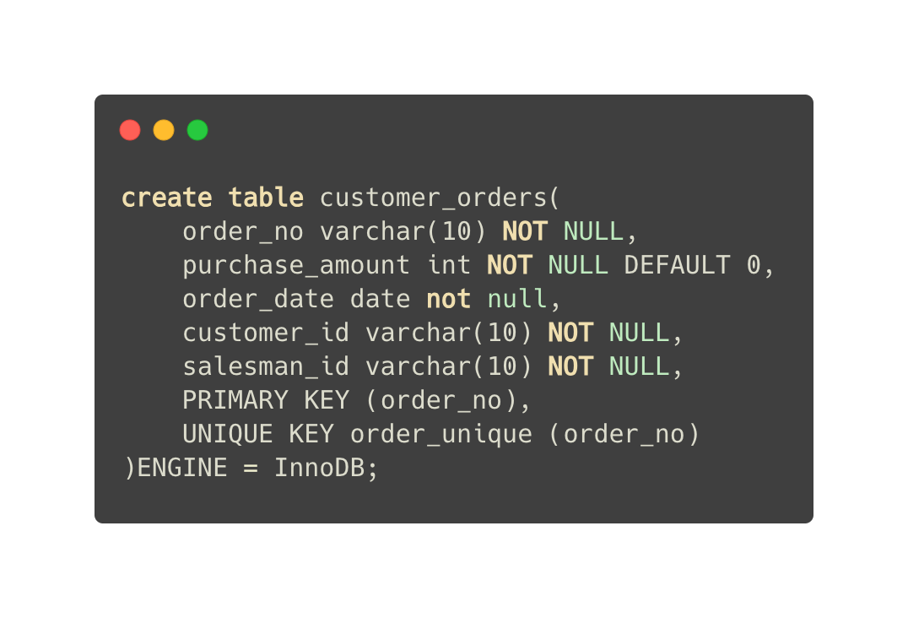
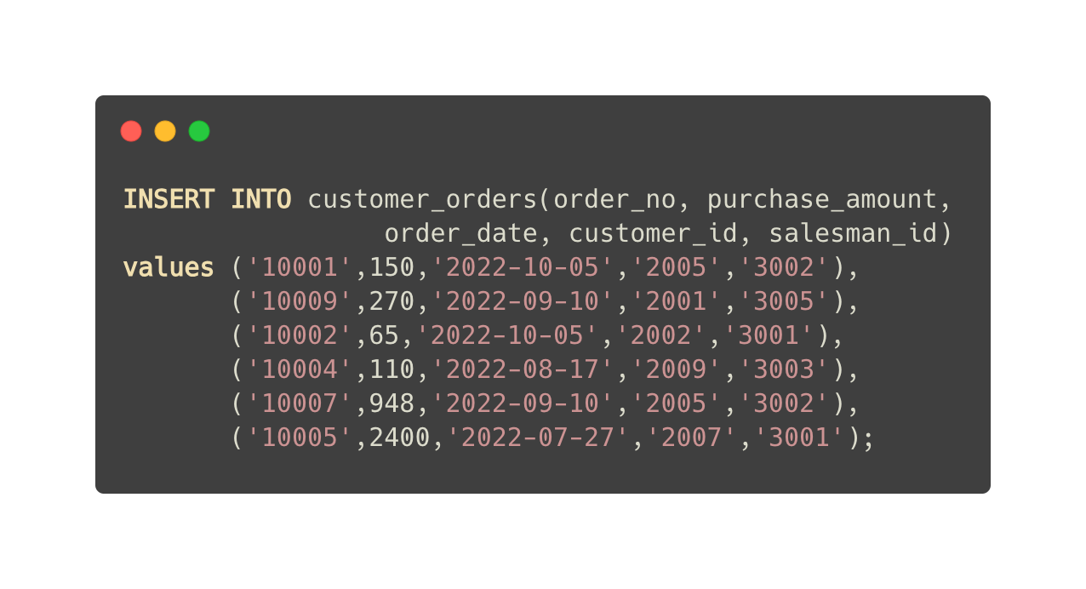
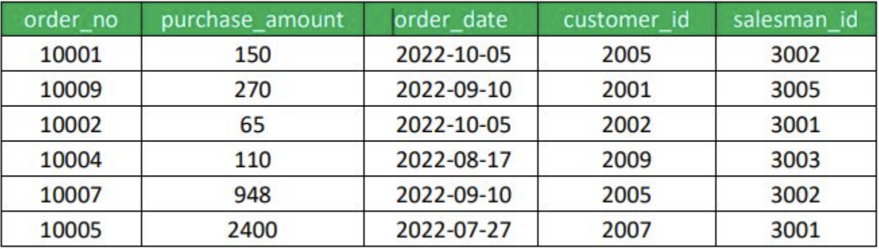
Create customer orders table in the ’KALBE’ database with this field and value as shown in the table below.

Slide 17
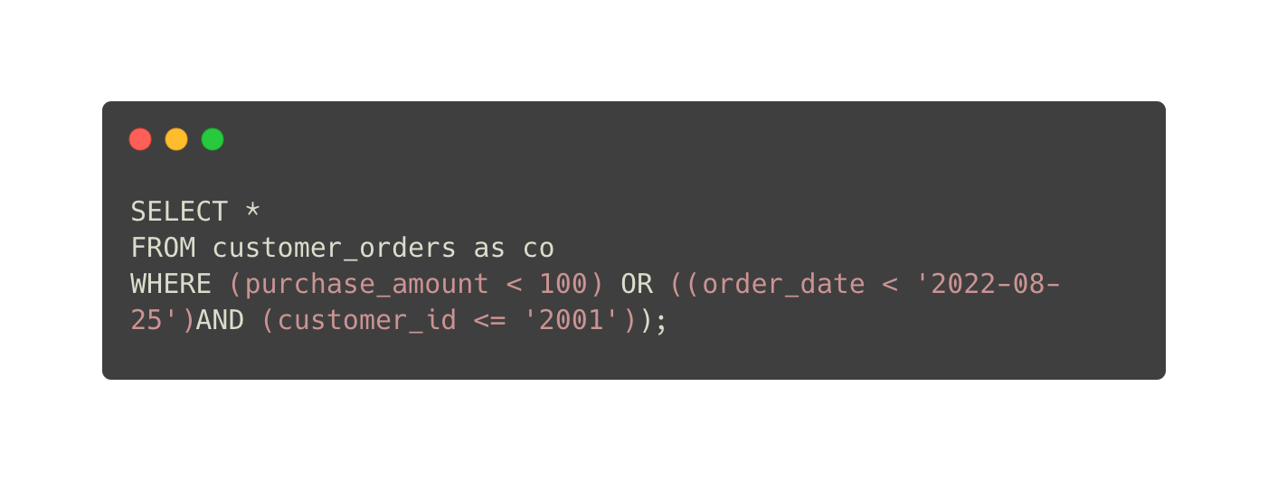
Create a Query to display all customer orders where purchase amount is less than 100 or exclude those orders which order date is on or greater than 25 Aug 2022 and customer id is above 2001.

Slide 18
Sales Order Table
Task 5
Star Scheme

Slide 19
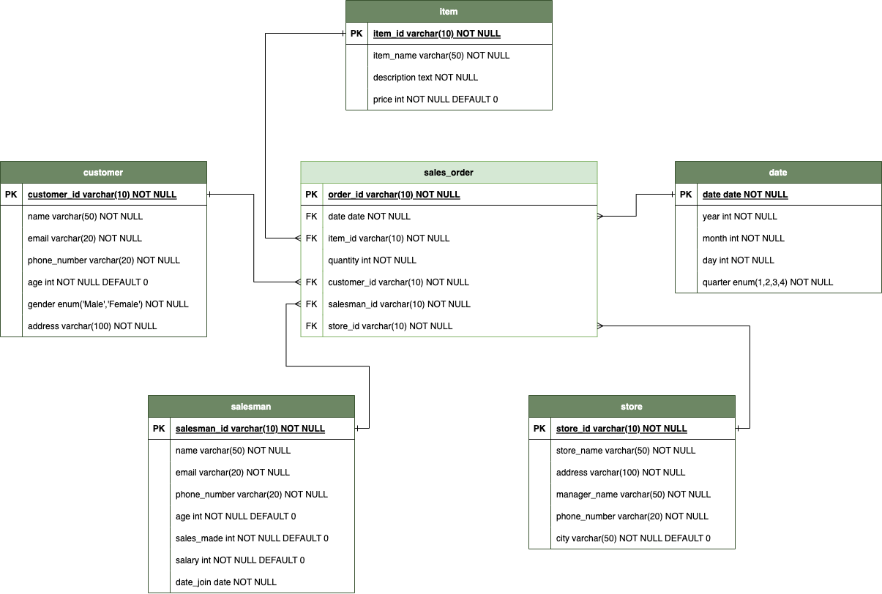
Create a simple star schema for KALBE database consist of 1 Fact and 5 Dimensions using Physical Data Model Theory.

Slide 20
Thank You!
billawalhaesri@gmail.com

