Slide 1

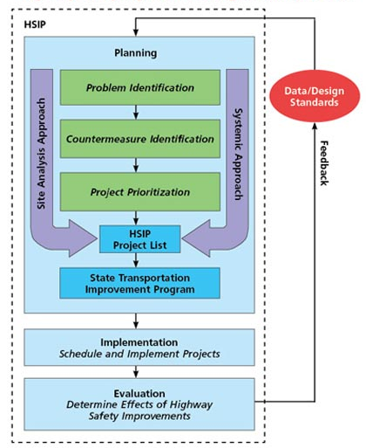


PLANNING AND INVESTMENT STRATEGY
CS-322
DESIGN AND ANALYSIS OF ALGORITHM
MUHAMMAD FARRUKH SEIKH 15B-013-BS, BILAWAL SAIKH 15B-054-BS,
HAFIZ YASIR IQBAL 15B-032-BS
DYNAMIC PROGRAMING
FLOW CHART
In computer science, mathematics, management science, economics and bioinformatics, dynamic programming (also known as dynamic optimization) is a method for solving a complex problem by breaking it down into a collection of simpler subproblems, solving each of those subproblems just once, and storing their solutions.
An investment strategy guide an investor's actions with asset allocation. Strategies vary,but they are based on individual goals, risk tolerance and future needs for capital.
INVESTMENT STRATEGY
ALGORITHM
Create your
investment plan
INVEST(d, n)
initialize tables I and R of size 11, all filled with 0s
for k = 10 downto 1
q = 1
for i = 1 to n
if r[i][k] > r[q][k] // i now holds the investment which looks best for a given year
q = i
if R[k + 1] + drI[k + 1]k - f[1] > R[k + 1] + dr[q][k] - f[2] // If revenue is greater when money is not moved
R[k] = R[k + 1] + drI[k + 1]k - f[1]
I[k] = I[k + 1]
else
R[k] = R[k + 1] + dr[q][k] - f[2]
I[k] = q
return I as an optimal stategy with return R[1].
4 steps to creating your plan
1. Set specific and realistic goals
4. Develop an investment policy statement
2. Calculate how much you need to save each month
3. Choose your investment strategy
REFRENCES
https://walkccc.gitbooks.io/clrs/Chap15/15-10.html
https://www.getsmarteraboutmoney.ca/invest/investing-basics/making-a-plan/create-your-investment-plan/
Introduction To Algorithm (Second Edition)by T.Cormen, C. Leiserson, and R . Rivest

