Slide 1


Kubernetes

Slide 2
What is Kubernetes?
Kubernetes is a portable, extensible open-source platform for managing containerized workloads and services, that facilitates both declarative configuration and automation. It has a large, rapidly growing ecosystem. Kubernetes services, support, and tools are widely available.

Slide 3
Why K8S?
Developers are lazy and somewhere in the mid-late 80s they started abbreviating the words based on their first letter, last letter, and number of letters in between. This is why you’ll sometimes see i18n for internationalization and l10n for localization. There are also new numeronyms such as Andreessen Horowitz (a16z) and of course our favorite kubernetes (k8s).

Slide 4
Why do we need Kubernetes?
a container platform
a microservices platform
a portable cloud platform and a lot more.
Kubernetes provides a container-centric management environment. It orchestrates computing, networking, and storage infrastructure on behalf of user workloads. This provides much of the simplicity of Platform as a Service (PaaS) with the flexibility of Infrastructure as a Service (IaaS), and enables portability across infrastructure providers.
K8S Allows developers / system operators to cut to the cord and truly run a container-centric dev / microservice environment

Slide 5
Kubernetes is not completely PaaS
Kubernetes is not a traditional, all-inclusive PaaS (Platform as a Service) system (Incounterary to OpenShift).
Kubernetes operates at the container level rather than at the hardware level, it provides some generally applicable features common to PaaS offerings, such as deployment, scaling, load balancing, logging, and monitoring.

Slide 6
Kubernetes is not completely PaaS
Does not deploy source code and does not build your application - CI/CD Does
Does not provide application-level services, such as middleware (e.g., message buses), data-processing frameworks (for example, Spark), databases (e.g., mysql), caches, nor cluster storage systems (e.g., Ceph) as built-in services
Does not dictate logging, monitoring, or alerting solutions.
Does not provide nor mandate a configuration language/system (e.g., jsonnet). It provides a declarative API that may be targeted by arbitrary forms of declarative specifications.
Does not provide nor adopt any comprehensive machine configuration, maintenance, management, or self-healing systems.

Slide 7
K8S: Concepts
To work with Kubernetes, we use Kubernetes API objects to describe our cluster’s desired state:
what applications or other workloads we want to run
what container images they use, the number of replicas, what network and disk resources we want to make available.
setting our desired state by creating objects using the Kubernetes API (typically via the command-line interface - kubectl)
Once we’ve set our desired state, Kubernetes Control Plane works to make the cluster’s current state match the desired state

Slide 8
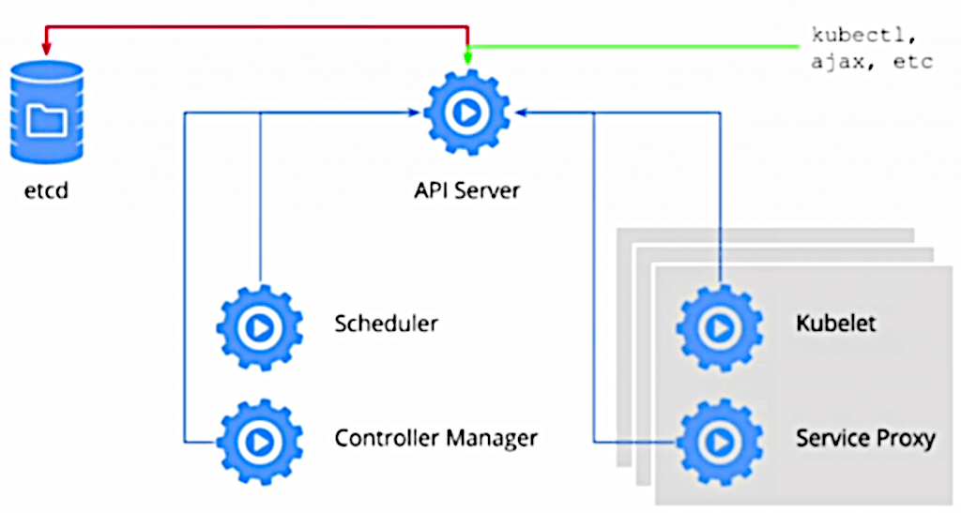
K8S: Concepts
Kubernetes performs a variety of tasks automatically–such as starting or restarting containers, scaling the number of replicas of a given application, and more. The Kubernetes Control Plane consists of a collection of processes running on your cluster:
Kubernetes Master:
etcd
kube-apiserver
kube-controller-manager
kube-scheduler
Non-master:
kubelet
kube-proxy

Slide 9
K8S: Concepts
etcd - highly-available key value store used as Kubernetes’ backing store for all cluster data
kube-apiserver - Validates and configures data for the api objects which include pods, services, replicationcontrollers, and others. Exposes the Kubernetes API. It is the front-end for the Kubernetes control plane. It is designed to scale horizontally – that is, it scales by deploying more instances.
kube-scheduler - its job is to take pods that aren’t bound to a node, and assign them one along with hardware/software/policy constraints

Slide 10
K8S: Concepts
kube-controller-manager - is a an application control loop that watches the shared state of the cluster through the apiserver and makes changes attempting to move the current state towards the desired state:
Node Controller - Responsible for noticing and responding when nodes go down
Replication controller - Responsible for maintaining the correct number of pods for every replication controller object in the system
Endpoints Controller - Populates the Endpoints object (that is, joins Services & Pods)
Service account & Token Controllers - Create default accounts and API access tokens for new namespaces

Slide 11
K8S: Concepts
Cloud-controller-manager - runs controllers that interact with the underlying cloud providers. cloud-controller-manager allows cloud vendors code and the Kubernetes core to evolve independent of each other and develops functionality (by the cloud providers) that will be linked to K8S cloud-controller-manger. The following controllers have cloud provider dependencies
Node Controller: For checking the cloud provider to determine if a node has been deleted in the cloud after it stops responding
Route Controller: For setting up routes in the underlying cloud infrastructure
Service Controller: For creating, updating and deleting cloud provider load balancers
Volume Controller: For creating, attaching, and mounting volumes, and interacting with the cloud provider to orchestrate volumes

Slide 12
K8S: Concepts
On each non-master node:
kubelet - which communicates with the Kubernetes Master.
kube-proxy - A network proxy which reflects Kubernetes networking services on each node.

Slide 13
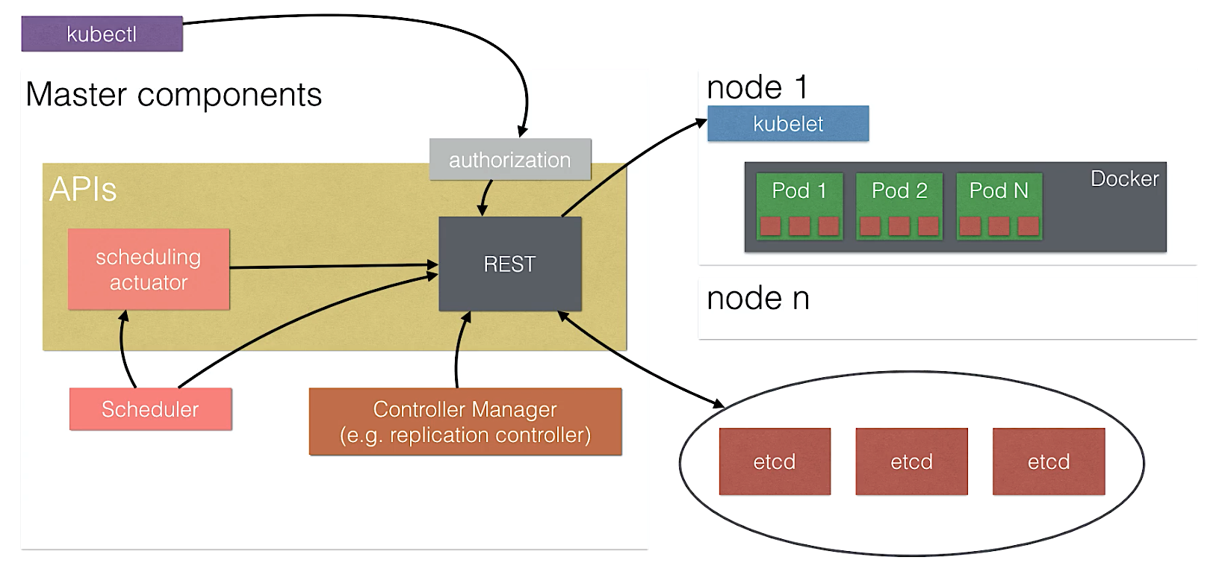
K8S: Concepts

Slide 14
K8S: Objects
Kubernetes contains a number of abstractions that represent the state of your system: deployed containerized applications and workloads, their associated network and disk resources and other :
The basic Kubernetes objects include:
Pod
Service
Volume
Namespase
The higher-level abstractions called Controllers:
ReplicaSet
Deployment
StatuefulSet
DaemonSet
Job

Slide 15
K8S: Objects
For this current course we have already created the Kubernetes environment on CentOS for you, please ask mentor to provide the credentials.
- by this sign we would mark the practice part
Get to the course Kubernetes master environment using SSH CLI (command line interface):
Type the following command to get the kubectl version and cluster configuration:
>kubectl --version
>kubectl cluster-info
The output should be like this:
>Kubernetes v1.9.2+coreos.0
>Kubernetes master is running at http://localhost:8080 KubeDNS is running at http://localhost:8080/api/v1/namespaces/kube-system/services/kube-dns:dns/proxy

Slide 16
K8S: Objects
Type the following command to get cluster nodes configuration:
>kubectl get nodes
NAME | STATUS | ROLES | AGE | VERSION
ip-172-24-2-10.eu-central-1.compute.internal | Ready | master | 23h | v1.9.2+coreos.0
ip-172-24-3-10.eu-central-1.compute.internal | Ready | node | 23h | v1.9.2+coreos.0
ip-172-24-3-11.eu-central-1.compute.internal | Ready | node | 23h | v1.9.2+coreos.0

Slide 17
K8S: Objects
Pod is the basic building block of Kubernetes–the smallest and simplest unit in the Kubernetes object model that you create or deploy. A Pod represents a running process on your cluster.
Pods in a Kubernetes cluster can be used in two main ways:
Pods that run a single container. The “one-container-per-Pod” model is the most common Kubernetes use case
Pods that run multiple containers that need to work together. A Pod might encapsulate an application composed of multiple co-located containers that are tightly coupled and need to share resources.

Slide 18
K8S: Objects

Slide 19
K8S: Objects
To get the pods list, please run the following on the master node:
>kubectl get pods
We have already installed the test application there- Nexus repository manager, so the output should be like this:
*-please note, that the name ID part should differ per item:
edgy-grizzly-sonatype-nexus-6d6bf984f-stbxb
NAME | READY | STATUS | RESTARTS | AGE
edgy-grizzly-sonatype-nexus-6d6bf984f-stbxb | 1/1 | Running | 0 | 25m

Slide 20
K8S: Objects
To see the details about the object, please run:
>kubectl describe pod edgy-grizzly-sonatype-nexus-6d6bf984f-stbxb
To see the object’s logs, please run:
>kubectl logs edgy-grizzly-sonatype-nexus-6d6bf984f-stbxb
To delete* the pod, please run:
>kubectl delete pod edgy-grizzly-sonatype-nexus-6d6bf984f-stbxb
*- no worries, the pod would be deleted, albeit the Replica set would start the other one with the new ID. Check this by kubectl get pods

Slide 21
K8S: Objects
On-disk files in a Container are ephemeral, which presents some problems for non-trivial applications when running in Containers.
when a Container crashes, kubelet will restart it, but the files will be lost - the Container starts with a clean state.
when running Containers together in a Pod it is often necessary to share files between those Containers.
The Kubernetes Volume abstraction solves both of these problems.

Slide 22
K8S: Objects
Kubernetes supports several types of Volumes:
awsElasticBlockStore
azureDisk
azureFile
cephfs
configMap
csi
downwardAPI
emptyDir
fc (fibre channel)
flocker
gcePersistentDisk
gitRepo (deprecated)
glusterfs
hostPath
iscsi
local
nfs
persistentVolumeClaim
projected
portworxVolume
quobyte
rbd
scaleIO
secret
storageos
vsphereVolume

Slide 23
K8S: Objects
Let’s elaborate some of them:
ConfigMap volume- resource provides a way to inject configuration data into Pods. The data stored in a ConfigMap object can be referenced in a volume of type configMap and then consumed by containerized applications running in a Pod.
Basically, the ConfigMap mechanism stores the alias mapping for the parameters to keep containerized applications portable.

Slide 24
K8S: Objects
A Secret volume is used to pass sensitive information, such as passwords, to Pods. You can store secrets in the Kubernetes API and mount them as files for use by Pods without coupling to Kubernetes directly. secret volumes are backed by tmpfs (a RAM-backed filesystem) so they are never written to non-volatile storage.

Slide 25
K8S: Objects
A PersistentVolumeClaim volume is used to mount a PersistentVolume into a Pod. PersistentVolumes are a way for users to “claim” durable storage (such as a GCE PersistentDisk or an iSCSI volume) without knowing the details of the particular cloud environment. Basically it’s like a shortcut to the external provider.

Slide 26
K8S: Objects
An NFS volume allows an existing NFS (Network File System) share to be mounted into your Pod. The contents of an nfs volume are preserved and the volume is merely unmounted when the pod is removed. This means that an NFS volume can be pre-populated with data, and that data can be “handed off” between Pods. NFS can be mounted by multiple writers simultaneously.

Slide 27
K8S: Objects
To get the pod’s volume information, please run:
>kubectl describe pod edgy-grizzly-sonatype-nexus-6d6bf984f-stbxb
And see the “Volumes” section:
…
Volumes:
nexus-data-volume:
Type: PersistentVolumeClaim (a reference to a PersistentVolumeClaim in the same namespace)
ClaimName: edgy-grizzly-sonatype-nexus
ReadOnly: false
default-token-7gr5x:
Type: Secret (a volume populated by a Secret)
SecretName: default-token-7gr5x
Optional: false
…

Slide 28
K8S: Objects
Let’s elaborate the volumes, please run:
>kubectl get pvc
#For the PersistentVolumeClaim
>kubectl get secrets
Run ‘describe’ on the objects to see the details
NAME | STATUS | VOLUME | CAPACITY | ACCESS MODES | STORAGECLASS | AGE
edgy-grizzly-sonatype-nexus | Bound | nexus | 10Gi | RWO |  | 10h
NAME | TYPE | DATA | AGE
default-token-7gr5x | kubernetes.io/service-account-token | 2 | 94d

Slide 29
K8S: Objects
PVs are resources in the cluster. PVCs are requests for those resources and also act as claim checks to the resource. The interaction between PVs and PVCs follows this lifecycle. There are two ways PVs may be provisioned:
Static
A cluster administrator creates a number of PVs. They carry the details of the real storage which is available for use by cluster users. They exist in the Kubernetes API and are available for consumption.
Dynamic
When none of the static PVs the administrator created matches a user’s PersistentVolumeClaim, the cluster may try to dynamically provision a volume specially for the PVC.

Slide 30
K8S: Objects
To get the original PV our PVC has been mapped from, please run:
>kubectl get pv
>kubectl describe pv nexus
Source:
Type: NFS (an NFS mount that lasts the lifetime of a pod)
Server: 172.24.2.10
Path: /nfs/nexus
ReadOnly: false
Run the : ls -ltr /nfs/nexus to see the directory on the hosed Centos7 machine
NAME | CAPACITY | ACCESS MODES | RECLAIM POLICY | STATUS | CLAIM | STORAGECLASS | REASON | AGE
nexus | 10Gi | RWO | Recycle | RWO | default/edgy-grizzly-sonatype-nexus |  |  | 10h

Slide 31
K8S: Objects
Kubernetes supports multiple virtual clusters backed by the same physical cluster. These virtual clusters are called namespaces.
Namespaces are intended for use in environments with many users spread across multiple teams, or projects. For clusters with a few to tens of users, you should not need to create or think about namespaces at all. Start using namespaces when you need the features they provide.
Namespaces provide a scope for names. Names of resources need to be unique within a namespace, but not across namespaces.

Slide 32
K8S: Objects
You can list the current namespaces in a cluster using:
>kubectl get namespaces
NAME STATUS AGE
default Active 94d
kube-public Active 94d
kube-system Active 94d
default The default namespace for objects with no other namespace
kube-system The namespace for objects created by the Kubernetes system
kube-public This namespace is created automatically and is readable by all users (including those not authenticated). This namespace is mostly reserved for cluster usage, in case that some resources should be visible and readable publicly throughout the whole cluster. The public aspect of this namespace is only a convention, not a requirement.

Slide 33
K8S: Objects
To temporarily set the namespace for a request, use the
--namespace flag:
>kubectl --namespace=default get pods

Slide 34
K8S: Objects
A Kubernetes Service is an abstraction which defines a logical set of Pods and a policy by which to access them - sometimes called a micro-service. The set of Pods targeted by a Service is (usually) determined by a Label Selector.
The issue a service solves:
While each Pod gets its own IP address, even those IP addresses cannot be relied upon to be stable over time. This leads to a problem when some set of Pods provides functionality to other Pods inside the Kubernetes cluster.

Slide 35
K8S: Objects
You can list the current services:
>kubectl get svc
>kubectl describe svc edgy-grizzly-sonatype-nexus
…
Selector: app=sonatype-nexus,release=edgy-grizzly
LoadBalancer Ingress: a2c6d391d940c11e8897c0602957e95a-2114946216.eu-central-1.elb.amazonaws.com
Port: nexus 8081/TCP
TargetPort: 8081/TCP
…
The current service maps the AWS load balancer to the sonatype-nexus* pod via 8081 port, you could ensure that by: http://a2c6d391d940c11e8897c0602957e95a-2114946216.eu-central-1.elb.amazonaws.com:8081/

Slide 36
K8S: Objects
Kubernetes ServiceTypes:
ClusterIP: Exposes the service on a cluster-internal IP. Choosing this value makes the service only reachable from within the cluster. This is the default ServiceType.
NodePort: Exposes the service on each Node’s IP at a static port (the NodePort). A ClusterIP service, to which the NodePort service will route, is automatically created. You’ll be able to contact the NodePort service, from outside the cluster, by requesting <NodeIP>:<NodePort>.
LoadBalancer: Exposes the service externally using a cloud provider’s load balancer. NodePort and ClusterIP services, to which the external load balancer will route, are automatically created.
ExternalName: Maps the service to the contents of the externalName field (e.g. foo.bar.example.com), by returning a CNAME record with its value. No proxying of any kind is set up. This requires version 1.7 or higher of kube-dns.

Slide 37
K8S: Objects
A ReplicaSet ensures that a specified number of pod replicas are running at any given time. Kubernetes pods are mortal. They are born and when they die, they are not resurrected. ReplicaSets in particular create and destroy Pods dynamically (e.g. when scaling up or down).

Slide 38
K8S: Objects
To get the ReplicaSet list, please run:
>kubectl get replicasets
Please note that the replicaset name is mentioned in the describe pod output:
Controlled By: ReplicaSet/edgy-grizzly-sonatype-nexus-6d6bf984f
To get a Replicaset details please run:
>kubectl describe replicaset edgy-grizzly-sonatype-nexus-6d6bf984f
Here we could see that the ReplicaSet is controlled by the Deployment:
Controlled By: Deployment/edgy-grizzly-sonatype-nexus
NAME | DESIRED | CURRENT | READY | AGE
edgy-grizzly-sonatype-nexus-6d6bf984f | 1 | 1 | 1 | 2h

Slide 39
K8S: Objects
A Deployment controller provides declarative updates for Pods and ReplicaSets. You describe a desired state in a Deployment object, and the Deployment controller changes the actual state to the desired state at a controlled rate. You can define Deployments to create new ReplicaSets, or to remove existing Deployments and adopt all their resources with new Deployments.

Slide 40
K8S: Objects
To get the Deployment list, please run:
>kubectl get deployments
To get a Deployment details please run:
>kubectl describe deployment edgy-grizzly-sonatype-nexus
NAME | DESIRED | CURRENT | UP-TO-DATE | AVAILABLE | AGE
edgy-grizzly-sonatype-nexus | 1 | 1 | 1 | 1 | 3h

Slide 41
K8S: Objects
Like a Deployment, a StatefulSet manages Pods that are based on an identical container spec. Unlike a Deployment, a StatefulSet maintains a sticky identity for each of their Pods. These pods are created from the same spec, but are not interchangeable: each has a persistent identifier that it maintains across any rescheduling.
A StatefulSet operates under the same pattern as any other Controller. You define your desired state in a StatefulSet object, and the StatefulSet controller makes any necessary updates to get there from the current state.

Slide 42
K8S: Objects
StatefulSets are valuable for applications that require one or more of the following:
Stable, unique network identifiers.
Stable, persistent storage.
Ordered, graceful deployment and scaling.
Ordered, graceful deletion and termination.
Ordered, automated rolling updates.

Slide 43
K8S: Objects
Deployment and Scaling Guarantees:
For a StatefulSet with N replicas, when Pods are being deployed, they are created sequentially, in order from {0..N-1}.
When Pods are being deleted, they are terminated in reverse order, from {N-1..0}.
Before a scaling operation is applied to a Pod, all of its predecessors must be Running and Ready.
Before a Pod is terminated, all of its successors must be completely shutdown.

Slide 44
K8S: Objects
A DaemonSet ensures that all (or some) Nodes run a copy of a Pod. As nodes are added to the cluster, Pods are added to them. As nodes are removed from the cluster, those Pods are garbage collected. Deleting a DaemonSet will clean up the Pods it created:
running a cluster storage daemon, such as glusterd, ceph, on each node.
running a logs collection daemon on every node, such as fluentd or logstash.
running a node monitoring daemon on every node, such as Prometheus Node Exporter, collectd, Datadog agent, New Relic agent, or Ganglia gmond.

Slide 45
K8S: Objects
A Job creates one or more pods and ensures that a specified number of them successfully terminate. As pods successfully complete, the job tracks the successful completions. When a specified number of successful completions is reached, the job itself is complete. Deleting a Job will cleanup the pods it created.
A simple case is to create one Job object in order to reliably run one Pod to completion. The Job object will start a new Pod if the first pod fails or is deleted (for example due to a node hardware failure or a node reboot).

Slide 46
K8S: First deployment
It’s high time to create our first deployment!
Using vi (vim) create the deployment yaml file in the user home directory. As the example below, the deployment name is time-tracker-deployment.yaml and application name is time-tracker, please copy-paste the structure and enrich within your’s credentials :
>vi /home/centos/time-tracker-deployment.yaml
* - please put your docker hub name from the Docker exercises instead of <YOUR_DOCKER_HUB_NAME> placeholder

Slide 47
K8S: First deployment
apiVersion: apps/v1 kind: Deployment metadata: name: time-tracker labels: app: time-tracker spec: replicas: 3 selector: matchLabels: app: time-tracker template: metadata: labels: app: time-tracker spec: containers: - name: time-tracker image: <YOUR_DOCKER_HUB_NAME>/time-tracker:latest

Slide 48
K8S: First deployment
In this example:
A Deployment named time-tracker is created, indicated by the metadata: name field.
The Deployment creates three replicated Pods, indicated by the replicas field.
The selector field defines how the Deployment finds which Pods to manage. In this case, we simply select on one label defined in the Pod template (app: time-tracker).
The Pod template’s specification, or template: spec field, indicates that the Pods run one container, time-tracker, which runs the time-tracker Docker Hub image at latest version.
The Deployment opens tomcat’s port 8080 for use by the Pods.

Slide 49
K8S: First deployment
>kubectl create -f ~/time-tracker-deployment.yaml
Check the deployment, replicaset and pods:
>kubectl get deployments
>kubectl get replicasets
>kubectl get pods
You should see the 3 pods time-tracker-* running there

Slide 50
K8S: First deployment
Since the set of our services needs to be published to the outside, let’s create a LoadBalancer type service for that. It should create an AWS load balancer to map our 8080 port from all of 3 time-tracker nodes within the 80 port outside:
>vi /home/centos/time-tracker-LB-service.yaml

Slide 51
K8S: First deployment
apiVersion: v1 kind: Service metadata: name: time-tracker labels: app: time-tracker spec: type: LoadBalancer ports: - port: 80 targetPort: 8080 protocol: TCP selector: app: time-tracker

Slide 52
K8S: First deployment
In this example:
This specification will create a new Service object named “time-tracker” which targets TCP port 8080 on any Pod with the "app=time-tracker" label to the external targetPort (By default the targetPort will be set to the same value as the port field).
This Service will also be assigned an AWS load balancer.(type: LoadBalancer)
The Service’s selector will be evaluated continuously and the results will be POSTed to an Endpoints object also named “time-tracker”.
Kubernetes Services support TCP and UDP for protocols. The default is TCP.

Slide 53
K8S: First deployment
>kubectl create -f ~/time-tracker-LB-service.yaml
Check the services:
>kubectl get svc –o wide
…
time-tracker LoadBalancer 10.233.43.84 ac189ca6994b711e8897c0602957e95a-7077670.eu-central-1.elb.amazonaws.com 80:32076/TCP 2m app=time-tracker
…
Go to:
http://ac189ca6994b711e8897c0602957e95a-7077670.eu-central-1.elb.amazonaws.com/time-tracker-web-0.3.1/

Slide 54
K8S: First deployment

Slide 55
K8S: First deployment
Let’s clean everything up:
>kubectl delete deployment time-tracker
>kubectl delete svc time-tracker

Slide 56
K8S: Helm Charts
Helm is the package manager (analogous to yum and apt) and Charts are packages (analogous to debs and rpms). The home for these Charts is the Kubernetes Charts repository which provides continuous integration for pull requests, as well as automated releases of Charts in the master branch.

Slide 57
K8S: Helm Charts
To initiate the helm, please run:
>cd ~; helm init
Creating /home/centos/.helm
Creating /home/centos/.helm/repository
Creating /home/centos/.helm/repository/cache
Creating /home/centos/.helm/repository/local
Creating /home/centos/.helm/plugins
Creating /home/centos/.helm/starters
Creating /home/centos/.helm/cache/archive
Creating /home/centos/.helm/repository/repositories.yaml
Adding stable repo with URL: https://kubernetes-charts.storage.googleapis.com
Adding local repo with URL: http://127.0.0.1:8879/charts
$HELM_HOME has been configured at /home/centos/.helm.
Warning: Tiller is already installed in the cluster.
(Use --client-only to suppress this message, or --upgrade to upgrade Tiller to the current version.)
Happy Helming!

Slide 58
K8S: Helm Charts
To list all the available helm modules:
>helm search
To install tomcat webserver please run:
>helm install stable/tomcat
To get the external LB:
>kubectl get svc -o wide | grep tomcat | awk '{print "http://"$4"/sample"}'

Slide 59
K8S: Helm Charts
To delete the tomcat installed by helm:
>kubectl get pods | grep tomcat | awk -F '-' '{print $1"-"$2 }’
#virtuous-peacock
>helm delete <release>
#helm delete virtuous-peacock
#release "virtuous-peacock" deleted

Slide 60
K8S: Configure kubectl
During our course we used to have the ‘kubectl’ utility as given, however there are cases when you do need to configure it out of the scratch to be able to connect your cluster/clusters from the external environments.
For our main exercise, there is a need to install the kubectl utility on the CI server and connect it with the Kubernetes cluster. This is the real job for the true DevOps like we are!

Slide 61
K8S: Configure kubectl
Please ask tutor with the relevant credentials and connect to the Ubuntu CI server via the SSH CLI. Install the kubectl to the Ubuntu:
>sudo apt-get update && sudo apt-get install -y apt-transport-https
>curl -s https://packages.cloud.google.com/apt/doc/apt-key.gpg | sudo apt-key add –
>sudo touch /etc/apt/sources.list.d/kubernetes.list
>echo "deb http://apt.kubernetes.io/ kubernetes-xenial main" | sudo tee -a /etc/apt/sources.list.d/kubernetes.list
>sudo apt-get update
>sudo apt-get install -y kubectl

Slide 62
K8S: Configure kubectl
On the Centos K8S server via the SSH CLI (create a system user+bind):
>vi ~/account.yml
apiVersion: v1
kind: ServiceAccount
metadata:
name: admin-user
namespace: default
>vi ~/binding.yml
apiVersion: rbac.authorization.k8s.io/v1
kind: ClusterRoleBinding
metadata:
name: admin-user
roleRef:
apiGroup: rbac.authorization.k8s.io
kind: ClusterRole
name: cluster-admin
subjects:
- kind: ServiceAccount
name: admin-user
namespace: default

Slide 63
K8S: Configure kubectl
On the Centos K8S server via the SSH CLI (create a system user+bind):
>kubectl create -f ~/account.yml
> kubectl create -f ~/binding.yml

Slide 64
K8S: Configure kubectl
On the Centos K8S server via the SSH CLI:
>kubectl -n default describe secret $(kubectl -n default get secret | grep admin-user | awk '{print $1}’)
Name: admin-user-token-cxjkh
Namespace: default
Labels: <none>
Annotations: kubernetes.io/service-account.name=admin-user
kubernetes.io/service-account.uid=de954529-94d8-11e8-aba0-0620e18abe3e
Type: kubernetes.io/service-account-token
…

Slide 65
K8S: Configure kubectl
On the Centos K8S server via the SSH CLI:
>vi ~/get_conf.sh
server=https://35.159.54.196:6443 #Your Kubernetes Master node external IP
name=admin-user-token-cxjkh #Your tocken from the previous page
ca=$(kubectl get secret/$name -o jsonpath='{.data.ca\.crt}')
token=$(kubectl get secret/$name -o jsonpath='{.data.token}' | base64 -d)
namespace=$(kubectl get secret/$name -o jsonpath='{.data.namespace}' | base64 -d)
echo "
apiVersion: v1
kind: Config
clusters:
- name: default-cluster
cluster:
certificate-authority-data: ${ca}
server: ${server}
contexts:
- name: default-context
context:
cluster: default-cluster
namespace: default
user: default-user
current-context: default-context
users:
- name: default-user
user:
token: ${token}
" > config

Slide 66
K8S: Configure kubectl
On the Centos K8S server via the SSH CLI:
>chmod +x ~/get_conf.sh
>~/get_conf.sh
>cat ~/config
Copy the Centos ~/config file content to your Ubuntu: vi ~/.kube/config

Slide 67
K8S: Configure kubectl
Check the connectivity from the Ubuntu CI server:
ubuntu@ip-172-31-44-83:~/.kube$ kubectl --insecure-skip-tls-verify get pods
Now we can manipulate with our kubernetes cluster from the external CI environment!!!
NAME | READY | STATUS | RESTARTS | AGE
edgy-grizzly-sonatype-nexus-6d6bf984f-stbxb | 1/1 | Running | 0 | 25m

Slide 68
Thanks!!!

