Slide 1
whakapapa
bs

Slide 2
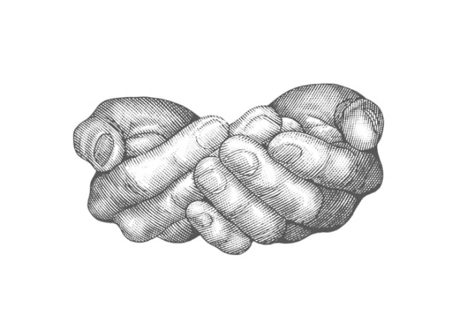
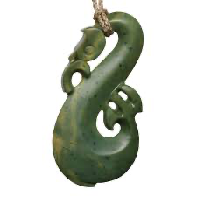

Manaakitanga is a Māori concept encompassing hospitality, generosity, care, and mutual respect, emphasizing the process of making others feel welcomed, valued, and supported. It involves actively showing kindness and concern for people's needs, ensuring they have what they require, and fostering positive, reciprocal relationships within families, communities, and beyond. A Manaia is a symbol in which represents these values as it is seen to look over people, and take care of things.

Slide 3
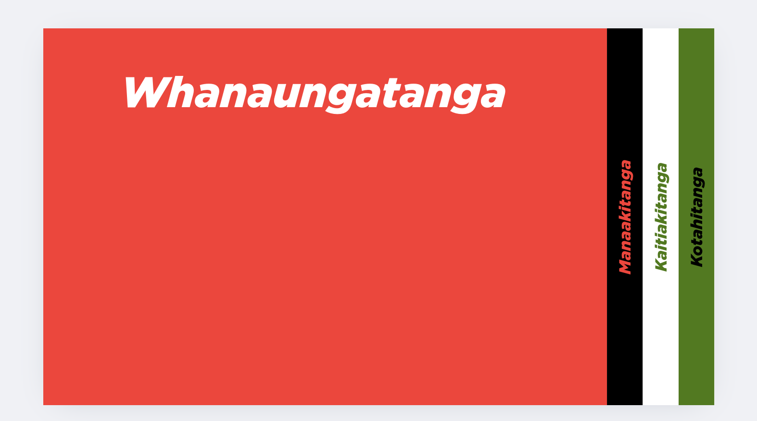
Initial Concepts

