Slide 1

Team 4:
Marek Bomastyk
Bilal Al Moubayed
Fanfan Jin Wang (Rosa)

Slide 2








Agenda
1. Introduction
2. Business Description
3. Technologies Used
4. Visualizations
5. Challenges
6. Conclusions
7. What’s next?

Slide 3


Introduction
Is Housing in Ireland expensive?
Data Set
Topic: ‘Market-based Household Purchases of Residential Dwellings’
Source: https://data.cso.ie/
Description: Volume sold from 2010 until 2021
Team Roles
Project Manager @Rosa Jin Wang
Researcher @Bilal Al Moubayed
Business Analyst @Marek Bomastyk
How many houses are sold every year?
*Rotative, subject to change*

Slide 4

Business Description
Description
Our dataset (how? why? what?)
What do we want to discover?
How do we describe our success?

Slide 5


Technologies Used
Technologies Used
Microsoft Office: Excel and PowerPoint
Google Shared Docs
Zoom
Python Jupyter Notebook
Accomplishment
Main data exploration
Descriptive statistics
Few plots to investigate data

Slide 6

Now the Graphs!!
Everybody loves Graphs

Slide 7

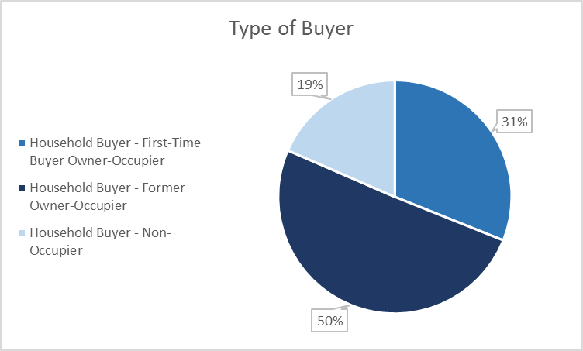
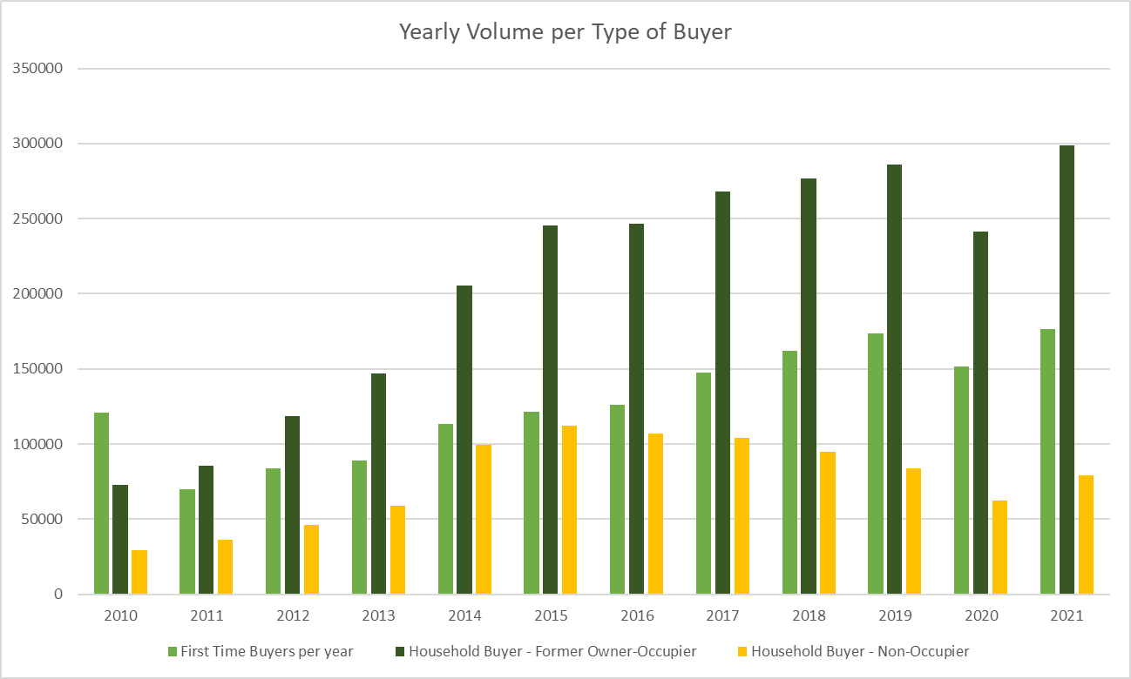

Visualizations
Type of buyer insights
New buyers' numbers > second home buyers
Investors make up only 19% of the market

Slide 8
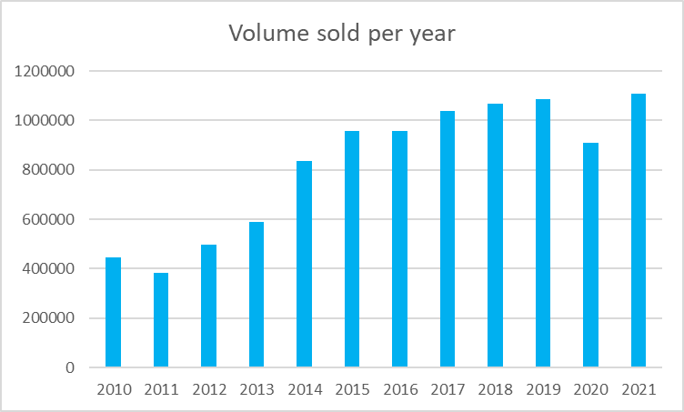
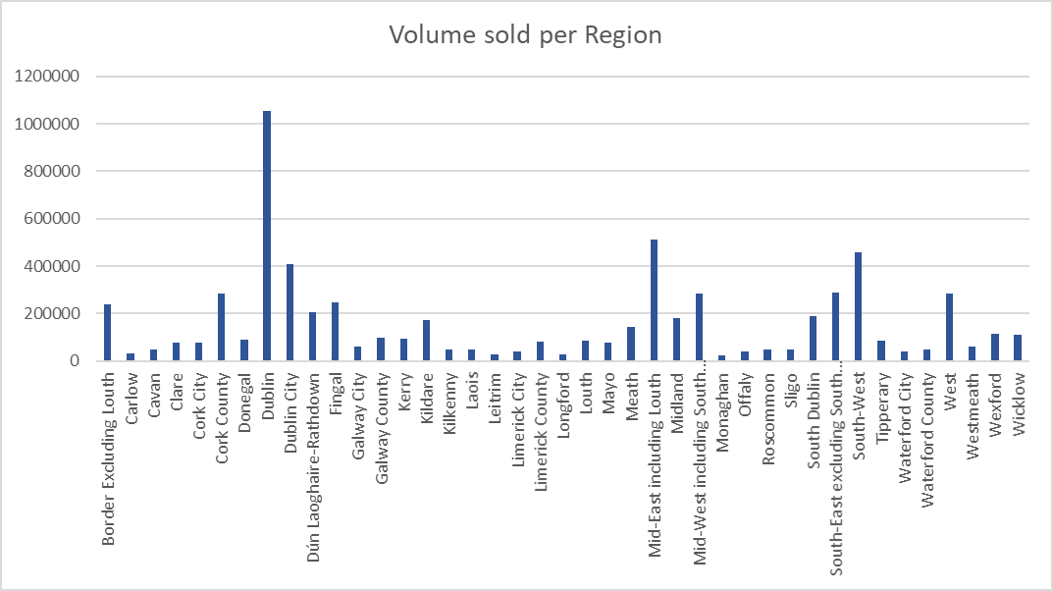
Visualizations
Volume Sold - Insights
First Home Buyer Scheme 2017 increased volume
Covid 19 decrease volume of purchases

Slide 9
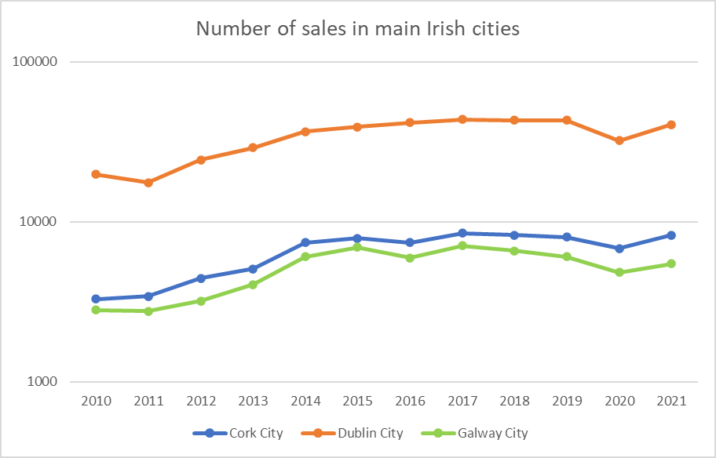
Visualizations
Volume Sold - Insights
Similarity in increasing volume of sales between the three main cities.
Slightly drop in Galway and Cork 2016
Drop in Dublin 2011, however Cork and Galway increased.
Next Steps: Why did it drop in 2011?

Slide 10

Challenges
Challenges
Working as a group with full time jobs
Working remotely for coordination
Using new tools such as Github
Time management – Setting deadlines

Slide 11
Conclusions
From the project process overall
Group collaboration with the current situation>> Flexibility and adaptation.
Finding proper dataset that meets the requirements of the CA>> Ask for help.
Starting using new tools>> mentor each other.
From the dataset – Housing
Covid did affect the volume off sales (2020 peak in the graph).
Dublin is the most sought after area for housing.
First time buyer scheme introduced Jan 2017 (2015-2016 same).
Assuming 2010 -2013 renting in Dublin was possible.

