Slide 1

Rockbuster
LLC
Stealth
A Mov ie R e n ta l Com p an y
A n a ly si s pr o je ct
Bilel Yahyaoui
DECEMBER 2024

Slide 2
Outline
Project Overview
Key Questions and Objectives
Data Overview
Analysis
Recommendations

Slide 3

Project Overview
Rockbuster Stealth LLC used
to operate movie rental stores
worldwide. However, due to
the rise of streaming services like Netflix and Amazon Prime, we faced tough competition. To remain competitive, we plan to leverage our current movie licenses and launch an online video rental service.

Slide 4
● What was the average rental duration for all
videos?
Key
Questions
and
Objectives
● Which movies contributed the most/least to
revenue gain?
● Which countries are Rockbuster customers
based in?
● Do sales figures vary between geographic
regions?
● Where are customers with a high lifetime value
based?

Slide 5












DATA Overview
What was the average rental duration for all videos?
 | Film length | Rental Rate | Replacement Cost | Rental Duration
Maximum | 185 min | 4,99 $ | 29,99 $ | 7 days
Minimum | 46 min | 0,99 $ | 9,99 | 3 days
Average | 115,27 min | 2,98 $ | 19,98 $ | 4,98 days
1000 Movies
109 Countries
600
Cities
2
Stores
599 Customers
Language
English
Total Revenue
61312,04
Modal Rating
PG-13

Slide 6
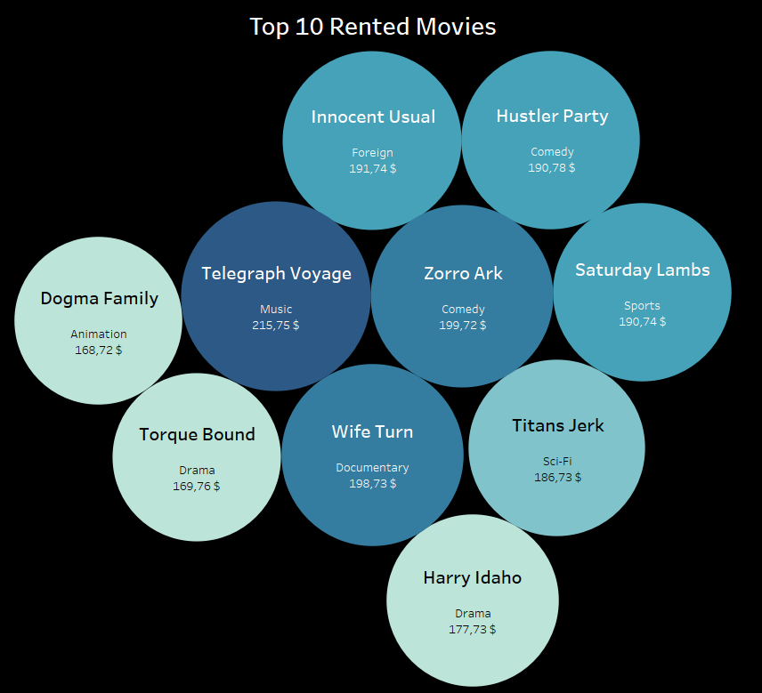
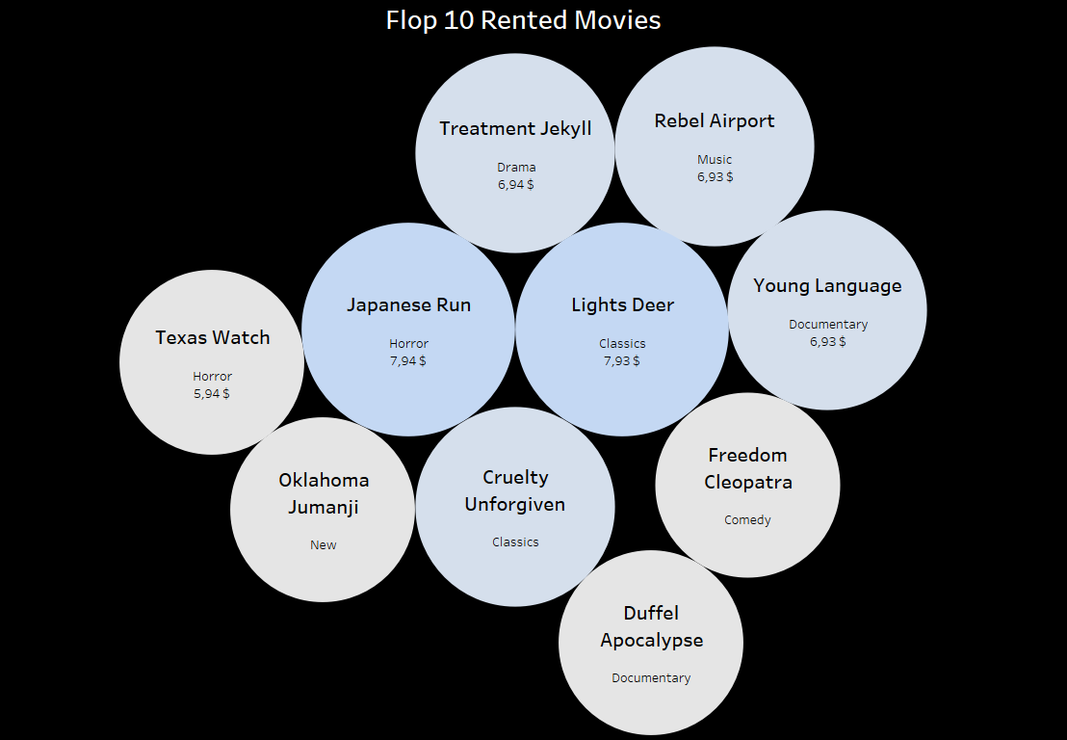


Movies Analysis
Which movies contributed the most/least to revenue gain?

Slide 7
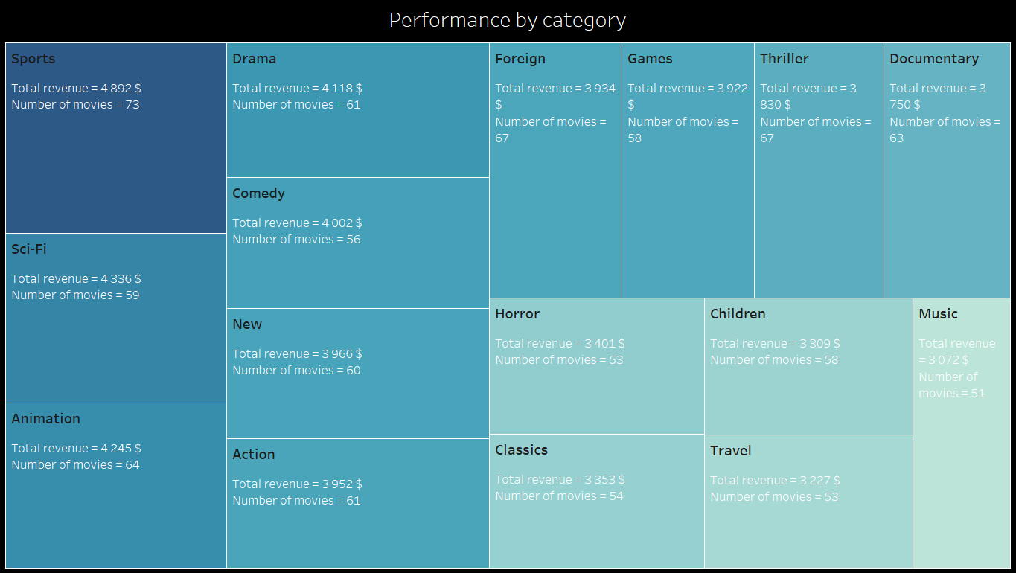
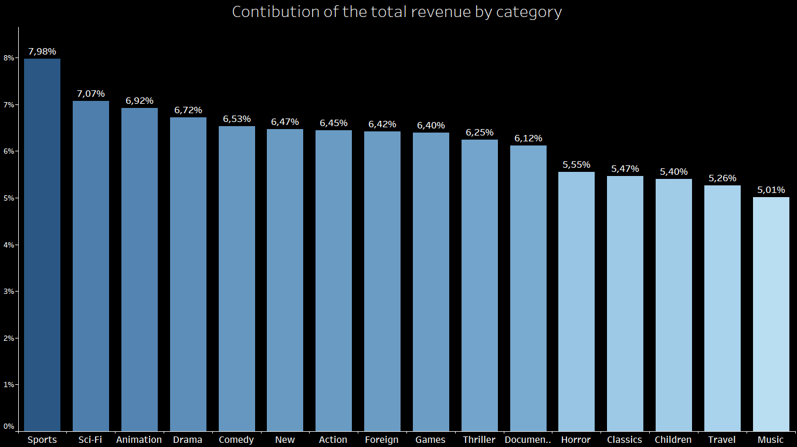
Sports is the most popular category of movies, representing around 8% of total rental with 4892 $ of revenue.
Sci-FI, Animation, Drama, Comedy, New, Action, Foreign, Games, Thriller and Documentary come in the second position representing each one betwenn 6 and 7 % ( around 65% as a total) of the total rental with (4336 –3750) $ of revenue.
The last categories, below 3401 $ each, we find Horror, Classics, Children, Travel and Music representing each one between 5 and 5,5 % ( around 27% as a total) .
AS for number of movies, all categories are close to each other.
As mentioned on the Data overview, PG-13 is the top rating group in terms of tatal revenue.

Slide 8


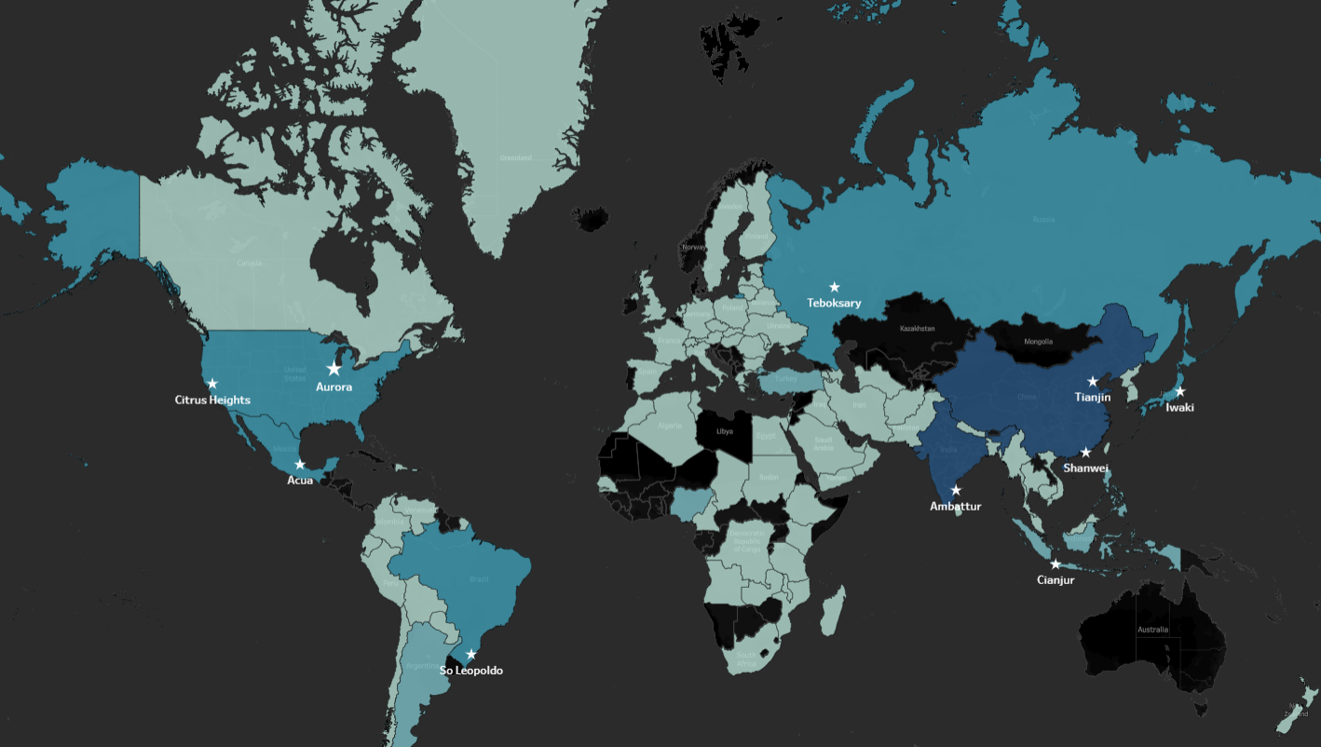
Customers Analysis
Which countries and cities are Rockbuster customers based in?

Slide 9
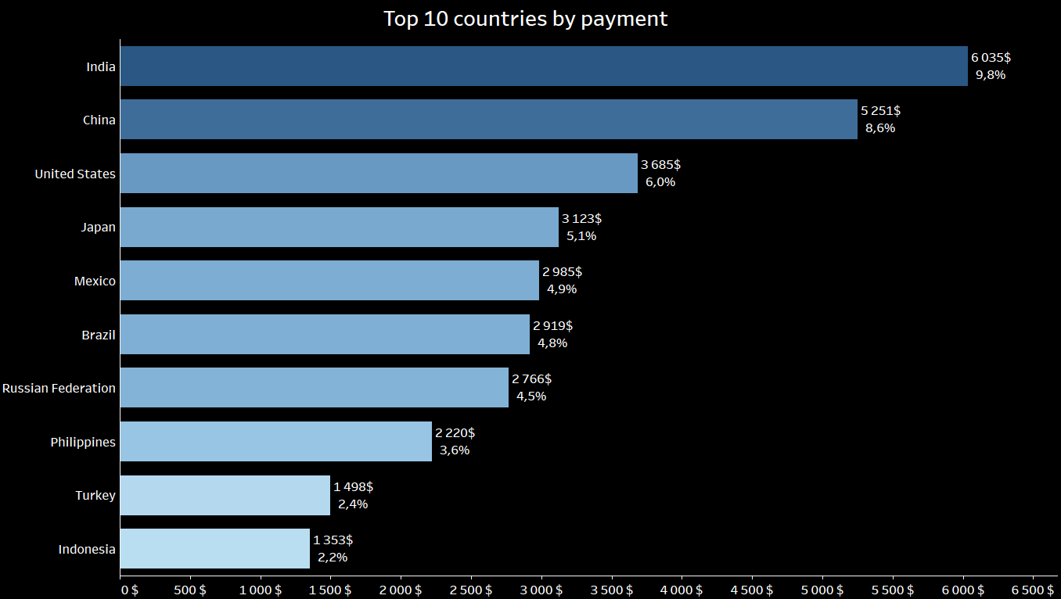
Do sales figures vary between geographic regions?
India (60 customers) , China ( 53 customers) and United States ( 36 customers) are the leaders making 24,4 % of the global Revenue from 149 customers.
Top 10 countries from 109 countries provide more than 50 % of the total Revenue from 315 customers.

Slide 10
Where are customers with a high lifetime value based?
Top 5 customers from the top 10 cities who’ve paid the highest total amounts to Rockbuster
First Name | Last Name | Country | City | Total amount paid
Arlene | Harvey | India | Ambattur | 111.76 $
Kyle | Spurlock | China | Shanwei | 109.71 $
Marlene | Welch | Japan | Iwaki | 106.77 $
Glen | Talbert | Mexico | Acua | 100.77 $
Clinton | Buford | United States | Aurora | 98.76 $

Slide 11
Recommendations
1 : Our movies are just in English, even if we should have available more languages, this needs to change and extend.
2: Consider increasing the price for highly rented genre and decreasing it for those with low rentals.
3: Increase number of movies for Sports Sci-FI, Animation, Drama, Comedy, New, Action, Foreign, Games, Thriller and Documentary categories, also for PG-13 and N-17 rating since these are best rented and bought genre.
4: Investing less in unpopular categories.
5: Increase market and national content in the best performing markets, such as India and China.
6: Reward system for loyal customers and collect and measure customer satisfaction along the process.

Slide 12






Thank You
Questions ?
December 2024
Bilel Yahyaoui
y.bilel@gmail.com
Tableau Dashboard 1
Tableau Dashboard 2

