Slide 1
Your keys. Your control.
One step from your Swissquote account.
A self-custody wallet Swissquote could launch: the bank builds the tool, but never holds the keys.
EPFL Hackathon · Swissquote track · working prototype on regtest, Bitcoin signet and Ethereum Sepolia
Notes:
Opening line: the bank builds the tool, but never holds the keys. 30 seconds.

Slide 2
Self-custody today means leaving the bank
Today
The cost for the bank
The cost for the client
The client withdraws crypto to an external wallet and leaves the Swissquote ecosystem.
Lost trades, lost conversions back to CHF, often the whole relationship.
A lost seed phrase means lost funds. Nobody can help, not even the bank.
Our answer: keys stay with the client, recovery is built in, and every flow stays one click from the Swissquote account.
Notes:
The client who wants their own keys withdraws to an external wallet. Swissquote loses the next trades, the conversions back to CHF and often the relationship. A lost seed phrase means lost funds, and Swissquote cannot help.

Slide 3
Custody: client seed + a rule enforced by Bitcoin
or( pk(CLIENT), and( pk(SWISSQUOTE), and( pk(TRUSTED CONTACT), older(D) ) ) )
Client alone
Swissquote alone
Swissquote + contact
Client stays active
Spends at any time, even with Swissquote stopped.
Never. Rejected by consensus.
Only on coins unmoved for D blocks. Before D: non-BIP68-final.
Any spend or Refresh restarts the delay.
tested
tested
tested on signet
tested
Demo D = 6 blocks. Production target (parameter): about 6 months. What we give up: a stolen seed is spent at once (mitigated by biometric unlock; hardware wallet in production). MPC does better there.
Notes:
We combine two models: the client's own seed, and an on-chain rule. The delay is a consensus rule, not a promise of our software. That is where we differ from a 2-of-3 MPC. Compared with five models in docs/custody-models.md.

Slide 4
Architecture: what is real, what is mocked
Bank app (client/)
e-banking + crypto tab. Public keys and PSBTs only
bank-mock (Swissquote guardian)
separate process, own key. Mocked re-KYC
Bitcoin
regtest (bitcoind) + signet (Esplora)
Client Wallet
separate app, own storage. Seed, biometrics, confirmation screen
Trusted-contact console
decodes and signs. Phrase never stored
Ethereum Sepolia
Safe + Candide recovery module, public paymaster
Legend: green = real · yellow = mocked · blue-grey = reference implementation. Not shown: attack panel (regtest demo).
Notes:
Green is real, yellow is mocked, blue-grey is a reference implementation. The bank mock is a separate process with its own storage. The client app holds no private key: checked by validate:inv5 with a positive control.

Slide 5
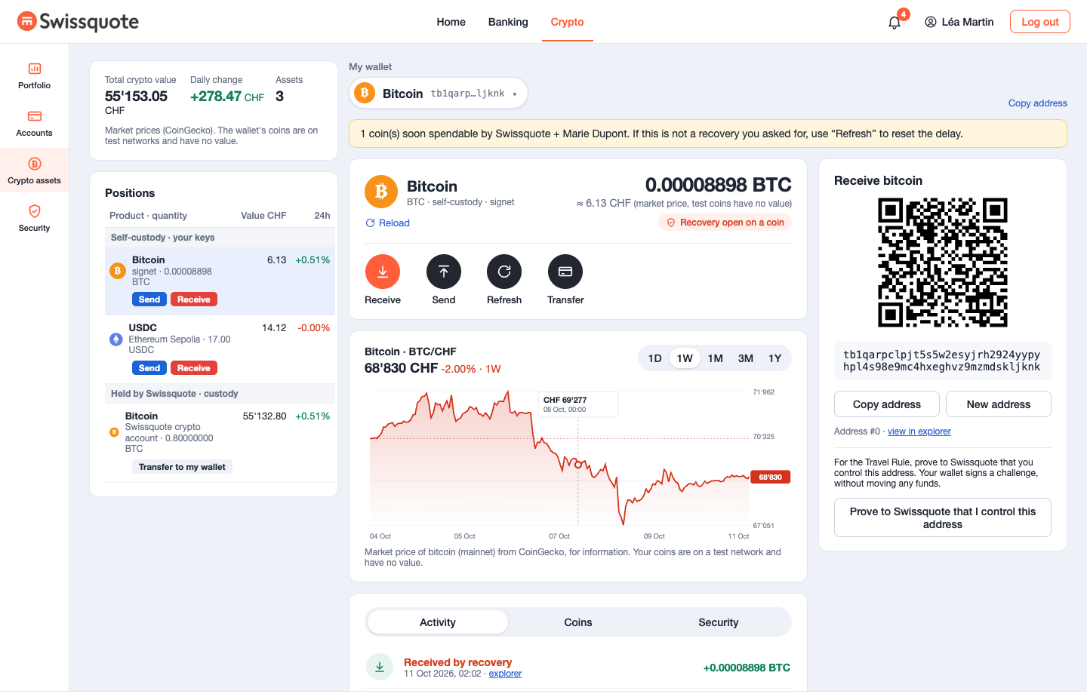
Creation and authentication
Creation
Seed generated in the client's own wallet; only the public key goes to the bank. Linked to the client's identity through the bank session.
Everyday signing
Biometric unlock of the Client Wallet, then a confirmation screen that decodes the transaction itself.
High value
Above 0.2 BTC: passkey re-authentication with Swissquote, then retyping the last 6 characters of the address in the wallet.
Screenshot: the app on real signet. Total value is a market-price reading of test coins.
Notes:
The wallet is created from inside the e-banking session, so Swissquote knows which public keys belong to which client. Passkey step-up above 0.2 BTC. Ethereum threshold is not configured: said openly. Wallet unlock by biometrics (WebAuthn PRF) was verified by typecheck, build and UI text only, not by an end-to-end run.

Slide 6
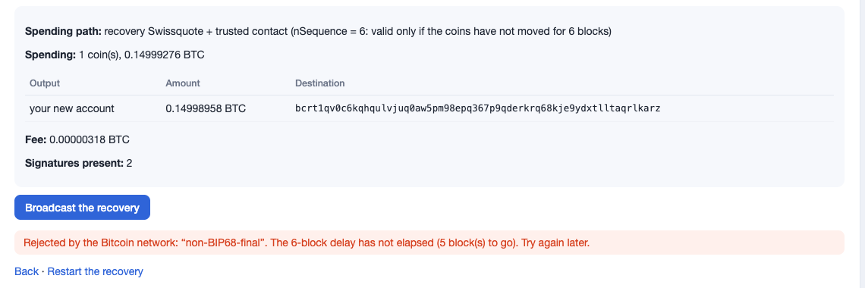
Recovery: lose the wallet, keep the funds
1
2
3
4
5
6
Re-KYC
New wallet
Swissquote signs
Contact signs
Broadcast: refused
After D: accepted
What stops an attacker
Stolen phone and email: the app holds no key, and re-KYC refuses wrong answers (403).
Swissquote + contact too early: rejected by consensus.
A hostile recovery on Ethereum: the owner can cancel during the delay.
Observed on regtest, then on real signet from the interface.
Notes:
Walk through the six steps. The network itself rejected the early broadcast: non-BIP68-final. After D it is accepted. Real signet recovery: tx c5ca6873 from the interface.

Slide 7
Threat model: the track's three questions
Question | Bitcoin | Ethereum (Safe + recovery module)
Who could steal the funds? | The client. Swissquote + contact together, only on coins unmoved for D blocks. | The client. Swissquote + contact together, only if the client does not cancel their recovery in time.
Who could lock the client out? | Nobody: spending needs no Swissquote and no app. | Nobody for the owner key. Without the paymaster (a third party), the client pays gas.
Can Swissquote move funds without the client? | Alone: no. With the contact: yes after D (the grey zone), unless the client refreshed. | Alone: no, two guardians needed. With the contact: yes after the delay if not cancelled.
Accepted limits: Swissquote gone AND key lost = funds lost. Contact loses their key = recovery impossible. A stolen seed spends at once.
Notes:
Answer plainly, including the grey zone. Evidence: attacks 1, 2, 3 on regtest, invariant 1; Ethereum steps 16 and 18 on real Sepolia.

Slide 8
Every claim points to a recorded run
36
19 / 19
3
2
steps, each with a commit and a report in docs/validation
end-to-end Chrome checks, desktop layout (phone: 20 / 20)
attacks refused or survived against a real node
real signet transactions: client spend and recovery broadcast at D
Reproduce: npm run regtest:up, then npm run demo (three commands). Checks: validate:6:ui, test:attacks, validate:inv5 (no private key in client/ or its bundle).
Last full run of the checks listed above was recorded before steps 17 to 36; later steps were verified by typecheck and build, plus browser checks where noted in their reports.
Notes:
docs/validation holds one report per step with the command and the observed output. Do not claim more than was run.

Slide 9
Bonus: Ethereum with no ETH (gasless)
What ran on the real Sepolia, with 0 ETH
Honest status
Safe + recovery module + two guardians created in one sponsored operation.
Swissquote alone is refused by the contract.
Swissquote + contact start a recovery; finalizing early is refused.
Recovery to a new key: the new key owns the Safe, the old one is refused.
The owner cancels a hostile recovery.
Gasless: real, via a public paymaster (third party). Abuse control is the paymaster's rate limit only.
Compliant dApp: partial. Operations are decoded in plain language and unlimited approvals are flagged. No sanctions screening, no approved-dApp list.
Ethereum passkey threshold: not configured.
Signing without a paymaster: not tested.
Notes:
Candide's public paymaster pays the gas; it is a third party, not Swissquote. Abuse prevention: the public paymaster is rate-limited per IP; we did not build our own abuse detection. Compliant dApp: only the plain-language decoding of the operation before signing exists, with an unlimited-approval flag. No sanctions screening, no approved dApp list.

Slide 10
Legal reading: software, not custody (hypothesis)
Custody
Travel Rule
Swissquote alone can never move the funds: consensus refuses.
The only joint power is Swissquote + a contact chosen by the client, after a delay the client resets by any spend.
This is the grey zone the track names. We argue it rather than deny it.
The wallet is created inside the bank session, so ownership is proved, not declared.
Swissquote sends only after a signed single-use challenge (BIP-322); a deposit is credited only if all inputs come from a registered wallet.
Paying a third party from the wallet: Swissquote does not sign, so we hypothesise it is not the sending institution.
Verified by validate:7 and validate:11 on regtest. Withdrawals are regtest only.
Notes:
These are design hypotheses to confirm with a lawyer, as written in docs/travel-rule.md. The ownership proof is BIP-322 on the client key, not on the P2WSH address itself: bip322-js does not handle P2WSH.

Slide 11
Business case: an honest break-even
Annual gain = N × p × ( V × f × t + s ) − C
−CHF 67,500
≈ 2,730
CHF 55
at illustrative values: fees alone do not cover the cost
retained clients needed to break even, other values fixed
gain per retained client per year at those values
Levers: retained trades and conversions, a paid recovery service, new self-custody-minded clients, lower "I lost my phrase" support. The inputs we need from Swissquote: N, V, f, and the current cost of verifying an external address.
Notes:
None of these figures is a Swissquote figure. The product does not pay for itself on fees alone at illustrative values; the pitch rests on real N, V, f from Swissquote and on strategic value. Break-even: about 2,730 retained clients.

Slide 12
Limits, AI use and what comes next
Limits
AI tools
Next
Stolen seed: spent at once.
Few external wallets sign this script.
Bank, re-KYC and email are mocked.
Code not audited.
Claude Code (Opus 5.5, Sonnet 5.5): spec review, code, tests, validation reports, docs, these slides.
The human decided the custody model; every claim is tied to an executed test.
No AI-written cryptography: established libraries only.
Taproot: the client spend looks like a normal payment.
Trusted-contact inbox and notifications.
Change of contact.
Secure element or hardware wallet.
Sanctions screening of destinations.
Notes:
The code was written very quickly and mainly by the AI and has not been audited. Say so. Slides themselves were drafted with Claude Code.

Slide 13
Create. Sign. Lose it. Recover.
Self-custody, with a Swiss bank one step away.
Live demo: npm run regtest:up, then npm run demo
Notes:
Offer to run the live demo, with the recorded video as backup.

