Slide 1

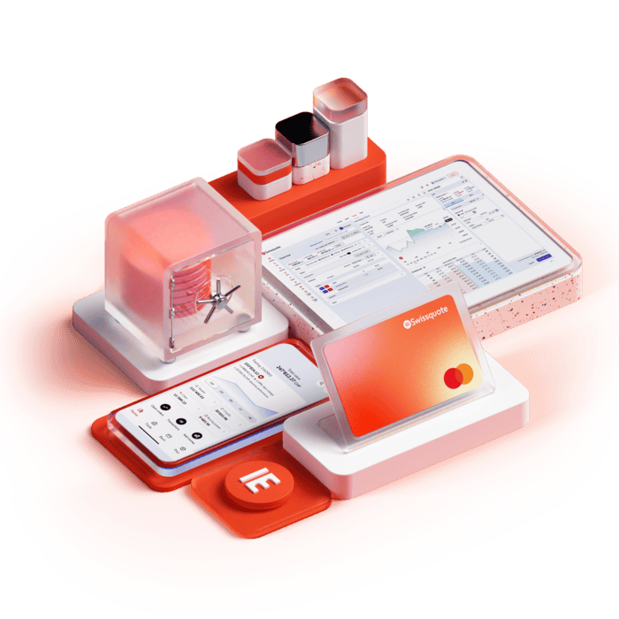
Your keys.
Your control.
A self-custody wallet one step from your Swissquote account.
The bank builds the tool, but never holds the keys.
EPFL Hackathon · Swissquote track
Notes:
[10 s] Self-custody means leaving the bank. We built the wallet where clients keep their keys and stay with Swissquote.

Slide 2
THE DEMONSTRATION
A + B: why it holds
A
The client's key
B
A rule enforced by the chain
In their own wallet. Spends alone, at any time.
Swissquote + a trusted contact, only after a delay D.
A + B ⇒
Swissquote alone
Swissquote + contact
Client stays active
Key lost
can do nothing
refused by the network before D
the delay restarts
recovery after D
Each one tested on a real node. D = 6 blocks in the demo, about 6 months in production.
Notes:
[25 s] Our design is A plus B. A: the client's own key, always able to spend alone. B: a rule enforced by the chain: Swissquote and a trusted contact can recover, but only after a delay. So Swissquote alone can do nothing, before the delay the network refuses, and a lost key is recoverable. All tested on a real node.

Slide 3
THE REQUIRED POINTS
One answer to each point of the brief
Required point | Our answer
Custody model | Client key + on-chain rule. Threat model written, grey zone argued, contact can be changed.
Architecture | Separate processes, each part labelled real or mocked.
Wallet creation | Seed made on the client's own device. The bank only gets public keys.
Authentication | Biometric passkey, checked by the server, to open the crypto area and to sign. Above 0.2 BTC: extra check.
Recovery | Bank + contact after D. A stolen password gets nothing. Swissquote gone: Emergency exit, key alone (Bitcoin).
Business case | Flows stay in the app. Break-even formula with explicit assumptions.
Bonus | Gasless: real (public paymaster). Compliant dApp: partial.
Notes:
[20 s] Every point of the brief has a one-line answer here. Two to notice: the server checks a biometric passkey to open the crypto area, so a stolen password gets nothing; and if Swissquote disappears, an Emergency exit signs with the client's key alone.

Slide 4
THE CHOICE
Why not MPC or a smart wallet?
MPC 2-of-3
Smart wallet (Safe + passkey)
Swissquote + partner can sign at once. The delay would be a rule in their software, so a colluding bank skips it.
The library leaves recovery and storage to us: no browser or mobile support (cb-mpc, read in its docs, not run).
Our first plan. The problems we found: one delay per recovery module, a passkey owner that is itself a contract, and Ethereum only: no Bitcoin.
So: the key stays a plain seed (A), the delay lives in Bitcoin consensus (B). On Ethereum, where it fits, we do use a Safe.
Notes:
[30 s] Why not MPC or a smart wallet? I looked at both first. MPC lets Swissquote and a partner sign immediately: the delay is only software. My first plan, a Safe with a passkey, had too many problems, and it is Ethereum only, so no Bitcoin. So the key is a plain seed and the delay is Bitcoin consensus. On Ethereum, we do use a Safe.

Slide 5
WHY SWISSQUOTE
What Swissquote gains
Keeps the flows
No custody burden
Lower cost, new clients
Trades and CHF conversions stay in the app instead of leaving with the withdrawal.
Swissquote cannot move the funds alone (hypothesis, to confirm with a lawyer).
Ownership proof for the Travel Rule is automatic. A lost phrase is no longer a lost fund. A bank offer for self-custody-minded clients.
Honest numbers: with illustrative inputs, break-even is about 2,730 retained clients. We need Swissquote's real volumes.
Notes:
[25 s] Why Swissquote? Today self-custody means the client withdraws and takes the trades away. Here the flows stay in the app. Swissquote cannot move the funds alone, so, subject to a lawyer, no custody burden. Travel Rule proofs become automatic. Honestly, break-even is about 2,700 clients at our illustrative numbers.

Slide 6
Real and mocked, openly
Real
Mocked
Keys, scripts, delays and transactions on regtest, signet and Sepolia.
The bank, the KYC and the CHF accounts.
Known limit: if Swissquote disappears and the client loses their key, the funds are lost.
Live demo
Notes:
[10 s] Real: keys, scripts, delays, transactions. Mocked: the bank and the KYC. Now, live.

