Slide 1

Exploratory Data Analysis
G2M Insight for Cab Investment Firm
Bilgan Kiris
October 20th 2024

Slide 2

Agenda
Executive Summary
Problem Statement
Approach
EDA
EDA Summary
Recommendations

Slide 3
Executive Summary
This project analyzes the customer behavior and cab usage across USA trends to identify which cab company to invest in.
Key findings include:
Higher cab usage observed on holidays and weekends
Longer trips have a direct correlation with increased revenue

Slide 4
Problem Statement
The Client
XYZ is a private firm in US. Due to remarkable growth in the Cab Industry in last few years and multiple key players in the market, it is planning for an investment in Cab industry and as per their Go-to-Market(G2M) strategy they want to understand the market before taking final decision.
Objective: With identifying key trends and factors, provide a strategic recommendation for which cab company to invest in.

Slide 5
Approach
Identify data sources
Removing duplicates and handling missing values
Creating hypothesis
Identify number of cab users by city
Company demographic analysis
Cab usage in regular days vs holidays
Average profit margin for each company
Revenue distribution by payment mode
Revenue vs distance travelled
City population vs revenue
Hypothesis results

Slide 6
Data Sources
Cab_Data = Contains information about the cab rides, including details about trip distances, prices, and cab types.
Customer_ID = Provides customer details such as demographics, age, income, and occupation.
City_Data = Contains city-related information, including population, density, and regional classifications.
Transaction_ID = Detailed transaction data with information on each cab ride, including dates, payment methods, and ride duration.

Slide 7
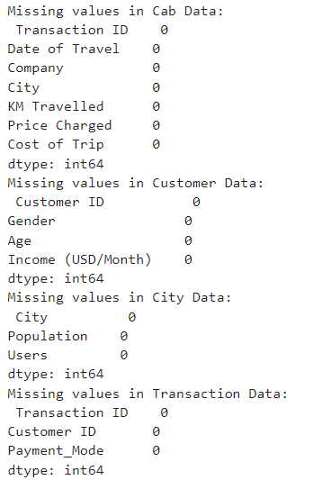

Duplicates & Missing Values
Checking if there is any duplicates or missing values in our given data.

Slide 8
Creating Hypothesis
1. The company with the higher number of users also has the highest revenue
2. Cab usage increases on holidays/weekends than regular days
3. Longer trips generate more revenue for the cab company.
4. Revenue is ultimately correlated with the population of its city
5. People with highest incomes are most likely to use cabs than lower income bracket people

Slide 9
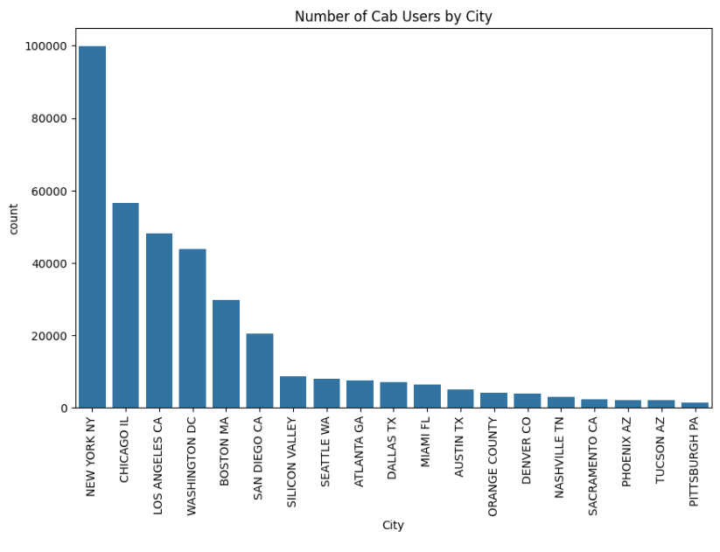
Identify number of cab users per city
Identifying cities with the highest and lowest cab usage.

Slide 10
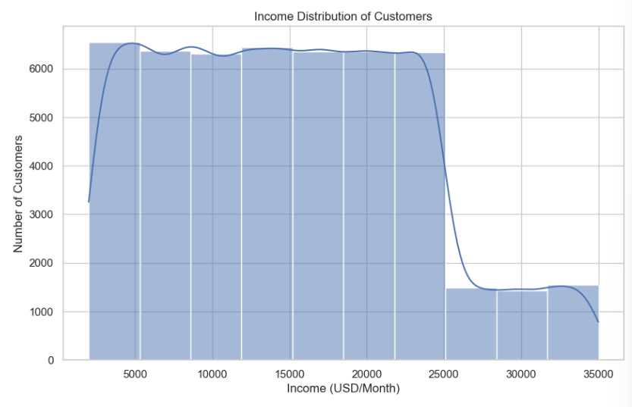
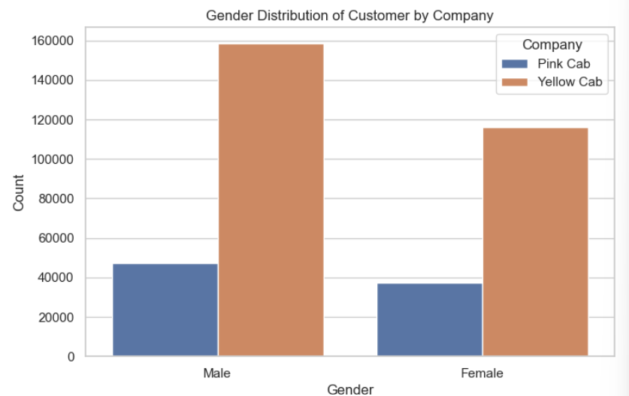
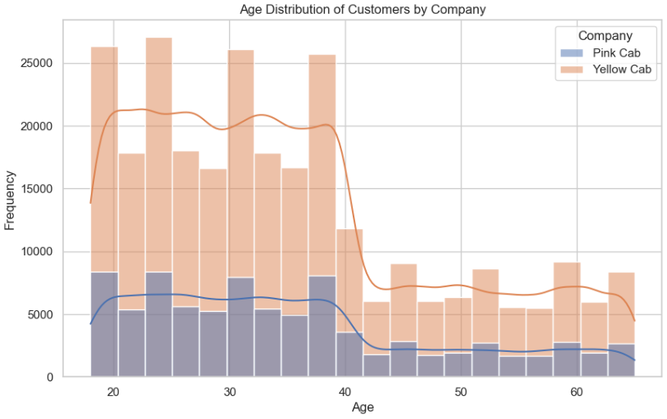
Company Demographic Analysis
Analyzed customer demographics, including age, gender, and income distribution.

Slide 11
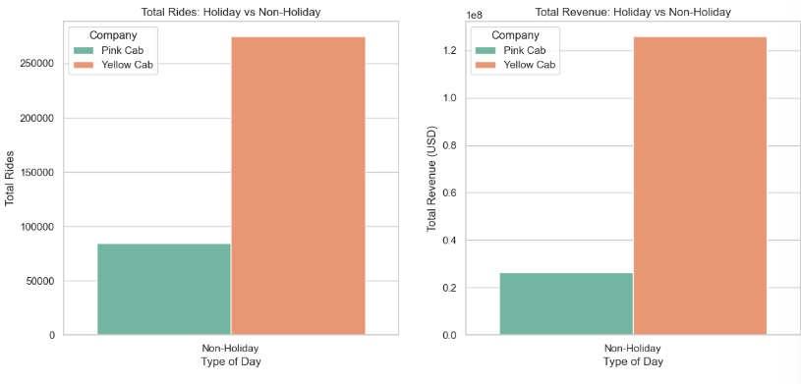
Cab Usage in Regular Days vs Holidays
Compared total rides and revenue on holidays vs. non-holidays, with holidays having having number of cab rides and revenue.

Slide 12
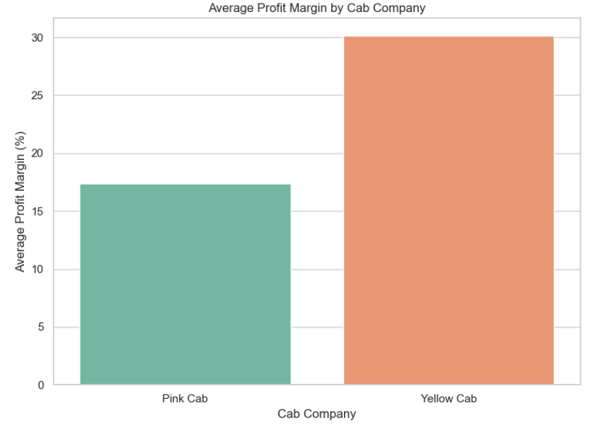
Average Profit Margin for Each Company
Calculated and compared profit margins for each cab company. Yellow Cab has the highest revenue compared to Pink Cab.

Slide 13
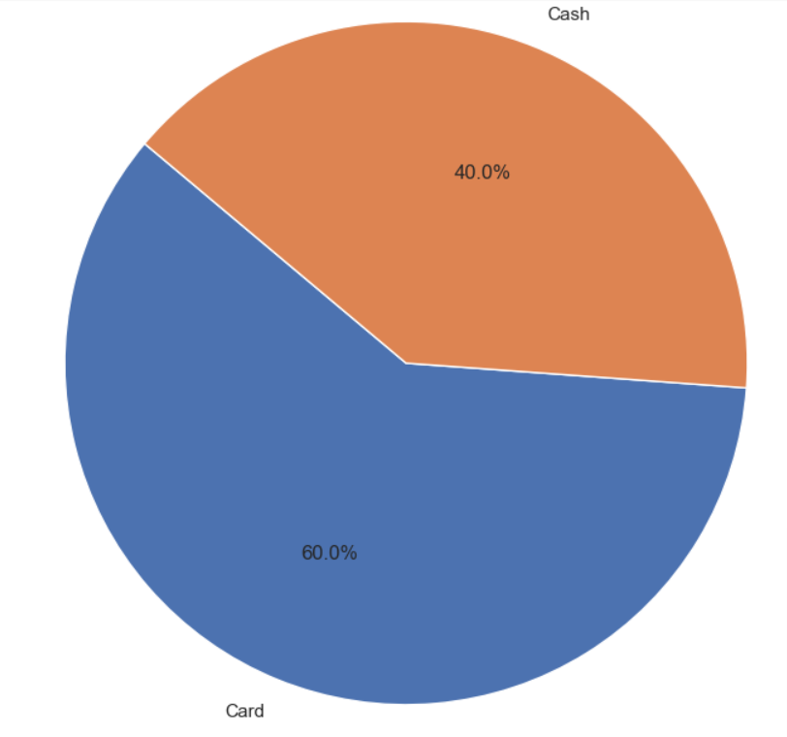
Revenue Distribution by Payment
Analyzed how different payment methods contribute to revenue.
Most transactions were done via credit card.

Slide 14
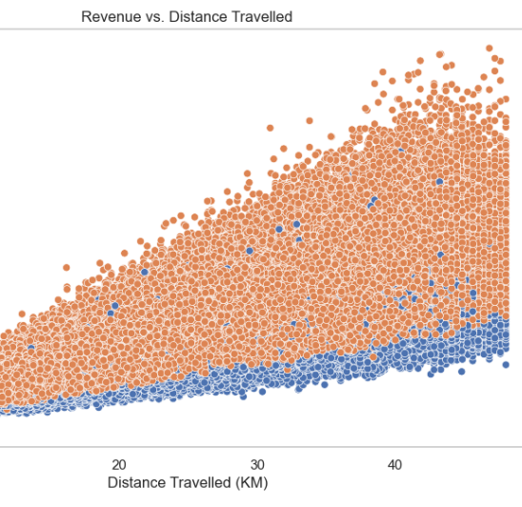
Revenue vs Distance Traveled.
Yellow Cab generated highest revenue vs distance traveled.

Slide 15
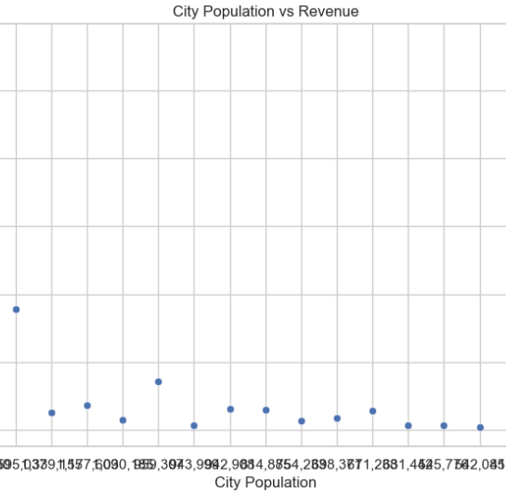
City Population vs Revenue
Analyzed the correlation between city population size and revenue, with larger cities tends to have higher revenues.

Slide 16
Hypothesis Results
Hypothesis 1: The company with the highest number of users also has the highest revenue
Result: Observing the data results, while having the lowest number of users, # Pink Cab has the highest revenue compared to Yellow Cab.
Hypothesis 2: Cab usage increases on holidays compared to regular days
Result: Yellow Cab leads in the revenue.
Hypothesis 3: Longer trips generate more revenue for the cab company
Results: Comparing the graph results, Yellow Cab generates more revenue with longer distance trips
Hypothesis 4: Revenue is correlated with the population of its city
Results: Although the top 3 cities with most population density holds the highest revenue, # the lowest population cities also seem to have a spike in revenue.
Hypothesis 5: People with highest incomes are most likely to use cabs than lower income bracket people
Result: According to the Number of Customer vs Income graph, we can identify that the people with # high income have the lowest number of cab customers, where lowest to middle income bracket people using more cabs.

Slide 17
Thank You

