Slide 1
Yapay Zeka
Artificial Intelligence
Prof.Dr. Cemil Oz
Office: D8-408
Phone: 295-5598
coz@sakarya.edu.tr
Office hours:
Monday: 15:00 -16:00
Thursday: 14:00-15:00
Friday :---

Slide 2
Yapay zeka Dersinin Amacı (The aim of Artificial intelligent course)
Ders boyunca yapay zeka nedir?
Yapay zekanın dayandığı algoritma ve metotlar nelerdir?
Diğer yapay zeka algoritmaları bunlar ile ilgili dersler?
Yapay zekayı kimler kullanır ve nasıl?
Yapay zeka ile ilgili seçmeli derler ve proje çalışmalarında ki seçenekler nelerdir?

Slide 3
Textbook / Recommended Reading
Artificial Intelligence: A Modern Approach(Second Edition) by Stuart Russell and Peter Norvig,

Slide 4
Bu dersin konuları(Topics will be cover)
Search algorithm (arama algoritmaları)
Artificial neural network(YAPAY SİNİR AĞLARI)
Fuzzy logic (bulanık mantık)
Expert system (uzman sistemler)
Agent technology (zeki etmen teknolojisi)
IA applications (YZ uygulamaları)

Slide 5
Değerlendirme(Grading policy)
Final sınavı(Final Exam %45)
Vize(Midterm Exam) %45
Quizzes %5
Programlama Ödevi(Programming Assignments) %30 (ATLEAST THREE)
Ödevler(Homeworks) %20

Slide 6
Exams and quizzes :
Programlama ödevleri, herkes kendisi yapacak(Individual Assigments)
Kitap not vb kapalı(Course metarials closed )
Final ve vize kaçırıldığında ancak yeniden bu sınavları alabilmeniz doktor raporu ve idarenin onayı ile olabilir.(Final and Midterm Exams(only if you miss these exams, you can retake these exam with doctor’s excuse))

Slide 7
Cheating policy
Ödevlerin sizin alın terinizle size özel olmalı (Your work in this class must be your own)
Kopya ve hile yapmaya sıfır tolerans göstereceğim Kopya çeken ve veren sıfır alır.(I have a zero tolerance policy towards cheating of any kind and any student who cheats will get a faliiling grade in this course.)
Kopya olayından kopya alanda verende sorumludur. (Both the cheater and the student who aidded the cheater will be held responsible for the cheating.)

Slide 8
Big questions
Can machines think? Makinalar düşüne bilirmi?
And if so, how? Eğer düşünebilirlerse nasıl?
And if not, why not? Eğer düşünemiyorlarsa niçin?
And what does this say about human beings? Bu insanlar hakkında ne bilgi verir?
And what does this say about the mind? Ve Akıl hakkında ne bilgi verir?

Slide 9
What is artificial intelligence?
There are no clear consensus on the definition of AI. Yapay zeka tanımı üzerinde herkesin üzerinde mutabık kaldığı bir tarif yoktur.
Here’s one from John McCarthy, (He coined the phrase AI in 1956) - see http:// www. formal. Stanford. EDU/ jmc/ whatisai/)
Q. What is artificial intelligence?
A. It is the science and engineering of making intelligent machines, especially intelligent computer programs. It is related to the similar task of using computers to understand human intelligence, but AI does not have to confine itself to methods that are biologically observable. Yapay zeka, zeki makinalar, özelliklede zeki bilgisayar programları yapma mühendislik ve bilimidir. Yapay zeka, İnsan zekasını anlamada bilgisayar kullanarak benzer görevleri başarmadır. Ancak YZ kendini biyolojik olarak gözlenebilir metodlarla sınırlandırmak zorunda değil.

Slide 10
Yapay Zeka (Artificial Intelligence); öğrenme, gerekçeleme, problem çözme, yabancı bir dili alma v.b. gibi insanoğlunun davranışlarını gösterebilen sistemlerle ilgilenen bir bilgisayar bilimidir.
Yapay Zeka’nın ana amacı insanların davranışlarının ve sezgisel yeteneklerinin bilgisayar üzerinde benzetimidir.
İnsanoğlu esas olarak Bilgi’yi (Knowledge) kullanmakta ve onu işlemektedir. Bu yüzden bilgi ve bilginin kullanımı Yapay Zeka’nın da anahtar karakteristikleridir.
.

Slide 11
Yapay Zeka’nın standart bir tanımı yapılamamakla beraber, yapılagelen tanımların ortak yönleri şunlardır;
YZ bir bilgisayar bilim dalıdır,
YZ bilgi ve davranışa dayanır,
YZ zeki davranışları araştırmaktadır.
Zeka rakam ya da veriler yerine bilgiye dayalı mantıksal bir süreçtir. Bilgi ve bilginin işlenmesi ile zeki davranışlar ortaya çıkarılabilir.
Q. Yes, but what is intelligence?
Intelligence is the computational part of the ability to achieve goals in the world. Zekilik, dünyadaki hedefleri başarmadaki yeteneğin hesapsal kısmıdır.
Varying kinds and degrees of intelligence occur in people, many animals and some machines. Değişen çeşitlilikte ve derecede zekilik insanlarda, çoğu hayvanlarda ve makineler de bulunur.

Slide 12
Other possible AI definitions
AI is a collection of hard problems which can be solved by humans and other living things, but for which we don’t have good algorithms for solving. YZ insanlar ve hayvanlar tarafından çözülebilen zor problemler topluluğudur. Fakat bunları çözmek için iyi algoritmalara sahip değildir.
  e. g., understanding spoken natural language, medical diagnosis, circuit design, learning, self-adaptation, reasoning, chess playing, proving math theories, etc. Bunlar, Konuşulan dili anlama, tıbbi teşhis,Devre dizaynı, öğrenme, öz uyarlama(kendi kendini ayarlama), sebep sonuç ilişkisi çıkarma, satranç vb oyunlar oynama, matematik teoremlerinin ispatı.

Slide 13
Other possible AI definitions
• Definition from R & N book: a program that
  Acts like human (Turing test).
  İnsan gibi davranan
  Thinks like human (human-like patterns of thinking steps)
  İnsan gibi düşünen
  Acts or thinks rationally (logically, correctly) .
  Davranma ve düşünme mantıklı ve doğru olmalı
• Some problems used to be thought of as AI but are now considered not. Bazı problemler yapay zeka olarak algılana gelmişlerdir. Fakat değillerdir.
  e. g., compiling Fortran in 1955, symbolic mathematics in 1965, pattern recognition in 1970 (bunlar fortran derleme, sembolik matematik ve Örüntü tanıma vb.)

Slide 14
What’s easy and what’s hard?
It’s been easier to mechanize many of the high level cognitive tasks we usually associate with “intelligence” in people
İnsanlarda zekaya dayandırılarak yüksek seviyedeki bir çok görevleri açıklamak mümkündür.
  e. g., symbolic integration, proving theorems, playing chess, some aspect of medical diagnosis, etc. Sembolik birleştirme, teoremleri ispatlama, satranç gibi oyunları oynama, tıbbi teşhisler, vs.

Slide 15
It’s been very hard to mechanize tasks that animals can do easily(hayvanların kolayca yapabildiği davranış ve hareketleri mekanize etmek çok zor olmaktadır)
  walking around without running into things( Bir ortamda, var olan cisimlere çarpmadan hareket edebilme)
  catching prey and avoiding predators (Avını yakalama ve avcılardan kaçma)
  interpreting complex sensory information (visual, aural, …) (Kompleks algılama birimlerinden gelen bilgileri yorumlama)
  modeling the internal states of other animals from their behavior(Diğer hayvanların, hareketlerinden onları anlama ve modelleme)
  working as a team (ants, bees)( arılar ve karıncalar gibi takım halinde çalışmak)
Is there a fundamental difference between the two categories?(Bu iki kategori arasında yapısal bir farklılık var mıdır?)
Why some complex problems (e.g., solving differential equations, database operations) are not subjects of AI(Niçin bazı kompleks problemler YZ nın konuları değildir. Dif denklem çözümü vs.)

Slide 16
Foundations of AI
Computer
Science &
Engineering
Mathematics
Philosophy
AI
Economics
Biology
Psychology
Linguistics
Cognitive
Science

Slide 17
YZ tarihi(History of AI)
AI has roots in a number of scientific disciplines (YZ’nın kökleri çok sayıda bilim dalına dayanır.)
  computer science and engineering (hardware and software)(bilgisayar mühendisliği ve bilimi)
  philosophy (rules of reasoning)(felsefe-yaşam biçimi, sebep sonuç ilişkisi)
  mathematics (logic, algorithms, optimization) (matematik: lojik, algoritma, optimizasyon vs.)
  cognitive science and psychology (modeling high level human/animal thinking) (bilinçsel bilim ve pisikoloji)
  neural science (model low level human/animal brain activity)
  (sinir bilimi- insan ve hayvan beyin aktiviteleri)
  Linguistics (dil bilimi)

Slide 18
YZ tarihi(History of AI)
The birth of AI (1943 – 1956)
YZ’nın doğuşu
  Pitts and McCulloch (1943): simplified mathematical model of neurons (resting/firing states) can realize all propositional logic primitives (can compute all Turing computable functions)
  1943 de Nöronların matematiksel modelini basitleştirmişlerdir. Turing hesaplanabilir fonksyonların tamamını hesaplayabilir.
  Allen Turing: Turing machine and Turing test (1950)
  1950 de Turing makinası ve testini gerçekleştirmiştir.
  Claude Shannon: information theory; possibility of chess playing computers
  Enformatik teorisi geliştirilmiş, bilgisayarın satranç oynama olasılığı bu çerçevede gerçekleştirilmeye çalışılmış.

Slide 19
Early enthusiasm (1952 – 1969)
Önemli,heyecan verici gelişmeler (1952-1969)
  1956 Dartmouth conference
  John McCarthy (Lisp);
  1956 da Dartmouth konferansında Lisp programı duyurulmuştur.
  Marvin Minsky (first neural network machine);
  İlk Yapay sinir makinesi gerçekleştirilmiş.
  Alan Newell and Herbert Simon (GPS);
  Emphasize on intelligent general problem solving
  GSP (means-ends analysis);
  Lisp (AI programming language);
  Resolution by John Robinson (basis for automatic theorem proving);
  heuristic search (A*, AO*, game tree search)
  Sezgisel Arama (A*, AO*, oyun ağacı arama)
Emphasis on knowledge (1966 – 1974)
  domain specific knowledge is the key to overcome existing difficulties
  knowledge representation (KR) paradigms
  declarative vs. procedural representation

Slide 20
Knowledge-based systems (1969 – 1999)
1969-1999 arasında Bilgi tabanlı sistemlerde
  DENDRAL: the first knowledge intensive system (determining 3D structures of complex chemical compounds)
  DENTRAL yazılımı karmaşık kimyasal karışımların 3B yapılarını belirlemek için gerçekleştirilmiştir.
  MYCIN: first rule-based expert system (containing 450 rules for diagnosing blood infectious diseases)
  MYCIN: İlk kural tabanlı uzman sistemdir( Kan yolu ile bulaşan mikrobları teşhis etmede kullanılmıştır ve 450 kuralı vardır.)
  PROSPECTOR: first knowledge-based system that made significant profit (geological ES for mineral deposits)
  Yüklü miktarda kazanç getiren ilk kural tabanlı sistemdir.Madenlerin bulunması için yeryüzü dalgalarını analiz eden programdır.

Slide 21
AI became an industry (1980 – 1989)
1980-1989 yılları arasında
  wide applications in various domains
  Geniş bir alanda, çok çeşitli uygulamalar
  commercially available tools
  Ticari Yapay zeka araçları
Current trends (1990 – present)
1990-günümüze kadar süre gelen eğilim
  more realistic goals
  Daha gerçekci amaçlar.
  more practical (application oriented)
  Daha çok pratik uygulamalar.
  distributed AI and intelligent software agents
  Dağıtık YZ ve Zeki etmen(intelligent agent) yazılımları
  resurgence of neural networks and emergence of genetic algorithms.
  Yapay sinir ağlarında yenilikler ve genetik algoritmalarda geliştirme ve yenilikler

Slide 22
Possible Approaches
Like humans
Well
Rational
agents
Think
GPS
AI tends to work mostly in this area
YZ genellikleişaretli alanda çalışır
Act
Heuristic
systems
Eliza

Slide 23
Think well
Like humans
Well
Think
GPS
Rational
agents
Act
Eliza
Heuristic
systems
Develop formal models of knowledge representation, reasoning, learning, memory, problem solving, that can be rendered in algorithms.
Bilgi temsil etmede, sebep sonuç ilişkisi çıkarımda, öğrenmede, hafıza ve problem çözümünde geçerli modeller geliştirme.
There is often an emphasis on a systems that are provably correct, and guarantee finding an optimal solution.
Sistemde sıklıkla heyecan verici ve doğru olan bir çözüm vardır ve optimal bir çözümü bulmayı garanti eder.

Slide 24
Act well (iyi hareket et)
Like humans
Well
Think
GPS
Rational
agents
For a given set of inputs, generate an appropriate output that is not necessarily correct but gets the job done.
Verilen giriş seti için, çıkış üret, sonuç optimal veya doğru olamaya bilir. Ama iş yerine getirilsin.
A heuristic (heuristic rule, heuristic method) is a rule of thumb, strategy, trick, simplification, or any other kind of device which drastically limits search for solutions in large problem spaces.
Geniş arama uzayına sahip olan problemlerin çözümünde, problem çözüm uzayını düşürücü basitleştirmeler, çözüm yolları, hileler ve el sayması gibi yordamlar kuralıdır.
Heuristics do not guarantee optimal solutions; in fact, they do not guarantee any solution at all: all that can be said for a useful heuristic is that it offers solutions which are good enough most of the time.
– Feigenbaum and Feldman, 1963, p. 6
Act
Eliza
Heuristic
systems

Slide 25
Act well (iyi hareket et)
Like humans
Well
Think
GPS
Rational
agents
Heuristics do not guarantee optimal solutions; in fact, they do not guarantee any solution at all: all that can be said for a useful heuristic is that it offers solutions which are good enough most of the time.
– Feigenbaum and Feldman, 1963, p. 6
Sezgisel yaklaşım optimal sonucu garanti etmez. Yeterince iyi bir sonuç bulması çoğu zaman kabul edilir
Act
Eliza
Heuristic
systems

Slide 26
Think like humans
Like humans
Well
Think
GPS
Rational
agents
Cognitive science approach
Bilinçsel bilimler yaklaşımı.
Focus not just on behavior and I/O but also look at reasoning process.
Computational model should reflect “how” results were obtained.
Provide a new language for expressing cognitive theories and new mechanisms for evaluating them
GPS (General Problem Solver): Goal not just to produce humanlike behavior (like ELIZA), but to produce a sequence of steps of the reasoning process that was similar to the steps followed by a person in solving the same task.
Act
Eliza
Heuristic
systems

Slide 27
Act like humans
Like humans
Well
Think
GPS
Rational
agents
Act
Eliza
Heuristic
systems
Behaviorist approach.
Not interested in how you get results, just the similarity to what human results are.
Exemplified by the Turing Test (Alan Turing, 1950).

Slide 28
Turing Test
Three rooms contain a person, a computer, and an interrogator.
The interrogator can communicate with the other two by teleprinter.
The interrogator tries to determine which is the person and which is the machine.
The machine tries to fool the interrogator into believing that it is the person.
If the machine succeeds, then we conclude that the machine can think.

Slide 29
Eliza
ELIZA: A program that simulated a psychotherapist interacting with a patient and successfully passed the Turing Test.
Coded at MIT during 1964-1966 by Joel Weizenbaum.
First script was DOCTOR.
  The script was a simple collection of syntactic patterns not unlike regular expressions
  Each pattern had an associated reply which might include bits of the input (after simple transformations (my → your)
Weizenbaum was shocked at reactions:
  Psychiatrists thought it had potential.
  People unequivocally anthropomorphized.
  Many thought it solved the NL problem.

Slide 30
Eliza
I am the psychotherapist. Please, describe your problems. Each time you are finished talking, type RET twice.
i'm having a hard time with my students
Why do you say that?
well, they keep asking me for money
Maybe your plans have something to do with this.
what plans?
Is it because of your life that you say what plans?
No, it's because I didn't know what you were talking about
Is it because you didn't know what I was talking about that you came to me?
no, it's because i wanted to see if you could pass the turing test
Does it bother you that you wanted to see if I could really pass the turing test?
…..
How do you reconcile problems at school?
This is a waste of time. Good bye
My secretary will send you a bill.
This is a transcript of a conversation with an Eliza-like program found in Emacs
Try typing
  Meta-x doctor
in your favorite Emacs.

Slide 31
Colby’s PARRY
H: Good afternoon. My name is Doctor Jones.
P: Pleased to meet you.
H: How are you?
P: All right I guess.
H: Could you tell me your name?
P: Pat Smith.
H: I though you might have some problems.
P: I've been upset lately.
H: By what?
P: People get on my nerves sometimes.
H: Tell me more.
P: Do you know anything about bookies?
...
Kenneth Colby modeled a paranoid using the same techniques circa 1968.
PARRY has basic emotions. If it gets angry, its replies become more hostile.
In a Turing test, expert psychiatrists were unable to distinguish PARRY’s ramblings from those of real paranoids.

Slide 32
Parry meets
Eliza
Please tell me *this* isn't AI!
P: I don't understand your motives.
E: Why don't you understand my motives?
P: Shouldn't I be?
E: Why do you say that just now?
P: That's just the way it is.
E: Suppose that's the way it were not.
P: So?
E: I am not sure I understand you fully.
P: You harp on the same questions too much.
E: What does that similarity suggest to you?
P: I don't get you.
E: Do you wish that you did get I?

Slide 33
What can AI systems do
Here are some example applications
Computer vision: face recognition from a large set
Robotics: autonomous (mostly) automobile
Natural language processing: simple machine translation
Expert systems: medical diagnosis in a narrow domain
Spoken language systems: ~1000 word continuous speech
Planning and scheduling: Hubble Telescope experiments
Learning: text categorization into ~1000 topics
User modeling: Bayesian reasoning in Windows help (the infamous paper clip…)
Games: Grand Master level in chess (world champion), checkers, etc.

Slide 34
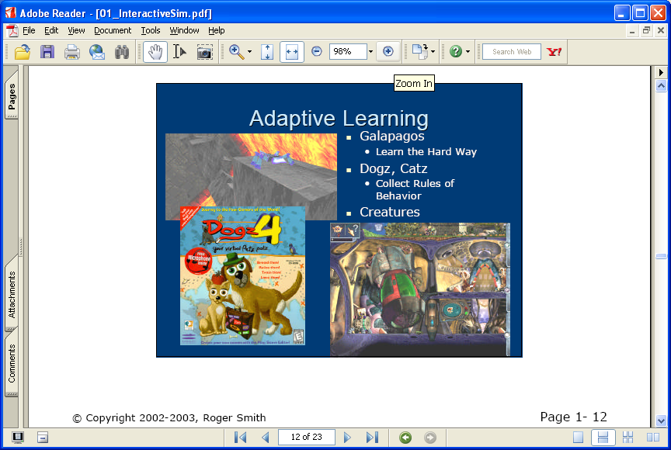

Slide 35
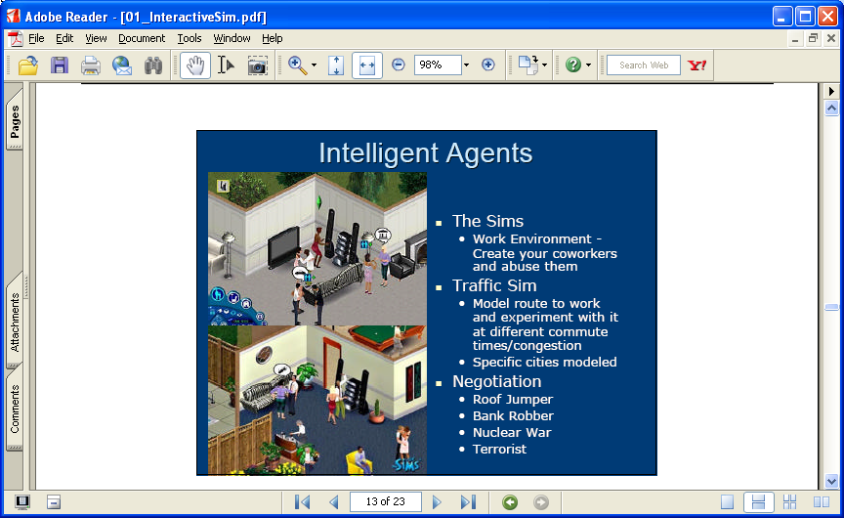

Slide 36
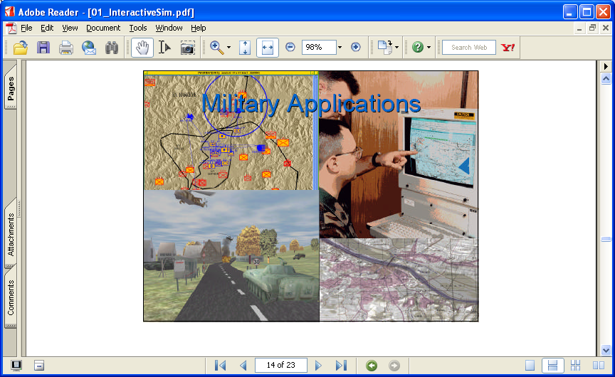

Slide 37
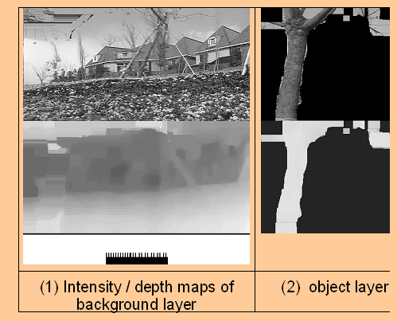

Slide 38
What can’t AI systems do yet?
Understand natural language robustly (e.g., read and understand articles in a newspaper)
Surf the web
Interpret an arbitrary visual scene
Learn a natural language
Play Go well
Construct plans in dynamic real-time domains
Refocus attention in complex environments
Perform life-long learning
Exhibit true autonomy and intelligence!

