Slide 1
Carcinogenesis:
Chemicals, Tobacco & Radiation
Year 3 Medical Students · Mechanisms, Exposures, Prevention
CHEMICALS
TOBACCO
RADIATION
Prof. Dr. Ş. Bilge Gürsel
Ondokuz Mayıs University Faculty of Medicine · Department of Radiation Oncology
Year 3 Medicine · Carcinogenesis Lecture · Introduction
1/41
Notes:
Welcome students. Introduce yourself and the three pillars of today’s lecture: chemical carcinogens, tobacco (including other tobacco products and sidestream smoke), and radiation carcinogenesis. Emphasize that the same biological story — DNA injury, clonal selection, and progression — links all three. Tell them speaker notes are also provided as a Word document for study.

Slide 2
Learning Objectives
01
Explain genotoxic vs non-genotoxic chemical carcinogenesis
02
Classify carcinogens (IARC) and list major environmental/occupational agents
03
Describe exposure routes and practical protection strategies
04
Detail tobacco smoke constituents, products, MSS vs SSS, and mechanisms
05
Outline radiation types, DNA injury pathways, environmental & medical exposure
Year 3 Medicine · Carcinogenesis Lecture · Introduction
2/41
Notes:
Read the five objectives aloud. Tell students that by the end they should be able to explain mechanisms, classify exposures, and counsel patients about tobacco and radiation risks. This is a Year-3 foundational lecture — focus on mechanisms and clinical relevance, not memorizing every chemical.

Slide 3
Why This Matters for Year-3 Doctors
• Most cancers are linked to modifiable environmental and lifestyle exposures
• Physicians must recognize occupational and lifestyle carcinogens in the history
• Prevention (tobacco, workplace, sun, radon, rational imaging) is clinical work
• Mechanistic literacy helps you understand pathology, oncology, and public health
• Same DNA-injury biology underlies chemicals, smoke, and radiation
★ Environment + lifestyle dominate population cancer burden.
Year 3 Medicine · Carcinogenesis Lecture · Introduction
3/41
Notes:
Open with curiosity: if inheritance explains <15% of cancers, what explains the rest?

Slide 4
Big Picture Numbers
• Lifetime cancer risk in developed countries ≈ 30%
• ~85–95% of cancers relate to environmental / lifestyle factors
• Inherited cancer syndromes: <15%
• Avoidable contributors (classic estimates): tobacco ~30%, diet, infections, radiation/UV, occupation, pollution
• Geographic differences largely track exposures, not only genes
Year 3 Medicine · Carcinogenesis Lecture · Introduction
4/41
Notes:
Cite Doll-type avoidable-risk teaching figures as order-of-magnitude guidance, not exact local statistics.

Slide 5
PART 01
Chemical Carcinogens
Mechanisms · classification · exposures · protection
Year 3 Medicine · Carcinogenesis Lecture · Chemical Carcinogens
5/41
Notes:
We now enter chemical carcinogenesis — the core mechanism block of the lecture.

Slide 6
What Is a Chemical Carcinogen?
• An agent that increases cancer incidence after exposure (human and/or experimental evidence)
• Historic landmark: Percival Pott (1775) — scrotal cancer in chimney sweeps (soot / PAHs)
• Modern framework: IARC Monographs integrate human, animal, and mechanistic data
• Latency may be years to decades after exposure begins
• Dose, route, duration, and host factors determine individual risk
Year 3 Medicine · Carcinogenesis Lecture · Chemical Carcinogens
6/41
Notes:
Tell the Pott story briefly — it invented environmental cancer thinking.

Slide 7
IARC Classification of Carcinogenic Agents
Group 1 — Carcinogenic to humans
Sufficient evidence in humans
Group 2A — Probably carcinogenic
Limited human + sufficient animal evidence
Group 2B — Possibly carcinogenic
Limited evidence in humans
Group 3 — Not classifiable
Inadequate evidence currently
Source: IARC Monographs — https://monographs.iarc.who.int/
Year 3 Medicine · Carcinogenesis Lecture · Chemical Carcinogens
7/41
Notes:
Walk down the pyramid. Group 1 means established human carcinogen — examples: tobacco smoke, benzene, asbestos, ionizing radiation, ethanol, aflatoxin. Stress that classification is about hazard evidence, not individual risk prediction. Always ask: who is exposed, how much, how long?

Slide 8
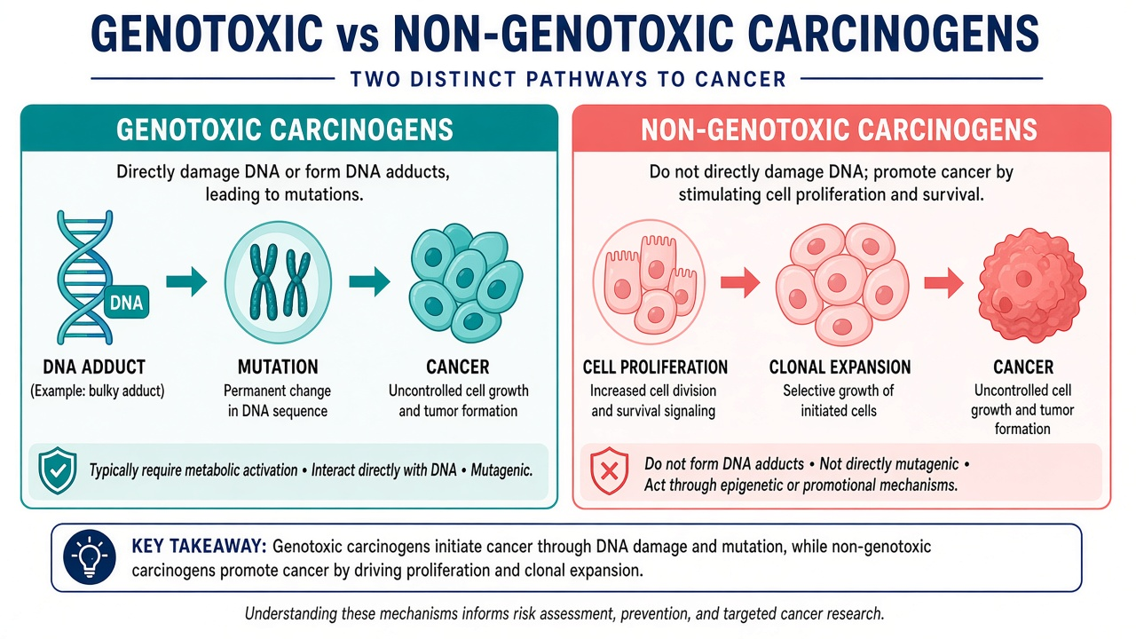
Genotoxic vs Non-Genotoxic — Visual Overview
Two mechanistic families — many real-world agents combine features of both
Year 3 Medicine · Carcinogenesis Lecture · Chemical Carcinogens
8/41
Notes:
Use this figure as the fork in the road. Genotoxic agents mutate DNA. Non-genotoxic agents drive proliferation, receptor signaling, cytotoxicity with regeneration, or oxidative stress. Ask a student for one example of each before you reveal lists.

Slide 9
Mechanisms in Detail
Genotoxic
Non-genotoxic
• DNA-reactive parent compound or metabolite
• DNA adducts, strand breaks, chromosomal injury
• Often mutagenic in short assays
• Direct-acting (alkylators) vs procarcinogens (need CYP450 activation)
• Examples: PAHs, nitrosamines, aflatoxin, benzene metabolites
• Do not directly mutate DNA as first step
• Mitogens / cytotoxicants / receptor agonists
• Promote clonal expansion of initiated cells
• Harder to detect — often need rodent bioassays
• Examples: some hormones, certain promoters, chronic irritation pathways
Year 3 Medicine · Carcinogenesis Lecture · Chemical Carcinogens
9/41
Notes:
Stress metabolic activation: many chemicals are safe until CYP450 creates the ultimate carcinogen. Inter-individual enzyme differences partly explain susceptibility.

Slide 10
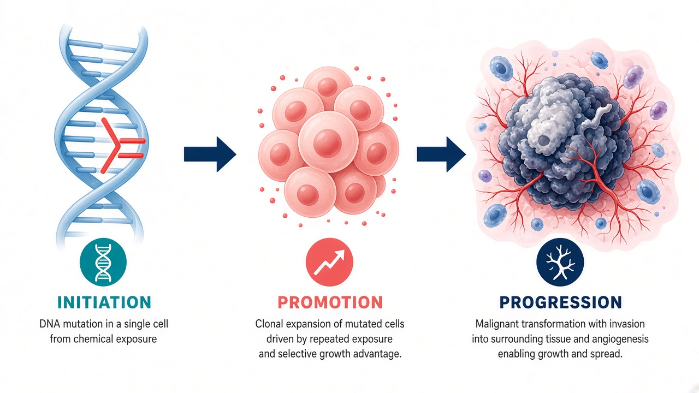
Initiation–Promotion–Progression — Diagram
The master sequence of chemical (and many physical) carcinogenesis
Year 3 Medicine · Carcinogenesis Lecture · Chemical Carcinogens
10/41
Notes:
Walk left to right on the figure. Initiation = irreversible DNA hit. Promotion = expansion. Progression = invasion/metastasis. Return to this figure when you discuss tobacco and radiation.

Slide 11
Initiation → Promotion → Progression
1. INITIATION
2. PROMOTION
3. PROGRESSION
• Irreversible DNA change
• Oncogene / suppressor hits
• DNA-repair failure
• Alone rarely = tumor
• Clonal expansion
• Mitogenic, reversible
• Needs repeated exposure
• Not mutagenic alone
• Genetic instability
• Invasion / metastasis
• Inflammation, angiogenesis
• Clinically malignant
Year 3 Medicine · Carcinogenesis Lecture · Chemical Carcinogens
11/41
Notes:
This is the master flowchart of the lecture. Initiation is the heritable DNA hit. Promotion expands that clone under continuous stimulation and is reversible if the promoter stops. Progression is irreversible evolution toward invasion and metastasis. Classic teaching model: mouse skin — benzo[a]pyrene initiator then phorbol ester promoter.

Slide 12
Classification by Carcinogenic Action / Behavior
• By mechanism: genotoxic vs non-genotoxic
• By need for activation: direct-acting vs procarcinogens
• By role in multistage model: initiators, promoters, progressors, complete carcinogens
• By evidence strength: IARC Groups 1 / 2A / 2B / 3
• By source: occupational, environmental, dietary, pharmaceutical, lifestyle
• Complete carcinogen = can drive more than one stage (e.g., some PAHs in practice)
Year 3 Medicine · Carcinogenesis Lecture · Chemical Carcinogens
12/41
Notes:
Students confuse ‘classification systems.’ Put all five on the board as complementary lenses.

Slide 13
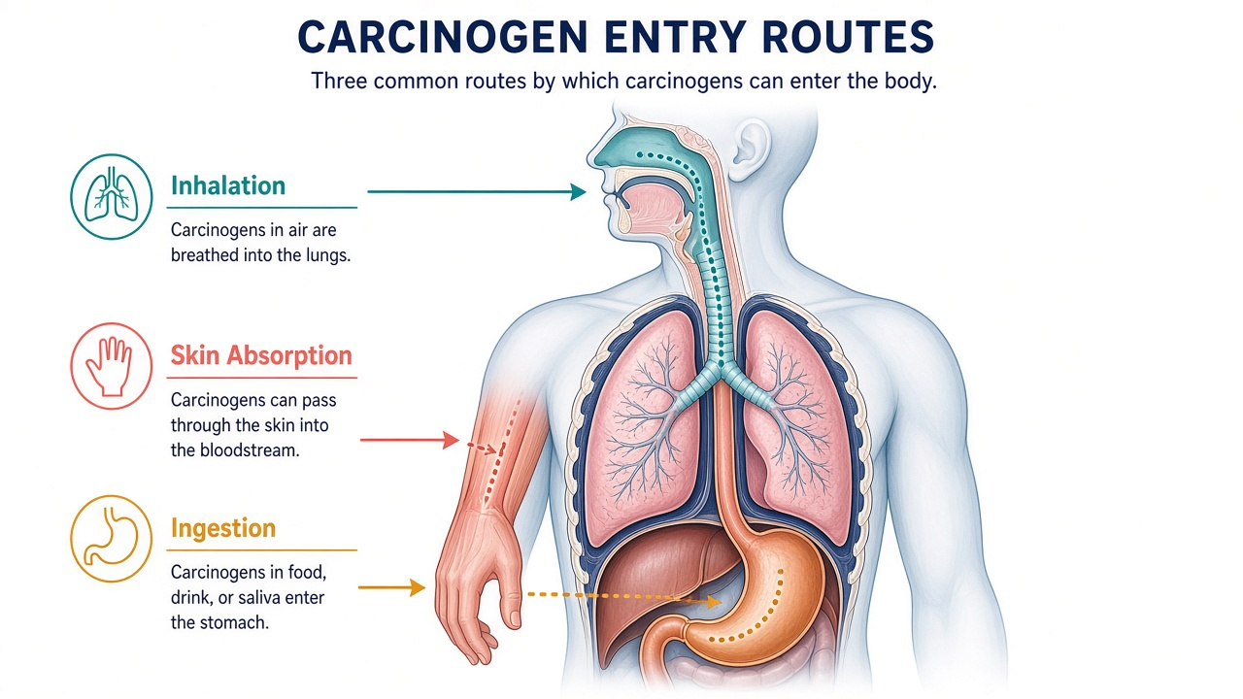
Exposure Routes — Visual
Inhalation · Skin absorption · Ingestion — intensity × duration × susceptibility
Year 3 Medicine · Carcinogenesis Lecture · Chemical Carcinogens
13/41
Notes:
Point to each portal on the figure. Ask which dominates in factories (inhalation). Mention arsenic in water (ingestion) and solvent dermatitis/absorption (skin).

Slide 14
Types of Exposure to Carcinogens
↑
◉
↓
+
INHALATION
SKIN CONTACT
INGESTION
INJECTION /
OTHER
Gases, fumes, dusts, smoke
Solvents, oils, pesticides
Food, water, hand-to-mouth
Medical, parenteral, rare
Most common occupational route
Absorption through intact skin
Contaminated diet or accidents
Iatrogenic or intentional routes
Year 3 Medicine · Carcinogenesis Lecture · Chemical Carcinogens
14/41
Notes:
Risk ≈ intensity × duration × susceptibility × route. Inhalation dominates workplaces. Skin absorption is underestimated for solvents. Ingestion matters for foodborne toxins like aflatoxin and contaminated water (arsenic). Mention that the same agent can affect different organs depending on route and metabolism.

Slide 15
Environmental Chemical Carcinogens — Examples
• Air pollution / combustion products — PAHs, fine particulates (with lung cancer evidence for pollution)
• Contaminated water — arsenic (skin, lung, bladder cancers)
• Foodborne — aflatoxin B1 (liver), nitrates/nitrosamines (context-dependent)
• Persistent organics — dioxins, some PCBs (long half-life, fat storage)
• Second-hand tobacco smoke as an environmental carcinogen in shared air
• Pesticide residues — population risk usually lower than high occupational exposure
Year 3 Medicine · Carcinogenesis Lecture · Chemical Carcinogens
15/41
Notes:
Distinguish high-dose occupational clusters from low-dose general population exposures.

Slide 16
Occupational Carcinogens — High-Yield List
• Asbestos → mesothelioma; also lung and several other sites
• Benzene → leukemia
• Vinyl chloride → hepatic angiosarcoma
• Aromatic amines (e.g., benzidine) → bladder cancer
• Wood dust → sinonasal / nasopharyngeal cancers
• Silica, diesel exhaust, coal tars, chromium, nickel, cadmium — site-specific risks
• Painting / welding work and night-shift work — discuss as recognized risk contexts
Year 3 Medicine · Carcinogenesis Lecture · Chemical Carcinogens
16/41
Notes:
Use agent → cancer flash pairs. Ask students for vinyl chloride and asbestos before revealing.

Slide 17
Selected Agent–Cancer Pairs
Organics
Dusts / fibers / metals
• Benzene → leukemia
• PAHs → lung, skin, urinary tract
• Vinyl chloride → liver angiosarcoma
• Benzidine → bladder
• Aflatoxin B1 → hepatocellular carcinoma
• Ethanol → multiple sites (IARC 1)
• Asbestos → mesothelioma + lung
• Silica → lung
• Wood dust → sinonasal
• Arsenic → skin, lung, bladder
• Chromium / nickel → lung (± nasal)
• Cadmium → lung
Year 3 Medicine · Carcinogenesis Lecture · Chemical Carcinogens
17/41
Notes:
This is a high-yield exam slide. Pause and quiz.

Slide 18
Protection Against Chemical Carcinogens
1. Eliminate / Substitute
Remove the agent or replace with safer alternative
2. Engineering controls
Ventilation, closed systems, process enclosure
3. Administrative controls
Training, rotation, exposure limits, labeling
4. PPE (last line)
Respirators, gloves, goggles, protective clothing
5. Medical surveillance
Biological monitoring, early detection where indicated
Year 3 Medicine · Carcinogenesis Lecture · Chemical Carcinogens
18/41
Notes:
Teach the industrial-hygiene hierarchy: PPE is not the first answer. Substitution and engineering controls prevent more cancer than gloves alone. Link to regulation (exposure limits), workplace rights, and the physician’s role in occupational history-taking.

Slide 19
PART 02
Tobacco & Cancer
Contents · mechanisms · products · MSS vs SSS
Year 3 Medicine · Carcinogenesis Lecture · Tobacco & Cancer
19/41
Notes:
Tobacco is the most important avoidable chemical carcinogen mixture in clinical practice.

Slide 20
Tobacco — Scale of the Problem
• Leading preventable cause of cancer death worldwide
• Causes ~80–90% of lung cancer deaths in many populations
• Also causes cancers of mouth, throat, larynx, esophagus, stomach, pancreas, kidney, bladder, cervix, colon/rectum (evidence varies by site), and AML
• Dose–response with pack-years
• Risk falls after cessation — earlier quitting yields larger benefit
Year 3 Medicine · Carcinogenesis Lecture · Tobacco
20/41
Notes:
Make it clinical: every history should include smoking status and pack-years.

Slide 21
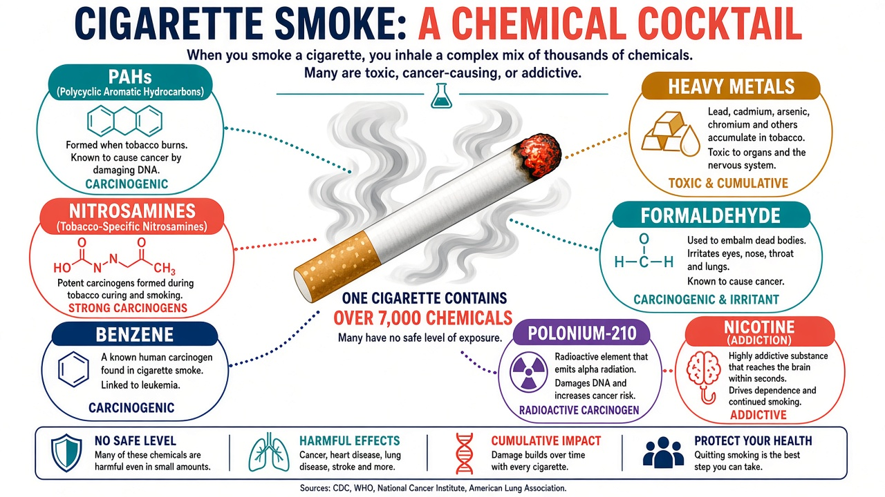
What’s Inside Smoke? — Chemical Cocktail
~4,000 chemicals · >70 known carcinogens · nicotine sustains addiction
Year 3 Medicine · Carcinogenesis Lecture · Tobacco
21/41
Notes:
Narrate the bubbles: PAHs and nitrosamines damage DNA; metals and Po-210 add to the burden; nicotine is not the main mutagen — it is the addiction engine that keeps exposure chronic.

Slide 22
Key Carcinogens in Tobacco Smoke
• Polycyclic aromatic hydrocarbons (e.g., benzo[a]pyrene)
• Tobacco-specific nitrosamines (NNK, NNN and related)
• Volatile organics: benzene, 1,3-butadiene, formaldehyde, acrolein
• Metals: arsenic, cadmium, chromium, nickel
• Polonium-210 (radioactive)
• Tar = complex carcinogenic mixture deposited in airways
Year 3 Medicine · Carcinogenesis Lecture · Tobacco
22/41
Notes:
Link back to chemical section: many of these are classic IARC agents.

Slide 23
Mechanism of Tobacco Carcinogenesis
• Inhalation → deposition in airways and absorption of systemic toxicants
• Metabolic activation (CYP pathways) → DNA adducts
• Driver mutations accumulate (e.g., TP53, KRAS patterns historically linked to smoking)
• Chronic inflammation and oxidative stress promote progression
• Field cancerization along the aerodigestive tract
• Systemic delivery explains distant sites (bladder, pancreas, cervix, AML)
Year 3 Medicine · Carcinogenesis Lecture · Tobacco
23/41
Notes:
Draw the pathway on the board if time: Smoke → activation → adduct → mutation → field → cancer.

Slide 24
Tobacco & Nicotine Products — Broader Than Cigarettes
Cigarettes
Cigars / pipes
Waterpipe / shisha
Combusted; highest multi-site cancer evidence
Oral, laryngeal, esophageal, lung risks
Long sessions; high CO & toxicant load
Smokeless tobacco
Bidís / kreteks
E-cigarettes / heated products
Oral / pancreatic cancer; no combustion but still carcinogens
Often high exposure; regional products
Not risk-free; evolving evidence; not for never-users
Year 3 Medicine · Carcinogenesis Lecture · Tobacco
24/41
Notes:
Do not let students think ‘only cigarettes cause cancer.’ Combusted products share many toxicants. Smokeless tobacco still delivers nitrosamines. Waterpipe sessions can deliver large toxicant doses. E-cigarettes: stress they are not harmless, evidence is evolving, and they should not be started by never-smokers; cessation context is different.

Slide 25
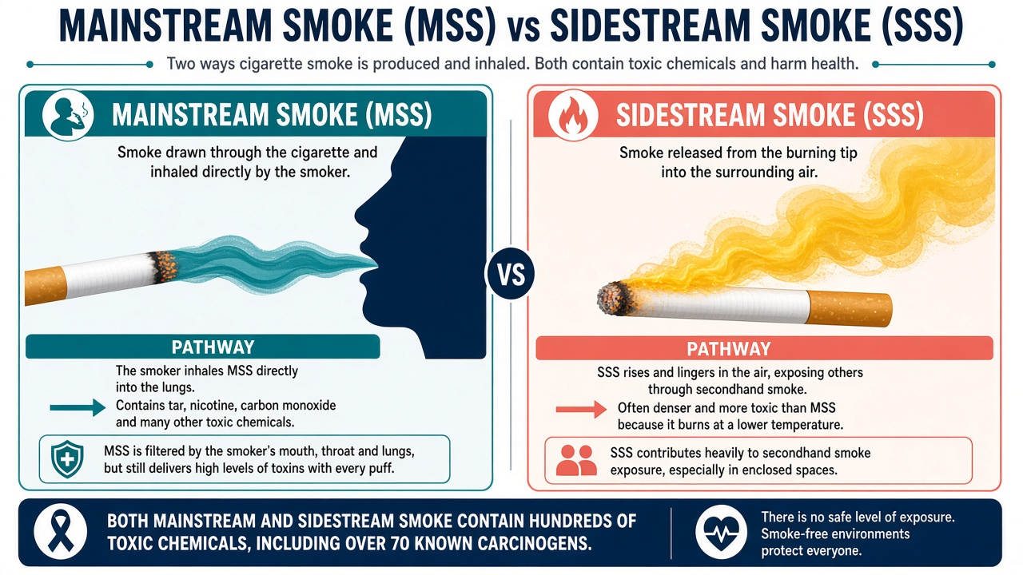
Mainstream vs Sidestream Smoke — Visual
MSS enters the smoker; SSS rises from the tip and dominates second-hand smoke
Year 3 Medicine · Carcinogenesis Lecture · Tobacco
25/41
Notes:
Stand at the figure and define MSS vs SSS. Ask: which exposes children in a car? (SSS/second-hand).

Slide 26
Mainstream vs Sidestream Smoke
MAINSTREAM SMOKE (MSS)
SIDESTREAM SMOKE (SSS)
• Drawn through the cigarette into the smoker’s mouth
• Filtered partly by the tobacco rod / filter
• Primary exposure for the active smoker
• Delivers nicotine + full carcinogen load
• Dose often summarized as pack-years
• Rises from the smoldering tip between puffs
• Generated at lower temperature → different chemistry
• Often richer in some toxicants per mg
• Major component of second-hand (environmental) smoke
• Causes disease in nonsmokers — not ‘mild’ exposure
Year 3 Medicine · Carcinogenesis Lecture · Tobacco
26/41
Notes:
Define clearly. Sidestream smoke is a major part of second-hand smoke. Because combustion conditions differ, SSS can be disproportionately toxic for some compounds. Emphasize smoke-free policies protect workers and children. Second-hand smoke is an IARC Group 1 carcinogen.

Slide 27
Second-Hand (Environmental) Tobacco Smoke
• Mixture of SSS + exhaled MSS
• IARC Group 1 carcinogen
• Causes lung cancer in nonsmokers; also cardiovascular and respiratory disease
• Children: higher relative intake; linked to multiple harms
• No safe threshold for involuntary exposure in public-health messaging
• Smoke-free laws are cancer prevention, not etiquette
Year 3 Medicine · Carcinogenesis Lecture · Tobacco
27/41
Notes:
Connect to pediatrics and occupational health (hospitality workers historically heavily exposed).

Slide 28
Clinical Counseling Pearls — Tobacco
• Ask–Advise–Assist–Arrange at every opportunity
• Quantify pack-years; document cessation date
• Synergy: tobacco + asbestos / radon / alcohol (site-dependent)
• Do not present ‘light’ or filtered cigarettes as safe
• E-cigarettes: discuss honestly — potential harm-reduction tool for some smokers, risk for youth initiation
Year 3 Medicine · Carcinogenesis Lecture · Tobacco
28/41
Notes:
Role-play one 60-second cessation advice if time allows.

Slide 29
PART 03
Radiation Carcinogenesis
Types · DNA mechanisms · environment · medical exposure
Year 3 Medicine · Carcinogenesis Lecture · Radiation Carcinogenesis
29/41
Notes:
Radiation is a physical carcinogen that creates chemical injury in DNA — bridging physics and pathology.

Slide 30
Types of Radiation Relevant to Carcinogenesis
Ionizing
Electromagnetic
Particulate
Ionizing
Non-ionizing
UV
Other
non-ionizing
X-rays, γ-rays
α, β, neutrons, protons
UVA, UVB, UVC
RF, ELF, etc.
Medical imaging, therapy, background, accidents
Radon daughters, nuclear, some therapy beams
Sunlight, tanning beds → skin cancers / melanoma
Generally not established like ionizing/UV for solid evidence of cancer
Year 3 Medicine · Carcinogenesis Lecture · Radiation
30/41
Notes:
For Year 3, focus on ionizing radiation and UV as established carcinogens. Particulate radiation (alpha from radon) is highly damaging locally. Avoid spending lecture time on controversial RF debates — state that evidence is not comparable to tobacco, asbestos, or ionizing radiation.

Slide 31
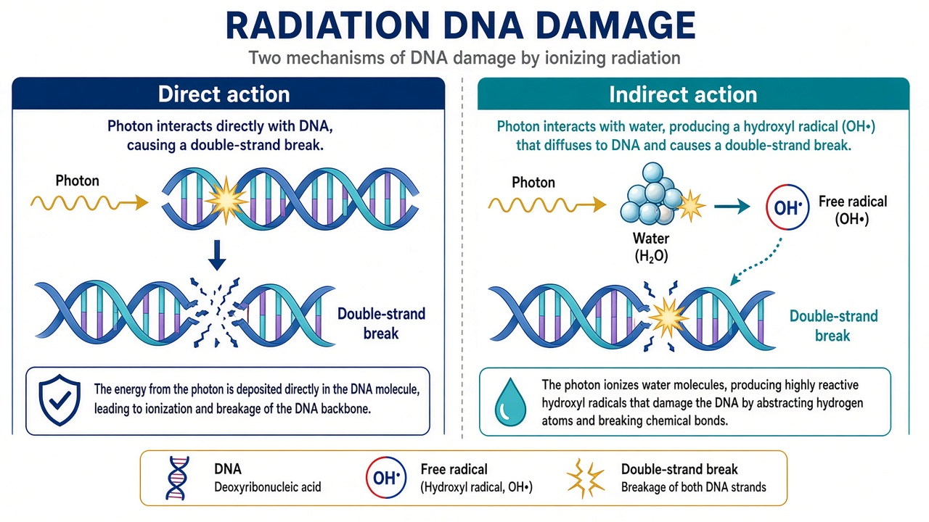
How Radiation Damages DNA
Direct hits vs indirect free-radical (•OH) attack — both can yield mutagenic misrepair
Year 3 Medicine · Carcinogenesis Lecture · Radiation
31/41
Notes:
Explain direct vs indirect action. X/γ rays act largely via water radiolysis. Double-strand breaks are critical; misrepair causes chromosomal aberrations and cancer risk.

Slide 32
Radiation DNA Injury — Detail
Direct action
Indirect action
• Photon/particle energy hits DNA
• Base damage, crosslinks, SSB/DSB
• More important for high-LET radiation (α, neutrons)
• Clustered damage harder to repair
• Radiolysis of water → •OH and other radicals
• Radicals attack DNA/proteins/lipids
• Dominant for low-LET X/γ rays
• Oxygen enhances damage (oxygen effect)
Year 3 Medicine · Carcinogenesis Lecture · Radiation
32/41
Notes:
Mention that stochastic cancer risk has no sharp practical ‘safe zero’ — risk rises with dose, while tissue reactions (deterministic) have thresholds.

Slide 33
From Misrepair to Cancer
• Misrepaired DSB → chromosomal aberrations / mutations
• Hits to oncogenes, tumor suppressors, or genome-maintenance genes
• Genomic instability may persist in progeny cells
• Latency: leukemias earlier; solid tumors often decades later
• Human evidence: atomic-bomb survivors, medical cohorts, radon miners, UV epidemiology
Year 3 Medicine · Carcinogenesis Lecture · Radiation
33/41
Notes:
Age at exposure matters — children often have higher lifetime risk for many tissues.

Slide 34
Tissue Sensitivity Highlights
• Highly sensitive: bone marrow (leukemia), thyroid (especially children), breast, lung
• UV targets skin → BCC, SCC, melanoma
• Radon targets lung — α-particle dose to bronchi
• Fractionation and dose rate modify biologic effect
• Combined exposures (e.g., smoking + radon) can be synergistic
Year 3 Medicine · Carcinogenesis Lecture · Radiation
34/41
Notes:
Ask: why is thyroid cancer a classic after childhood neck irradiation / fallout?

Slide 35
Environmental vs Medical Radiation Exposure
ENVIRONMENTAL / BACKGROUND
MEDICAL EXPOSURE
• Cosmic rays (higher at altitude / flights)
• Terrestrial radionuclides in soil/rock
• Radon gas indoors — major natural lung carcinogen
• Internal radionuclides (K-40, etc.)
• Fallout / accidental releases (rare but historic lessons)
• Diagnostic: X-ray, CT, fluoroscopy, nuclear medicine
• Interventional radiology — can deliver high skin/organ doses
• Radiotherapy — high therapeutic doses; secondary cancer risk small but real
• Principles: justification + optimization (ALARA)
• Never withhold indicated imaging from fear alone
Year 3 Medicine · Carcinogenesis Lecture · Radiation
35/41
Notes:
Radon is the teaching pearl for environmental exposure — second leading cause of lung cancer after smoking in many countries, synergistic with tobacco. For medical exposure, teach justification and ALARA. CT is useful but not casual. Radiotherapy’s benefit outweighs secondary cancer risk when indicated; survivors still need long-term awareness.

Slide 36
Medical Radiation — What Future Doctors Must Do
• Justify every exam: will the result change management?
• Optimize: lowest dose compatible with diagnostic quality (ALARA)
• Prefer non-ionizing alternatives when equally appropriate (US/MRI)
• Special caution: pregnancy, children, high-dose fluoroscopy
• Radiotherapy: curative/palliative benefit outweighs secondary-cancer risk when indicated
• Communicate risks honestly without scaring patients away from needed care
Year 3 Medicine · Carcinogenesis Lecture · Radiation
36/41
Notes:
This is a professionalism slide as much as a science slide.

Slide 37
Chemicals + Tobacco + Radiation — Shared Biology
• All can initiate DNA damage (adducts, strand breaks, oxidative lesions)
• Promotion via inflammation and proliferation is a shared chapter
• Real patients stack exposures: smoker + radon + occupational dust
• Prevention packages beat single slogans
• Your clinical habit: exposure history + counseling + appropriate imaging
Year 3 Medicine · Carcinogenesis Lecture · Integration
37/41
Notes:
Draw a simple Venn on the board: overlapping mechanisms, distinct sources.

Slide 38
PART 04
Prevention & Close
Turn mechanisms into action
Year 3 Medicine · Carcinogenesis Lecture · Prevention & Close
38/41
Notes:
Finish with agency — most of these risks are modifiable.

Slide 39
Integrated Prevention Checklist
• Never start / stop tobacco; eliminate second-hand smoke exposure
• Workplace: substitution, ventilation, training, PPE, regulation
• Sun protection; avoid tanning beds
• Test/mitigate radon where relevant
• Limit alcohol; healthy weight and diet patterns
• Vaccination where relevant (HPV, HBV) — infection-related cancer prevention
• Rational medical imaging — justification + ALARA
Year 3 Medicine · Carcinogenesis Lecture · Prevention
39/41
Notes:
Have the class shout items before you click through.

Slide 40
Take-Home Messages
1
Carcinogens act by damaging DNA or promoting clonal growth — often both.
2
IARC Group 1 agents are established human carcinogens; exposure control saves lives.
3
Tobacco is a multi-carcinogen mixture; MSS and SSS both matter; other products are not safe.
4
Ionizing radiation and UV are proven carcinogens; risk depends on dose, age, and tissue.
5
Prevention hierarchy: eliminate/substitute → engineering → admin → PPE; plus tobacco cessation & ALARA.
6
Take an exposure history: occupation, smoking, sun, radon, prior radiation.
Year 3 Medicine · Carcinogenesis Lecture · Summary
40/41
Notes:
Close by repeating these six points. Invite questions from each section. Remind students the Word document contains the full speaking script for revision.

Slide 41
Selected References
• IARC Monographs — https://monographs.iarc.who.int/
• WHO / IARC World Cancer Reports; tobacco & radiation fact sheets
• Robbins & Kumar — Basic Pathology (neoplasia / carcinogenesis)
• DeVita — Cancer: Principles & Practice of Oncology
• Perez & Brady / Gunderson — Radiation Oncology principles texts
• Doll R. avoidable causes of cancer (classic teaching estimates)
• National cancer institute / NIEHS environmental carcinogen resources
Year 3 Medicine · Carcinogenesis Lecture · References
41/41
Notes:
Point students to IARC as the living classification source.

