Slide 1
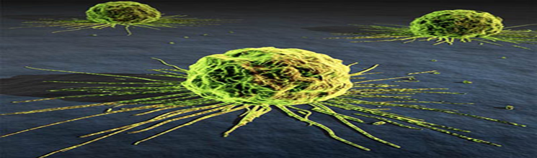
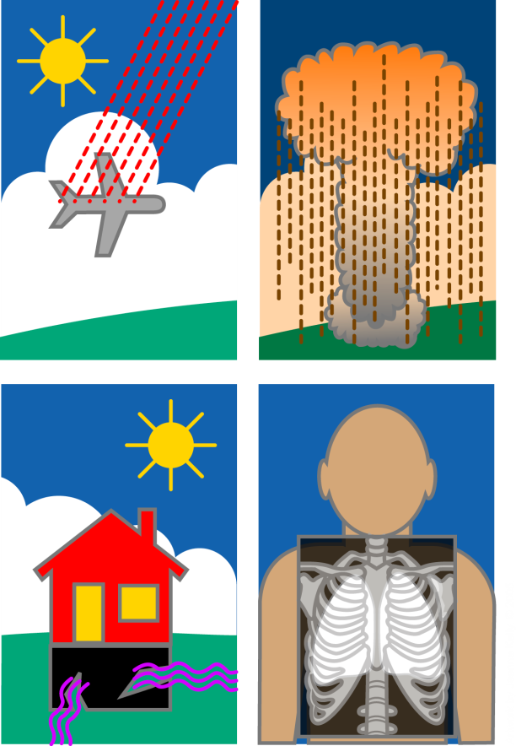
CANCER &
PREDISPOSING FACTORS
Prof. Dr. Ş. Bilge Gürsel

Slide 2
OBJECTIVES
Geographical and environmental factors which affect emergence of malignant tumors,
Carcinogenic mechanism of chemical agents
Occupational carcinogens and prevalent occupational cancer types
Relation between tobacco and cancer
Carcinogenic effect of radiation

Slide 3
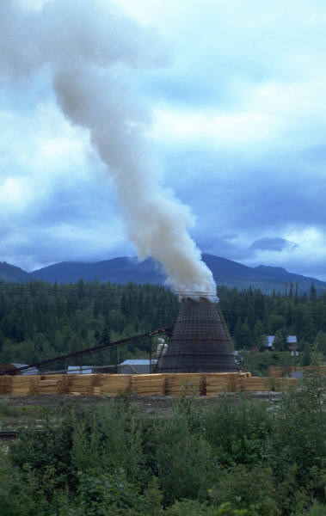

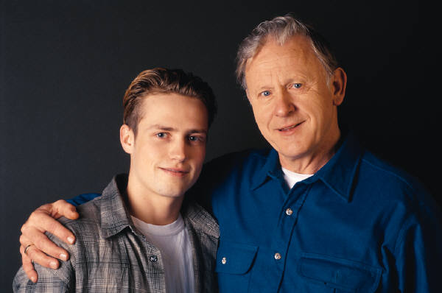
What Causes Cancer?
Family History
Lifestyle
Environment
Notes:
We know that there are three major contributing/risk factors for cancer. (Read slide)

Slide 4



Lifestyle Risks
Smoking
Diet high fat and low in fruits and vegetables
Lack of exercise
Unprotected exposure to the sun, (UV) rays
Obesity
Notes:
Two-thirds (67%) of all cancers are caused by the way we live.
Obesity is a lifestyle risk for developing cancer. In Utah 18% of adults are obese.

Slide 5
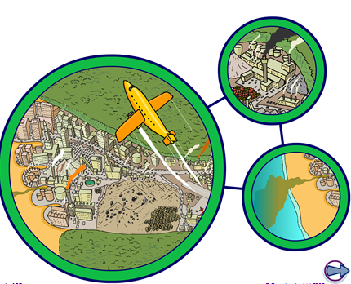
Human Impact on the Environment and the Environment Impact on Human

Slide 6
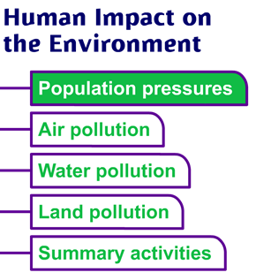

Slide 7
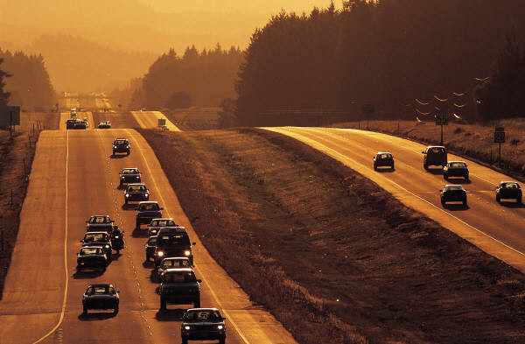
Environmental Risks
Second hand smoke
Air pollution
Industrial pollution
Chemical exposures
Researchers have estimated that between 2 and 8 percent of cancers can be attributed to workplace exposures.
Notes:
Researchers have estimated that between 2 and 8 percent of cancers can be attributed to workplace exposures. In the United States, this would represent between 24,500 and 98,000 new cases of cancer each year.
Diesel exhaust and other pollutants are linked to lung cancer, but unless you have had prolonged exposure, your risk is low. The Environmental Protection Agency regulates diesel exhaust emissions from motor vehicles under the Clean Air Act. For more information go to www.EPA.gov.
Smokers have 10 times the risk of getting lung cancer than a non-smoker.

Slide 8

Inherited Risks
Less than 15% of cancers are inherited
Gene mutations are linked to some inherited cancers
Cancers that may be caused by inherited gene mutations are:
  Colon cancer
  Breast cancer
  Ovarian
  Prostate cancer
  Skin cancer
Notes:
Remember to stress that only 15% are inherited. Everyone is at risk for cancer!

Slide 9
ENVIRONMENT AND CANCER
%27 of deaths are due to cancer in developped countries
In developped countries lifetime cancer risk is 30%
85-95% of cancers are due to environmental factors

Slide 10

Avoidable Factors
Proportion of Cancer Deaths Linked to Avoidable Risk Factors
Tobacco 29–31 percent
Diet 20–50 percent
Infections:
bacteria, viruses 10–20 percent
Ionizing and UV light 5–7 percent
Occupation 2–4 percent
Pollution:
air, water, food 1–5 percent
Source: Doll R. (UK data) Recent Results in
Cancer Research 1998; 154:3-21.

Slide 11
REASONS SUPPORTING ENVIRONMENTAL FACTORS IN CANCER ETIOLOGY
Dominance of certain cancer types in certain populations
Incidence change in migrated populations
Incidence change by time
Increase in incidence of certain cancers after exposure to certain agents

Slide 12
There is clear discrimination of incidence and death rates between specific cancer types all around the world
Racial susceptibility cannot be excluded.
It is believed that most of the geographic diferences are due to environmental reasons
This effect can be seen in comparison of mortality rates between Japanese emigrants to the USA and children born to these families in the USA

Slide 13

Influencing Rates and Risks
New Cases of Colorectal Cancer*
Japan
United States
*Annual incidence rate per 100,000
Japanese males born in U.S.
142.5
Japanese females
born
in U.S.
90.1
Japanese males born in Japan
69.3
Japanese females born in Japan
63.5
So scientists study what exposures or characteristics differ between Japanese immigrants and their descendants in the U.S. to better understand the environmental factors that may be influencing their colon cancer rates and risks
Notes:
The environment influences cancer rates and risks. We can see this by comparing cancer rates in different countries, and how rates change when people move from one country to another.
For example, U.S.-born Japanese men have twice the rate of colon cancer as native-born Japanese men, and U.S.-born Japanese women have colon cancer rates 40 percent higher than their counterparts born in Japan. So scientists study what exposures or characteristics differ between Japanese immigrants and their descendants in the U.S. to better understand the environmental factors that may be influencing their colon cancer rates and risks.

Slide 14
CARCINOGENES
The substances which increase the cancer incidence in experimental animals when contacted to them
1775, Percival Pott first time demonstrated the role of environmental chemicals in cancer. Increased risk of scrotal cancer in chimney sweeps was defined. Years later the carcinogenic in it is defined as polycyclic aromatic hydrocarbons agent.

Slide 15
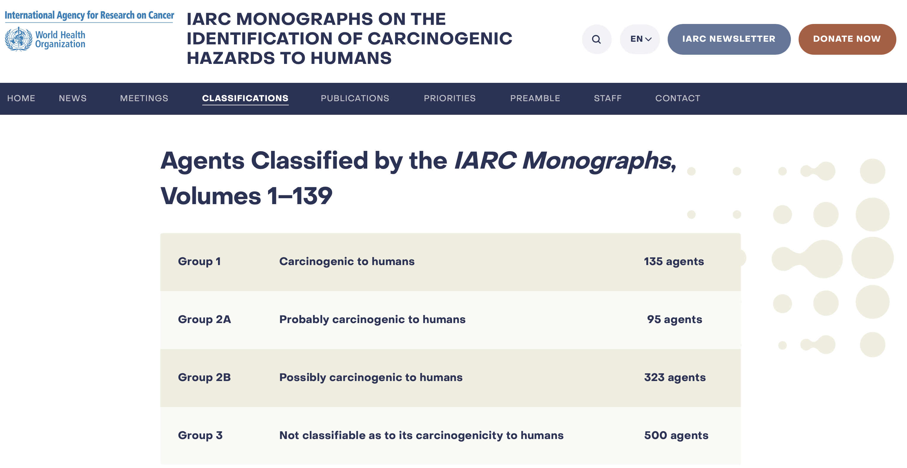
Agents that can be carcinogenic IARC(The International Agency for Research on Cancer) categorization
https://monographs.iarc.who.int/agents-classified-by-the-iarc/

Slide 16
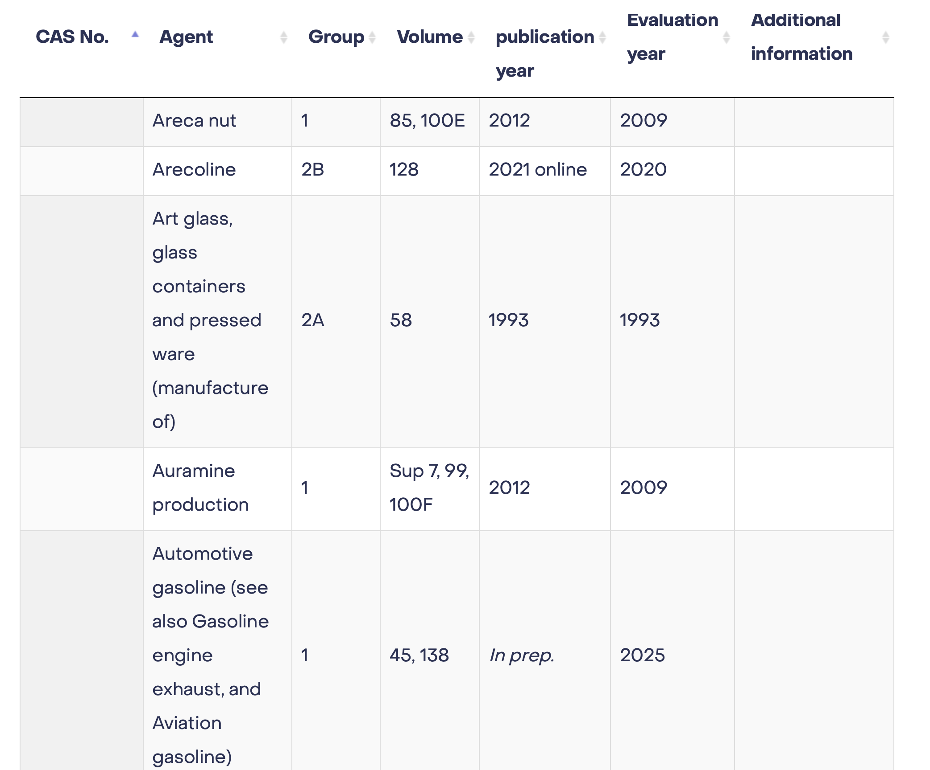

Slide 17
How do carcinogens enter the body?
Skin absorption. Many solvents and other chemicals go directly through the skin.
Ingestion. Swallowing of a carcinogen.
Inhalation. Breathing gases, fumes and vapors is the most common form of exposure.

Slide 18
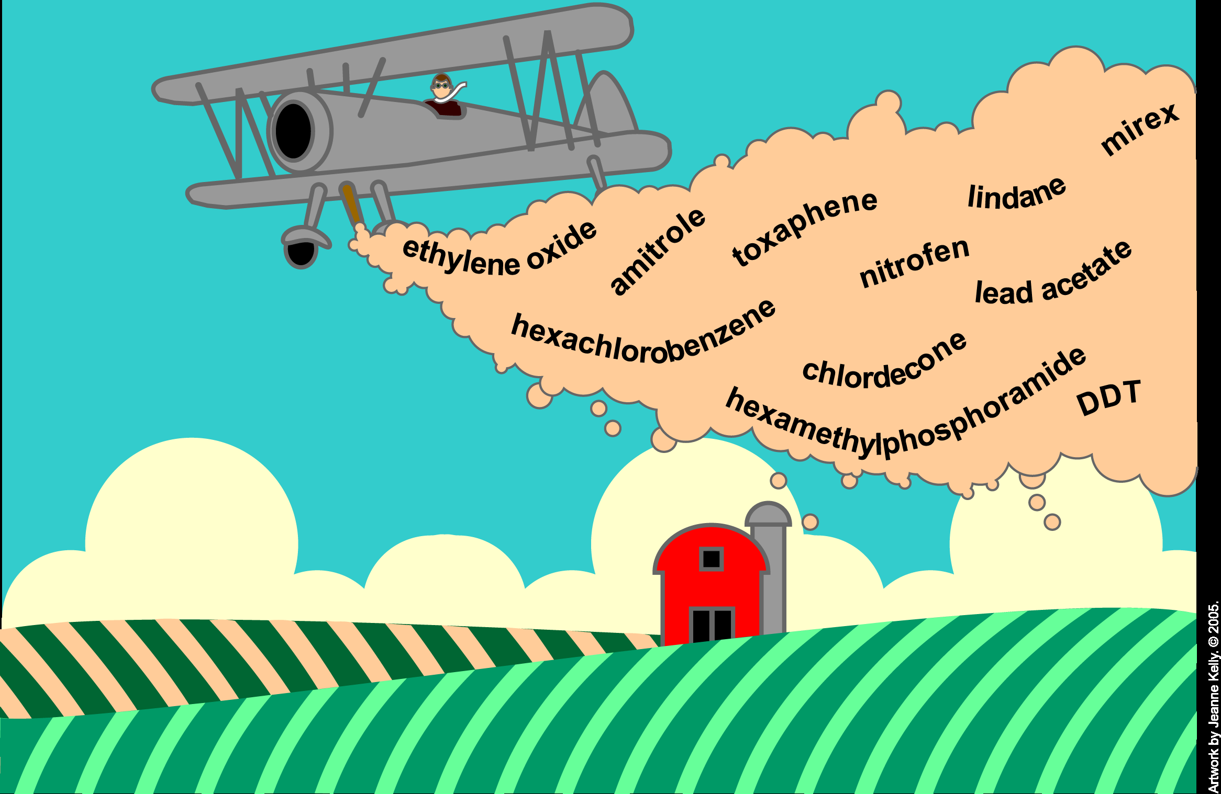
About 20 ingredients in pesticides have been found to cause cancer in animals. Studies of people with high exposure to pesticides--farmers, crop duster pilots, pesticide manufacturers--have shown higher rates of blood and lymphatic system cancers in these people, as well as melanoma and cancers of the lip, stomach, brain, lung, and prostate.
Notes:
About 20 ingredients in pesticides have been found to cause cancer in animals. Studies of people with high exposure to pesticides--farmers, crop
duster pilots, pesticide manufacturers--have shown higher rates of blood and lymphatic system cancers in these people, as well as melanoma and
cancers of the lip, stomach, brain, lung, and prostate.

Slide 19
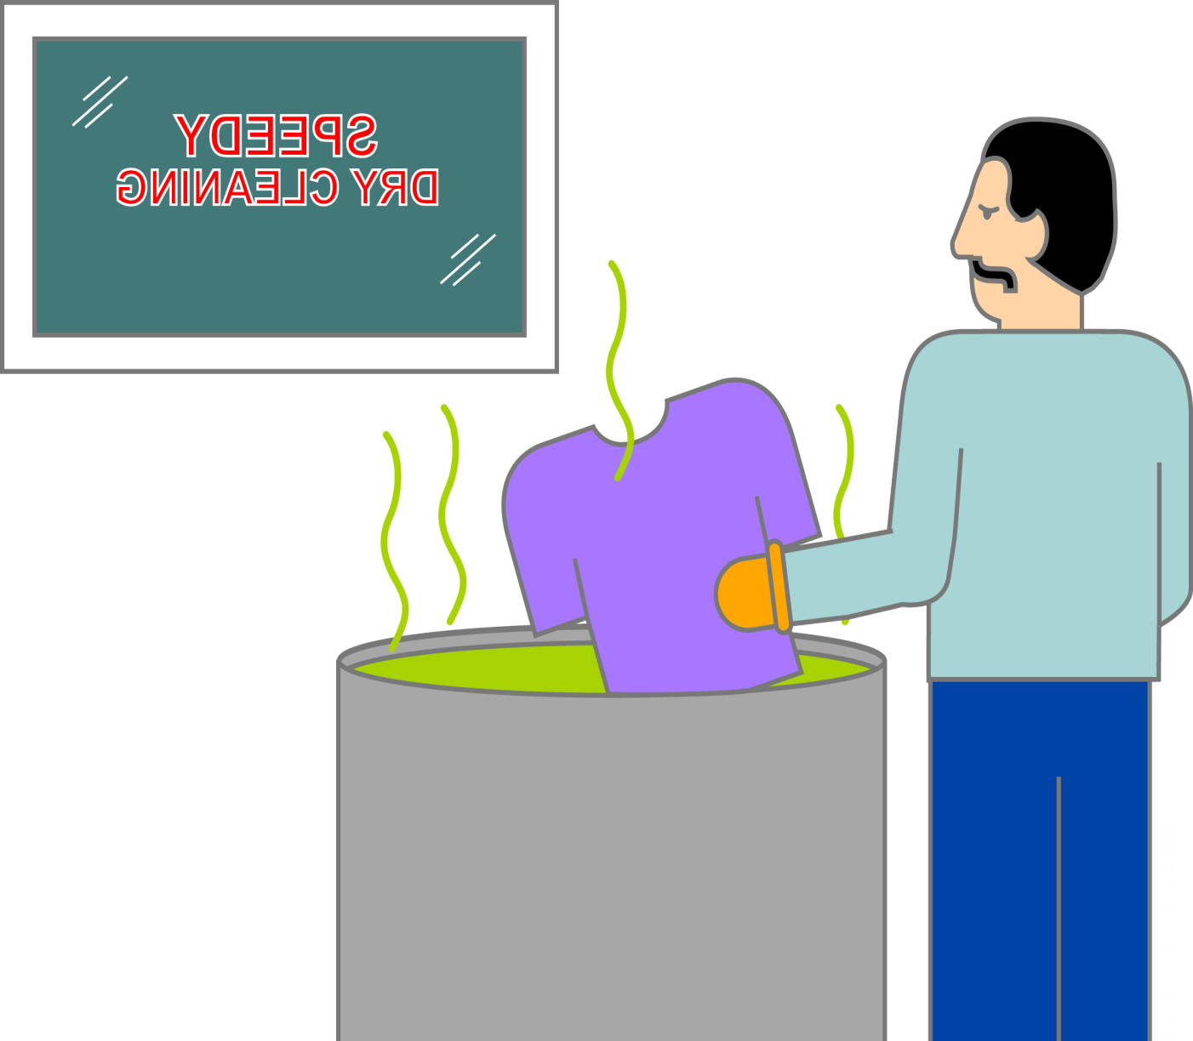
Solvents
Solvents are used in paint removers, grease removers, paint thinners, and dry cleaning. The solvents benzene, carbon tetrachloride, chloroform, and methylene chloride have been linked to human cancer.
The strongest evidence linking a solvent to cancer involves benzene, which is also found in cigarette smoke and gasoline. It increases the risk of leukemia.
Notes:
Solvents are used in paint removers, grease removers, paint thinners, and dry cleaning. The solvents benzene, carbon tetrachloride, chloroform, and methylene chloride have been linked to human cancer.
The strongest evidence linking a solvent to cancer involves benzene, which is also found in cigarette smoke and gasoline. It increases the risk of leukemia.
If you must work with solvents, work outside or make sure the area is well ventilated.

Slide 20
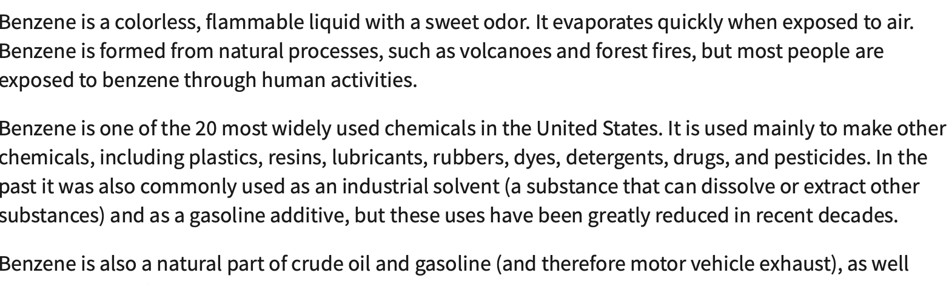
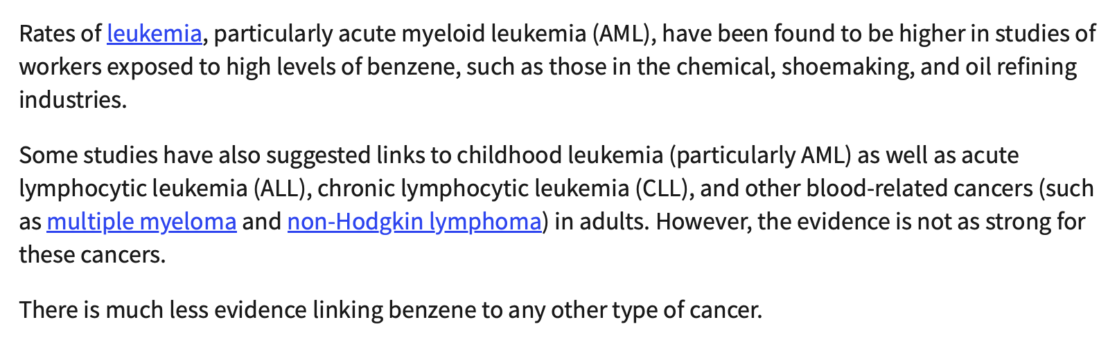

BENZENE

Slide 21
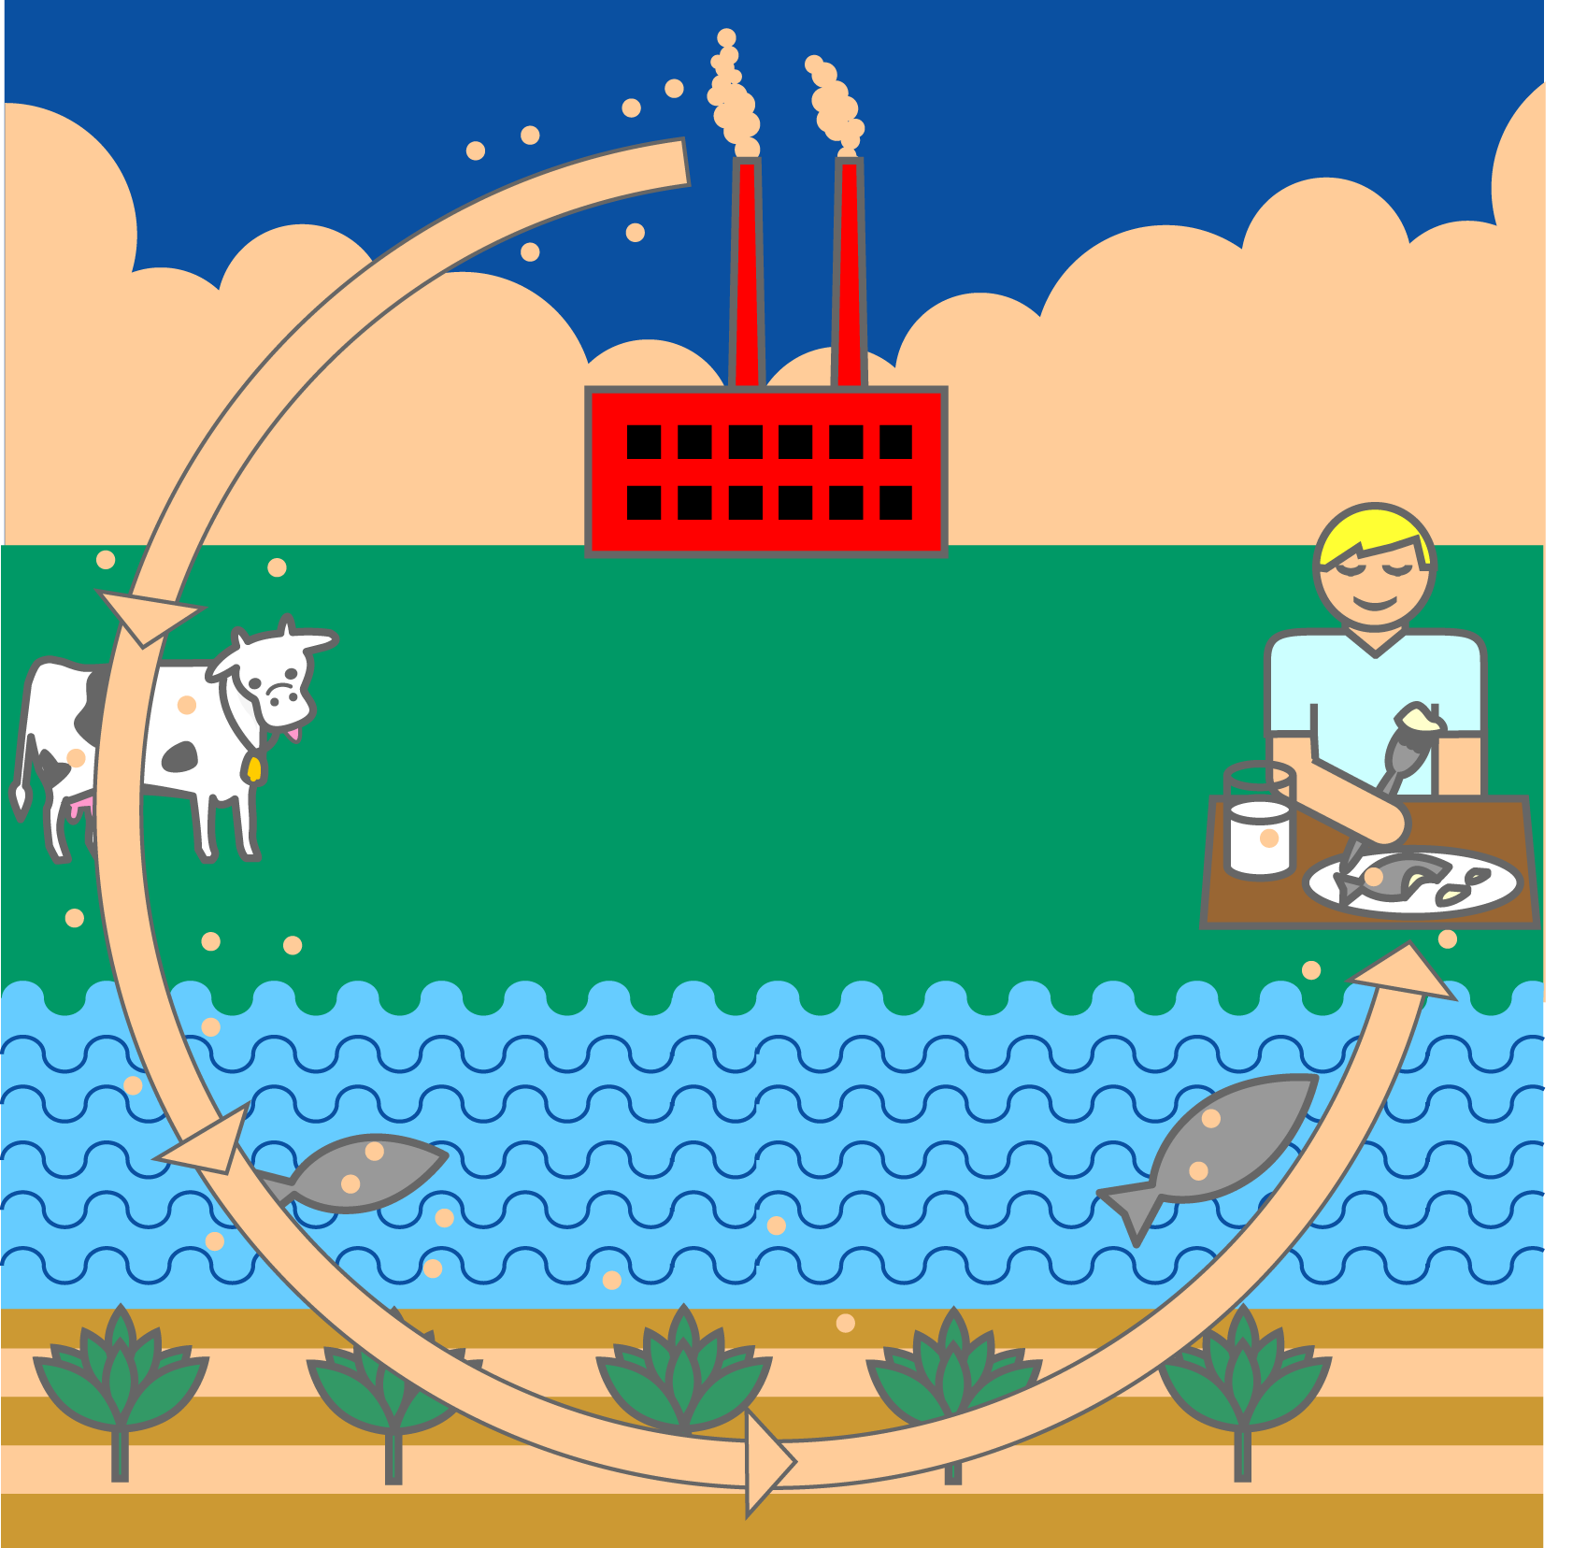
Dioxins
Dioxins are byproducts of paper bleaching, smelting, and waste incineration. They are widespread in the environment because they break down very slowly. They also accumulate in fat cells. Most of our exposure to dioxins comes from eating dairy products, fish, and meat.
Notes:
Dioxins are byproducts of paper bleaching, smelting, and waste incineration. They are widespread in the environment because they break down very slowly. They also accumulate in fat cells. Most of our exposure to dioxins comes from eating dairy products, fish, and meat.

Slide 22
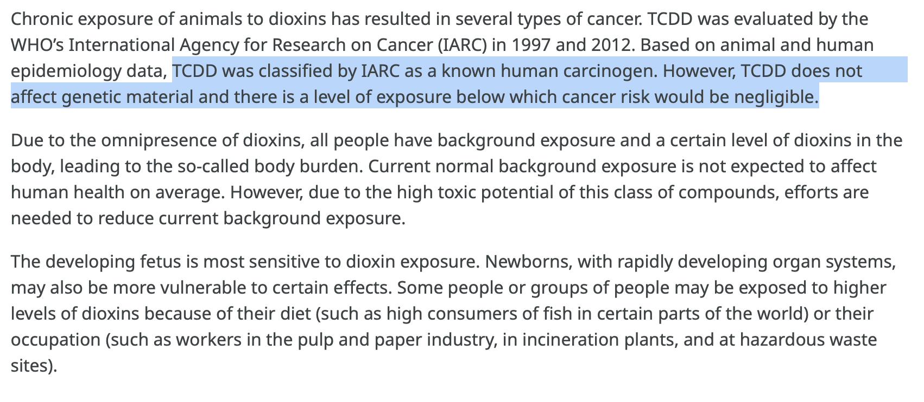

DİOXİNS
Their half-life in the body is estimated to be 7 to 11 years.

Slide 23

Polycyclic Aromatic Hydrocarbons
These compounds (known as PAHs) come from the burning of carbon-based material. They are found in wood smoke, car exhaust, cigarette smoke, and charcoal-grilled foods. Sausages and roasted coffees may also contain PAHs. These compounds have been linked to increased risks of lung, skin, and urinary cancers
Notes:
These compounds (known as PAHs) come from the burning of carbon-based material. They are found in wood smoke, car exhaust, cigarette smoke, and charcoal-grilled foods. Sausages and roasted coffees may also contain PAHs. These compounds have been linked to increased risks of lung, skin, and urinary cancers.

Slide 24
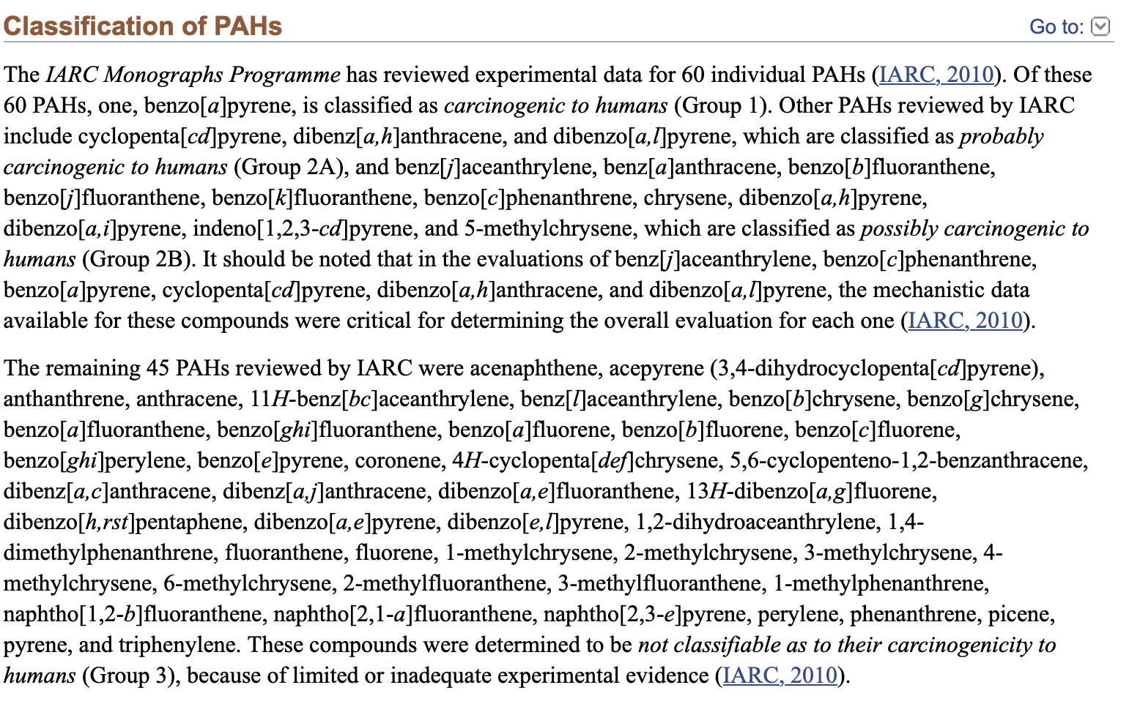

PAHs

Slide 25
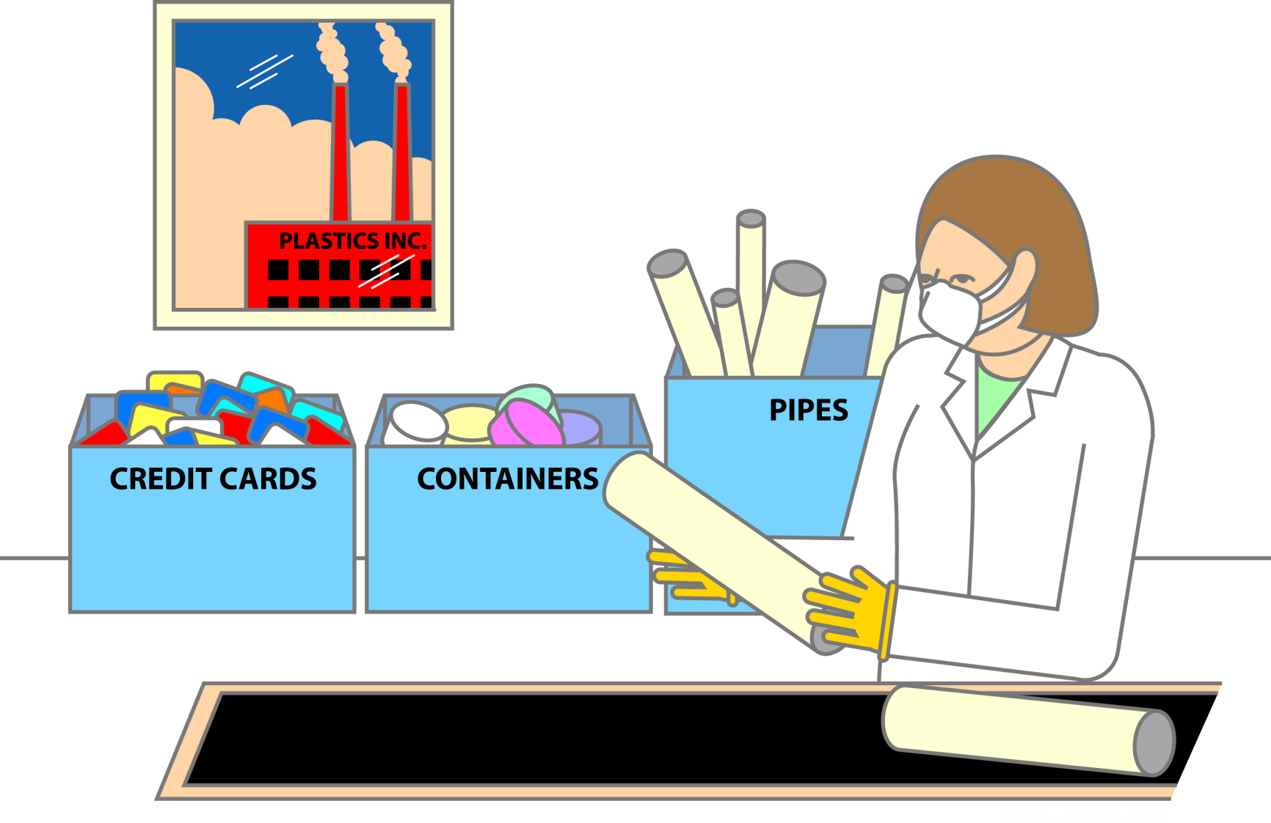
Other Carcinogens: Vinyl Chloride
Vinyl chloride is used in the plastics industry and has been associated with lung cancer and with angiosarcomas (blood-vessel tumors) of the liver and brain. Most people are not routinely exposed to vinyl chloride unless they work in plastics manufacturing plants. People who live close to such plants also may be exposed through contaminated air.
Notes:
Vinyl chloride is used in the plastics industry and has been associated with lung cancer and with angiosarcomas (blood-vessel tumors) of the liver and brain. Most people are not routinely exposed to vinyl chloride unless they work in plastics manufacturing plants. People who live close to such plants also may be exposed through contaminated air.

Slide 26
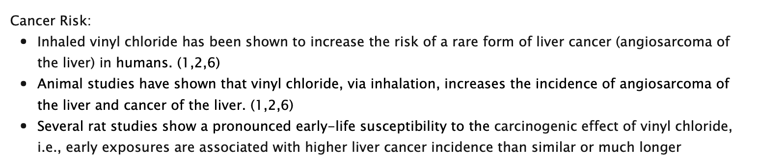
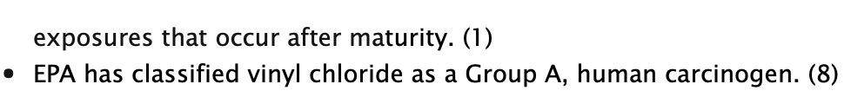

VINYL CHLORIDE

Slide 27
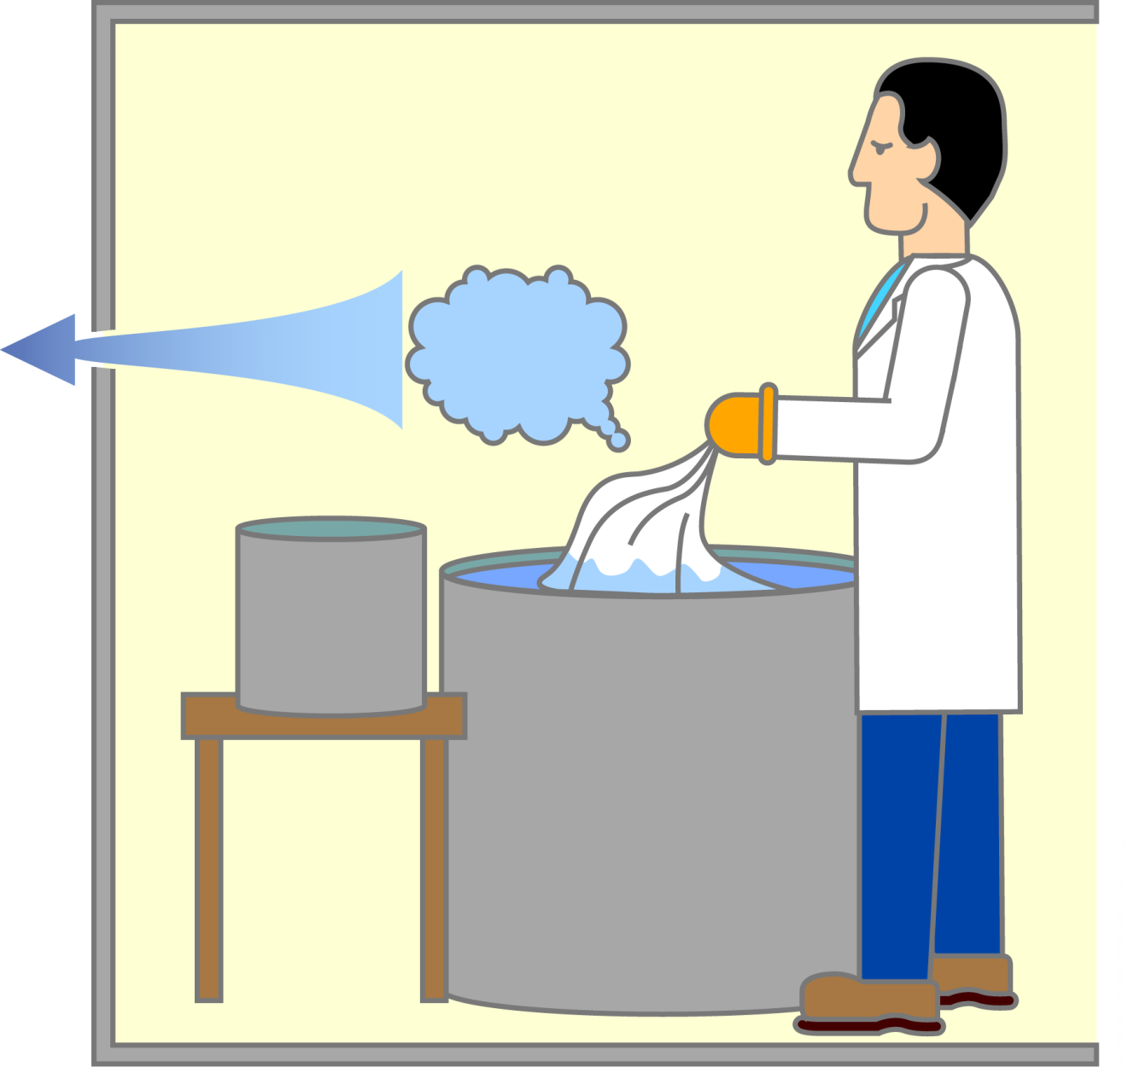
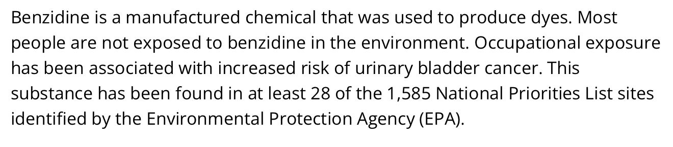
Other Carcinogens: Benzidine
Work station
Benzidine has been known to be associated with cancer since the 1920s. It is used in the production of dyes for paper, textiles, and leather.
Dye dust
Process container
Bulk container
Notes:
Benzidine has been known to be associated with cancer since the 1920s. It is used in the production of dyes for paper, textiles, and leather. Exposure to these dyed products is not hazardous, however.

Slide 28
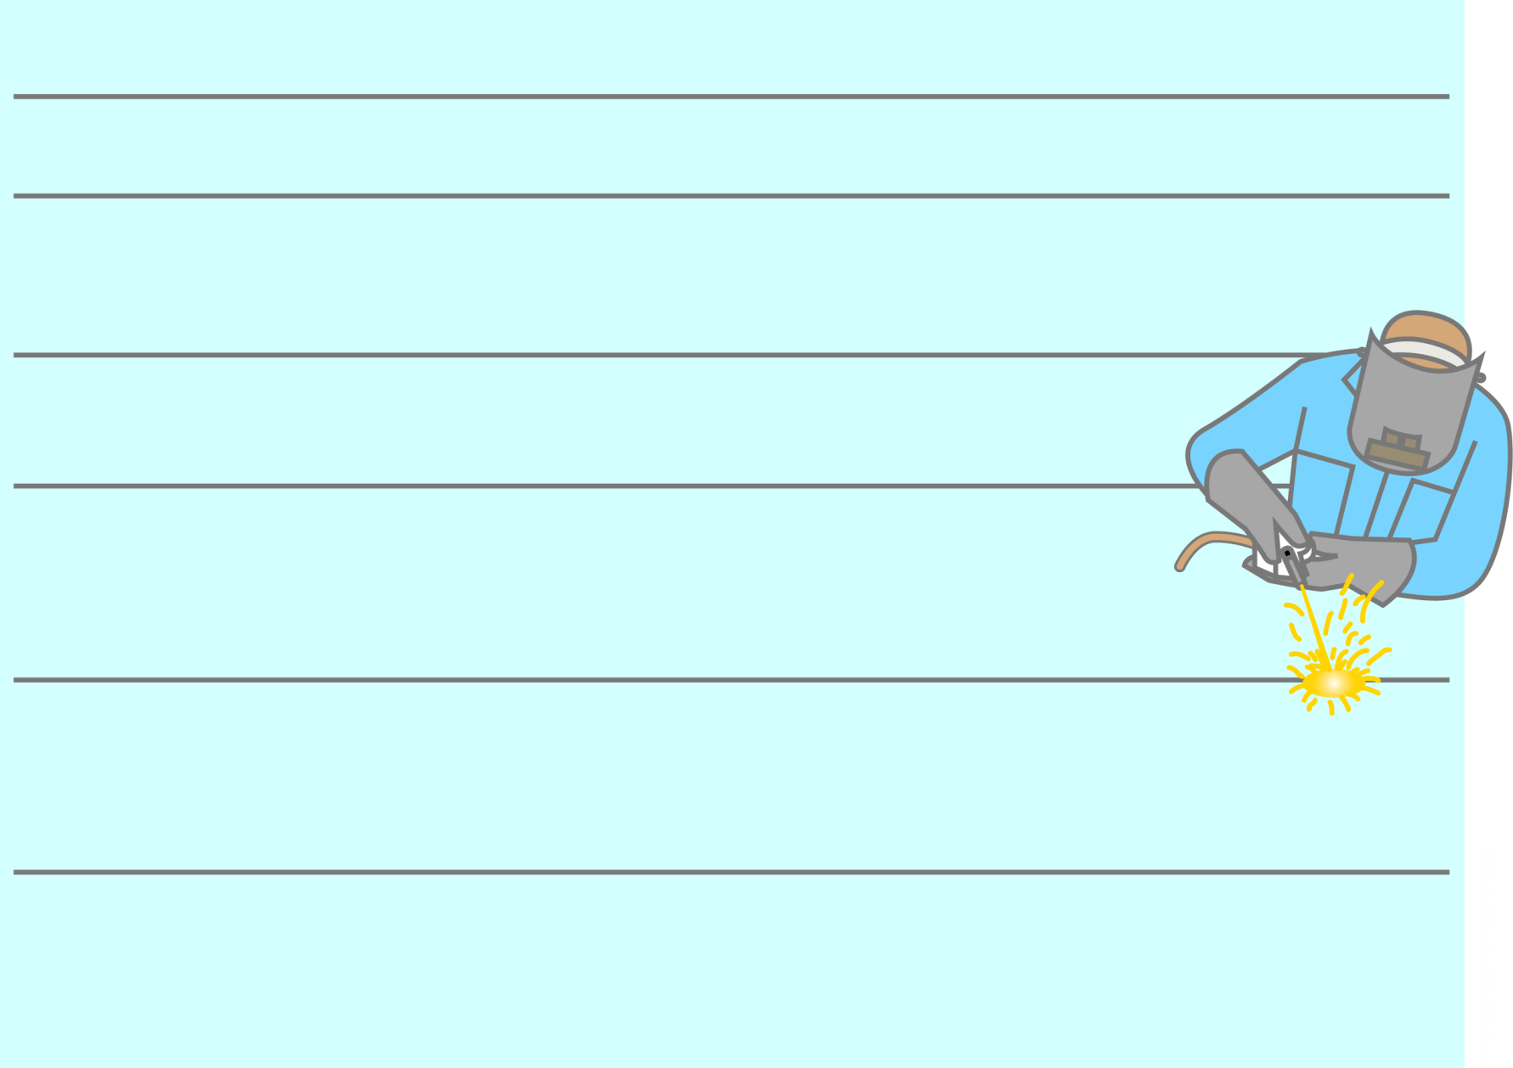
Other Carcinogens: Metals
Metal Cancers Present in Human Carcinogen?
Arsenic Skin, lung, bladder, Wood preservatives, Yes
kidney, liver glass, pesticides
Beryllium Lung Nuclear weapons, Yes
rocket fuel, ceramics,
glass, plastic,
fiberoptic products
Cadmium Lung Metal coatings, Yes
plastic products,
batteries, fungicides
Chromium Lung Automotive parts, Yes
floor covering, paper,
cement, asphalt
roofing; anti-corrosive
metal plating
Lead Kidney, brain Cotton dyes, metal Probable carcinogen
coating, drier in paints,
varnishes and pigment
inks, certain plastics,
specialty glass
Nickel Nasal cavity, lung Steel, dental fillings, Nickel metal:
copper and brass, Probable carcinogen
permanent magnets,
storage batteries, Nickel compounds:
glazes Yes
Notes:
Some metals--including arsenic, beryllium, cadmium, chromium, lead, and nickel--have been associated with several types of cancer, including lung, kidney, brain, skin, and liver cancers.

Slide 29
Occupational cancer
Occupational cancer can arise from exposure to many substances or from certain occupational circumstances such as:
asbestos fibers (colorectal, larynx, lung, ovary, pharynx, stomach cancers, mesothelioma)
• wood dusts (nasopharynx, Sino nasal cancers)

Slide 30
Occupational cancer 2
• UV radiation from sunlight (skin cancers)
• metalworking fluids and mineral oils (bladder, lung, Sino nasal, skin cancers)
• silica dust (lung cancer)
• diesel engine exhaust (bladder, lung cancers)
• coal tars and pitches (non-melanoma skin cancer)

Slide 31
Occupational cancer 3
• work as a painter (bladder, lung)
work as a welder (lung cancer, melanoma of the eye)
shift (night) work (breast cancer).

Slide 32
Liver Cancer: Documented Links
• Aflatoxin B1 (Aflatoxins) [Strong]
• Androgens [Strong]
• ethyl alcohol (ethanol) [Strong]
• Hydrocarbons [Strong]
• N-nitrosodimethylamine [Strong]
• arsenic [Good]
• captafol [Good]
• PCBs[Good]
• thorium dioxide (Thorostat) [Good]
• trichloroethylene (TCE) [Good]
• vinyl chloride [Good]
Source: Solomon G, Schettler T, Janssen S. “CHE Toxicant and Disease Database.” Accessed 3-22 06:http://database.healthandenvironment.org/.

Slide 33
Melanoma: Documented Links
• UV radiation [Strong]
Thyroid Cancer: Documented Links
Ionizing radiation [Strong]
ethylene thiourea (ETU) [Good]
Source: Solomon G, Schettler T, Janssen S. “CHE Toxicant and Disease Database.” Accessed 3-22-06: http://database.healthandenvironment.org/.
Notes:
Next few slides provide examples of cancers in Canada that have been the fastest on the increase, at least for some age groups, in the past decade – just in the past 10 years [1992-2001].
- Explain -- Solomon, Schettler, Janssen database
At: healthandenvironment.org.
- Each of these lists includes evidence considered to be “strong” or “good” in the CHE database and does not include what CHE describes as “limited or conflicting evidence.”
Melanoma – increasing among all age groups except 20-49.
Thyroid – increasing among all age groups, especially under 75!
************************
Carcinogens source: Solomon G, Schettler T, Janssen S. “CHE Toxicant and Disease Database.” Accessed 3-22-06: http://database.healthandenvironment.org/.
Disease trends source: Cancer Surveillance On-Line, Public Health Agency of Canada, http://dsol-smed.phac-aspc.gc.ca/dsol-smed/cancer/index_e.html.

Slide 34
Non-Hodgkin’s Lymphoma: Documented Links
Dichlorvos [Good]
Ionizing radiation [Good]
MCPA [Good]
Organochlorine pesticides [Good]
Organophosphates [Good]
PCBs [Good]
Phenoxyacetic acid herbicides [Good]
Solvents [Good]
Tetrachloroethylene (PCE) [Good]
Trichloroethylene (TCE) [Good]
1,3-butadiene [Strong]
Benzene [Strong]
Dioxins/TCDD [Strong]
2,4-D [Good]
Agent Orange [Good]
Aldrin [Good]
Aromatic amines [Good]
Carbon tetrachloride [Good]
Chlorophenols [Good]
Creosotes [Good]
DDT/DDE [Good]
Dicamba [Good]
Source: Solomon G, Schettler T, Janssen S. “CHE Toxicant and Disease Database.” Accessed 3-22-06: http://database.healthandenvironment.org/.
Notes:
NHL
************************
Carcinogens source: Solomon G, Schettler T, Janssen S. “CHE Toxicant and Disease Database.” Accessed 3-22-06: http://database.healthandenvironment.org/.
Disease trends source: Cancer Surveillance On-Line, Public Health Agency of Canada, http://dsol-smed.phac-aspc.gc.ca/dsol-smed/cancer/index_e.html.

Slide 35
Breast Cancer: Documented Links
Active smoking [Strong]
Estrogens/DES [Strong]
Ethyl alcohol (ethanol) [Strong]
Ionizing radiation [Strong]
Second hand smoke [Strong?]
Aromatic amines [Good]
Ethylene oxide [Good]
PAHs [Good]
PCBs [Good]
Progestins [Good]
Solvents [Good]
tetrachloroethylene (PCE) [Good]
Source: Solomon G, Schettler T, Janssen S. “CHE Toxicant and Disease Database.” Accessed 3-22-06: http://database.healthandenvironment.org/.
Notes:
Breast
************************
Carcinogens source: Solomon G, Schettler T, Janssen S. “CHE Toxicant and Disease Database.” Accessed 3-22-06: http://database.healthandenvironment.org/.
Disease trends source: Cancer Surveillance On-Line, Public Health Agency of Canada, http://dsol-smed.phac-aspc.gc.ca/dsol-smed/cancer/index_e.html.

Slide 36
Childhood Brain Cancer: Documented Links
• Ionizing radiation [Strong]
• dichlorvos [Good]
• lindane [Good]
• Pesticides [Good]
• Second-hand smoke [Good]
• Solvents [Good]
Source: Solomon G, Schettler T, Janssen S. “CHE Toxicant and DiseaseDatabase.” Accessed 3-22-06: http://database.healthandenvironment.org/.

Slide 37
Childhood Leukemias: Documented Links
• benzene [Strong]
• Ionizing radiation [Strong]
• Agent Orange [Good]
• carbon tetrachloride [Good]
• Chlorinated solvents [Good]
• Metal dusts [Good]
• Pesticides [Good]
• Secondhand smoke [Good]
• trichloroethylene (TCE) [Good]
Source: Solomon G, Schettler T, Janssen S. “CHE Toxicant and Disease Database.” Accessed 3-22-06: http://database.healthandenvironment.org/.

Slide 38
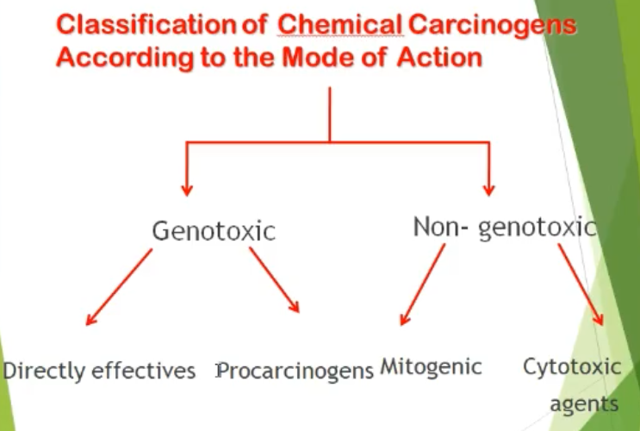

Slide 39

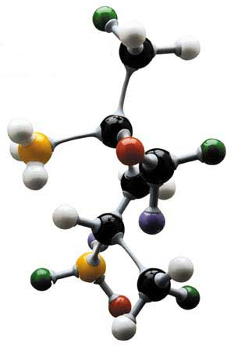
Classification of Carcinogens According to the Mode of Action
GENOTOXIC:
DNA-reactive or DNA-reactive metabolites
Direct interaction to alter chromosomal number/integrity
May be mutagenic or cytotoxic
Usually cause mutations in simple systems
DNA Adduct
Mutation
Cancer

Slide 40
Genotoxic Carcinogen
Chemical capable of producing cancer by directly altering the genetic material of target cells.
1- Direct carcinogens (no metabolic activation).
– Alkylating agents.
2-Indirect carcinogens (procarcinogenes) (metabolic activation).
– Polycyclic aromatic hydrocarbons.
– Aromatic amines.
– Nitrosamines.
– Natural substances.
3– Inorganic carcinogens.
4- Ni, Cr, Cd, As.

Slide 41
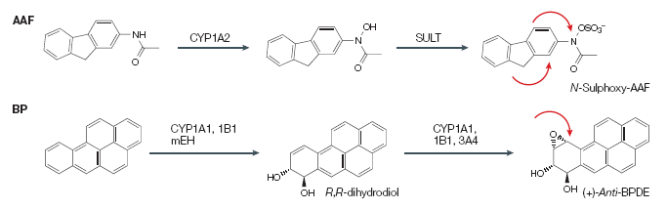
METABOLIC ACTIVATION REQUIRES SPECIALIZED ENZYMES: e.g. CYP450s
(receptors, co-factors and many other enzymes are also involved)

Slide 42
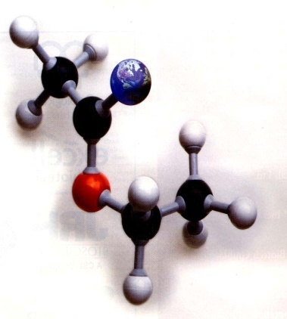
Classification of Carcinogens According to the Mode of Action
NON-GENOTOXIC:
Do not directly cause DNA mutation
Mechanism of action is not completely understood
Difficult to detect - requires rodent carcinogen bioassay
?
Mutation
Cancer

Slide 43
Non-Genotoxic Carcinogens
Mitogens:
stimulation of proliferation
mutations may occur secondarily to cell proliferation
may cause preferential growth of preneoplastic cells
2) Cytotoxicants:
cytolethal
induce regenerative growth
mutations may occur secondarily to cell proliferation

Slide 44
Mechanisms of Non-Genotoxic Carcinogenesis
Increased cell proliferation
Decreased apoptosis
Changes in gene expression
Induction of metabolizing enzymes
Activation of receptors (signaling)
Oxidative stress
???

Slide 45
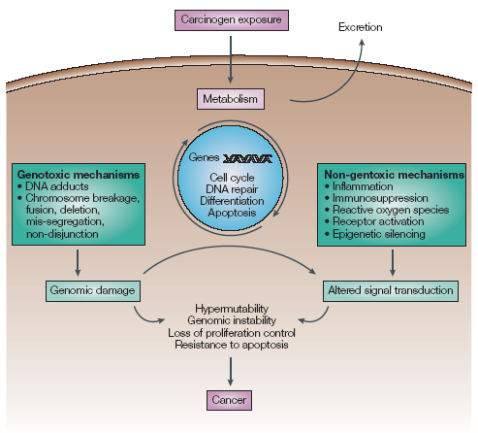
PROPOSED CARCINOGENIC EVENTS
Genotoxic and non-genotoxic effects of carcinogen

Slide 46
Different Steps of Carcinogenesis
Initiation: Mutation in one or more cellular genes controlling key regulatory pathways of the cell (irreversible)—must be a heritable DNA alteration.
Promotion: selective growth enhancement induced in the initiated cell and its progeny by the continuous exposure to a promoting agent.
Progression: results from continuing evolution of unstable chromosomes; further mutations from genetic instability during promotion—results in further degrees of independence, invasiveness, metastasis, etc.

Slide 47
Initiation - point at which an irreversible alteration, usually genetic, is introduced into a target cell. (genotoxicity)=Interaction with DNA
May involve conversion of proto-oncogen to oncogen
Initiation:
(1) is essentially irreversible
(2) caused only by carcinogenic compounds
(3) occurs rapidly after carcinogen exposure
(4) Generally alone does not result in tumor formation
Several exposures to an initiator may result in tumor without presence of a promoter.

Slide 48
Targets of Initiation
Chemical carcinogens initiate cells via:
Mutational activation of oncogenic (proliferative) pathways (e.g. growth factor receptors and downstream signaling proteins, proteins involved in cell cycle checkpoints.
Mutational inactivation of apoptotic (cell death) pathways (e.g. growth inhibitory receptors, proteins involved in apoptosis, tumor suppressors).
Mutational inactivation of DNA repair mechanisms (e.g. BER, NER, etc).
Mutational inactivation of antioxidant response (e.g. SOD).

Slide 49
Promotion
Epigenetic event—change in gene expression without change in DNA.
Mitogenic (Not mutagenic) Stimulates proliferation. Causes both mutated and normal cells to proliferate.
Enhances the effect of the genotoxic initiating agent by establishing clones of initiated cells.
Long delay possible between administration of initiating agent and promoting agent.
Promotion is reversible.

Slide 50
Promotion is the process whereby an initiated tissue or organ develop focal proliferations and it requires the presence of continuous stimulation.
A promotor: is a substance which doesn't damage DNA but enhance growth of tumor induced by genotoxic carcinogens e.g.: skin cancer in mice can be induced by application of benzo [α ] pyrene ( initiator) followed by phorbol ester from cotton oil ( promoter).
Promotion
(1) reversible
(2) acts only after exposure to an initiating agent
(3) requires repeated administration of a
promoter
(4) is not carcinogenic in itself

Slide 51
Progression
Progression is an irreversible process and leads to metastasis.
Progression requires:
Further mutations from genetic instability (chromosomal instability) during promotion.
Recruitment of inflammatory immune cells to the tumor.
The tumor cell acquiring “wound-healing” characteristics (secretion of chemo-attractants to attract inflammatory immune cells, angiogenesis factors, proteases, etc).
Examples of progressor agents: inflammation, asbestos fibers, benzene, benzoyl peroxide, other peroxides, oxidative stress,

Slide 52
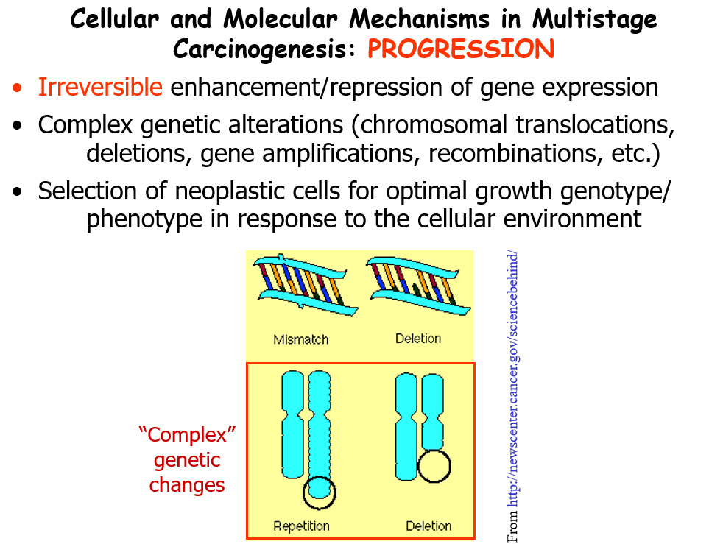

Slide 53
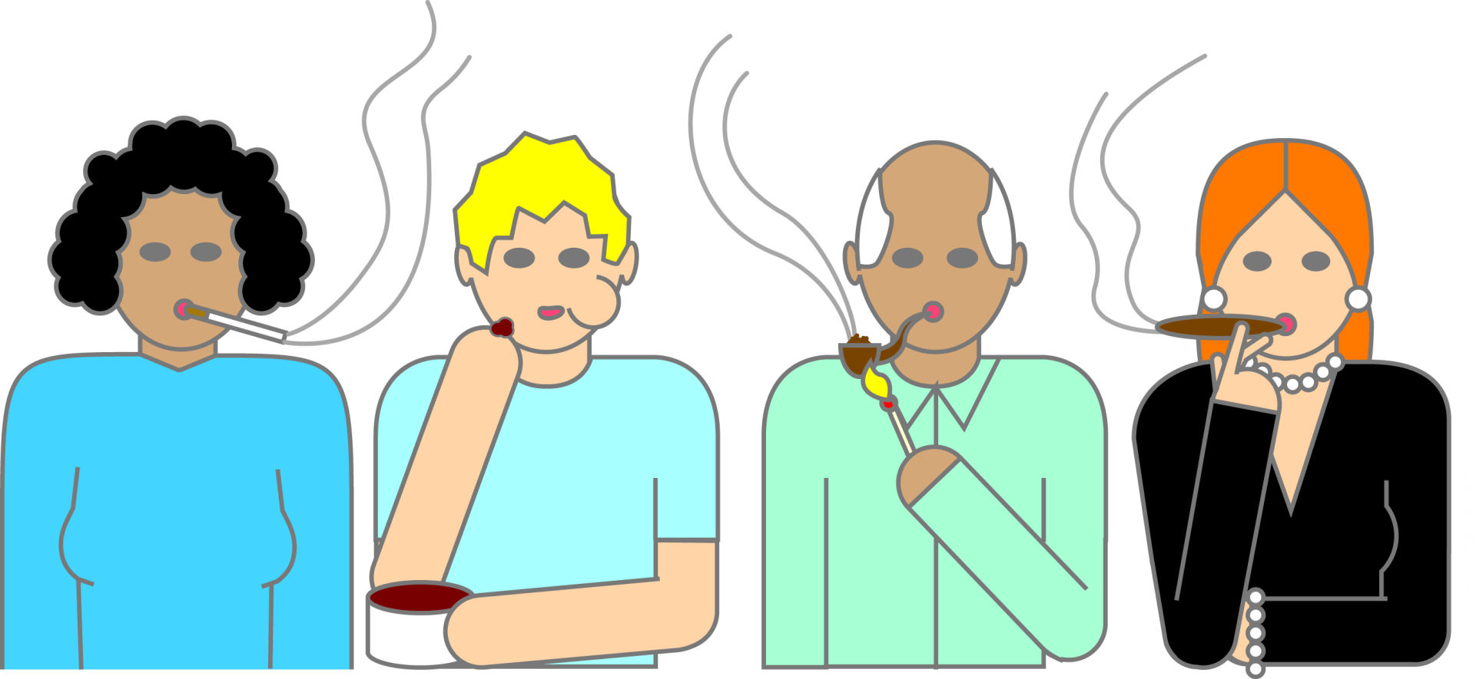
Tobacco
aminostilbene arsenic benz[a]anthracene benz[a]pyrene benzene benzo[b]fluoranthene
benzo[c]phenanthrene benzo[f]fluoranthene cadmium chrysene dibenz[a c]anthracene
dibenzo[a e]fluoranthene dibenz[a h]acridine dibenz[a j]acridine dibenzo[c g]carbazone
N-dibutylnitrosamine 2,3-dimethylchrysene indeno[1,2,3-c d]pyrene S-methylchrysene
S-methylfluoranthene alpha-naphthylamine nickel compounds N-nitrosodimethylamine
N-nitrosomethylethylamine N-nitrosodiethylamine N-nitrosonornicotine N-nitrosoanabasine
N-nitrosopiperidine polonium-210

Slide 54
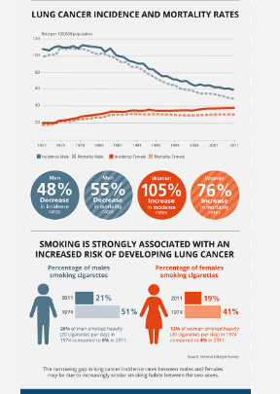
Cigarette smoking causes an estimated 443,000 deaths each year, including approximately 49,000 deaths due to exposure to secondhand smoke.
Lung cancer is the leading cause of cancer death among both men and women in the United States, and 90 percent of lung cancer deaths among men and approximately 80 percent of lung cancer deaths among women are due to smoking.
Smoking causes many other types of cancer, including cancers of the throat, mouth, nasal cavity, esophagus, stomach, pancreas, kidney, bladder, and cervix, and acute myeloid leukemia.
Notes:
Tobacco
Cigarette, cigar, and pipe smoking have been linked to more than a dozen types of cancer, including lung, mouth, bladder, colon, and kidney cancers. Chewing tobacco and snuff increase the risk of oral cancer, and second-hand smoke increases the risk of lung cancer.
Here you can see the percent of males and females who smoke cigarette. For males it is abut %50 percent in Turkey and below %20 percent for women

Slide 55
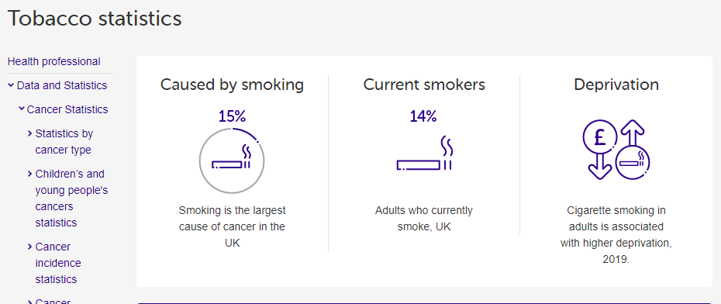
When a cigarette burns, it releases a dangerous cocktail of about 4,000 chemicals including:
more than 70 cancer-causing chemicals
hundreds of other poisons.
nicotine, a highly addictive drug, and many additives designed to make cigarettes taste nicer and keep smokers hooked.

Slide 56
Cancer-causing chemicals in tobacco smoke
Tar - a mixture of dangerous chemicals
Arsenic - used in wood preservatives
Benzene - an industrial solvent, refined from crude oil
Cadmium - used in batteries
Formaldehyde - used in mortuaries and paint manufacturing
Polonium-210 - a highly radioactive element
Chromium - used to manufacture dye, paints and alloys
1,3-Butadiene - used in rubber manufacturing
Polycyclic aromatic hydrocarbons - a group of dangerous DNA-damaging chemicals
Nitrosamines - another group of DNA-damaging chemicals
Acrolein - formerly used as a chemical weapon
Other chemicals

Slide 57
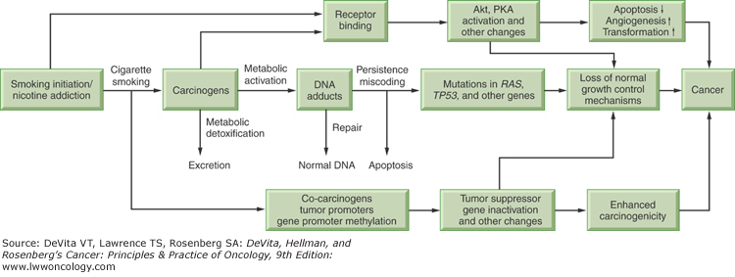

Slide 58
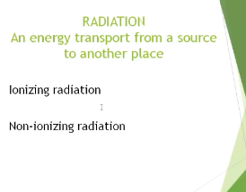
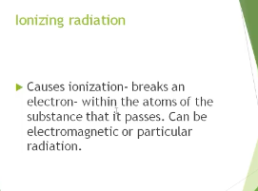
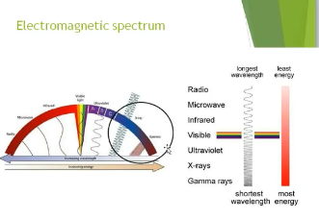
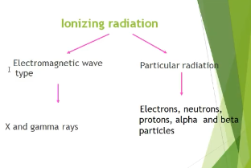

Slide 59
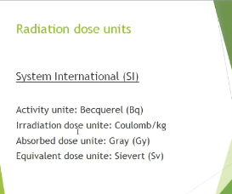
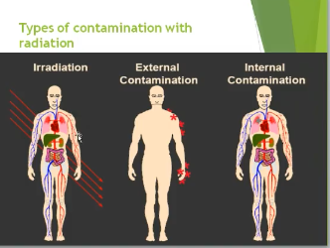

Slide 60
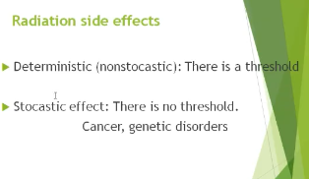

Slide 61
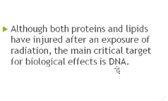
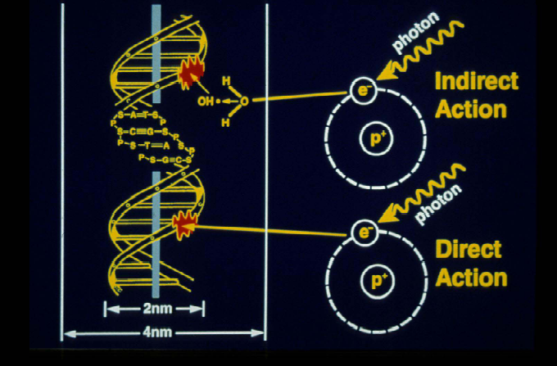
Interaction of Radiation with DNA

Slide 62
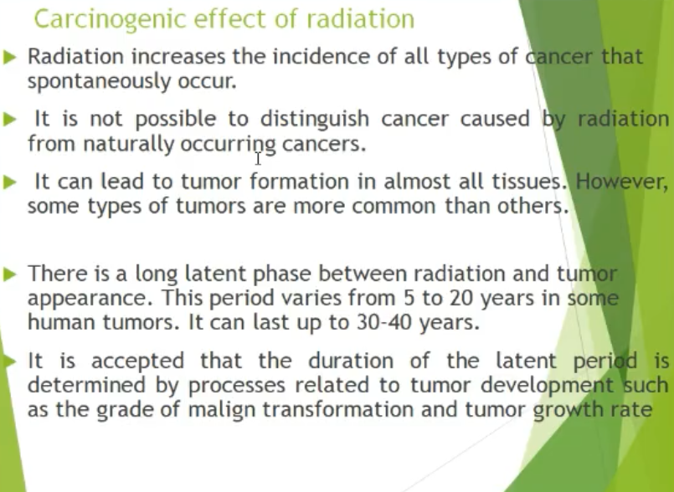

Slide 63
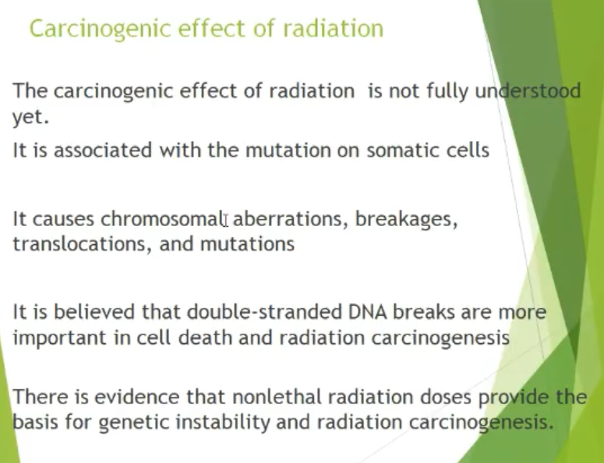

Slide 64
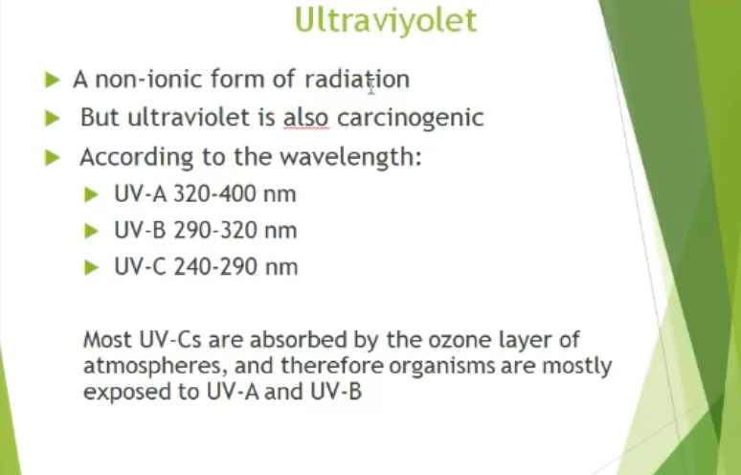

Slide 65
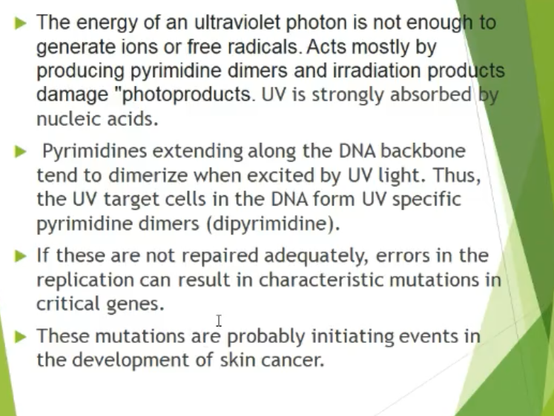

Slide 66
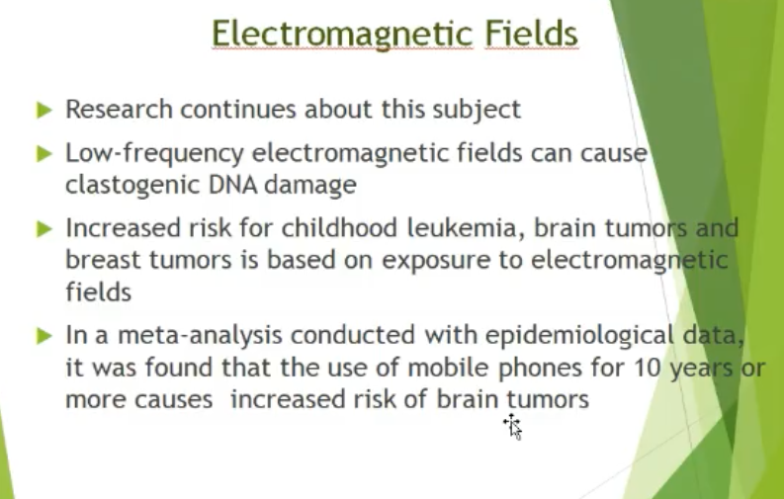

Slide 67
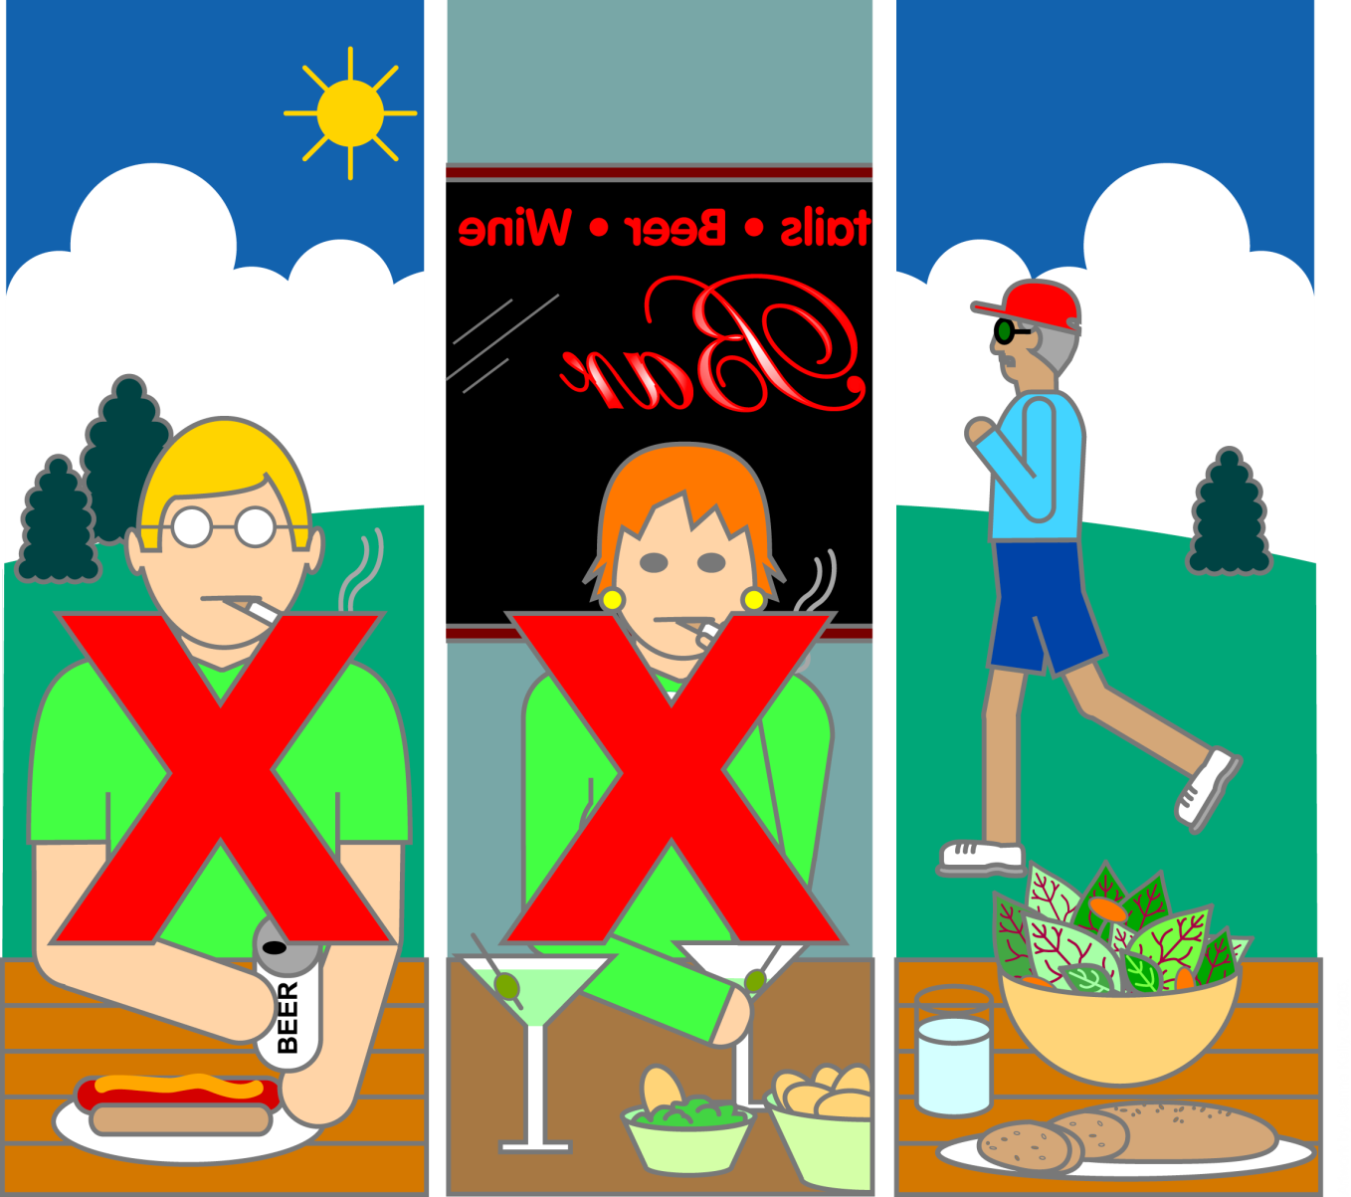
Avoid the “Avoidable” Risk Factors
Notes:
While it is prudent to be aware of environmental exposures to carcinogens, it is also wise to minimize exposures to “avoidable” risk factors. Three major avoidable factors linked to cancer deaths involve poor behavior choices, so choose well: eliminate use of tobacco products, use alcohol in moderation, and make better dietary choices. If good behavior choices in these three areas prevailed, approximately half of all cancer deaths could be prevented.

Slide 68
References
1. Scientific Aspect of Cigarette Smoking. Ed. Ayla Tür. Logos Medical Publising, 2005.
2. Principles and Practice of Radiation Oncology. Ed. Perez Ca, Brady LW
Halperin EC, Schmid-Ullrich RK.. Lippincott-Williams&Wilkins,
3. Basic Pathology. Ed. Robbins and Kumar
4. www.niehs.nih.gov
5. Cancer, Principles & practice of Oncology. Ed. DeVita VT, Hellman S, Rosenberg SA. 9th edition. Lippincott-Williams&Wilkins,
6. https://monographs.iarc.who.int/list-of-classifications/
7. http://www.who.int/en
8. http://globocan.iarc.fr/Default.aspx
9. https://www.nih.gov/about-nih/what-we-do/nih-almanac/national-cancer-institute-nci

