Slide 1

TurkishMedQA-LLM: Specialized Medical Question-Answering Model
BIL 471/571
Natural Language Processing Project
Bekir Bilgehan Tekin - 211401008
Mehmet Yasin Tosun - 211401003
Semih Uçan - 211401012

Slide 2
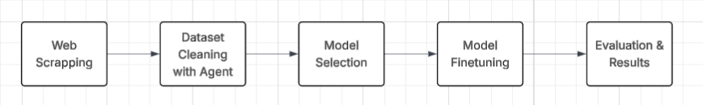
Overview
Our goal is to develop a medical question-answering system tailored specifically for the Turkish language, by leveraging the capabilities of LLMs.

Slide 3

Dataset Description
Applied page-by-page scraping with BeautifulSoup on 25 medical categories from doktorsitesi.com
62,500 raw QA pairs collected, 2,500 per category
Each QA pair linked with doctor metadata (name, title, clinic, speciality, etc.)
Gemini 1.5-based agent used to evaluate data quality by scoring each QA pair
Only QA pairs scored ≥7/10 were retained
Final dataset: ~47,000 high-quality QA pairs

Slide 4
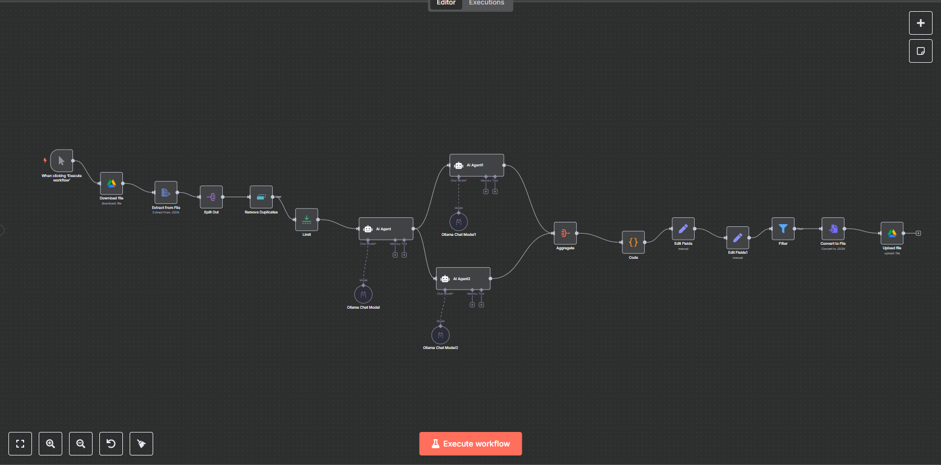
Agent Workflow

Slide 5
Literature Summary
Med-PaLM 2
Ensemble Refinement and Chain of Retrieval
Hippocrates-7B
Continued Pretraining, Instruction Tuning and Preference Optimization
MeLLaMA
Continued Pretraining and Instruction Tuning
MEDITRON-70B
Continued Pretraining , Instruction Tuning and RHLF for medical adaptation
Fully open-source, including model and training process
Achieved high performance across four major medical benchmarks
Notes:
Continued Pretraining (CPT): Retraining a pre-trained LLM with domain-specific (medical) data. Enhances understanding of medical terminology and concepts.
Instruction Fine-Tuning (SFT): Training the LLM using task-specific examples in a “question → answer” format.
Chain of Retrieval (CoR): Gathers relevant sources before generating answers.

Slide 6
Methodology
Data Preparation
Cleaned Turkish QA pairs were split into training, validation, and test sets
Model Selection
Used malhajar/Mistral-7B-v0.2-meditron-turkish, a Turkish-aligned MedLLM
Prompt Formatting
Simple structure —"Soru: <text>\n Yanıt: <text>"
Instruction Fine-Tuning
Model was fine-tuned to adapt to Turkish medical language and reasoning

Slide 7
Experiments
Tested base Mistral-7B model in zero-shot and few-shot configurations. Evaluation via BLEU and ROUGE-L scores
Fine-tuned English-only Meditron-7B model → poor Turkish fluency
Analyzed temperature variations (0.4, 0.7, 1.0) to observe changes in output quality
Selected and fine-tuned a Turkish-aligned Mistral-7B-meditron for final QA adaptation
Created a custom ~500-sample(20 QA per category) Turkish medical benchmark across ~25 specialties and evaluated model responses using accuracy as the primary metric.

Slide 8


Results and Discussion
Base Model (Mistral-7B - Meditron-Turkish): Without any fine-tuning, the model achieved an accuracy of 56.32%, demonstrating a reasonable understanding of Turkish medical questions in a zero-shot setting.
Fine-Tuned Model (Instruction-Tuned on Cleaned QA Pairs): After applying instruction fine-tuning on our curated and high-quality Turkish dataset (~47,000 QA pairs), the model’s accuracy increased significantly to 62.96%.

Slide 9
Conclusion & Future Work
Our fine-tuned Turkish medical QA model achieved a significant accuracy boost from 56.32% (base) to 62.96% after domain-specific instruction tuning. This confirms the importance of localized training data and medical adaptation when deploying LLMs for healthcare use cases.
In the next phase, we will explore In-Context Learning (ICL) for open-ended medical questions.
A reference agent will first generate a high-quality answer for each question.
Then, our fine-tuned model will produce its own answer.
We will compare both answers using similarity metrics (e.g., BLEU, ROUGE, embedding-based scores).
This setup enables evaluation without fixed ground-truth answers and supports more flexible benchmarking of open-ended QA performance.

