Slide 1
MICROSOFT AI INNOVATORS
Building a Local
RAG Assistant
LOCAL
PRIVATE
GROUNDED
What I built, tested, and learned with Microsoft Foundry Local
Bilgenur Pala
Python · SQLite · FastAPI · On-device AI
Notes:
Hello, I am Bilgenur Pala. I built a fully local RAG assistant with Microsoft Foundry Local. This project taught me how model execution, retrieval, grounding, evaluation, testing, and product delivery must work together.

Slide 2
ENGINEERING JOURNEY
02
I built the system in layers, not in one jump
#5–9
#10–13
#14–16
#17–19
#20 / #37
Prove
Retrieve
Ground
Validate
Explain
Architecture
SDK exploration
Embeddings
SQLite
Chunk-friendly docs
Idempotent ingest
Top-K search
Unit tests
Context packing
Fallback layers
Measured threshold
Reusable CLI
Model comparison
Failure analysis
Blind evaluation
Technical delivery
Public preview
FastAPI backend
Responsive UI
Learning story
The final product is the result of repeated build → measure → diagnose → improve cycles.
Source: docs/engineering-journal.md
Notes:
I did not build the final application in one step. I first proved each component, then created ingestion and retrieval, grounded the answers, measured failures, hardened the system, and finally delivered the API, web interface, documentation, and public preview.

Slide 3
FOUNDATION
03
Real hardware constraints shaped every model decision
The first engineering task was compatibility, not prompting.
01
02
03
Python 3.12
WinML SDK
Start small
Native ONNX Runtime wheels were available and stable, unlike the machine's default Python 3.14.
The Windows-specific package enabled the supported DirectML execution path and hardware acceleration.
A 0.5B model proved the runtime. Evaluation later justified moving to 1.5B; 7B could not be obtained on this device.
dir() → type() → inspect.signature() → working SDK call
Engineering journal: Sprint 0 and Issues #6, #14
Notes:
My first lesson was that local AI begins with the device. Python and SDK compatibility determined what could run. I also learned to explore unfamiliar APIs with dir, type, and inspect.signature instead of guessing method names from outdated examples.

Slide 4
ARCHITECTURE
04
RAG changed the model from a guesser into a grounded assistant
Question
Embedding
SQLite retrieval
Grounded prompt
Foundry Local
User question
qwen3 · 1024D
Cosine score · Top 3
Context + refusal rule
qwen2.5-1.5b · local
Documents, embeddings, prompts, and answers stay on the device after required artifacts are cached.
Knowledge base: 26 chunks across 5 Markdown files
Notes:
The core RAG flow is simple but powerful. I embed the question, compare it with document vectors stored in SQLite, retrieve the top three passages, and place them in the system prompt. The local model then answers from that controlled context.

Slide 5
RELIABILITY
05
Grounding needed two defenses—and both had limits
LAYER 1
LAYER 2
Similarity threshold
Decision-first system prompt
Low-score questions return a fixed fallback before the chat model is called.
The model first checks whether the context explicitly answers the question; related context is not enough.
Measured score gap
0.402 off-domain
0.50 final threshold
0.556 answerable
A high score still does not prove that the retrieved passage contains the answer.
Issues #15 and #17 · threshold recalibrated from 0.6 to 0.5
Notes:
Grounding required two defenses: a measured similarity threshold and a strict decision-first prompt. The threshold correctly skips obviously unrelated questions, but evaluation showed that a high similarity score still does not guarantee that the retrieved context actually answers the question.

Slide 6
EVIDENCE
06
Evaluation revealed failures that a demo would hide
8 / 10
7 / 10
0.3 s
Development evaluation after model, threshold, and prompt improvements.
Frozen blind evaluation with no tuning after the result.
Threshold-rejected questions return before generation.
Three deeper findings
01
Above ~0.75, similarity stopped separating answering and merely related passages.
02
The 1.5B model improved consistency, but larger capacity did not automatically improve grounding.
03
A failed query-prefix experiment was measured, documented, and deliberately reverted.
Source: docs/evaluation.md and docs/blind-evaluation.md
Notes:
Evaluation changed how I understood the system. The development set reached eight out of ten, but the frozen blind set reached seven. I learned that high similarity can still retrieve the wrong evidence, and a more fluent model can make an unsupported answer more convincing.

Slide 7
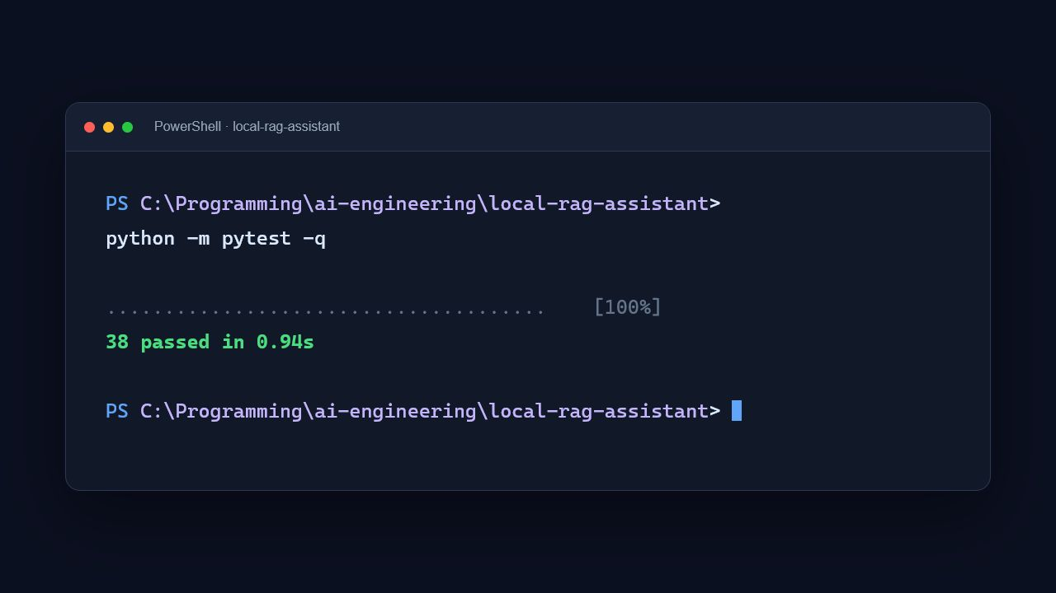
QUALITY
07
Tests converted engineering decisions into guarantees
The suite protects:
✓
Chunking and ingestion
✓
Cosine similarity and vector length
✓
Top-K ordering and source propagation
✓
Threshold boundary and fallback
✓
CLI cleanup and formatting
✓
FastAPI and web behavior
Current verification: 38 passed in 0.94s
Notes:
Testing made the project dependable. Dependency injection let me replace models and the database with fake clients, spies, and monkeypatches. The current suite verifies thirty-eight behaviors without loading a model, so it stays fast, deterministic, and useful during development.

Slide 8
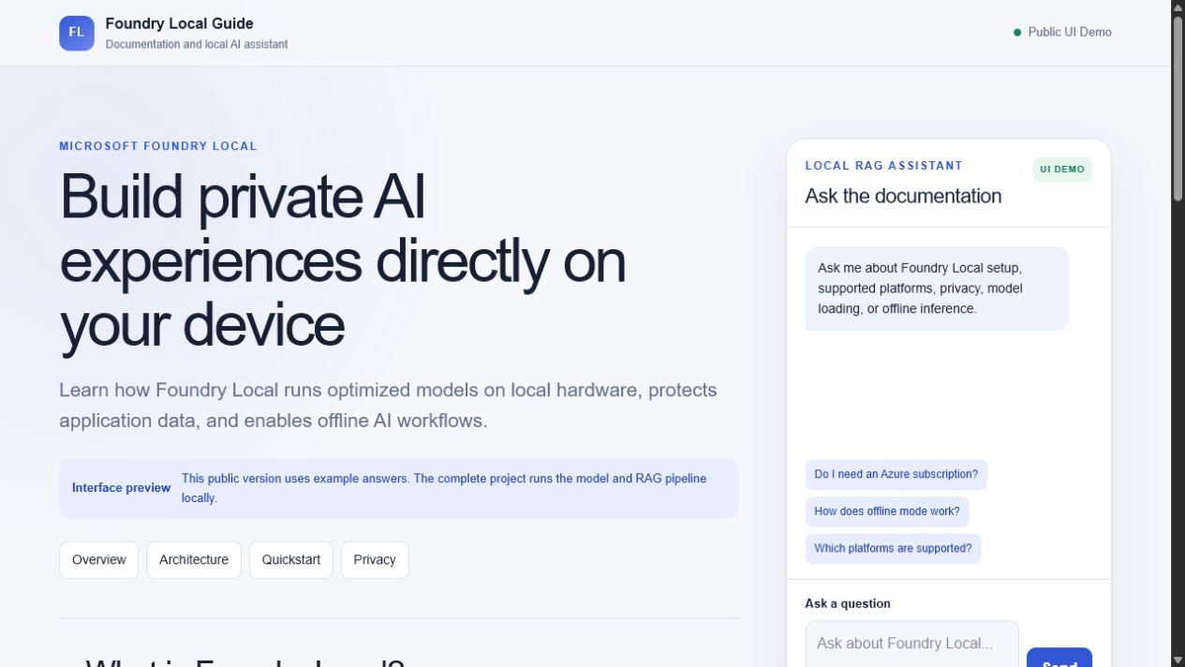
DELIVERY
08
The final product teaches Foundry Local and answers questions
One pipeline,
three interfaces
CLI
Direct technical use
API
Health, sources, and answers
WEB
Responsive learning experience
The public link is a UI preview.
Real RAG remains local.
Issues #20 and #37 · FastAPI + responsive web application
Notes:
The final system exposes one reusable RAG pipeline through the CLI, FastAPI, and a responsive learning page. I also published a clearly labeled interface preview. The hosted page demonstrates the experience, while the real models, documents, and inference stay local.

Slide 9
WHAT I LEARNED
Local AI is a complete
engineering system
01
02
03
04
Measure decisions
Design for failure
Separate concerns
Document honestly
Thresholds, models, and prompts should change because evidence justifies the change.
Fallback behavior and blind validation matter more than a polished happy-path demo.
Reusable services let the CLI, API, web UI, and tests share one domain pipeline.
Negative results and known limits are part of the engineering outcome.
I can now build, evaluate, and explain a private on-device AI application.
Bilgenur Pala · github.com/bilgenurpala/local-rag-assistant
Notes:
My main learning is that local AI is a complete engineering system. The model is only one layer. Reliable results come from measured retrieval, explicit failure behavior, reusable software, automated tests, clear documentation, and honest communication of limitations.

