Slide 1

The Association for Language Education Evaluation and Accreditation (DEDAK)

Slide 2
DEDAK’s PURPOSE
The purpose of the Association for Language Education Evaluation and Accreditation (DEDAK) is to contribute, primarily in the field of higher education, to the raising of the quality of language education to international standards and to sustain this endeavor through the following activities.
Set Standards for language education
Conduct evaluation and accreditation activities of language programs
Increase the number of DEDAK reviewers and experts in the field of quality in education
Provide trainings that detail how the standards can be achieved

Slide 3
WHAT DEDAK IS & WHAT IT IS NOT Meeting Standards
WHAT IT IS | WHAT IT IS NOT
Has Standards / Criteria Respects, supports and values differences – Mission/Needs Based Minimum standards and Holistic Approach Accreditation means meeting minimum standards and above | Standardization and Sameness/Copying Prescriptive /Only one way of doing things for compliance Checklist/Ticking Boxes Accreditation does not imply being perfect

Slide 4
WHAT DEDAK IS & WHAT IT IS NOT The Review
WHAT IT IS | WHAT IT IS NOT
Conducts Peer Reviews – Reviewer Trainings Reviewers to verify compliance | Conduct Audits Look for weak/problematic areas

Slide 5
WHAT DEDAK IS & WHAT IT IS NOT Outcome Oriented
WHAT IT IS | WHAT IT IS NOT
Outcome Oriented Reviews not only inputs and the process but also the results and how well the targeted outcomes were achieved. | Does not just review inputs and processes

Slide 6
WHAT DEDAK IS & WHAT IT IS NOT Non-Profit
WHAT IT IS | WHAT IT IS NOT
Non Profit Serves the interests and is for the good of the field Ethical Considerations | Does not recommend products nor is it affiliated with any product, does not collaborate or receive support from any entity that could create a conflict of interest

Slide 7
What Brought Us to Today
The ownership and support from the Foreign Language Schools
Knowledgeable members in the fields of quality and accreditation
A dedicated team of expert volunteers
The support and grants from international accreditation bodies, institutions
Expert members in the fields of accreditation and quality assurance and the support of accreditation boards
CEA former chair (Engin Ayvaz),
CEA chair (Ian Collins),
EAQUALS Board of Trustees member (Nergis Uyan),
13 CEA, 2 EAQUALS reviewers,
WSCUC Accreditation Assessment Leadership Academy graduate and person responsible for Turkey’s sole institutional higher education accreditation (WSCUC) (Didem Mutçalıoğlu),
Representatives from institutions that have successfully gone through an accreditation process,
Advice and guidance from the accrediting bodies of CEA and EAQUALS.
Current CEA Commissioners (Ian Collins & Didem Mutçalıoğlu)
Ownership
Support
Dedicated Volunteers
Experts within DEDAK

Slide 8
3nd Accreditation Applications
DEDAK accepts the 2024 accreditation applications from English Preparatory Programs within higher education institutions in Turkey between 1-30 November 2023.
Programs that intend to apply should send the fully completed application form with a wet-ink signature to info@dedak.org by 30 November 2023 at the latest.
The applications will be evaluated in December, and 8 main and 3 auxiliary programs will be announced, which will be invited to start the DEDAK accreditation process on 8 January 2024 at the latest.
​Selection based on
Elimination: Eligibility Criteria
Then Ranking: Through a scoring system, which will be formed by considering the fields for which information is requested in the form, such as the number and percentage of students that study in compulsory preparatory programs and readiness.

Slide 9
DEDAK Eligibility Criteria
The conditions for acceptance into the DEDAK accreditation process must have been in existence and implemented a minimum of 1 year before the accreditation application:
B1+ Exit Level
Students’ Level Placement and Progression
Organizational Chart
The exit level of the language program must be at the B1+ CEFR level at a minimum. This condition is also applicable for language programs that provide education to faculties/departments that provide instruction partially in English.
Students in the program must receive instruction in line with their language level; all level transitions must be done in accordance with a system that assesses and evaluates student learning outcomes.
There must be an organizational chart that contains the units/commissions that belong to the administrative and academic units of the program.
There must be respective units/commissions formed in the areas of Program/Materials Development and Assessment present in the program.
The program must have been up and running for a minimum of three (3) years.
Units/Commissions
Duration of Service

Slide 10
Accreditation Process after Application Approval
January 8, 2024
Announcement of programs to start the accreditation process
January 2024
Sending and receiving necessary documents and information
Within January
Accreditation Workshop
1 Full Day – 3 members from each institution
Within January
Institutions decide on report submission timeline
&
Payment of half of the accreditation fee

Slide 11
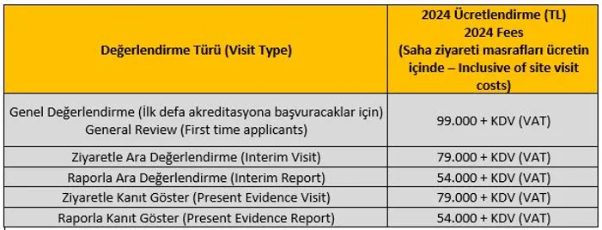
DEDAK 2024 Fees
* The CPI (Consumer Price Index) is 61.53% compared to September, when accreditation fees were determined in the previous year. This rate is taken as the basis for the increase, and it is slightly below, with an increase by 55%.
** 50% of the fee shall be due after the acceptance of the application and before the accreditation training, and 50% after the submission of the self-study report and before the site visit, if there will be one. *** Fees are charged for the accreditation review processes. There is no additional annual accreditation fee. For example, if an institution pays the General Review fee and receives accreditation after the review, it does not pay any other fee as long as there is no other review during the accreditation period.

Slide 12
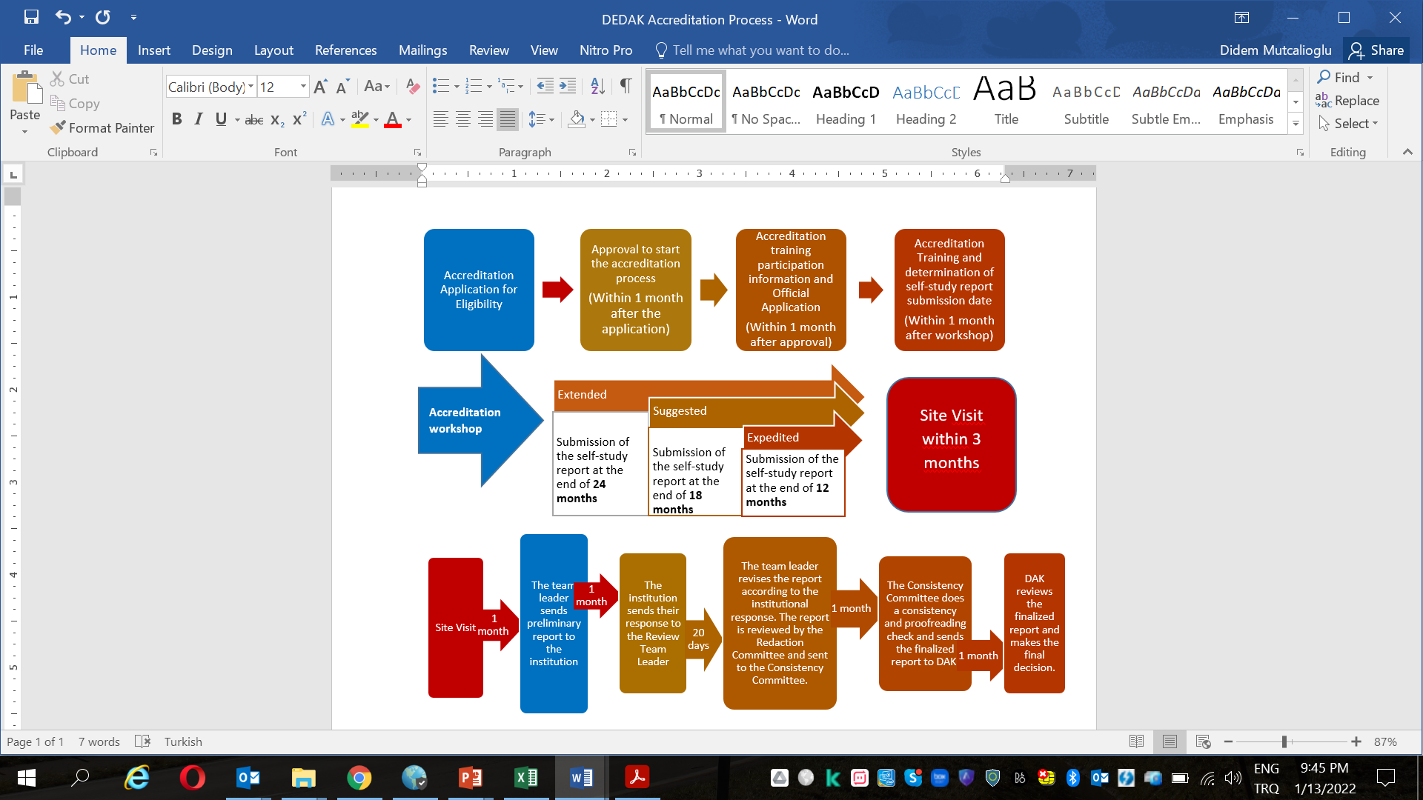
DEDAK Accreditation Process

Slide 13
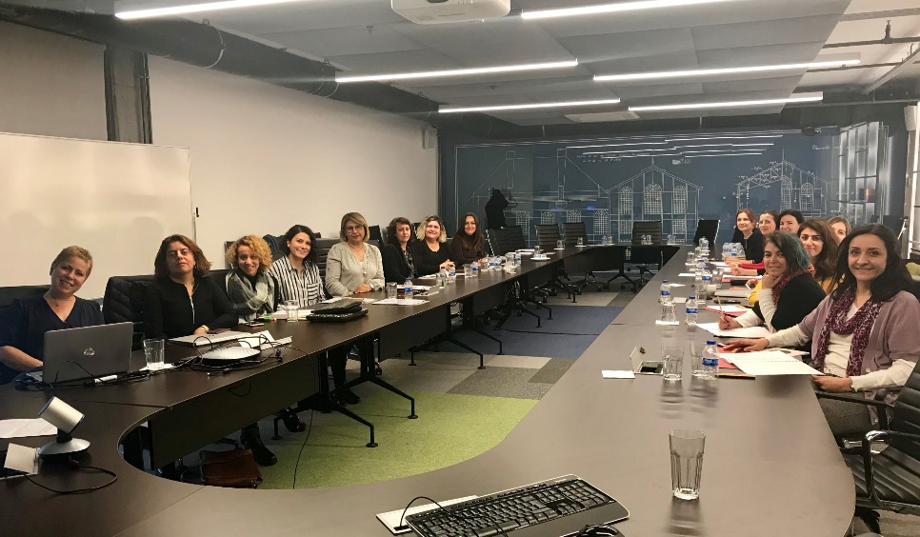
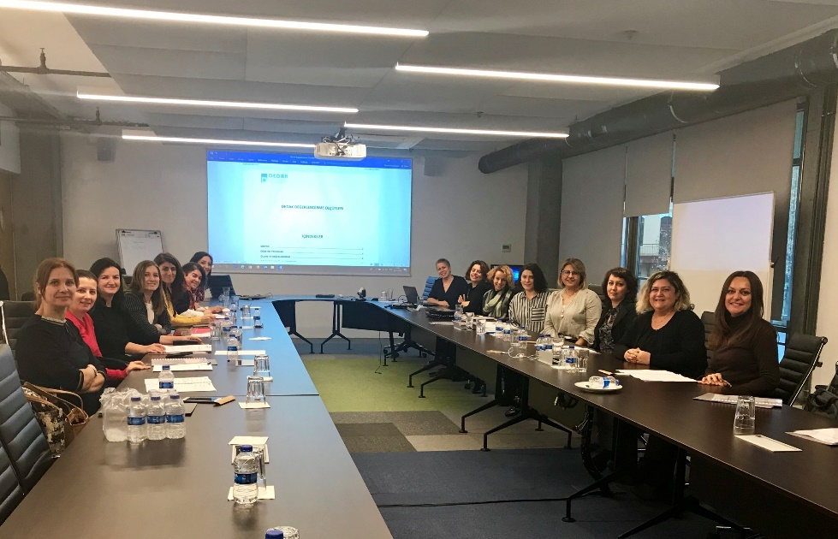
STANDARDS TO BE EVALUATED
8 Main Headings, 28 Sub Headings
Mission
Curriculum
Measurement and Assessment
Student Support and Services
Administrative Capacity
Faculty
Facilities, Equipment & Supplies
Continuous Improvement

Slide 14
EVALUATION STANDARDS
MISSION
Compatibility and Communication of the Mission
CURRICULUM
Consistency with the Mission and Needs
Content and Learning Outcomes
Curriculum Design and Instructional Materials
Program Length and Structure
Curriculum Delivery
MEASUREMENT AND ASSESSMENT
Level Placement System
Level Progression and Completion
Proficiency (EMI and NQF-HETR are taken into consideration - B1+)
Level Documentation
Notification of Students

Slide 15
EVALUATION STANDARDS
STUDENT SUPPORT and SERVICES
New Student Orientation
Notification of Students
Co-Curricular Activities
Student Grievances
ADMINISTRATIVE CAPACITY
Administrative Structure and Mission Alignment
Faculty Position and Assignment Processes
Notification of Assignment, Responsibility and Rights
Performance Evaluation
Administrative and Managerial Processes
Protection of Information
Employee Grievances

Slide 16
EVALUATION STANDARDS
FACULTY
Qualifications
Notification of Assignment, Responsibility and Rights
Performance Evaluation
Professional Development
FACILITIES, EQUIPMENT AND SUPPLIES
Facilities, Equipment and Supplies
CONTINUOUS IMPROVEMENT
Continuous Improvement

Slide 17
Example Standard
Student Support and Services Standard 1:
New Student Orientation
Standard 1: The Language Program conducts a new student orientation, providing students with all relevant information regarding the program.
Required responses
Explain how and when the new student orientation is presented and describe the content.
State how late-registered students obtain the same relevant information.
Verification
Documentation in the report
Verification on site
Program self-recommendations
Describe the planned changes within the Language Program under this standard.
Context
A student orientation that contains information about the teaching program, the administration,
student services and the measurement and assessment processes is provided to new students in
order to acquaint them with the program.

Slide 18
Important Documents for Sites
On DEDAK website under the Accreditation Process Tab
1. DEDAK Standards
2. DEDAK Self Study Report Template
3. DEDAK Review Standards Verification Handbook
4. DEDAK Guidelines for Writing the Self-Study Report
5. Accreditation Process for Programs Handbook
6. CEFR B1+ Level Description
7. Context of DEDAK Standards
8. DEDAK Self-Study Report Digital Delivery Guidelines
1. DEDAK Ölçütleri
2. DEDAK Öz Değerlendirme Raporu Şablonu
3. DEDAK Değerlendirme Ölçütleri Kanıt ve Gösterge Kılavuzu
4. DEDAK Öz Değerlendirme Raporu Yazım Kılavuzu
5. DEDAK Programlar için Akreditasyon Süreci Kılavuzu
6. CEFR B1+ Seviyesi Tanımı
7. DEDAK Ölçütleri Kapsamı
8. DEDAK Öz Değerlendirme Raporu Elektronik Teslim Kılavuzu

Slide 19
DEDAK Accreditation Important Information
Presenting evidence – Claims and statements without evidence are not taken into consideration– All evidence must included in the self-study report or shared on site.
Reviewer Team is the ears and eyes of DAK, DAK is the decision maker body
DEDAK will not tell you how to implement anything, the general principles and standards will offer guidance.
DEDAK reviews are only done in line with the standards.

Slide 20
Site Visit
2 full and 1 half days
Predetermined Schedule – If necessary, changes can be made during the site visit to find the evidence.
Meetings, document review and classroom observations.
3 reviewers: 1 Team Leader & 2 Reviewers
Purpose: Verify evidence documented in the report and on site.

Slide 21
Decisions
Decisions
Not Receive Accreditation
Candidacy
2 Year Accreditation
5 Year Accreditation

Slide 22
Decision Making Principles
The review team submits an accreditation decision recommendation based on the evidence presented for the 8 main headings and all the sub headings. DAK arrives at an accreditation decision based on the principles outlined below.
5 year accreditation: Given when criteria for the 8 main standards have been met.
2 year accreditation : Of the 8 main standards, at least 6 of the main standard criteria have been met and the remaining 2 main standards are partially met (If the partially met standards allow for the students to reach a B1+ level and finish the program successfully, the program is given candidacy status until the deficiencies have been addressed.)
Candidacy: This decision is rendered when at most the criteria for 2 main standards have not been met; or at most the criteria for 5 main standards have been partially met.
Denial: More than two of the main standards are not met, more than 5 of the main standards are partially met. This decision is rendered if no improvements in the process, no effort towards improvement and the lack of an infrastructure to improve are observed.

Slide 23
Where are we with institutions in the accreditation process
Pilot Program: Process finished with 5 years accreditation decision
8 Programs in the accreditation process
5 Programs that have submitted their Self-Study Reports:
5 Site visits until the end of January 2024

Slide 24
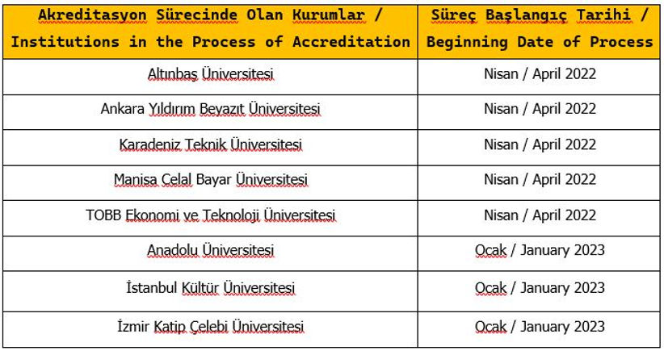
Programs in the Accreditation Process

Slide 25
Thank you!
Any questions?
e-mail: info@dedak.org
Web: dedak.org

