Slide 1

Fermata
Pay on proof.
Chargebacks for machine payments, decided on cryptographic evidence instead of a support ticket.
Live demo: fermata-production-9378.up.railway.app
Bilgin Kocak · Eskişehir, Turkey · Colosseum Crypto World's Fair — Tempo track · github.com/bilgin-kocak/fermata
Notes:
Hi, I'm Bilgin Kocak, and this is Fermata. AI agents are starting to pay for APIs one call at a time. When the API fails, the agent has no way to get its money back. Fermata is the chargeback for machine payments, and it is decided on cryptographic evidence instead of a support ticket. We call it pay on proof.

Slide 2
Agents pay blind.
THE PROBLEM
They pay per call
APIs fail
No recourse
Over MPP or x402, a cent at a time, before the answer arrives.
A 500, truncated JSON, or no answer at all.
A receipt proves the buyer paid, not that the API delivered.
Notes:
Agents already pay for APIs per call, over MPP or x402. They pay before the answer arrives, and APIs fail: a 500, truncated JSON, or silence. Today a receipt only proves that the buyer paid. Nothing proves that the seller delivered, so the money is simply gone.

Slide 3

Hold, prove, then release or refund
HOW IT WORKS
Released
1 · hold
2 · prove
Delivery proven: the vendor is paid.
Escrow on Tempo
TLSNotary
The agent's payment is held, tagged with the call's ID.
A record of exactly what the vendor's server sent, checked against a rule fixed on-chain.
Refunded
Failure proven, or no proof by the deadline.
Receipts prove the buyer paid. Fermata proves what the seller delivered — and anyone can re-check the proof offline.
Notes:
Fermata holds the agent's payment in escrow on Tempo. TLSNotary records exactly what the vendor's server sent, and that record is checked against a delivery rule the vendor fixed on-chain in advance. If the check passes, the vendor is paid. If it proves a failure, or no proof arrives in time, the agent is refunded by the contract.

Slide 4
Native to Tempo payments
BUILT ON TEMPO
Memo = call ID
One-transaction hold
Every hold, release and refund is a TIP-20 transfer whose memo is the call. The books reconcile from chain logs alone.
A TIP-20 permit plus the hold in one transaction; gas is paid in the same stablecoin.
A new MPP method
MPP over MCP
A custom fermata method for mppx, with the agent's own allow-lists:
Every service is also a paid MCP tool, so agents such as Claude pay on proof too.
fermata({ wallet, client, escrows, trustedVerifiers })
Notes:
It's built natively on Tempo. Every hold, release and refund is a TIP-20 transfer whose memo is the call ID, so the books reconcile from chain logs alone. Holds take one transaction with a permit. Payment is a new MPP method, which the agent adds with its own allow-lists of escrows and verifiers, and every service is also a paid MCP tool for agents like Claude.

Slide 5
100 paid calls, no human input
IT WORKS · TEMPO MODERATO TESTNET
3/3
96 / 4
1.03 s
canonical cases pass: release, proven-failure refund, timeout refund
of 100 calls released / refunded against a vendor failing ~3 % at random; 0 errors
TLSNotary proof per call (median); 7.5 s end to end, mostly waiting for two transactions
Every call settled on-chain with its memo; every proof downloadable and re-verifiable offline. Escrow 0x88A9…0763 on explore.testnet.tempo.xyz.
Run 2026-10-01 · pnpm demo:cases and demo:load --calls 100 --chain moderato · FACTS §15.5
Notes:
And it works on Tempo's public testnet. The three canonical cases pass: release, proven-failure refund and timeout refund. A hundred paid calls against a vendor that fails about three percent of the time: ninety-six released, four refunded, zero errors, and no human touched anything. A proof takes about one second.

Slide 6
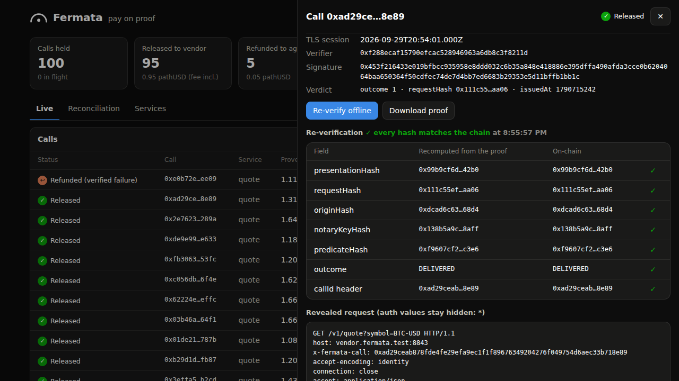
Real vendors, real agents
NOT A MOCK
The real npm registry
A real 200 was released; npm's real 404 was refunded. The certificate chains to Mozilla's roots, over the open internet, at about 2 s per proof.
A real Claude agent
Given only Fermata's MCP server, Claude bought two quotes and re-checked the proof: "The 0.01 was refunded to you, because the vendor returned HTTP 500."
Proof drawer: every hash is recomputed from the proof and matches the chain.
pnpm demo:real (3/3) and a headless Claude Code session, 2026-10-02, local Tempo emulation · FACTS §15.6, apps/mcp
Notes:
It isn't tied to our mock vendor. Fermata proves the real public npm registry over the open internet: a real 200 released, npm's real 404 refunded. And a real Claude agent, given only Fermata's MCP server, bought two quotes, got refunded for the broken one, and verified the proof itself.

Slide 7
No vendor cooperation, no dispute step
WHY IT'S DIFFERENT
Design | Who decides | Evidence | Refund
x402 / MPP receipt | the service | proof the buyer paid | service's discretion
Bursar (same track) | out of scope: invoicing | payment matched to invoice | none; never holds funds
Recourse | Chainlink enclave, after a bonded dispute | seller's own signature + SLA | escrow pays the dispute winner
ERC-8183 (draft) | one evaluator per job | out of scope | evaluator rejects, or expiry
Fermata | one verifier per service (v1: ours) | TLSNotary record of the vendor's own TLS session | automatic: proven failure, or no proof in time
The vendor signs nothing, so it cannot decline to. Shared limit: one trusted decider in v1 — a dishonest verdict is detectable, not prevented.
Checked against each project's public repository or the ERC text, 2026-10-02 · README "How Fermata compares"
Notes:
Here's how it compares. Receipts prove only that the buyer paid, and any refund is at the service's discretion. Bursar does invoicing and never holds funds. Recourse needs the seller's own signature and a bonded dispute. ERC-8183 leaves evidence out of scope. Fermata's evidence comes from the vendor's own TLS session, so the vendor can't decline to sign, and the agent doesn't have to dispute anything.

Slide 8
Paid only when the vendor gets paid
BUSINESS MODEL AND GO-TO-MARKET
First customers
API vendors already selling to agents over MPP or x402: data, search, inference, tools priced per call.
0.5 %
Wedge
Chargeback-grade trust without building it. Agents can safely buy from a vendor they've never seen; the vendor's API doesn't change.
fee on released payments, set on-chain (50 bps). Nothing on refunds.
Distribution
Where agents already pay: the fermata method in an mppx client, one claude mcp add for MCP agents.
Notes:
The business model is a half-percent fee on released payments, set on-chain, and nothing on refunds, so Fermata earns only when the vendor gets paid. First customers are API vendors already selling to agents. The wedge: chargeback-grade trust without building it, so agents can buy from vendors they've never seen.

Slide 9
Prove a random sample, not every call
UNIT ECONOMICS AT SCALE
Today: 66 MB × $0.09/GB
Sampled proving at 5 %
Still caught
$0.006
$0.0003
99.3 %
per proof: ≈ 1 s of MPC and 66 MB of traffic. Too much for a $0.01 call if every call is proved.
per call. The vendor can't tell which calls are checked.
chance a vendor failing 10 % of calls is caught within 1,000 calls.
Next: session escrow (one hold for many calls) and prove-on-dispute. v1 proves every call to show the mechanism.
Assumption: $0.09 per GB of traffic. Measured: 65.9 MB, ≈ 1 s per proof (FACTS §15.4–15.6). Caught = 1 − (1 − 0.05 × 0.10)^1000.
Notes:
Honest economics: one proof costs about a second and 66 megabytes of traffic, roughly six tenths of a cent, which is too much to spend on every one-cent call. So in production we prove a random five percent. That costs about three hundredths of a cent per call, and a vendor failing ten percent of calls is still caught with ninety-nine percent probability within a thousand calls.

Slide 10
Verifiable today; independent adjudication next
TRUST, ROADMAP AND THE ASK
What v1 trusts
Roadmap
One Fermata verifier signs each verdict, and the notary is ours. Every verdict points at a proof anyone can re-verify offline, so a dishonest verdict is detectable, not prevented.
Vendor-chosen verifiers, N-of-M quorum
On-chain proof verification
Session escrow and sampled proving
Vendor-hosted gateways
The ask
Pilot API vendors
Agent builders to try it
The accelerator
Live: fermata-production-9378.up.railway.app · github.com/bilgin-kocak/fermata · Testnet, unaudited
Notes:
To be precise about trust: in v1 one Fermata verifier signs the verdicts and the notary is ours. But every verdict points at a proof anyone can re-verify, so cheating is detectable. The roadmap removes us from the trust path. We're looking for pilot API vendors and agent builders; the live demo is linked on screen. Fermata: pay on proof.

