Slide 1
WaterApp
In a world where every drop of water is a precious gem, we find ourselves at a crossroads of responsibility and opportunity. The challenges of water scarcity and environmental degradation compel us to take action – action that reverberates through our daily lives, industries, and communities.
As we navigate through the upcoming screens, each click is a step towards understanding, awakening, and empowerment. We will witness the evolution of ideas that resonate beyond our digital realm, shaping our behaviors, choices, and impact on the planet. From login screens that guard the gateway to possibility, to surveys that amplify our voices, to tasks that transform us into water-saving heroes – every element we encounter carries a message, a purpose, and a vision.
Bilgin Kılıç August 2023

Slide 2
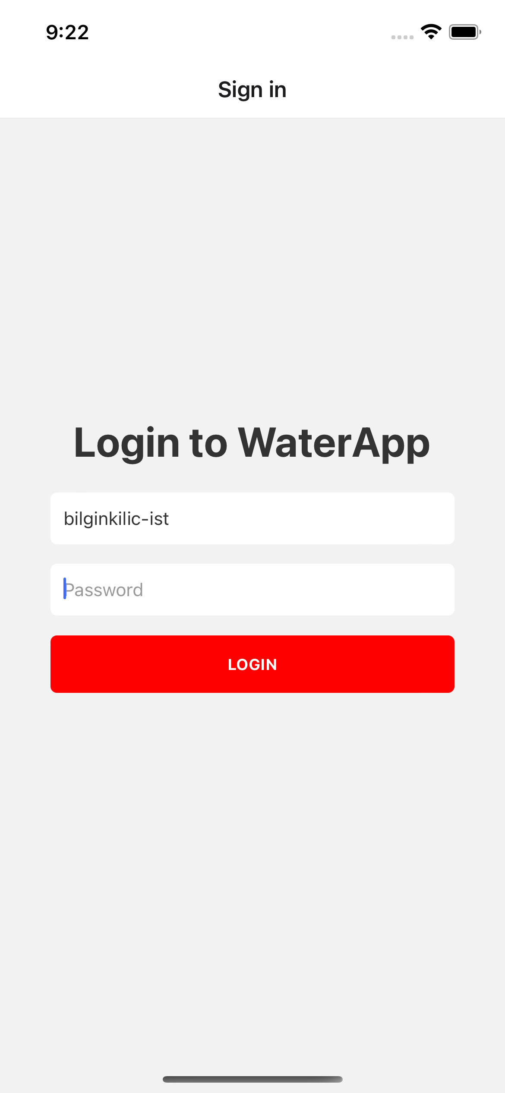
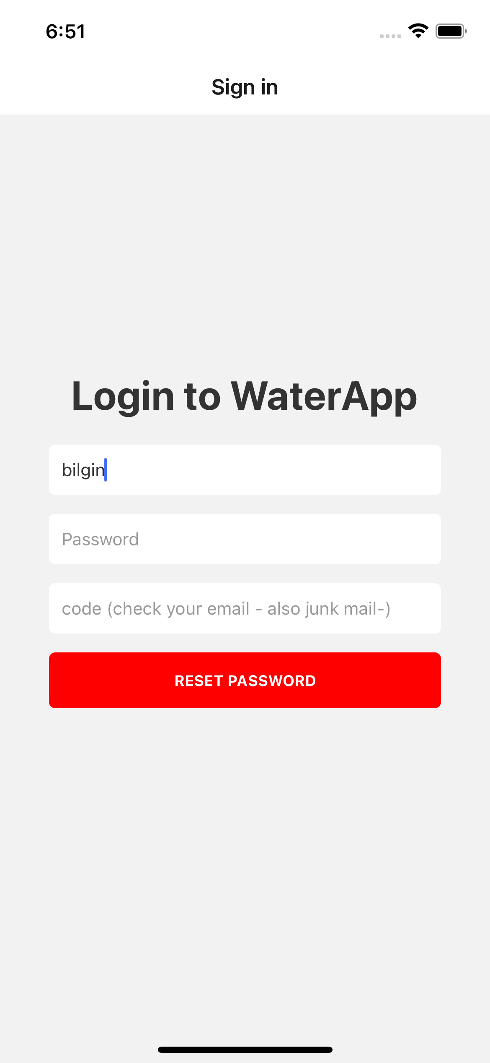
Login
Basics
The gateway of possibilities! The login screen is your key to accessing a realm of innovation and collaboration. Just like a door to an exclusive club, this screen is where you prove your identity to gain entry. It's your digital passport to a world of limitless potential.

Slide 3
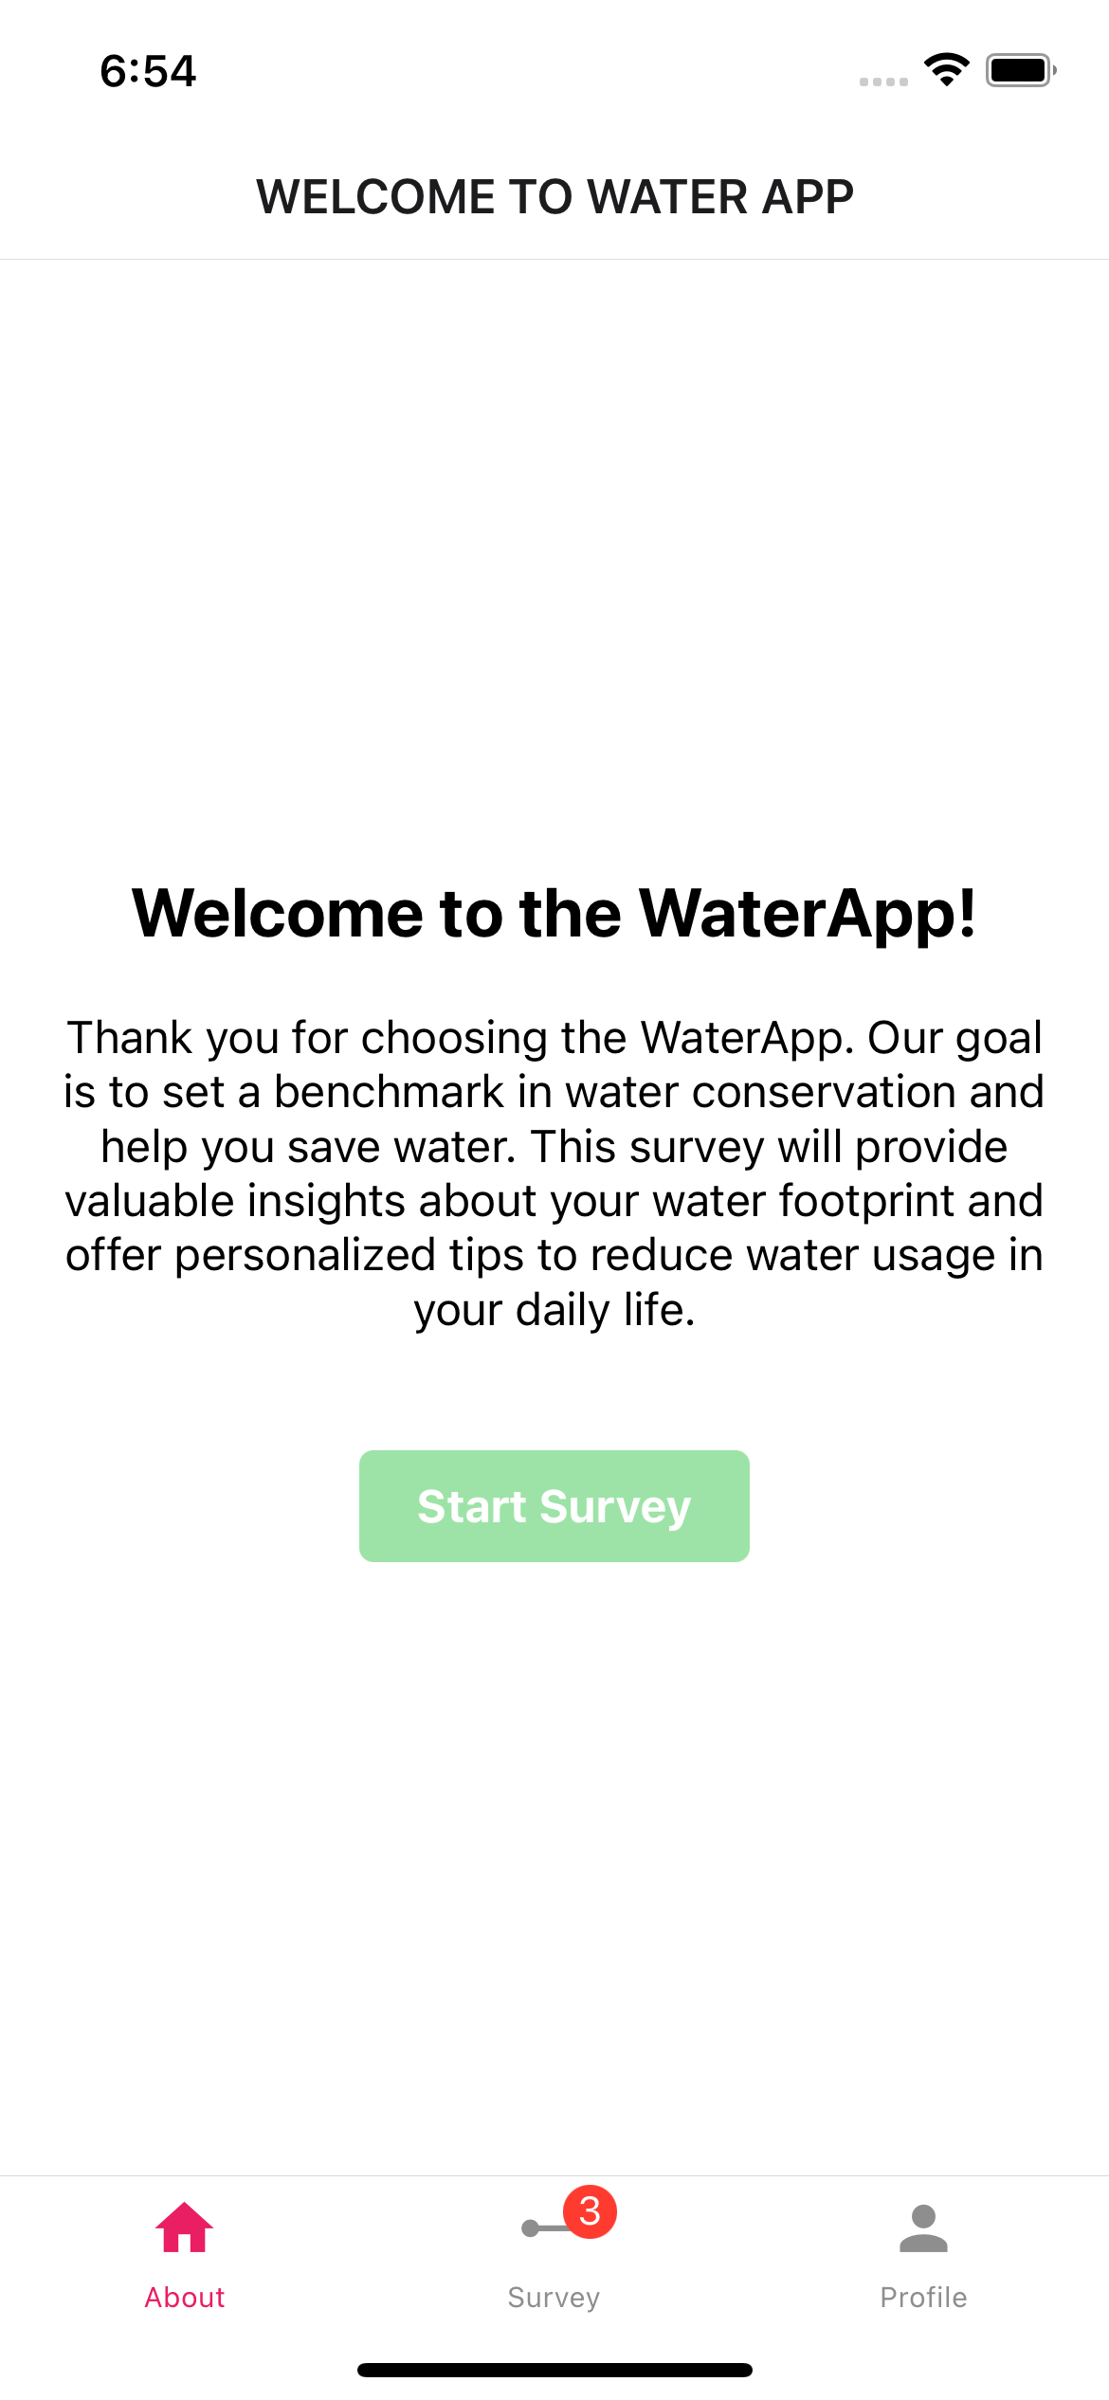
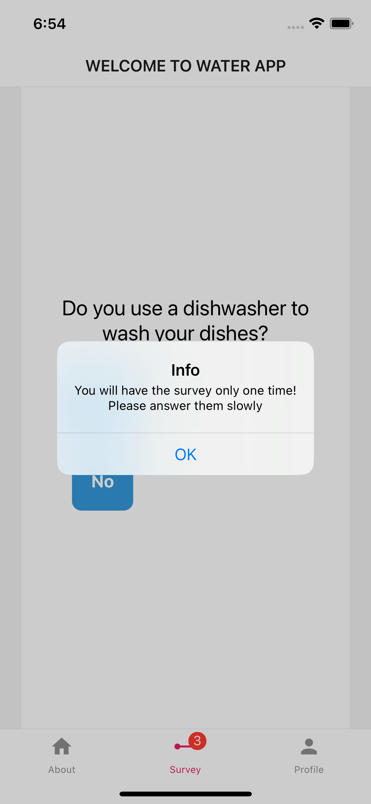
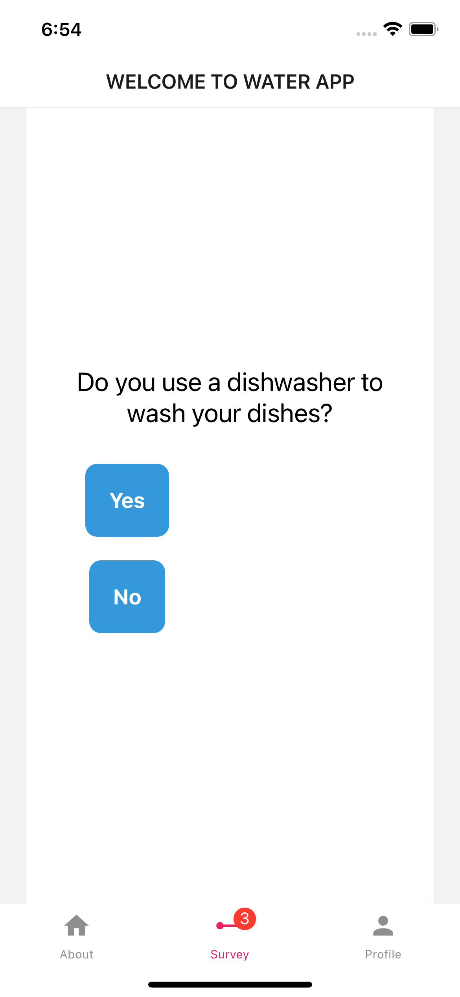
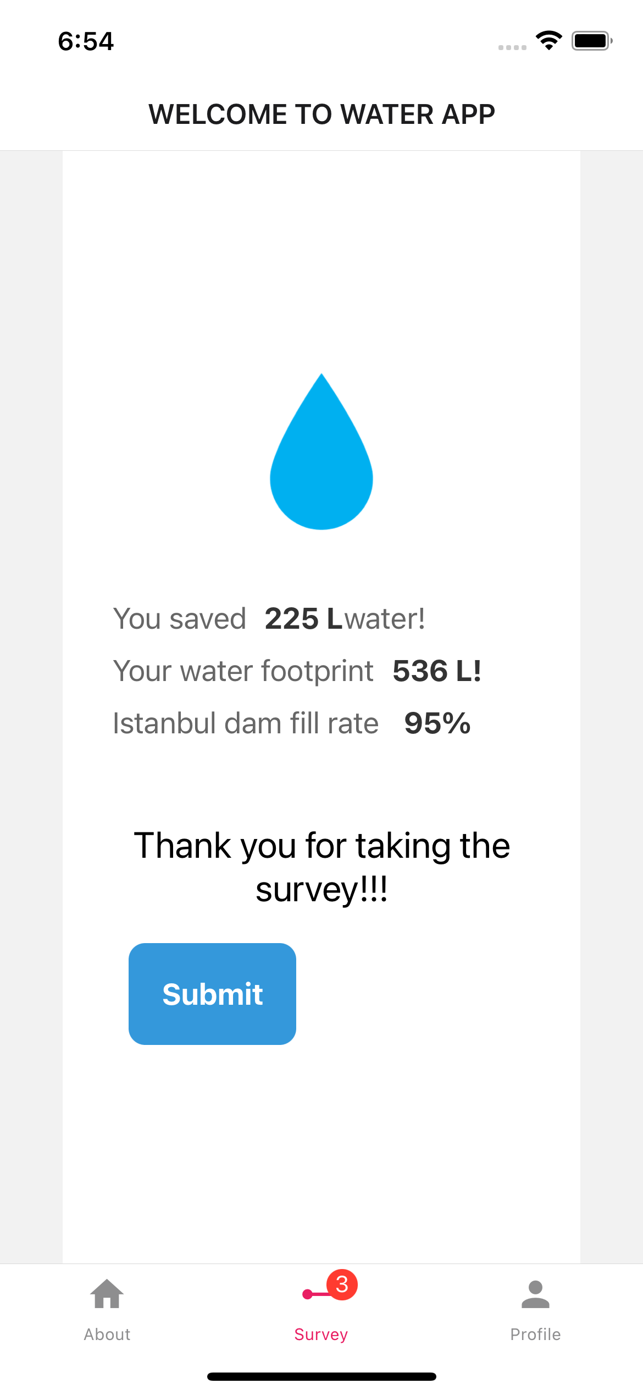
Welcome Screens
The Survey
Dive into a world of discovery and positive change with our Water Footprint Survey! Just as a pebble creates ripples in a pond, your actions create waves in the global water cycle. This survey is your compass to understanding the profound impact of your water usage and charting a course towards a more sustainable future

Slide 4
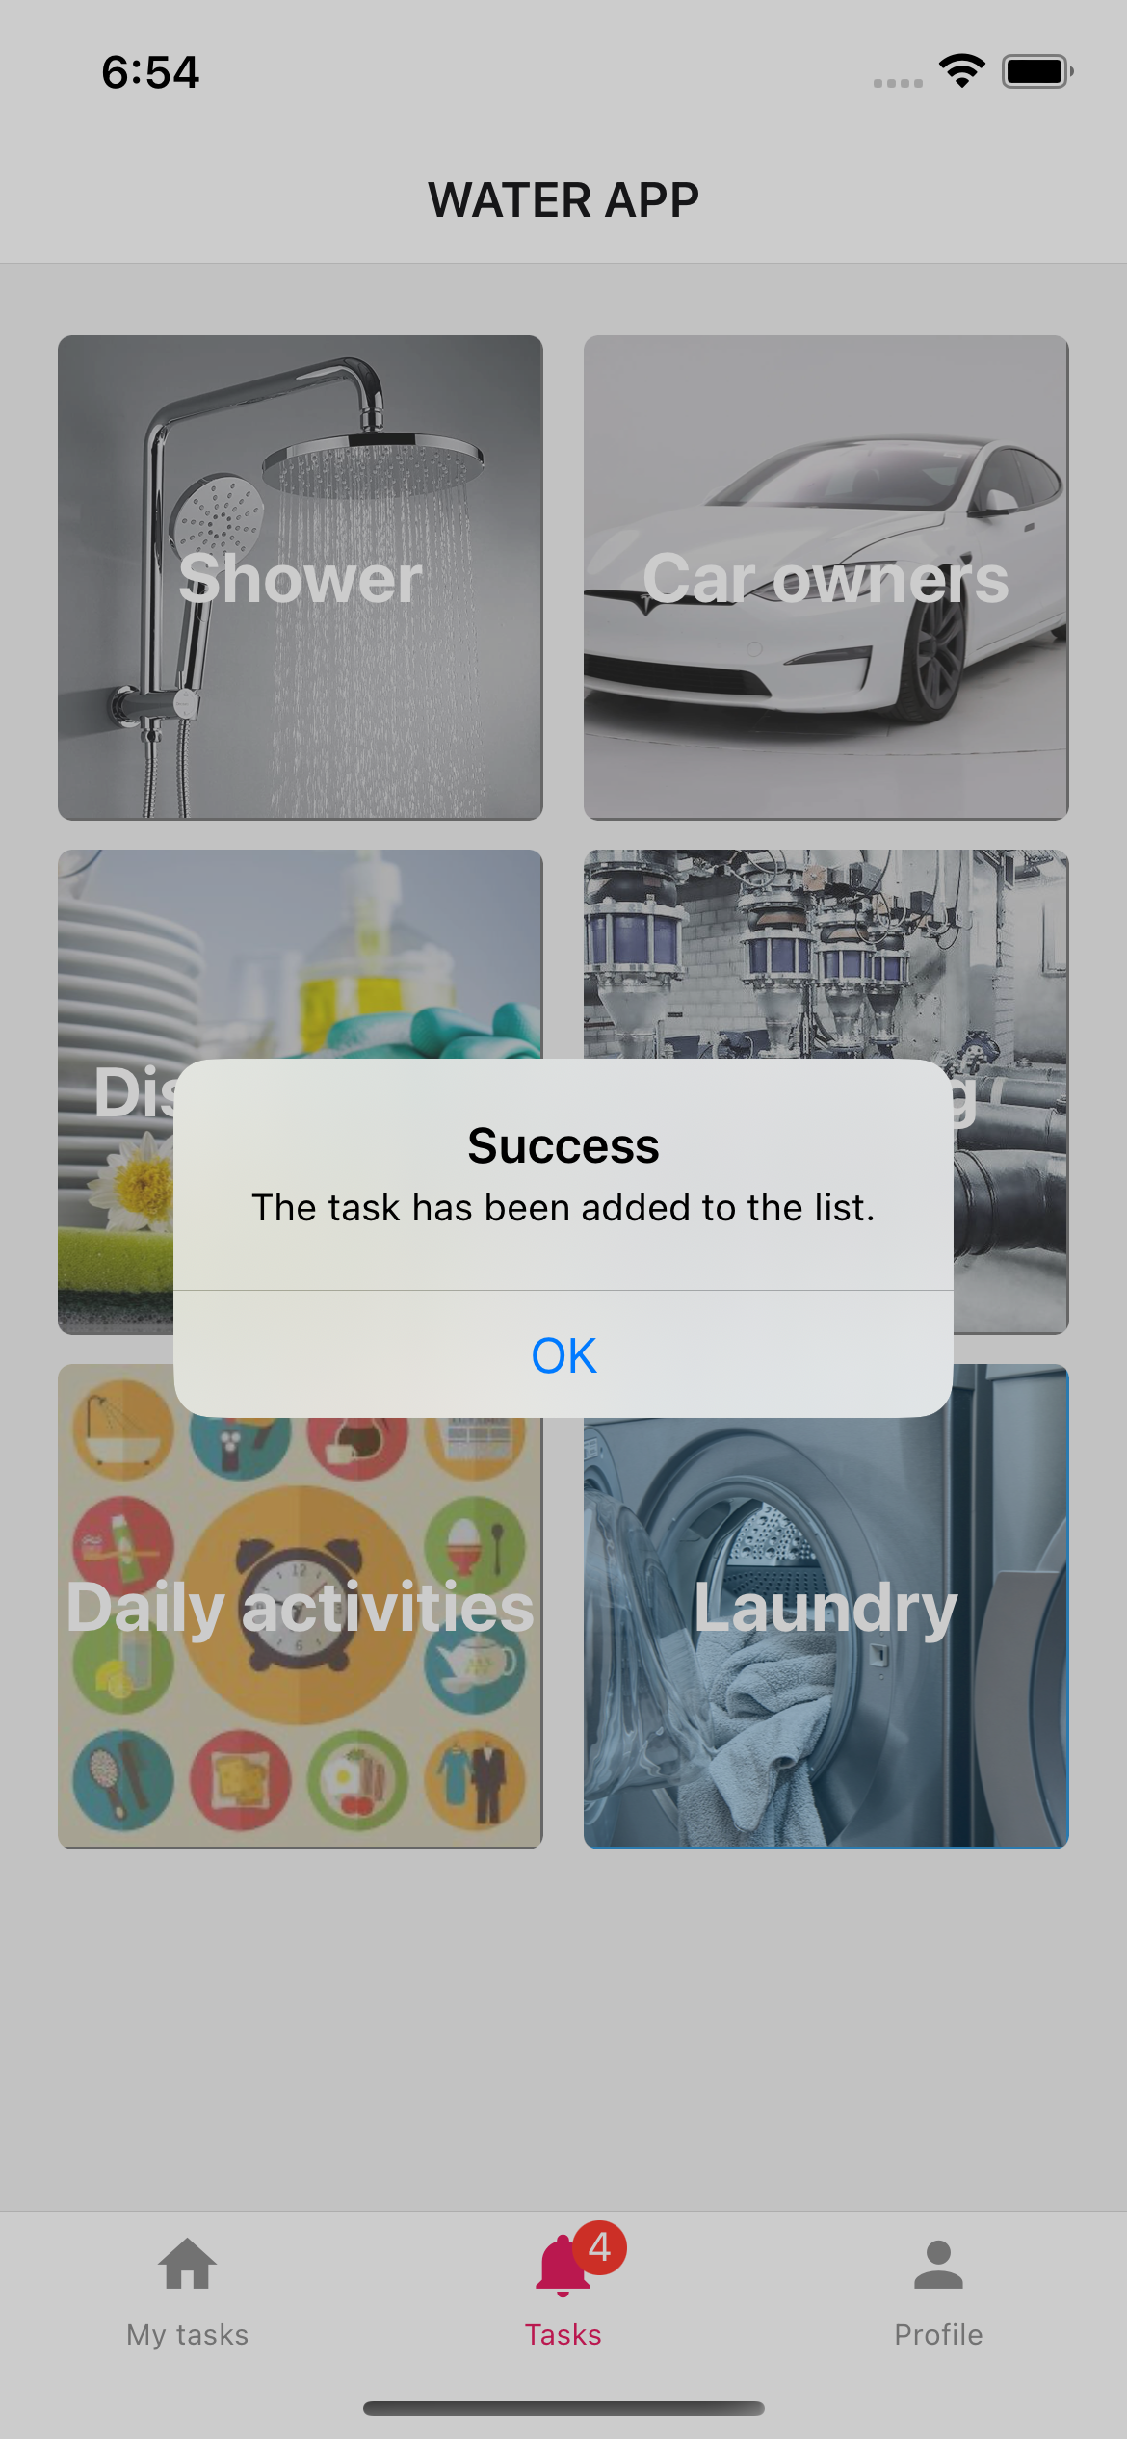
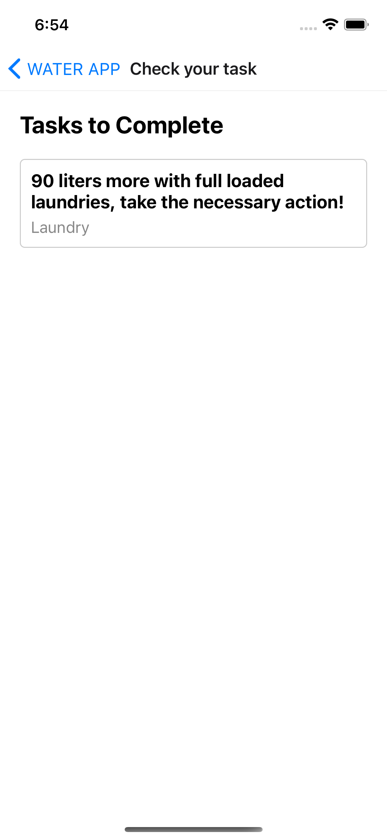
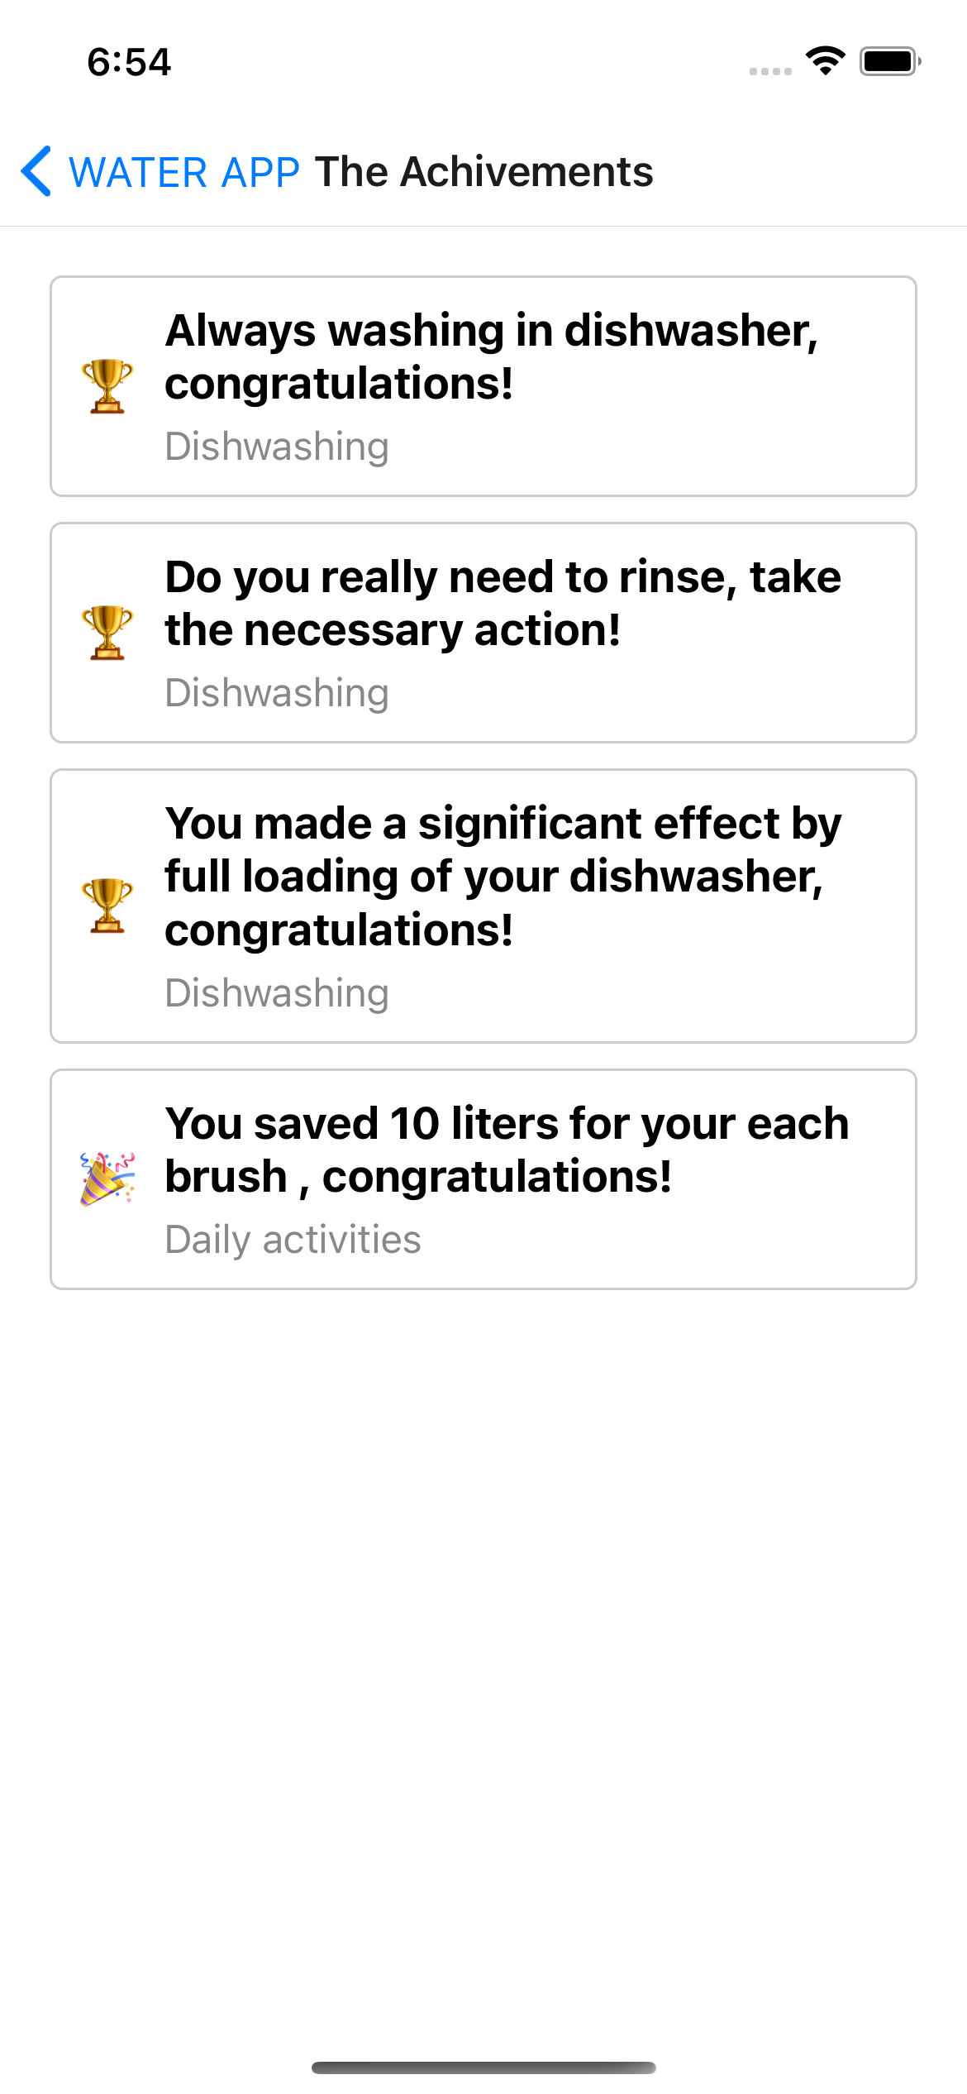
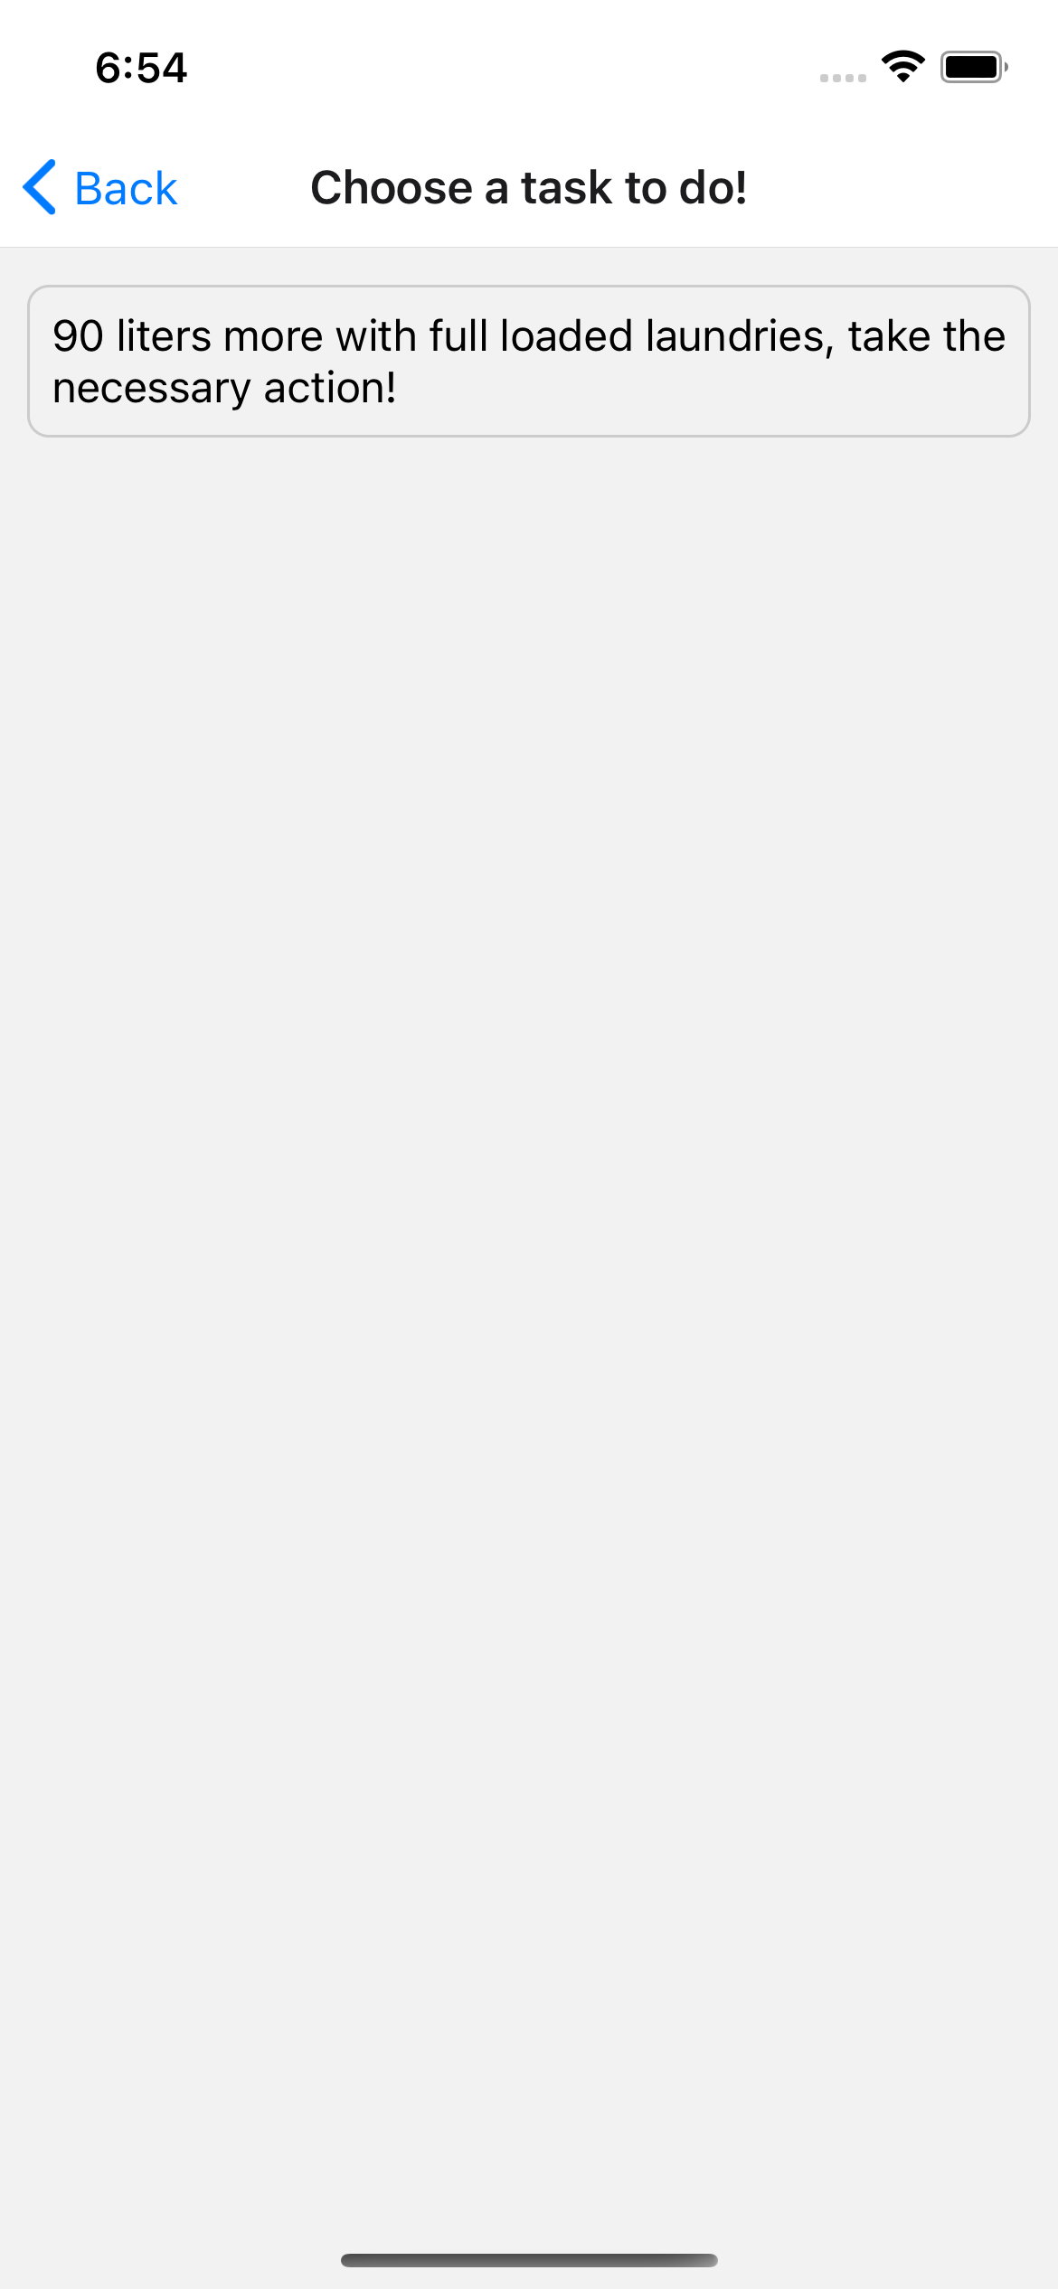
On boarding
The tasks
The heart of transformation! The Tasks Screen is your interactive roadmap to becoming a water-saving superhero. It's like embarking on a quest where every completed task is a step closer to reducing your water footprint and leaving a lasting impact on the planet.

Slide 5
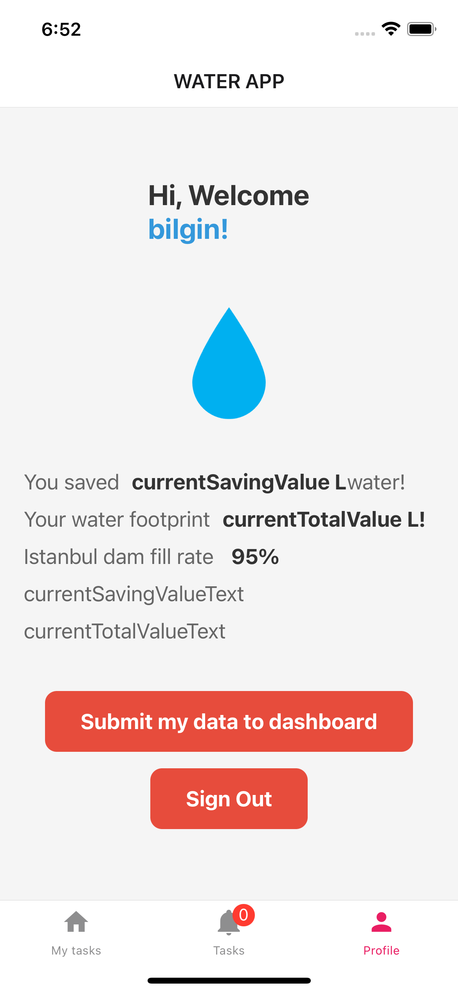
The challenge
Everyday visit the app
Step into your personal oasis of progress – the Profile Screen! Here, your journey towards water conservation unfolds like a captivating story. It's a canvas that chronicles your dedication, showcases your achievements, and invites you to be an active participant in a global movement.

Slide 6
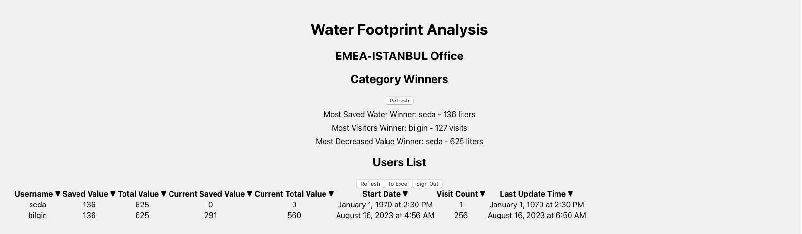
The dashboard
Admin use only
The ultimate control room of water conservation – the Dashboard! Here, administrators wield the power to recognize and celebrate the remarkable achievements of water-saving superheroes. It's like having a front-row seat to a grand performance, where the stars are those who make the biggest splash in saving water.

