Slide 1
Horozlar
ChargeMe

Slide 2
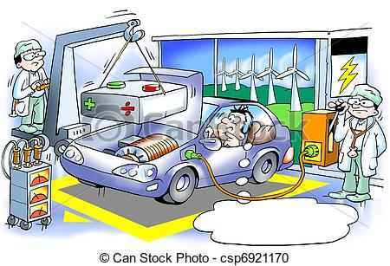

Slide 3
ChargeME Application
It’s an application that runs on wireless VtoV charging technology
Enabling to create a vehicle community that are willing to share their battery capacities
Finding locations nearby the member commuters and pairing demander and supplier vehicles
Tracking wireless connection and charging transfer status
Steering bonus transactions between VtoV
Using bonus at member merchants

Slide 4
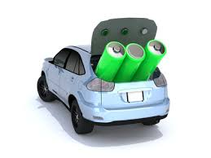
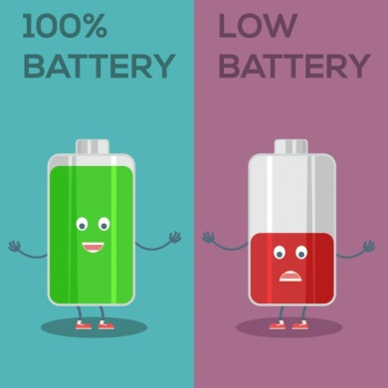

C.A.S.E
ChargeME Application
ChargeMe app is on the same way with Daimler C.A.S.E strategy
Efficiency in battery usage
and on investment of
charging stations
VtoV
connectivity
Share &
serve your energy

Slide 5
Advantages of ChargeMe
Time saving
Supporting VtoV Connectivity
Encouraging to share and enabling mobility
Enabling efficiency on battery usage and reducing new charging stations investments
Potantial collaboration opportunuties in new markets by using ChargeMe bonus system

Slide 6
ChargeME Application
Demonstration of ChargeME Application
Thanks..

