Slide 1
APPENDIX
Monte Carlo VaR — Mathematical Reference
Gaussian MC · t-Copula MC · GARCH-t-Copula MC
Backtesting · Instrument Pricing · Diagnostics

Slide 2
A. VaR Framework
Definition · Expected Shortfall · Backtesting Principles

Slide 3
A1 Value at Risk — Formal Definition
The single-number loss threshold exceeded with probability (1−α)
VaR Definition (99% confidence)
P( ΔV < −VaRₜ ) = 1 − α where α = 0.99
Equivalently: VaRₜ = −Q_{1−α}( ΔV )
Q_{1%}(ΔV) = 1st percentile of the simulated P&L distribution
VaR is reported as a POSITIVE number (a loss amount)
Expected Shortfall (ES / CVaR)
ES_{α} = −E[ ΔV | ΔV < −VaRₜ ]
= average loss in the worst (1−α)% of scenarios
ES is always ≥ VaR and is sub-additive (VaR is not).
Simulation-Based Estimation (M scenarios)
Sort simulated P&Ls: p₁ ≤ p₂ ≤ … ≤ p_M
VaR = −p_{ ⌊(1−α)M⌋ }
ES = −(1/k) Σᵢ₌₁ᵏ pᵢ where k = ⌊(1−α)M⌋
With M=10,000 and α=99%: the 1% tail = 100 scenarios → stable estimate
Key insight: VaR answers "On a bad day (1-in-100), how much do I lose?"
It does NOT tell you how bad things get beyond that threshold — that is what ES captures.

Slide 4
A2 Backtesting — Kupiec & Christoffersen Tests
Statistical tests for whether observed breach frequency matches the model's confidence level
Kupiec Proportion of Failures (POF) Test
H₀: p = 1 − α = 0.01 (true breach probability equals model assumption)
Under H₀: N ~ Binomial(T, 0.01) E[N] = T × 0.01
LR_UC = 2 [ N·ln(p̂/p₀) + (T−N)·ln((1−p̂)/(1−p₀)) ] ~ χ²(1)
where p̂ = N/T (empirical breach rate), p₀ = 0.01
Reject H₀ at 95% if LR_UC > 3.84 (i.e. N ≈ 54 for T=4019)
Christoffersen Independence Test
Tests whether breaches cluster (are NOT independent) — a separate failure mode
Transition counts: n₀₀ = calm→calm, n₀₁ = calm→breach,
n₁₀ = breach→calm, n₁₁ = breach→breach
π₀₁ = n₀₁/(n₀₀+n₀₁) π₁₁ = n₁₁/(n₁₀+n₁₁) π = (n₀₁+n₁₁)/T
LR_IND = 2 ln[ L(π₀₁,π₁₁) / L(π,π) ] ~ χ²(1)
Reject independence at 95% if LR_IND > 3.84
Our results: Gaussian N=248, t-Copula N=25, GARCH-t-Copula N=69.
Gaussian and GARCH rejected (too many breaches). t-Copula rejected (too few — over-conservative after implementation fixes).
GARCH-t-Copula is the only model that passes the Christoffersen independence test.

Slide 5
B. Portfolio & Data
Six instruments · 10-year walk-forward backtest · 2006–2024

Slide 6
B1 Portfolio Composition
V₀ = $1,000,000 | Backtest: Jan 2009 – Dec 2024 (T = 4,019 days)
Instrument
Type
Weight
Exposure
Risk Factor
SPY
US Equity ETF
25%
$250,000
SPY log return
GLD
Gold ETF
25%
$250,000
GLD log return
IEF
7-10Y Treasury
25%
$250,000
IEF log return
EURUSD
FX spot
25%
$250,000
EURUSD log return
IRS
Interest Rate Swap
—
$1,000,000 notional
DGS10 yield change
Straddle
ATM SPY options
—
2,000 shares
SPY price + VIX level
Linear positions: static inception shares (shares = V₀ × wⱼ / P₀ⱼ), never rebalanced.
IRS: fixed payer at 3% on $1M notional, 10-year maturity. Straddle: 30-day rolling ATM reset, 2,000 shares.
Six risk factors modelled in copula: EURUSD, GLD, IEF, SPY (log returns), VIX_ret (log), DGS10_chg (absolute).

Slide 7
C. Gaussian Monte Carlo
Multivariate normal simulation via Cholesky decomposition

Slide 8
C1 Gaussian MC — Algorithm
Rolling 750-day window | M = 10,000 scenarios | Full revaluation
Step 1 — Estimate parameters from rolling window W = [t−750, t)
μ = (1/750) Σ rₜ (6-vector of mean returns)
Σ = (1/749) Σ (rₜ−μ)(rₜ−μ)ᵀ (6×6 covariance matrix)
Σ += 1e-8 · I (regularise for Cholesky)
Step 2 — Cholesky simulation
L = chol(Σ) s.t. L Lᵀ = Σ (lower triangular)
Z ~ N(0, I) (M × 6 independent standard normals)
sim = Z Lᵀ + μ (M × 6 correlated scenarios)
Proof: Cov(L z) = L · Cov(z) · Lᵀ = L I Lᵀ = Σ ✓
Step 3 — Full revaluation per scenario i
P&L_linear = Σⱼ shares_j · price_now_j · (exp(rᵢⱼ) − 1) j ∈ {SPY, GLD, IEF, EURUSD}
P&L_IRS = IRS(rate_now + Δrᵢ) − IRS(rate_now)
P&L_strad = [BS(S·exp(rᵢ_SPY), K, T−1/252, rₜ, σ·exp(rᵢ_VIX)) − BS(S,K,T,rₜ,σ)] × shares
P&L_total = P&L_linear + P&L_IRS + P&L_strad
VaR_t = −Q₁%(P&L_total) [sign flip: VaR is a positive loss amount]

Slide 9
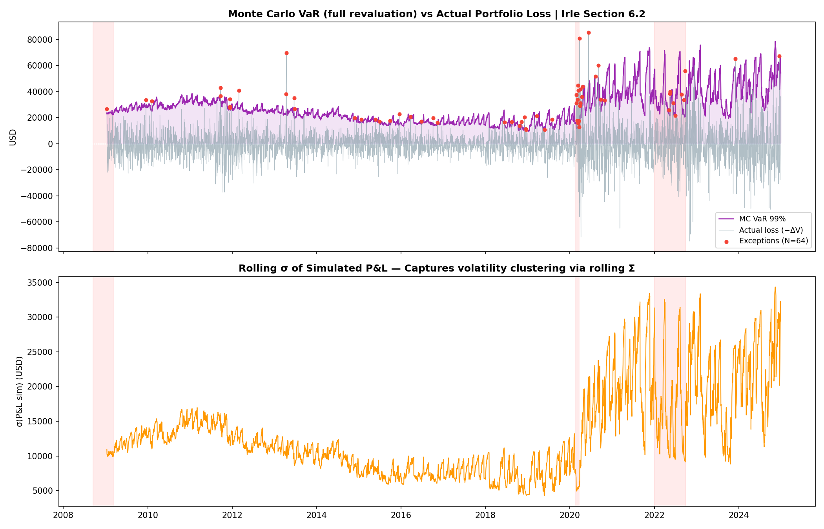
C2 Gaussian MC — Backtest Result
N = 248 breaches | Expected ≈ 40 | Kupiec REJECTED (p ≈ 0)
248 breaches (6.2% empirical breach rate vs 1% target). The model systematically
underestimates tail risk because fat tails and volatility clustering are both absent.

Slide 10
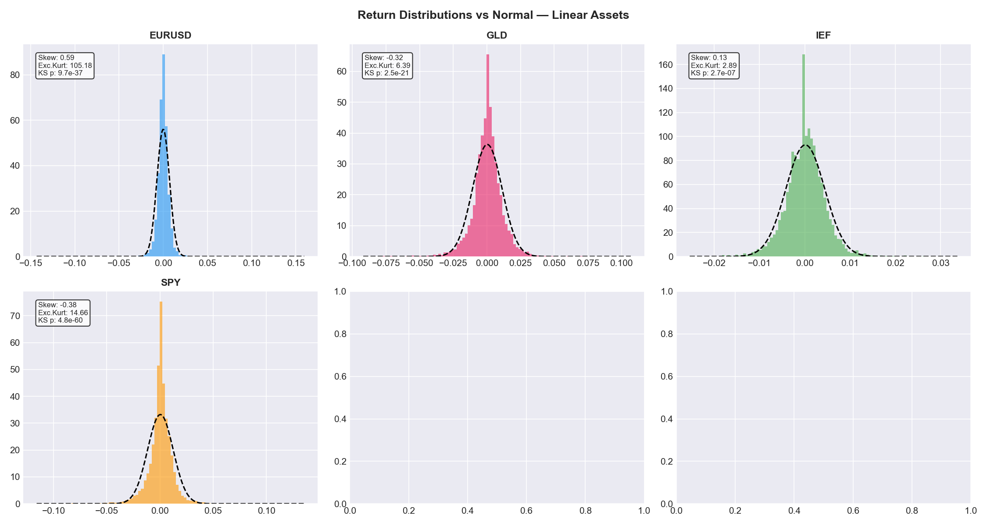
C3 Why Gaussian Fails — Fat Tails
Real financial returns have far more extreme events than the normal distribution predicts
Probability of a k-sigma event
Normal: P(|Z| > k σ) ↓ super-exponentially fast
Student-t: P(|Z| > k σ) ~ C · k^{−ν} (power-law tail)
For k = 5 (five-sigma event):
Normal : P ≈ 5.7 × 10⁻⁷ → once every ~3.5 million days
t(ν = 5) : P ≈ 5.8 × 10⁻⁵ → once every ~17,000 days (206× more likely)
t(ν = 3) : P ≈ 5.0 × 10⁻⁴ → once every ~2,000 days (2,850× more likely)
Empirically: SPY has had several 5σ+ days within a 15-year period.
Additional failure: no volatility clustering
Gaussian model uses fixed Σ estimated over 750 days.
After a crash, Σ barely changes for weeks → VaR stays low
even though the market is clearly in a high-vol regime.
GARCH directly addresses this by giving the model a memory.

Slide 11
D. t-Copula Monte Carlo
Student-t marginals · Sklar decomposition · Profile MLE for ν

Slide 12
D1 Copula Theory — Sklar's Theorem
Any multivariate distribution can be decomposed into marginals + a copula
Sklar's Theorem (1959)
For any joint CDF F(x₁,…,xₙ) with marginals F₁,…,Fₙ:
F(x₁,…,xₙ) = C( F₁(x₁), …, Fₙ(xₙ) )
where C: [0,1]ⁿ → [0,1] is the COPULA — a joint CDF with uniform marginals.
The copula captures the entire dependence structure, independently of the marginals.
Inversion (simulation use): if U = (U₁,…,Uₙ) ~ C then
Xⱼ = Fⱼ⁻¹(Uⱼ) has marginal Fⱼ and joint dependence C.
t-Copula vs Gaussian Copula — Tail Dependence
Gaussian copula: tail dependence λ_U = λ_L = 0 (assets become INDEPENDENT in extremes)
t-Copula: λ_L = 2·t_{ν+1}( −√((ν+1)(1−ρ)/(1+ρ)) ) > 0 for finite ν
Example (ν=5, ρ=0.7): P(SPY<1% AND GLD<1%) under t-copula ≈ 0.52%
vs independence: 0.01% and Gaussian copula: ≈ 0.11%
This is why Gaussian copula failed in 2008 — it had zero tail dependence.

Slide 13
D2 Student-t Marginals — Estimation
Each risk factor fitted independently by maximum likelihood
Student-t PDF
f(x; ν, μ, σ) = Γ((ν+1)/2) / [Γ(ν/2)·√(νπ)·σ] · (1 + (x−μ)²/(ν·σ²))^{−(ν+1)/2}
Parameters: ν = degrees of freedom (tail thickness; small ν = fatter tails)
μ = location (≈ mean for ν > 1)
σ = scale (≈ std dev × √((ν−2)/ν) for ν > 2)
As ν → ∞: t → Normal. For ν ≤ 4: variance may be infinite.
Fitted ν values (GARCH residuals, last refit)
EURUSD : ν ≈ 7.4 (fat tails)
GLD : ν ≈ 8.3 (fat tails)
IEF : ν ≈ 23.0 (near-Gaussian in calm periods)
SPY : ν ≈ 11.1 (moderate tails)
VIX_ret : ν ≈ 5.0 (very fat tails + strong skew)
DGS10_chg: ν ≈ 17.2 (near-Gaussian)
Hazen Rank Transform → Pseudo-observations
For each factor column j, compute uniform pseudo-observations:
Uᵢⱼ = rank(xᵢⱼ) / (n + 1) (Hazen formula; avoids 0 and 1)
These Uᵢⱼ ~ Uniform(0,1) marginally but retain the empirical
dependence structure. They are fed into the copula likelihood.
t-Copula Profile MLE
ν_copula = argmax_ν Σₜ log c(U_t; R, ν) over grid ν ∈ {2,3,…,20}
R estimated by Kendall's τ inversion: ρᵢⱼ = sin(π/2 · τ̂ᵢⱼ)

Slide 14
D3 t-Copula Simulation Algorithm
Cholesky + chi-squared mixing → joint fat-tailed copula draws
t-Copula Simulation (M scenarios, d=6 factors)
1. L = chol(R) (6×6 Cholesky of correlation matrix R)
2. Z ~ N(0, I_{d×d}) (M×6 independent standard normals)
3. Y = Z Lᵀ (M×6 correlated normals with Cov = R)
4. W ~ χ²(ν) (M independent chi-squared draws)
5. T = Y · √(ν / W) (M×6; divide each row by √(W/ν))
Interpretation: W is a SHARED random scaling per scenario.
When W is small (a rare event), ALL assets are scaled up together
→ simultaneous extreme moves (tail dependence).
6. U = F_{t,ν}(T) (apply t-CDF column-by-column → uniform)
Invert Marginals → Simulated Returns (Sklar in reverse)
7. rᵢⱼ = F_{t, νⱼ, μⱼ, σⱼ}⁻¹(Uᵢⱼ) for j = 1…6
Each column gets the correct marginal tail shape (factor-specific ν)
while the joint dependence is governed by the t-copula above.
Rolling refit schedule
Refit marginals + copula every 50 days on the most recent 750 observations.
Fresh M=10,000 copula draws every day (rng NOT reset between days → stochastic VaR series).

Slide 15
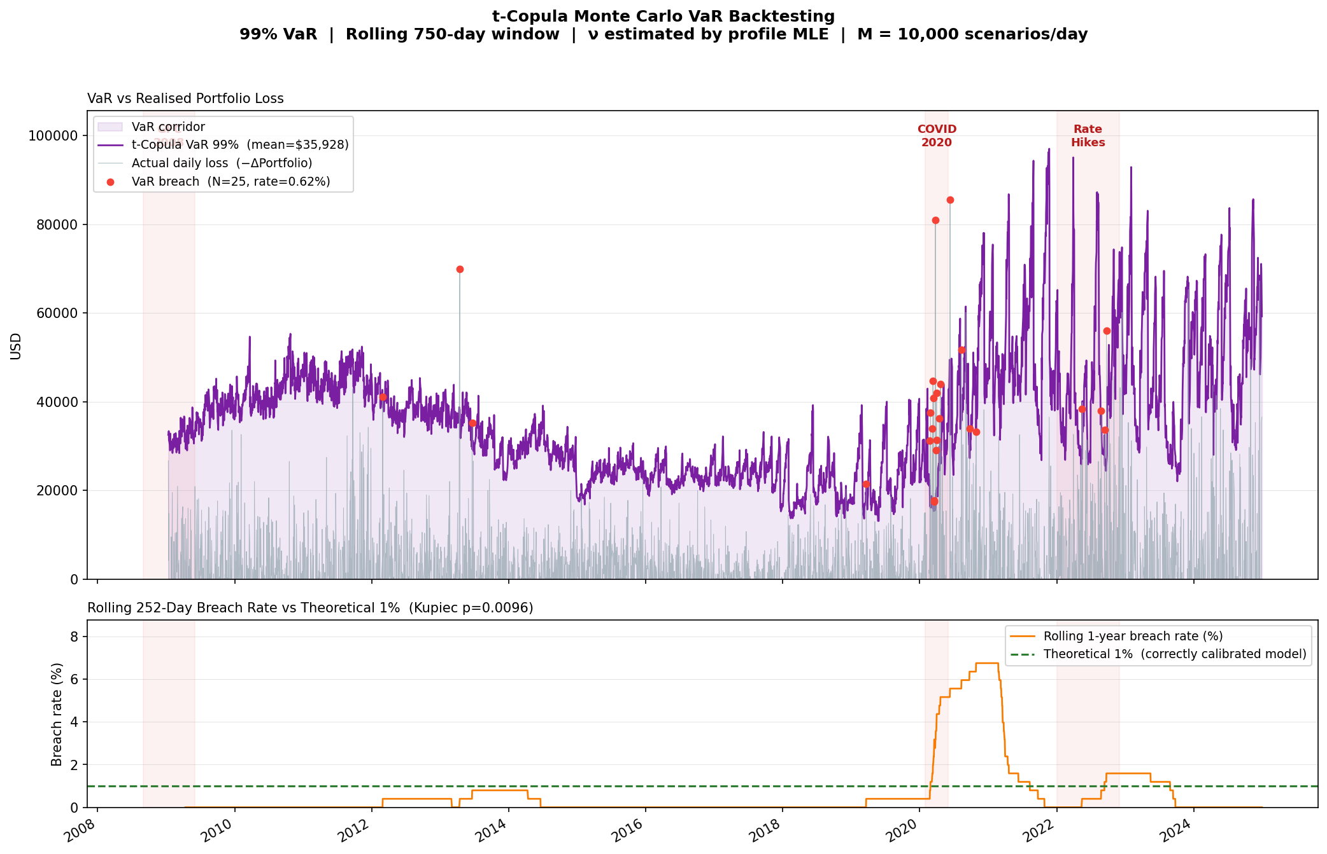
D4 t-Copula MC — Backtest Result
N = 25 breaches | Expected ≈ 40 | Kupiec REJECTED (too conservative)
25 breaches — VaR is too conservative after implementation fixes (static inception shares + correct IRS/straddle pricing).
Fat-tailed marginals (ν≈2–3) with no vol conditioning overstate risk once the portfolio's grown 3–4× since inception.
Opposite failure mode to GARCH: too few breaches, not too many.

Slide 16
E. GARCH-t-Copula Monte Carlo
GARCH(1,1) volatility forecasting · EWMA dynamic correlation · Full pipeline

Slide 17
E1 GARCH(1,1) Specification
Gives the model a memory of recent volatility — the key upgrade over the t-Copula
GARCH(1,1) conditional variance equation
σ²_{t+1} = ω + α · ε²_t + β · σ²_t
ω (omega) : long-run variance floor. Ensures σ²>0 at all times.
Unconditional variance: σ²_∞ = ω / (1 − α − β)
α (alpha) : ARCH coefficient. Size of yesterday's shock → today's vol.
Large α = fast reaction to new information.
β (beta) : GARCH coefficient. Persistence of the vol regime.
Large β = vol decays slowly (clustering).
α + β < 1 : stationarity condition. Typical empirical values: 0.97–0.99.
ν (nu) : degrees of freedom of t-distributed innovations.
Controls tail thickness of the residual distribution.
GARCH returns model
rₜ = μ + σₜ · zₜ where zₜ ~ t(ν) standardised
Standardised t: Var(zₜ) = 1 (not ν/(ν−2))
Requires std_scale = √((ν−2)/ν) correction when using scipy.
One-step-ahead forecast (used in simulation)
Given today's state (x_t, σ_t):
σ²_{t+1} = ω + α · x²_t + β · σ²_t
r_sim = μ + σ_{t+1} · z z drawn from t-copula
Numerical implementation note
Returns are scaled ×100 before GARCH fitting (GARCH_SCALE=100).
Optimizer works in percentage-point units (e.g. 0.8% → 0.8).
After fitting: ω is divided back by 100² to restore decimal units.

Slide 18
E2 EWMA Dynamic Correlation
Correlation updated daily using exponentially weighted standardised residuals (λ = 0.94)
EWMA Correlation Update (JP Morgan RiskMetrics)
Each day, after observing the new GARCH residual z_t = x_t / σ_t:
Q_{t+1} = λ · Q_t + (1−λ) · z_t · z_tᵀ
R_{t+1} = diag(Q_{t+1})^{−1/2} · Q_{t+1} · diag(Q_{t+1})^{−1/2}
where: Q_t = quasi-correlation matrix (not unit diagonal)
R_t = correlation matrix (unit diagonal enforced by normalisation)
λ=0.94 = decay factor (half-life ≈ 12 trading days)
Why standardise by σ_t first? We want pure correlation (not covariance).
Using raw returns would mix correlation changes with volatility changes.
Warm-up loop (prevents discontinuity at each GARCH refit)
At each refit: GARCH params (ω, α, β) change → σ_t series changes → z_t series changes.
To prevent a jump in Q when params change, the EWMA is replayed from scratch
by running the update equation through the full 750-day window of new residuals.
This ensures R_dynamic is continuous even after a refit.
Empirical correlations at last refit (Dec 2024): ρ(SPY,IEF)=+0.12 (was −0.40 pre-2022)
ρ(SPY,VIX)=−0.75 | ρ(IEF,DGS10)=−0.96 | ρ(GLD,IEF)=+0.43

Slide 19
E3 GARCH-t-Copula — Complete 8-Step Pipeline
Every step listed with inputs/outputs
Step 1
Fit GARCH(1,1)-t per factor
Input: 750-day rolling window returns. Output: (ω,α,β,μ,ν) per factor.
Step 2
Compute GARCH residuals
zₜ = (rₜ − μ) / σₜ → standardised residuals, roughly t(ν)-distributed.
Step 3
Rank pseudo-observations
Uᵢⱼ = rank(zᵢⱼ)/(n+1). Fed to copula likelihood for R and ν_copula estimation.
Step 3b
Initialise EWMA
Q₀ = sample cov of GARCH residuals. Warm-up replay over 750 days.
Step 4
Update R_dynamic daily
Q_{t+1} = λQ_t + (1−λ)z_t z_tᵀ → R_{t+1} (normalise diagonal to 1).
Step 5
Simulate M t-copula draws
U ~ t-Copula(R_dynamic, ν_copula). M=10,000 uniform scenarios.
Step 6
Invert & reconstruct returns
z_sim = t_ppf(U, ν) × std_scale. r_sim = μ + σ_forecast × z_sim.
Step 7
Full revaluation
P&L = linear (static shares) + IRS (annuity) + straddle (Black-Scholes).
Step 8
Extract VaR
VaR_t = −Q₁%(P&L_sim). Store and advance one day.

Slide 20
E4 std_scale Correction — Unit-Variance t Draws
Critical detail: scipy's t.ppf has variance ν/(ν−2), not 1
The problem
scipy.stats.t.ppf(u, df=ν) returns X ~ t(ν) with Var(X) = ν/(ν−2).
But GARCH is calibrated under the convention Var(z_t) = 1.
If we use raw ppf draws: r_sim = σ_forecast × ppf(u)
then Var(r_sim) = σ²_forecast × ν/(ν−2) ≠ σ²_forecast
For ν=8: ν/(ν−2) = 1.333 → volatility overstated by 15%.
The fix
std_scale_j = √( (νⱼ − 2) / νⱼ )
z_std = t.ppf(U, df=ν) × std_scale
Verification: Var(z_std) = [ν/(ν−2)] × [(ν−2)/ν] = 1 ✓
r_sim = μ + σ_forecast × z_std → Var(r_sim) = σ²_forecast ✓
Applied element-wise across all 6 factors with their own νⱼ.
This correction is NOT applied in the t-Copula model (mc_t_copula.py uses direct scipy t.ppf with loc/scale parameters).
Only the GARCH model needs it because it constructs z_std explicitly and multiplies by σ_forecast separately.

Slide 21
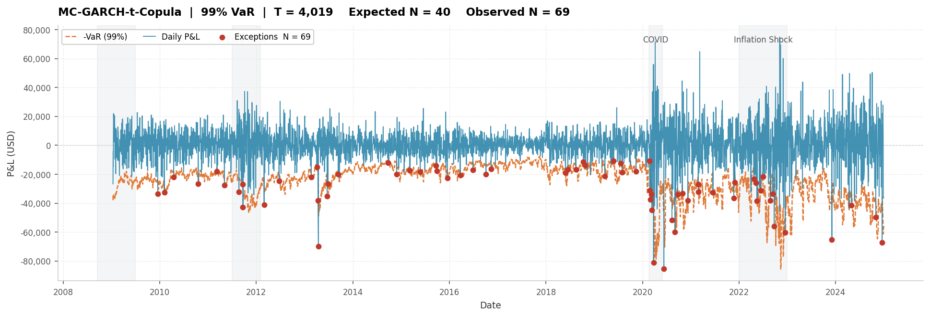
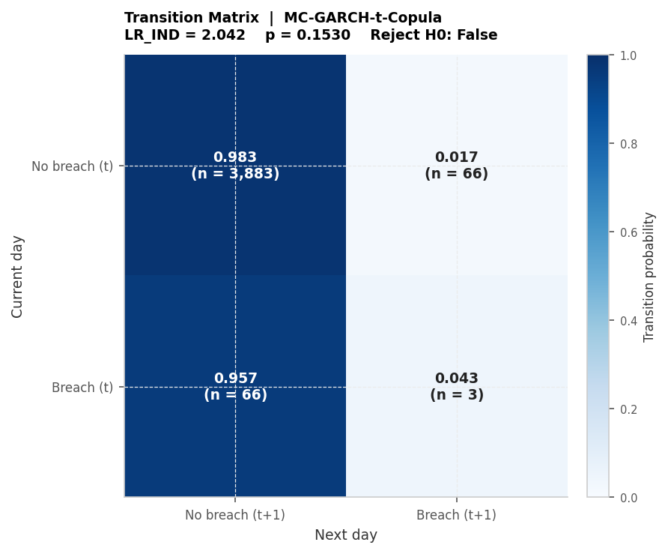
E5 GARCH-t-Copula MC — Backtest Result
N = 69 breaches | Expected ≈ 40 | Kupiec REJECTED | Independence: RETAINED
69 breaches — a 72% reduction from Gaussian (248). All 10 worst days are in 2022 (rate-hike regime).
Independence test RETAINED: breaches are not clustered, meaning the model tracks vol regimes correctly.
Kupiec still rejected because 2022 was a structural regime break the rolling-window model could not anticipate.

Slide 22
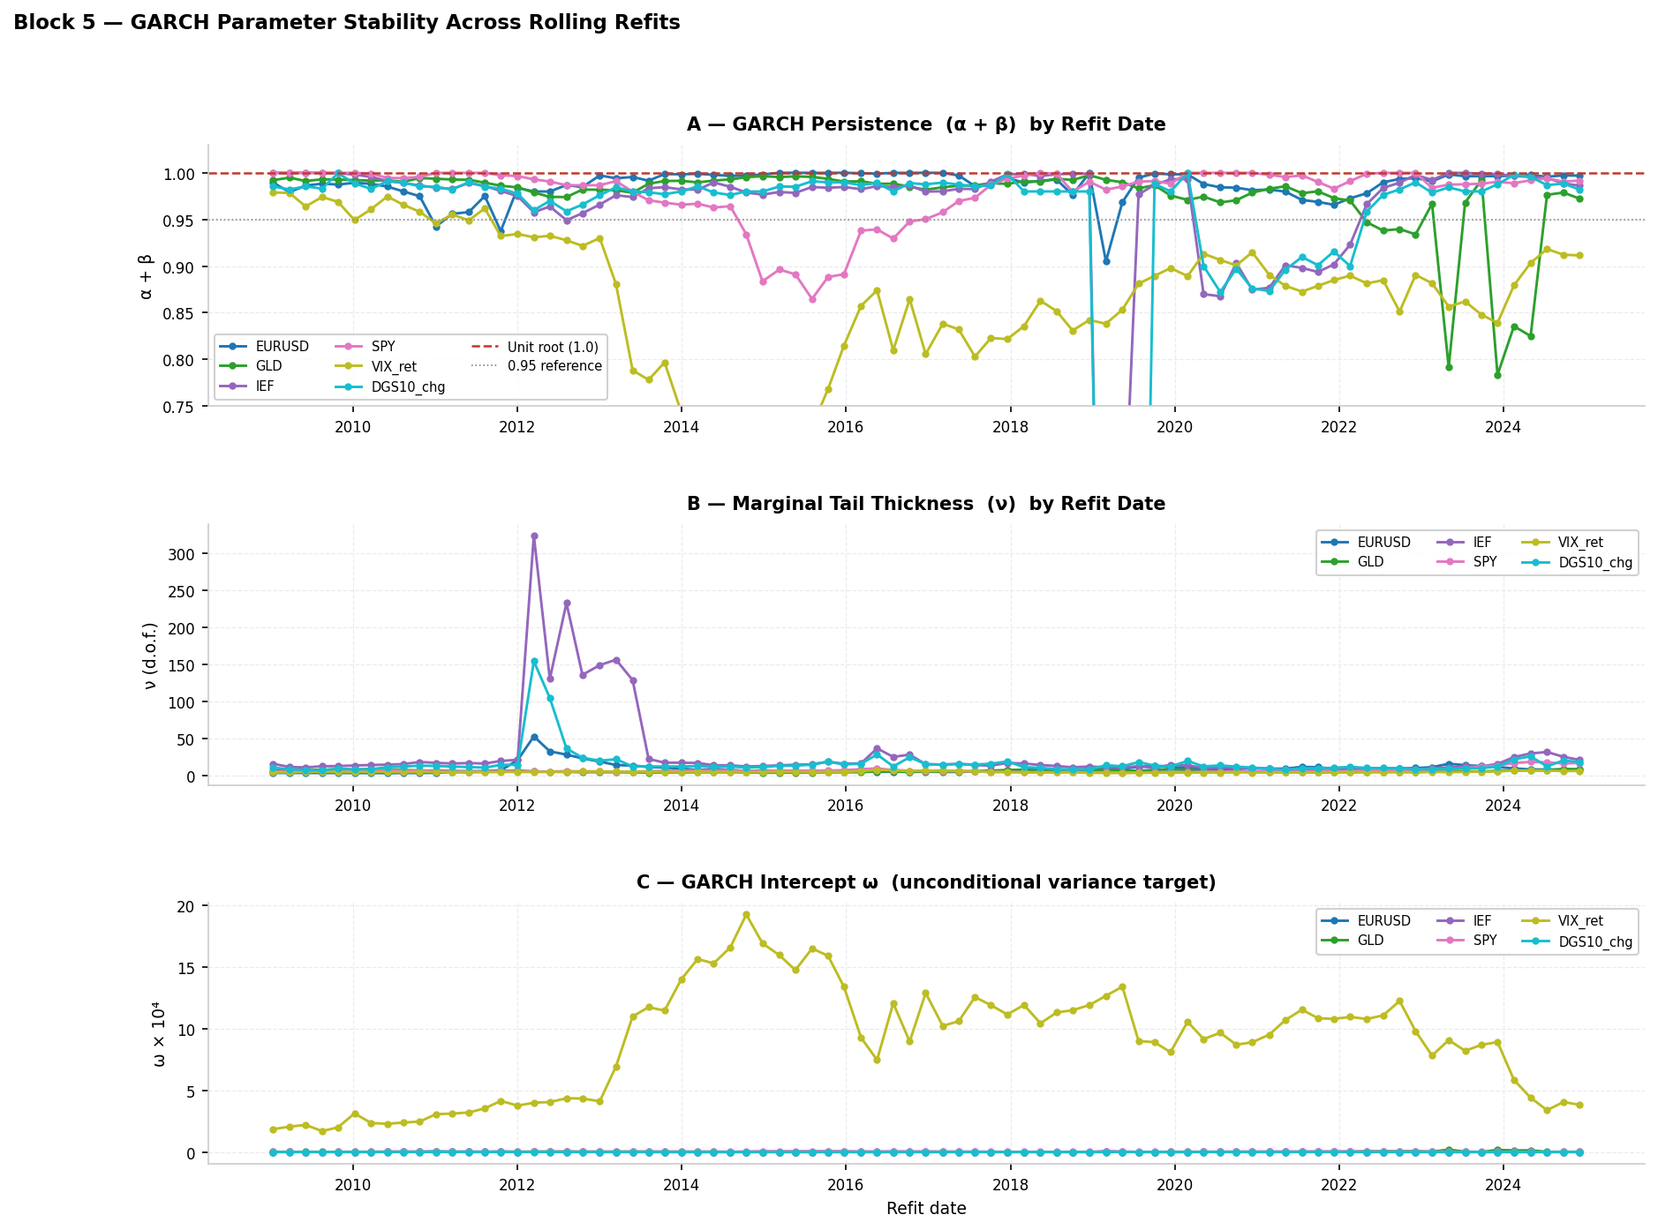
E6 GARCH Parameter Stability Over Time
How ω, α, β, ν evolve across the 15-year backtest window

Slide 23
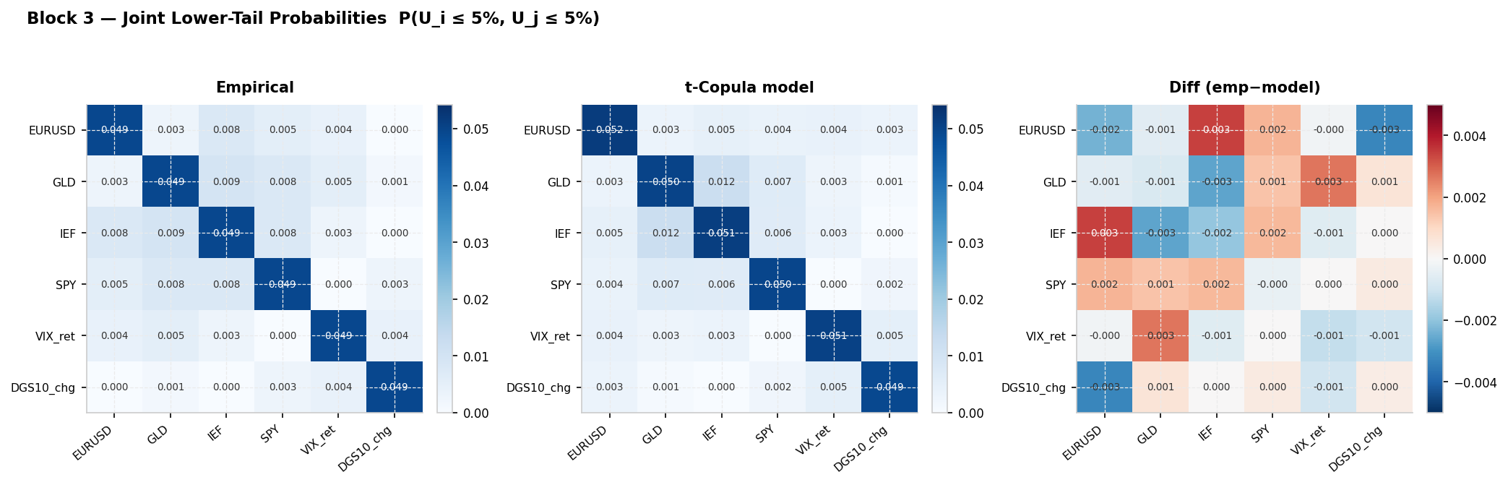
E7 Copula Tail Dependence — Model vs Empirical
Simulated joint tail frequencies vs actual co-crash rates in historical data

Slide 24
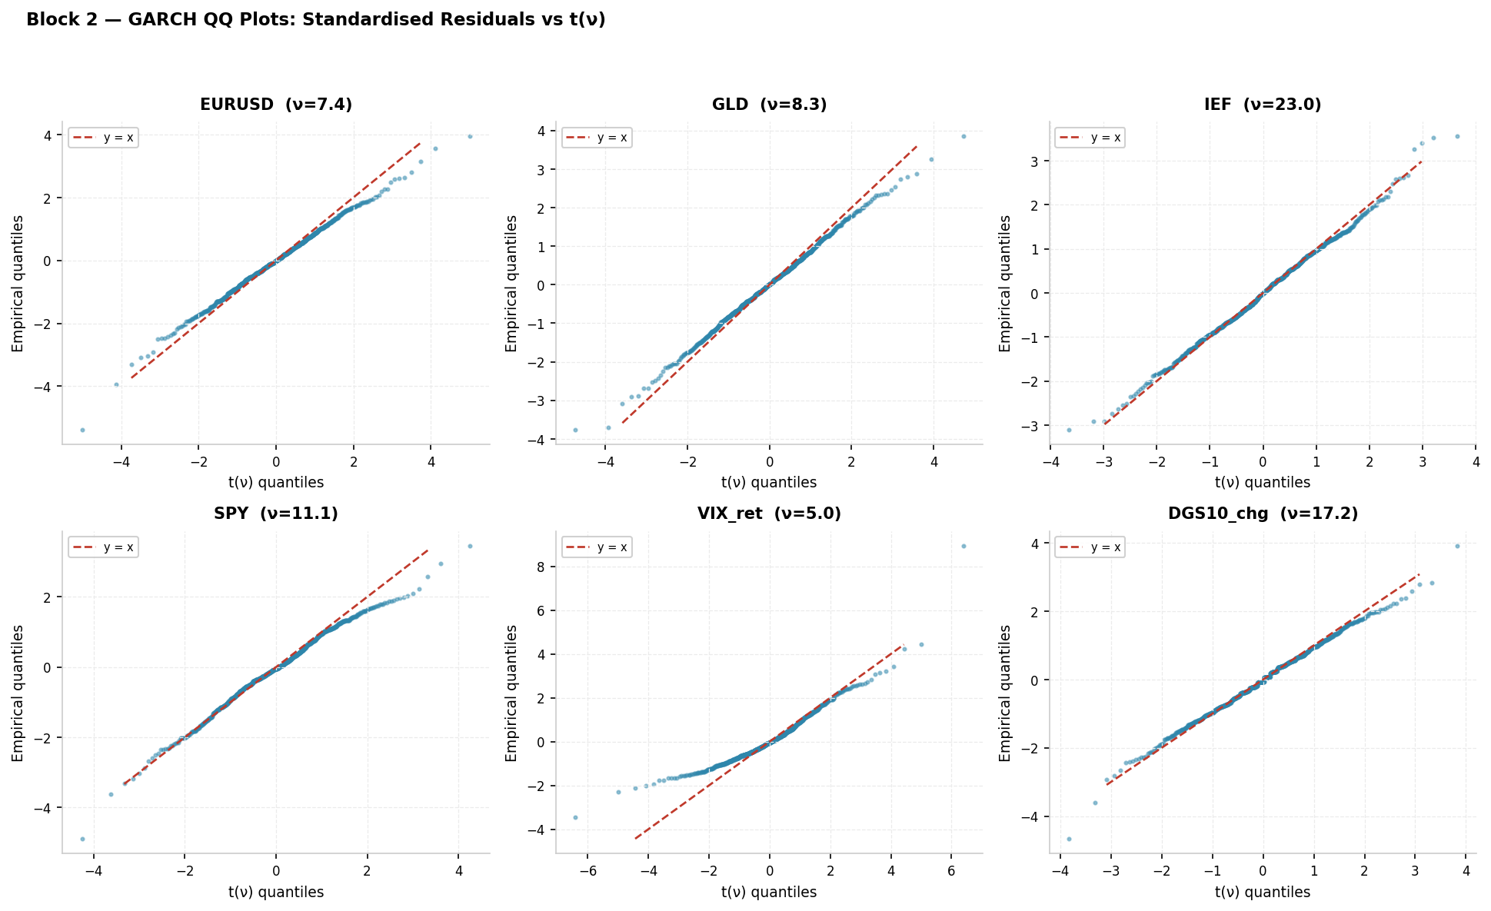
E8 GARCH Residual Q-Q Plots
Standardised residuals should lie on the t(ν) theoretical line if GARCH is correctly specified

Slide 25
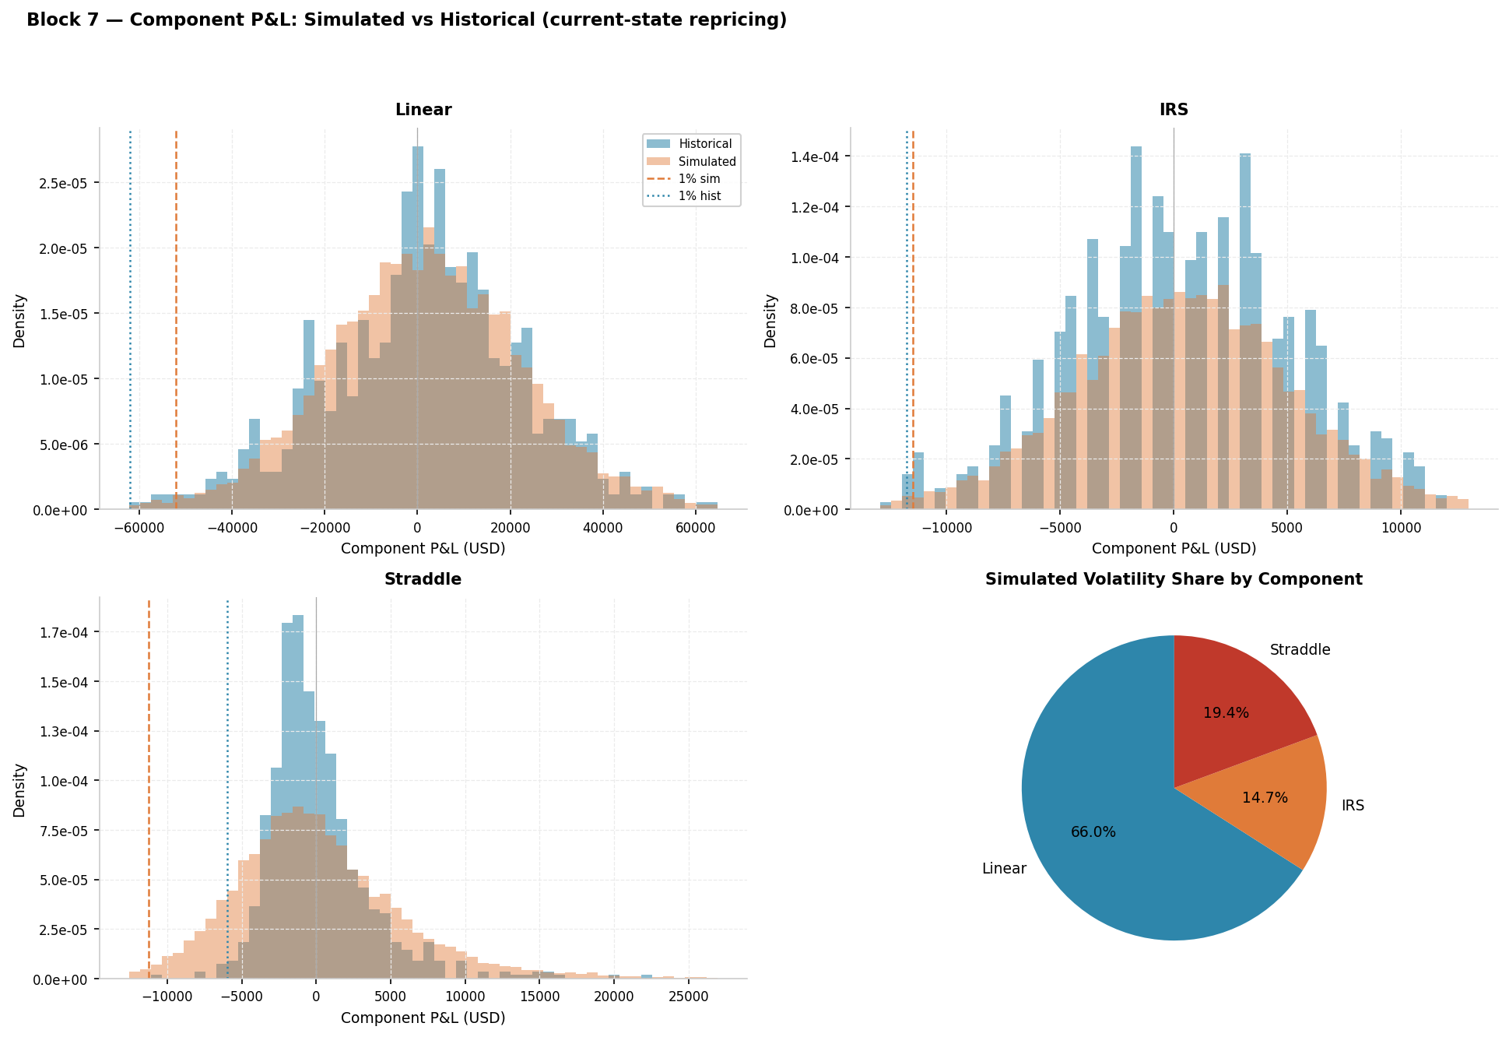
E9 Component P&L Breakdown — Simulated vs Actual
Linear, IRS, and straddle contributions to total P&L across the backtest period

Slide 26
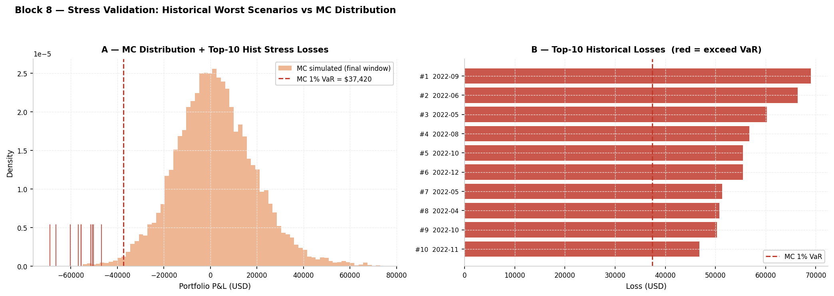
E10 Top 10 Loss Days — 2022 Regime Break
All 10 worst portfolio days occurred in 2022 — the Fed rate-hiking cycle
Rank
Date
Total P&L
Linear P&L
IRS P&L
Straddle P&L
1
2022-09-13
−$69,012
−$87,874
+$3,637
+$15,225
2
2022-06-13
−$66,402
−$103,156
+$20,135
+$16,618
3
2022-05-09
−$60,256
−$66,143
−$5,123
+$11,010
4
2022-08-26
−$56,744
−$70,179
+$729
+$12,706
5
2022-10-07
−$55,510
−$63,349
+$4,362
+$3,477
6
2022-12-15
−$55,502
−$57,049
−$3,655
+$5,202
7
2022-05-18
−$51,364
−$60,645
−$6,593
+$15,873
8
2022-04-29
−$50,765
−$64,664
+$2,911
+$10,987
9
2022-10-14
−$50,323
−$53,286
+$2,184
+$779
10
2022-11-02
−$46,773
−$50,319
+$2,184
+$1,362
Key insight: linear equity positions drove the losses (stocks + bonds falling together).
The straddle partially hedged through vol spikes but could not offset the scale of equity drawdowns.
The IRS was a mixed hedge: rising rates hurt the fixed-payer position on some days but not others.

Slide 27
F. Instrument Pricing
Black-Scholes straddle · IRS discrete annuity · Consistency across models

Slide 28
F1 Black-Scholes ATM Straddle Pricing
Full revaluation per scenario: straddle = call + put at the same strike
Black-Scholes Call & Put Formulas
d₁ = [ ln(S/K) + (r + σ²/2)·T ] / (σ√T)
d₂ = d₁ − σ√T
Call = S·N(d₁) − K·e^{−rT}·N(d₂)
Put = K·e^{−rT}·N(−d₂) − S·N(−d₁)
Straddle = Call + Put
Variables in simulation
S = S_now · exp(r_SPY) (simulated next-day SPY price)
σ = σ_now · exp(r_VIX) (simulated next-day implied vol)
r = r_now + Δr_DGS10 (simulated next-day yield)
K = strike (ATM at last 30-day reset)
T = T_now − 1/252 (one trading day of time decay)
P&L_straddle = [Straddle(S_sim,K,T_next,r_sim,σ_sim)
− Straddle(S_now,K,T_now,r_now,σ_now)] × shares
Straddle Greeks (why it profits from crises)
Vega = ∂(Straddle)/∂σ = S·√T·φ(d₁) > 0
→ gains value when implied volatility spikes (VIX surge in a crash)
Delta = ∂(Straddle)/∂S = N(d₁) − N(−d₁)
→ near zero ATM; small directional exposure
Theta = time decay < 0 (costs money every day without a large move)
Net effect in a crisis: large Vega gains >> Theta cost + small Delta loss
Net effect in calm markets: Theta bleeds value slowly each day

Slide 29
F2 Interest Rate Swap — Discrete Annuity Pricing
Fixed payer: receives floating (LIBOR/OIS), pays fixed 3% | Notional $1M, 10-year
Correct Formula: Discrete Annuity
V_IRS(r_float) = Notional × (r_float − r_fixed) × Σₖ₌₁ᴺ 1/(1 + r_float)ᵏ
For annual payments, N = maturity (years):
Annuity factor A(r, N) = Σₖ₌₁ᴺ 1/(1+r)ᵏ = [1 − (1+r)^{−N}] / r
V_IRS = Notional × (r_float − r_fixed) × A(r_float, N)
Positive when r_float > r_fixed (rising rates benefit fixed payer).
Simplified Formula (INCORRECT — used in earlier models)
V_IRS_simplified = Notional × (r_float − r_fixed) × N / (1 + r_float)
This applies a single discount factor to the entire undiscounted stream.
At r=4%, N=10: A_correct ≈ 8.11 vs N/(1+r) ≈ 9.62 → ~18% overestimate.
Fixed in all three MC models: now all use portfolio_pricing.price_irs (discrete annuity).
IRS P&L per scenario: P&L_IRS = V_IRS(rate_sim) − V_IRS(rate_now)
where rate_sim = rate_now + Δr_DGS10_sim (absolute yield change from simulation)

Slide 30
G. Model Comparison & Regime Break
What improved and what didn't — and why the fixes backfired

Slide 31
G1 Model Comparison Summary
Three models, same portfolio, same 4,019-day backtest, same α=99%
Model
Breaches N
Expected
Kupiec
Independence
Key feature added
Gaussian MC
248
≈ 40
REJECTED
REJECTED
Cholesky of rolling Σ, normal draws
t-Copula MC
25
≈ 40
REJECTED
REJECTED
+ fat-tailed marginals + tail dependence copula
GARCH-t-Copula
69
≈ 40
REJECTED
RETAINED
+ GARCH vol memory + EWMA dynamic correlation
Critical value
≈ 54
≈ 40
3.84 (χ²)
3.84 (χ²)
Kupiec 95% threshold for T=4,019
GARCH is the only model with a passing independence test — it correctly tracks when the market is calm vs volatile.
The remaining excess breaches (69 vs ~54 threshold) are concentrated in 2022 and cannot be eliminated by parameter tuning.
Why the attempted fixes (ν-cap + skewed-t for VIX) made things WORSE
GARCH residuals → pseudo-observations → copula fit → joint simulation → straddle P&L
Changing VIX distribution → reshuffles pseudo-obs → changes copula → more extreme upward VIX scenarios
More extreme VIX → long straddle makes more money in simulation → VaR goes DOWN → more real breaches.
The model had compensating effects around its own misspecifications. N went 69 → 72. Changes reverted.

Slide 32
G2 2022 Regime Break — Stocks and Bonds Fall Together
The root cause of residual Kupiec failure: a structural correlation regime shift
Historical SPY–IEF correlation by regime
2009–2014 (post-GFC, ZIRP) : ρ(SPY, IEF) ≈ −0.40 to −0.45 (bonds hedge stocks)
2015–2019 (normalisation) : ρ(SPY, IEF) ≈ −0.35 to −0.40 (still negative)
2020–2021 (COVID / ZIRP 2) : ρ(SPY, IEF) ≈ −0.45 (flight-to-safety intact)
2022–2023 (rate-hike cycle) : ρ(SPY, IEF) ≈ +0.10 to +0.30 (BREAK: positive correlation!)
2024 (late cycle) : ρ(SPY, IEF) ≈ +0.12 (still elevated)
The Fed raised rates from 0.25% to 5.50% in 18 months — fastest hiking cycle since the 1980s.
Rising rates → bond prices fall (IEF down) AND equity valuations fall (SPY down) simultaneously.
The model, trained on 750 days of mostly-negative SPY-IEF correlation, treated IEF as a hedge.
Why no rolling-window model could have anticipated this
The regime break in correlation happened suddenly in early 2022.
A 750-day rolling window in late 2021 still showed ρ ≈ −0.40.
As 2022 data flowed in, the EWMA gradually updated R_dynamic — but by then
the damage to the backtest score had already accumulated.
Resolution: Stressed VaR overlay (Basel 2.5) — take the maximum of:
(a) rolling VaR (current regime), (b) VaR from a fixed 2022 stress window.
This does not eliminate the break but ensures the model is never less than the stress-period VaR.

Slide 33
H. Additional Diagnostic Charts
GARCH ACF · Sign bias · P&L distribution · Correlation matrix

Slide 34
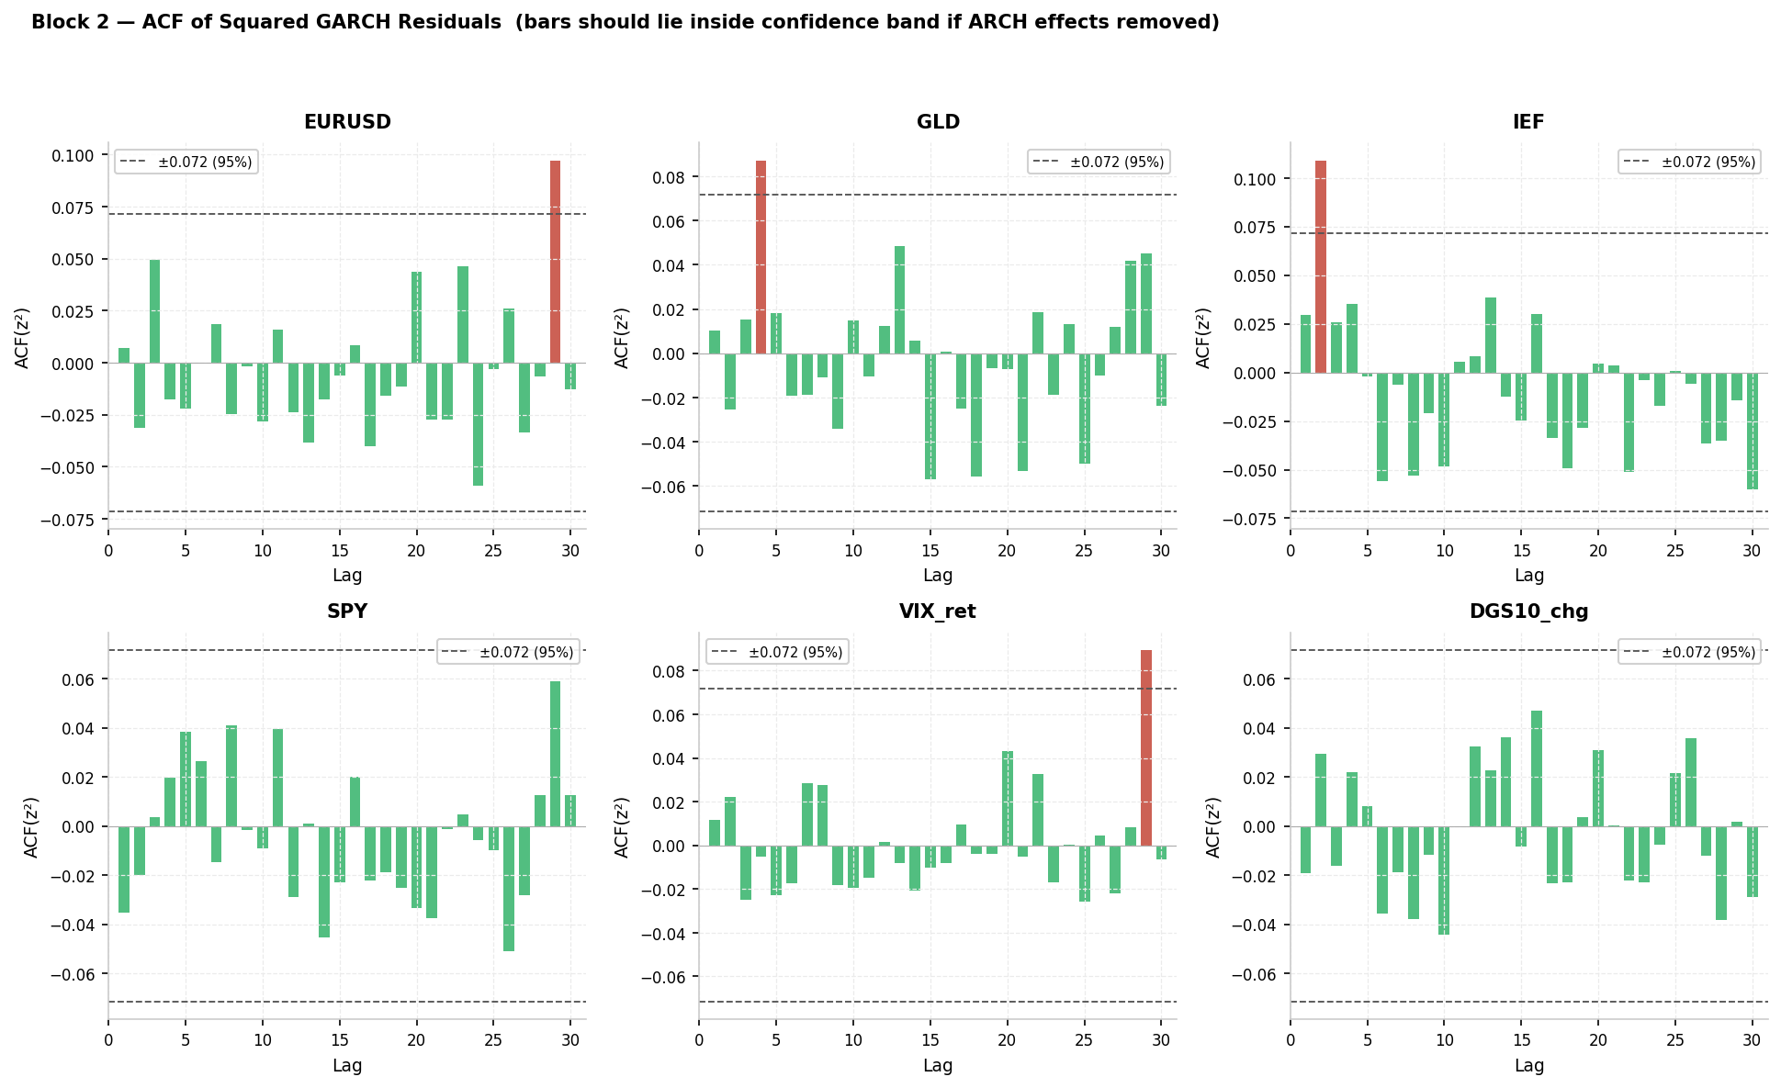
H1 GARCH ACF — Squared Residuals
No remaining autocorrelation in squared residuals confirms GARCH correctly captures volatility clustering

Slide 35
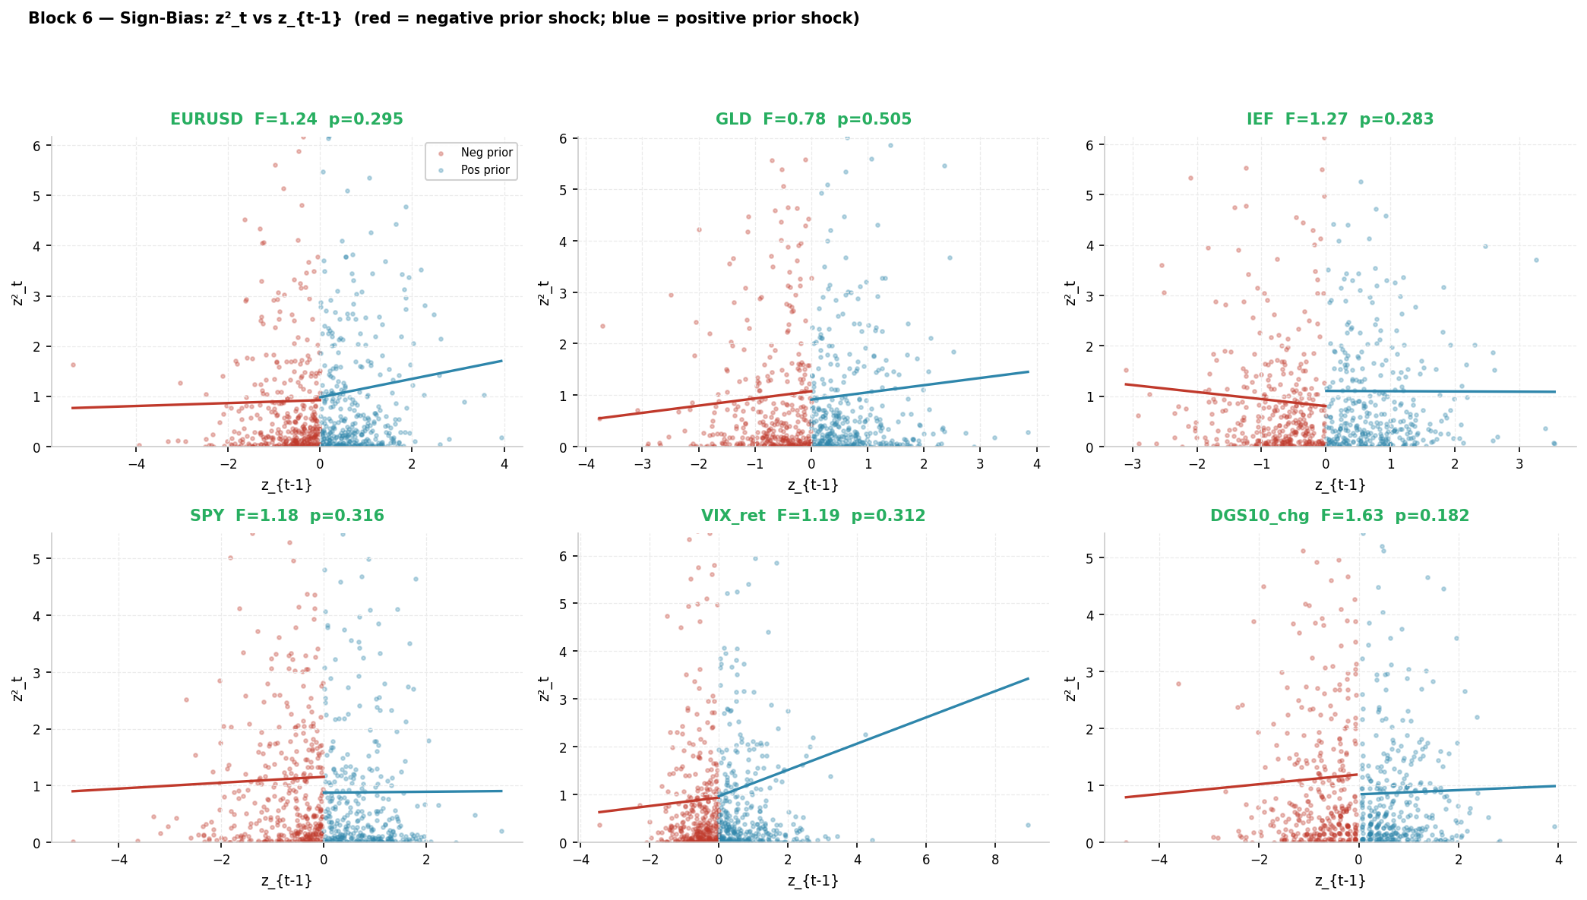
H2 Sign Bias Test
Tests whether positive vs negative shocks have asymmetric impact on volatility

Slide 36
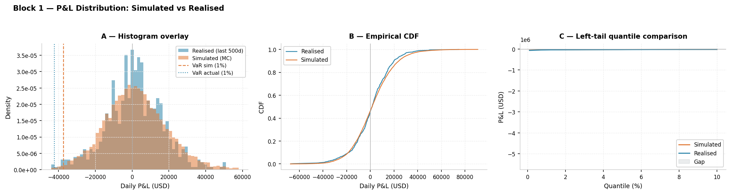
H3 Simulated P&L Distribution
Left tail of the 10,000-scenario P&L distribution — the VaR is the 1st percentile

Slide 37
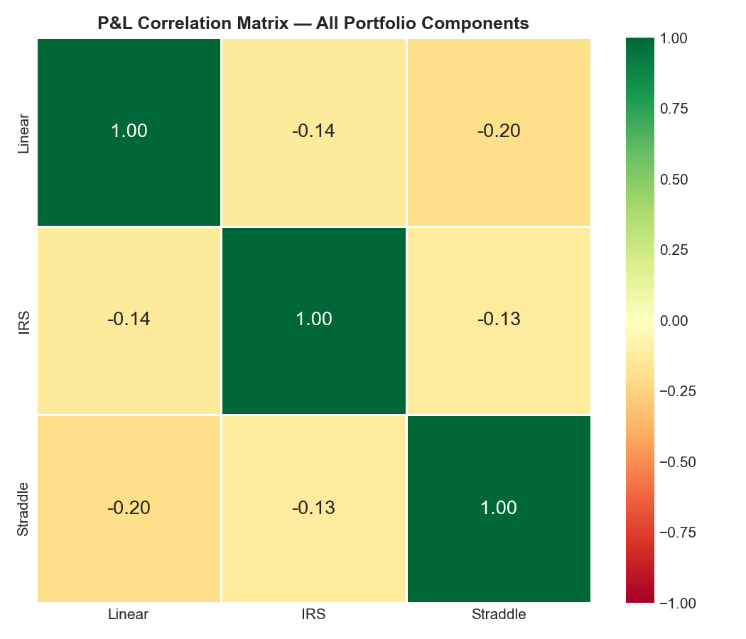
H4 Empirical Correlation Matrix
Rolling-average pairwise correlations across the 6 risk factors

